Slide 1

24 Wildcard Routing and Redirection
Peter H. Chen

Slide 2
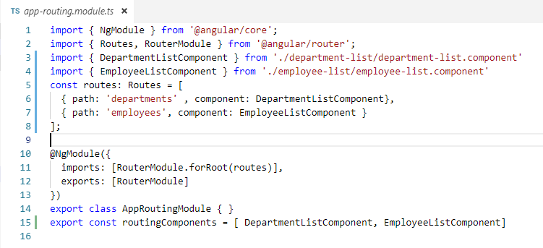
24 Wildcard Routing and Redirection
https://www.youtube.com/watch?v=N8FBmB2jme8&index=6&list=PLC3y8-rFHvwhBRAgFinJR8KHIrCdTkZcZ
We have created two routes in our application, one the departments and another one is employees.

Slide 3
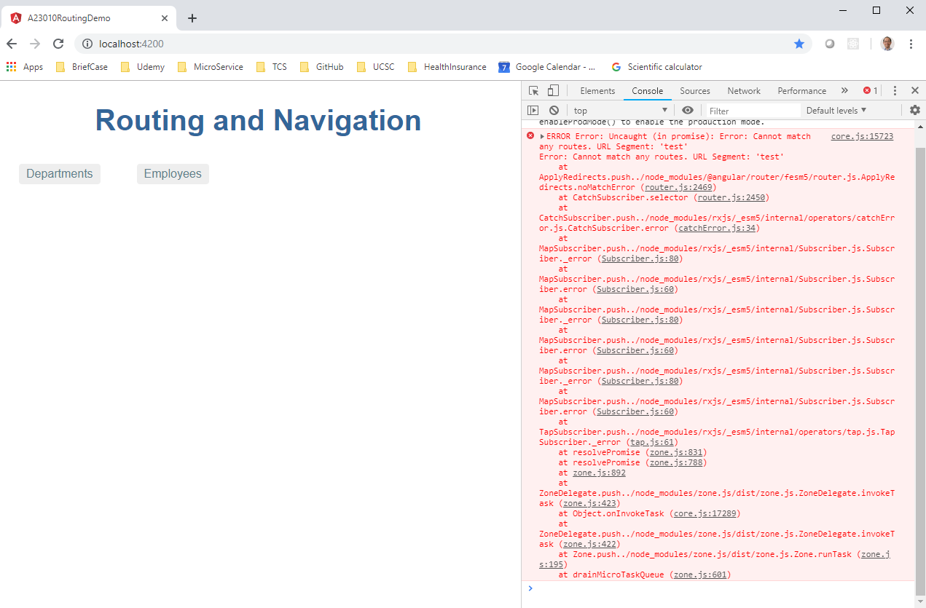
24 Wildcard Routing and Redirection
https://www.youtube.com/watch?v=N8FBmB2jme8&index=6&list=PLC3y8-rFHvwhBRAgFinJR8KHIrCdTkZcZ
Here is a problem: If user enter a route which is not configure in the application will encounter an error.
In the URL, if I try to navigate localhost:4200/test, you can see that there is some error in the console. In the console, the error message “Cannot match any routes. URL segment: ‘test’. This is not favorable, the better approach is to use wildcard route.

Slide 4
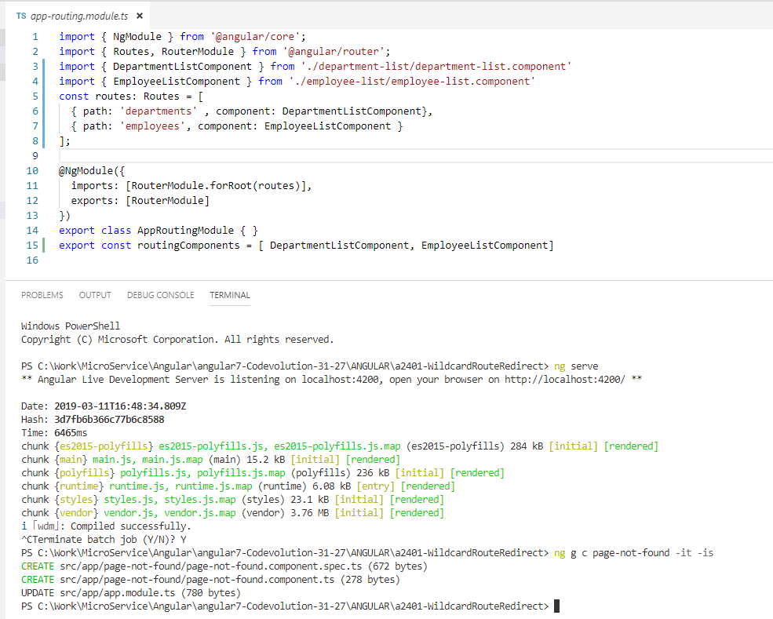
24 Wildcard Routing and Redirection
https://www.youtube.com/watch?v=N8FBmB2jme8&index=6&list=PLC3y8-rFHvwhBRAgFinJR8KHIrCdTkZcZ
Using wildcard route, the URL will route to other URL if the URL is not found.
> ng g c page-not-found –it –is
Note: g: Generate, c: component, it: inline template, is: inline style

Slide 5
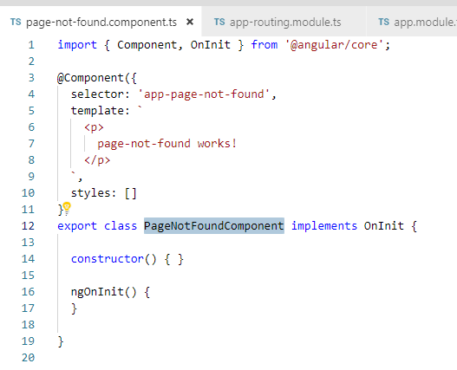
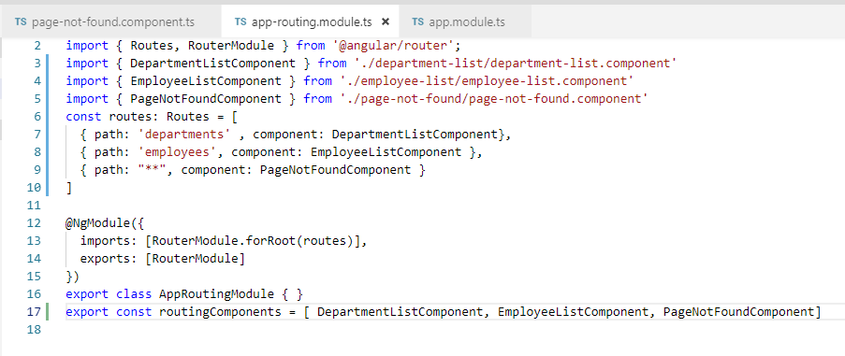
24 Wildcard Routing and Redirection
https://www.youtube.com/watch?v=N8FBmB2jme8&index=6&list=PLC3y8-rFHvwhBRAgFinJR8KHIrCdTkZcZ
Using wildcard route, the URL will route to other URL if the URL is not found.
> ng g c page-not-found –it –is
Note: g: Generate, c: component, it: inline template, is: inline style

Slide 6
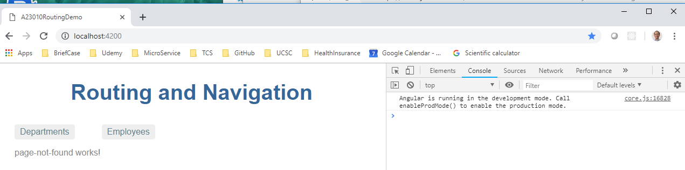
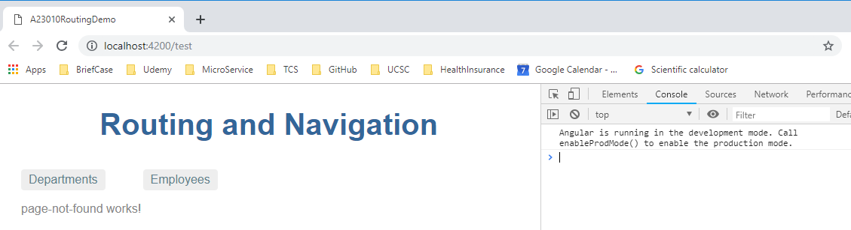
24 Wildcard Routing and Redirection
https://www.youtube.com/watch?v=N8FBmB2jme8&index=6&list=PLC3y8-rFHvwhBRAgFinJR8KHIrCdTkZcZ
Refresh or enter localhost:4200/test, we have extra “Page-not-found Works!” component displayed.
This is because the router try to the wildcard “**” and displayed.
There is a problem here: both “localhost:4200” and “localhost:4200/test” display “Page not found”. We need to control the route.

Slide 7
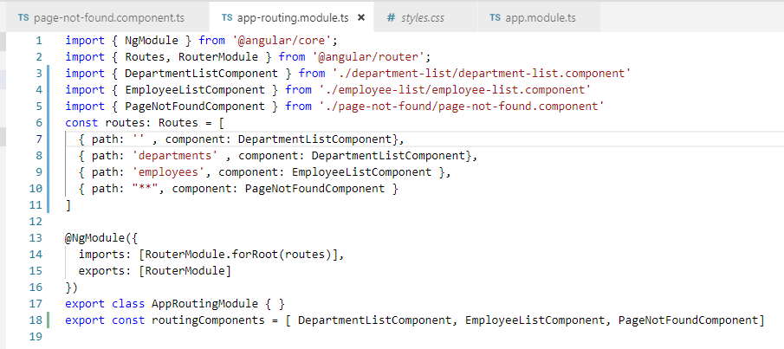
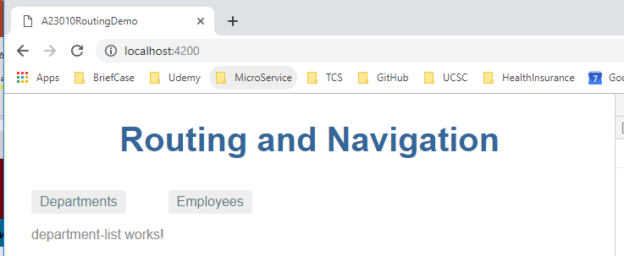
24 Wildcard Routing and Redirection
https://www.youtube.com/watch?v=N8FBmB2jme8&index=6&list=PLC3y8-rFHvwhBRAgFinJR8KHIrCdTkZcZ
Our application needs default route. For example, we wan the department route is the default router, we need to put the default route (‘’) for DepartmentListComponent.

Slide 8
24 Wildcard Routing and Redirection
https://www.youtube.com/watch?v=N8FBmB2jme8&index=6&list=PLC3y8-rFHvwhBRAgFinJR8KHIrCdTkZcZ
We can use redirect.

Slide 9
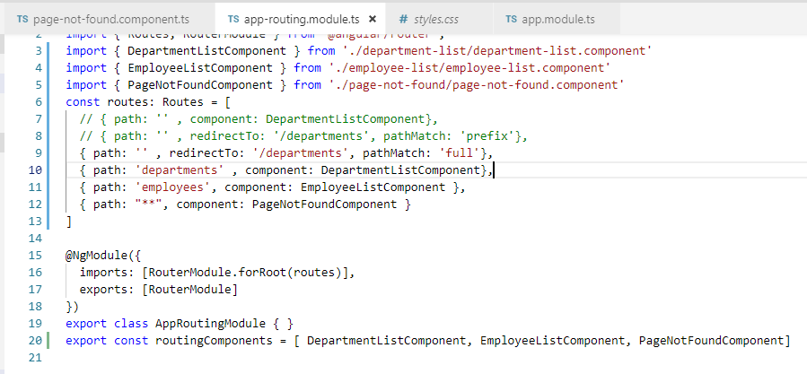
24 Wildcard Routing and Redirection
https://www.youtube.com/watch?v=N8FBmB2jme8&index=6&list=PLC3y8-rFHvwhBRAgFinJR8KHIrCdTkZcZ
We can use redirectTo:0 ‘/departments’ with pathMacth: ‘full’ to match ‘’.
With pathMacth: ‘prefix’ will not work since prefix (‘’) will match all the string and always route to ‘/departments’.

Slide 10
End of Chapter

