Slide 1

26 ParamMap Observable
Peter H. Chen

Slide 2
26 ParamMap Observable
https://www.youtube.com/watch?v=N8FBmB2jme8&index=6&list=PLC3y8-rFHvwhBRAgFinJR8KHIrCdTkZcZ
In the last section, we use snapshot of activatedRoute to read the route parameter but this approach has drawback.
In this section, we explain what is the drawback is.
In the department-detail component, we are going to add two anchor tags
<a>Previous</a>
<a>Next</a>.
The previous will go back to previous department and Next will go to next department.

Slide 3
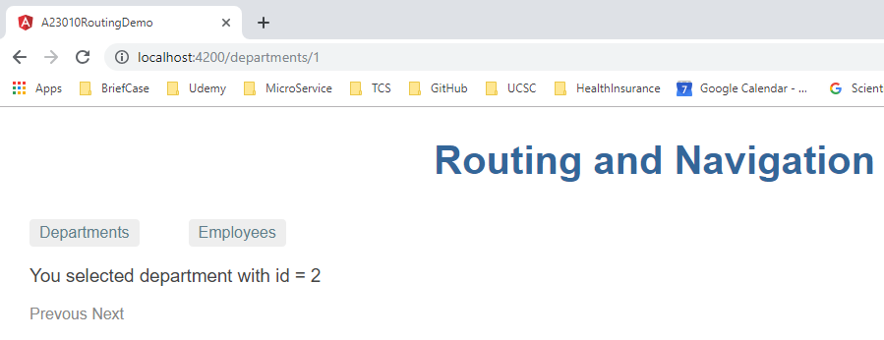
26 ParamMap Observable
https://www.youtube.com/watch?v=N8FBmB2jme8&index=6&list=PLC3y8-rFHvwhBRAgFinJR8KHIrCdTkZcZ
Click Previous, the URL reduce by one, but id =2 is not change.
The URL is update but view is not updated.
This is the drawback of snapshot approach.
When you navigate from one component and back to the previous component, the snapshot approach will not work.
Here is the reason why.

Slide 4
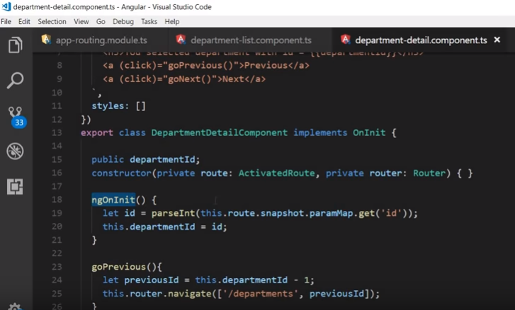
26 ParamMap Observable
https://www.youtube.com/watch?v=N8FBmB2jme8&index=6&list=PLC3y8-rFHvwhBRAgFinJR8KHIrCdTkZcZ
Angular need to figure out it can initialize or he can reuse the same component.
When we navigate back the same component, Angular simple reuse the component. No initialization implies. That is in the ngOnInit () method. The ngOnInit() method will not get called. The new id will never be get from URL.
To overcome this, to use the paramMap Observable.

Slide 5
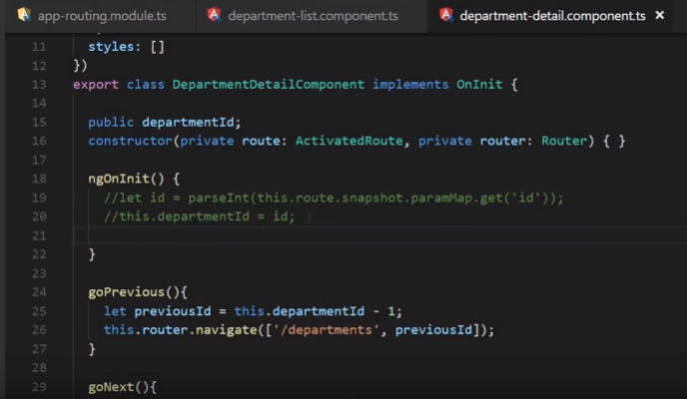
26 ParamMap Observable
https://www.youtube.com/watch?v=N8FBmB2jme8&index=6&list=PLC3y8-rFHvwhBRAgFinJR8KHIrCdTkZcZ
Let’s look at code, we will comment out the snapshot approach.

Slide 6
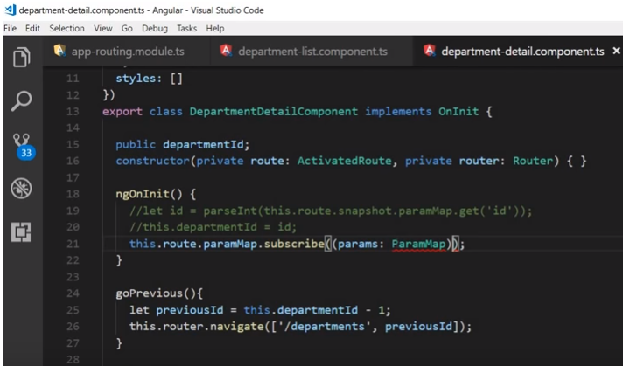
26 ParamMap Observable
https://www.youtube.com/watch?v=N8FBmB2jme8&index=6&list=PLC3y8-rFHvwhBRAgFinJR8KHIrCdTkZcZ
Let’s look at code, we will comment out the snapshot approach.
We have instant route call paramMap, this.route.paramMap.subscribe () is an Observable.
Subscribe is an arrow function with strong type with paramMap, this.route.paramMap.subscribe (params: ParamMap).

Slide 7
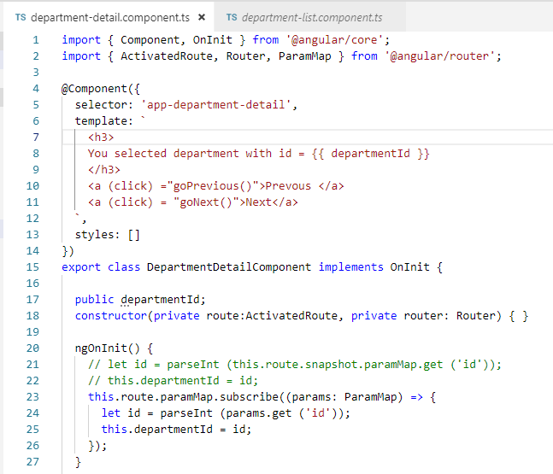
26 ParamMap Observable
https://www.youtube.com/watch?v=N8FBmB2jme8&index=6&list=PLC3y8-rFHvwhBRAgFinJR8KHIrCdTkZcZ
The ParamMap is from Router package. Make sure the Router package is imported.
Update ID by ParamMap. The Parameter Observable can detect and redo.

Slide 8
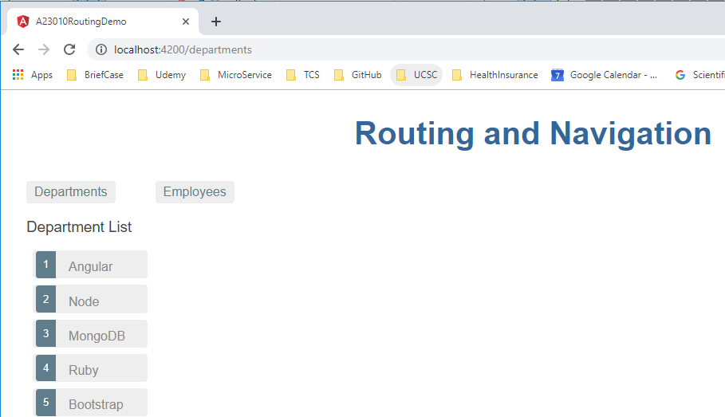
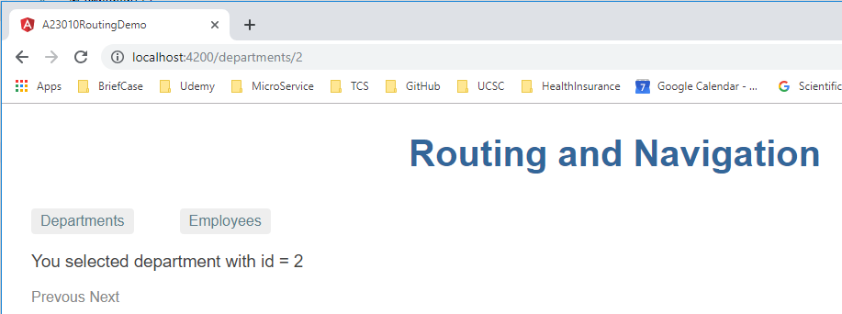
26 ParamMap Observable
https://www.youtube.com/watch?v=N8FBmB2jme8&index=6&list=PLC3y8-rFHvwhBRAgFinJR8KHIrCdTkZcZ
Go back to browser. Click

Slide 9
End of Chapter

