Slide 1

27 Optional Route Parameter
Peter H. Chen

Slide 2
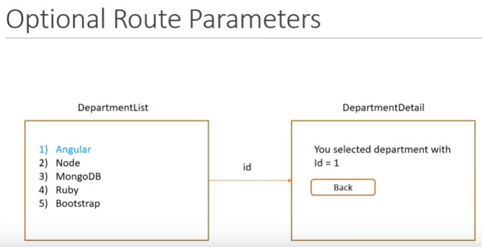
27 Optional Route Parameter
https://www.youtube.com/watch?v=gnTFkl2AF-w&list=PLC3y8-rFHvwhBRAgFinJR8KHIrCdTkZcZ&index=27
In this section, we discuss the Optional Route Parameters.
Here is the new requirement: In the DepartmentDetail component, we need to add Back button.
When we click on the Back button, we need to navigate back to the Department List Component. The previous list select department must be highlighted.
For example, if we click 1) Angular, it must be navigate to DepartmentDetail component. Over here, if we click Back button, it should be navigate back to the Department List and 1) Angular should be highlighted.
This can be achieved by Optional Route Parameter.

Slide 3
27.1 Add Button and Callback
Peter H. Chen

Slide 4
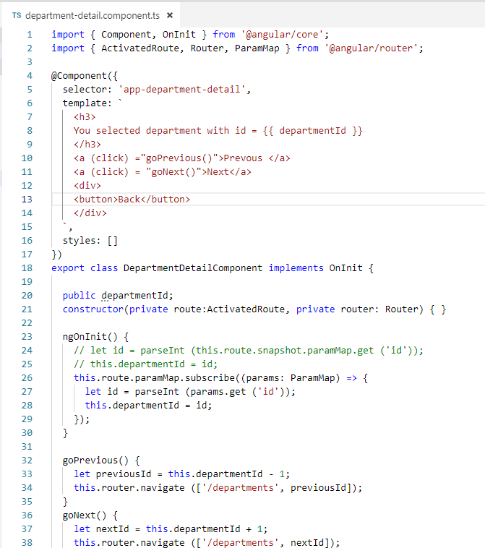
27.1 Add Button and Callback
https://www.youtube.com/watch?v=gnTFkl2AF-w&list=PLC3y8-rFHvwhBRAgFinJR8KHIrCdTkZcZ&index=27
Go Back to VS Code, the DepartmentDetail Component.
Let’s first add the button Back.

Slide 5
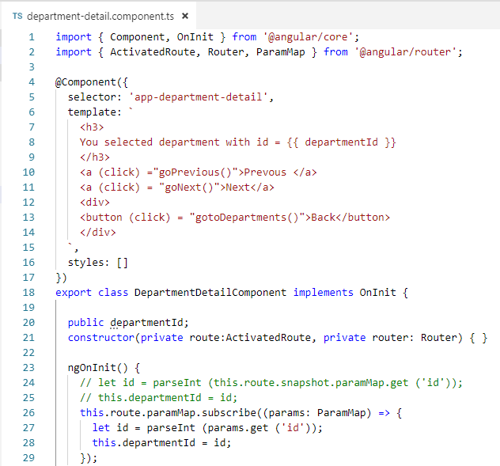
27.1 Add Button and Callback
https://www.youtube.com/watch?v=gnTFkl2AF-w&list=PLC3y8-rFHvwhBRAgFinJR8KHIrCdTkZcZ&index=27
Add event handler (click) = “gotoDepartments()”

Slide 6
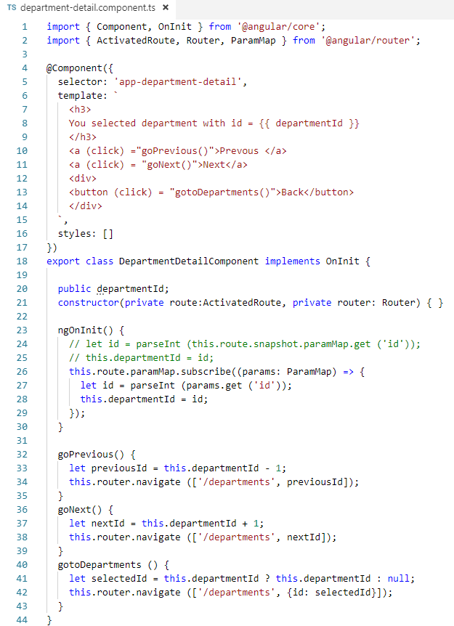
27.1 Add Button and Callback
https://www.youtube.com/watch?v=gnTFkl2AF-w&list=PLC3y8-rFHvwhBRAgFinJR8KHIrCdTkZcZ&index=27
Add callback function “gotoDepartments()”
let the selectedId = current department ID;
Once we have the department ID, we can navigate back the department with the parameter array router.navigate ([‘departments’, { id: selectedId }].

Slide 7
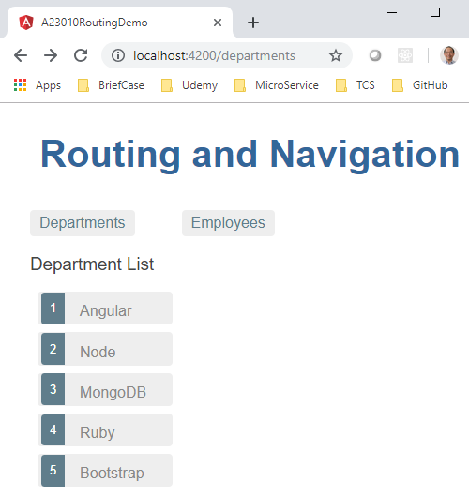
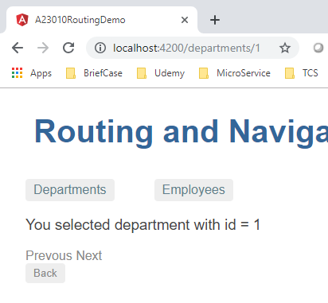
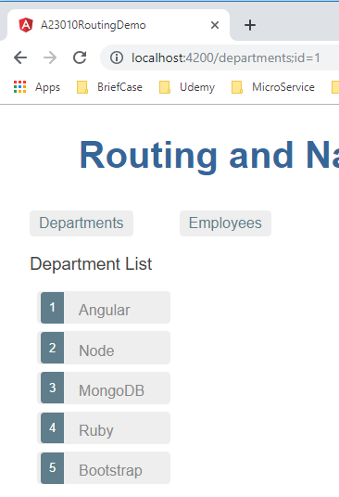
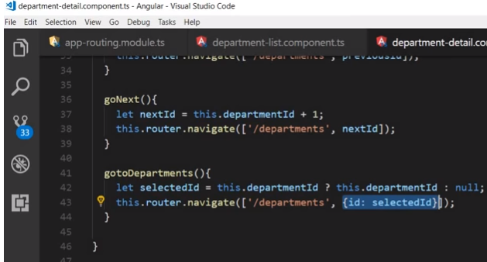
27.1 Add Button and Callback
https://www.youtube.com/watch?v=gnTFkl2AF-w&list=PLC3y8-rFHvwhBRAgFinJR8KHIrCdTkZcZ&index=27
Refresh the browser.
Click Back Button.
CLocalhost:4200/departments:id=1
Id is the key, 1 is the value

Slide 8
27.2 Get Optional ID and Set Color
Peter H. Chen

Slide 9
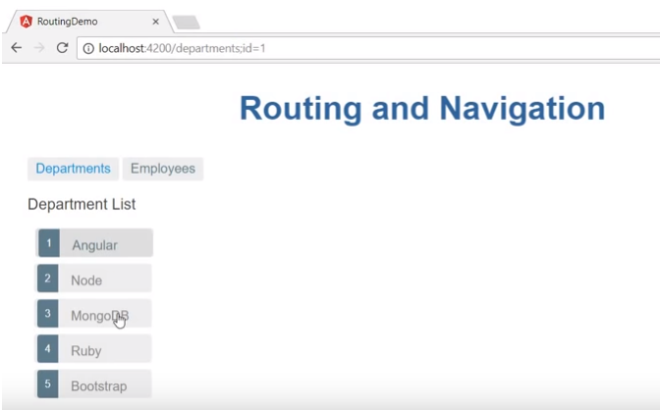
27.2 Get Optional ID and Set Color
https://www.youtube.com/watch?v=gnTFkl2AF-w&list=PLC3y8-rFHvwhBRAgFinJR8KHIrCdTkZcZ&index=27
The “id: selectedId” and “:id=1” is optional because it does not affect your view.
The optional parameter can be used to apply logic to the view.
We are going to read this parameter and search for the id on the view. If the id match, then highlight the department.

Slide 10
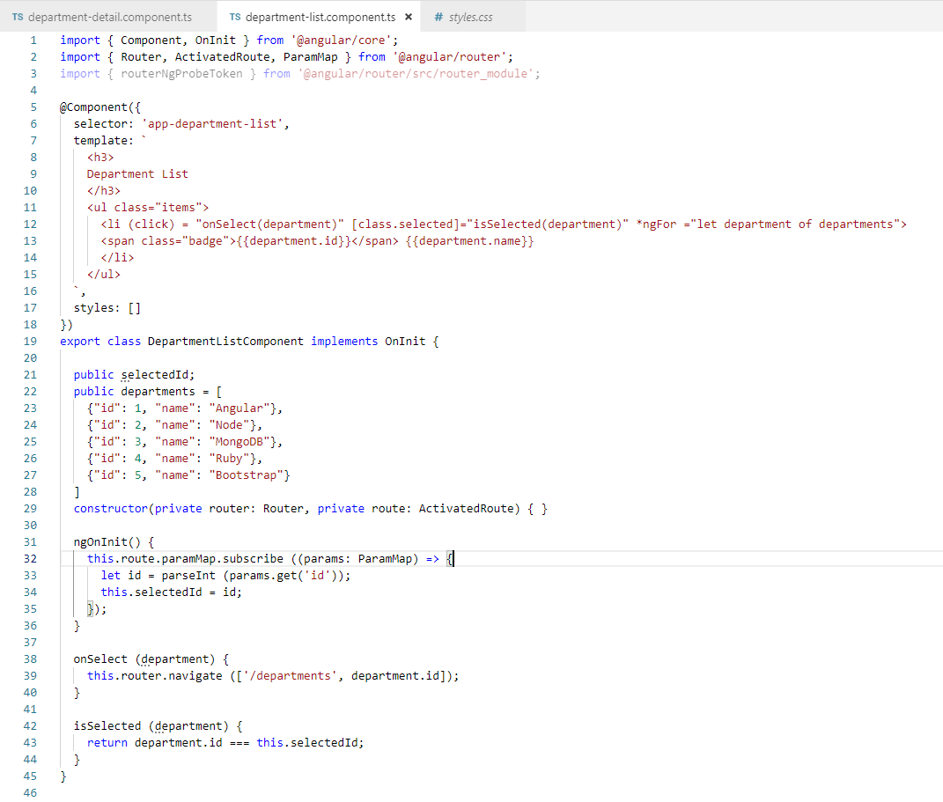
27.2 Get Optional ID and Set Color
https://www.youtube.com/watch?v=gnTFkl2AF-w&list=PLC3y8-rFHvwhBRAgFinJR8KHIrCdTkZcZ&index=27
Go back to departmentList Component. Use Observable and ParamMp to get Optional Parameter ID.

Slide 11

27.2 Get Optional ID and Set Color
https://www.youtube.com/watch?v=gnTFkl2AF-w&list=PLC3y8-rFHvwhBRAgFinJR8KHIrCdTkZcZ&index=27
Set the li color by class defined in style.css.

Slide 12
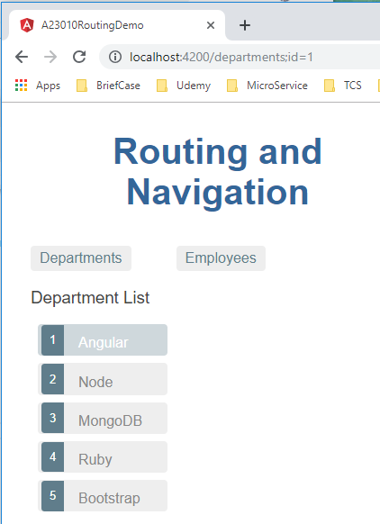
27.2 Get Optional ID and Set Color
https://www.youtube.com/watch?v=gnTFkl2AF-w&list=PLC3y8-rFHvwhBRAgFinJR8KHIrCdTkZcZ&index=27
Refresh the browser.
Click Back Button.
Get Optional ID and set match ID color.

Slide 13
End of Chapter

