Slide 1

9 Display Error Message
Peter H. Chen

Slide 2
9 Display Error Message
https://www.youtube.com/watch?v=U8FfRRLFmSY&list=PLC3y8-rFHvwhBRAgFinJR8KHIrCdTkZcZ&index=40
In this section, we will display appropriate error message when the form field is invalid.
This is very straight forward with the knowledge from previous sections.
The name field in our example is required field. When the form field is invalid, we need to display the error message “name is required.”

Slide 3
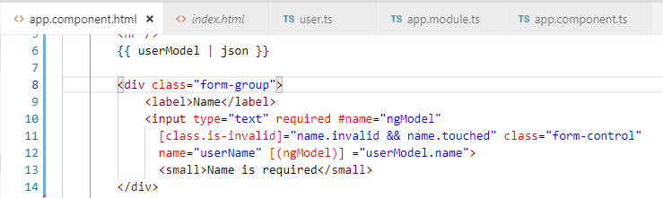
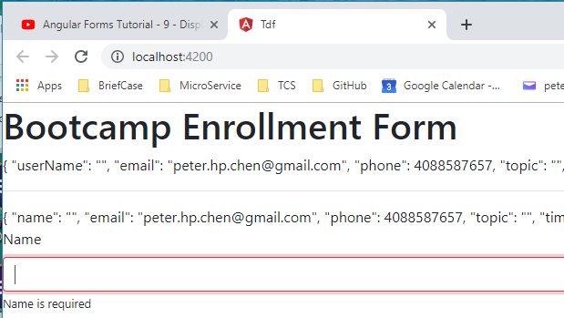
9 Display Error Message
https://www.youtube.com/watch?v=U8FfRRLFmSY&list=PLC3y8-rFHvwhBRAgFinJR8KHIrCdTkZcZ&index=40
Let’s add the message in the HTML.
In app.component.html, after the input element, add
<small>Name is required</small>
Check in the browser.

Slide 4
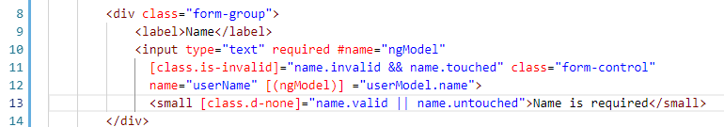
9 Display Error Message
https://www.youtube.com/watch?v=U8FfRRLFmSY&list=PLC3y8-rFHvwhBRAgFinJR8KHIrCdTkZcZ&index=40
We only want the message is shown when the name field is invalid.
Let’s add the condition on this message.
We can use either ngIf or class binding. We will use both of them.
For class binding, we will use “d-none” which is bootstrap 4 class for display property to none.
The condition is name.valid or name.untouched

Slide 5
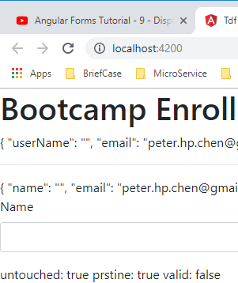
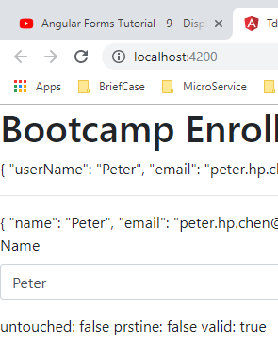
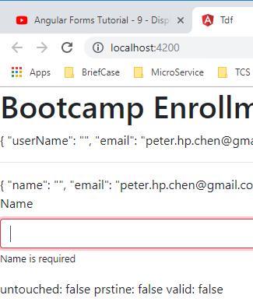
9 Display Error Message
https://www.youtube.com/watch?v=U8FfRRLFmSY&list=PLC3y8-rFHvwhBRAgFinJR8KHIrCdTkZcZ&index=40
Open the browser and check. Only the touched and blank display the error message.
Initially, blank field
(untouched: true)
Type “Peter”
(valid: true)
Remove name
(untouched: false
valid: false)

Slide 6
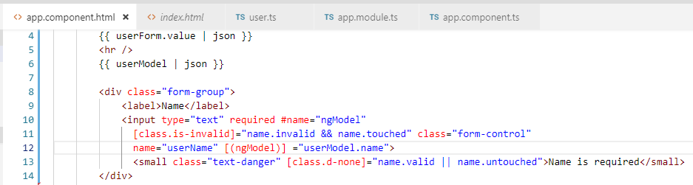
9 Display Error Message
https://www.youtube.com/watch?v=U8FfRRLFmSY&list=PLC3y8-rFHvwhBRAgFinJR8KHIrCdTkZcZ&index=40
Add class = “text-danger” for red color text message.

Slide 7
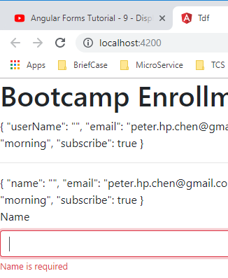
9 Display Error Message
https://www.youtube.com/watch?v=U8FfRRLFmSY&list=PLC3y8-rFHvwhBRAgFinJR8KHIrCdTkZcZ&index=40
Open the browser and check. Only the touched and blank display the error message.
Initially, blank field
(untouched: true)
Type “Peter”
(valid: true)
Remove name
Display red color
(untouched: false
valid: false)

Slide 8
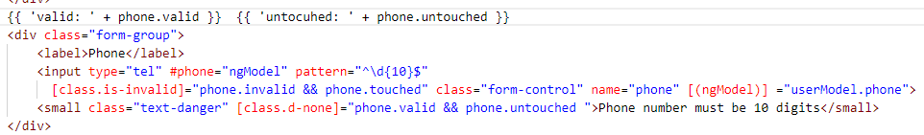
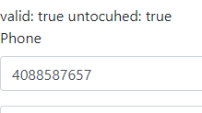
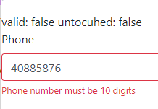
9 Display Error Message
https://www.youtube.com/watch?v=U8FfRRLFmSY&list=PLC3y8-rFHvwhBRAgFinJR8KHIrCdTkZcZ&index=40
Do the phone number field.
Remove some digit will display the error message.

Slide 9
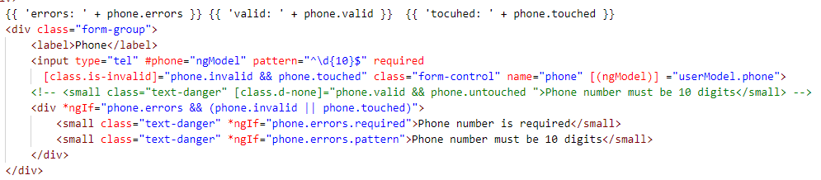
9 Display Error Message
https://www.youtube.com/watch?v=U8FfRRLFmSY&list=PLC3y8-rFHvwhBRAgFinJR8KHIrCdTkZcZ&index=40
Next, we use the error property on the ngModel.
Comment out the existing error message.

Slide 10
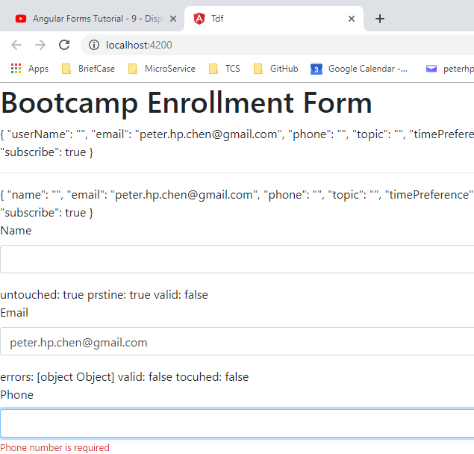
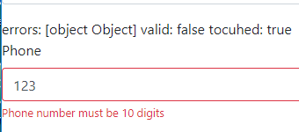
9 Display Error Message
https://www.youtube.com/watch?v=U8FfRRLFmSY&list=PLC3y8-rFHvwhBRAgFinJR8KHIrCdTkZcZ&index=40
Next, we use the error property on the ngModel.
Comment out the existing error message.

Slide 11
End of Chapter

