Slide 1

10 Validate Select Control
Peter H. Chen

Slide 2
10 Validate Select Control
https://www.youtube.com/watch?v=Ikn9eWLw3ys&list=PLC3y8-rFHvwhBRAgFinJR8KHIrCdTkZcZ&index=41
In the previous section, we validate the input elements.
In this section, we validate the select control.
For the topic select control, we need to ensure the topic is either Angular, React, or Vue.
It should not be “I am interested in”. If user select and leave “I am interested in”, we need to display an error message that says “Please select a topic.”
Let’s see how to do that.
The first and simplest way is use the required attribute on the select tag.
In the select tag, add the required attribute and then create a reference to ngModel.
#topic=“ngModel”
We are going to use class binding and we bind to the is-invalid class.

Slide 3
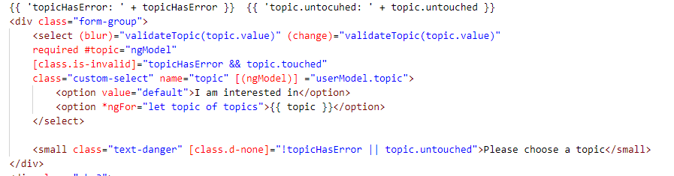
10 Validate Select Control
https://www.youtube.com/watch?v=Ikn9eWLw3ys&list=PLC3y8-rFHvwhBRAgFinJR8KHIrCdTkZcZ&index=41
Add (blur) and (change), and callback validateTopic ()

Slide 4
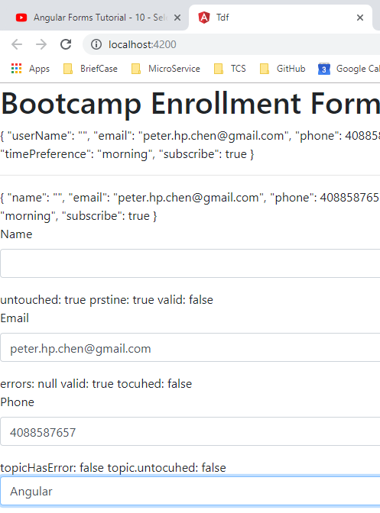
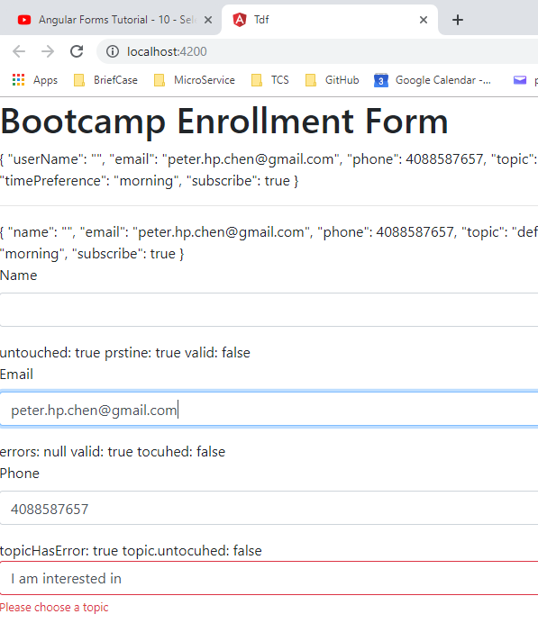
10 Validate Select Control
https://www.youtube.com/watch?v=Ikn9eWLw3ys&list=PLC3y8-rFHvwhBRAgFinJR8KHIrCdTkZcZ&index=41
Test on browser:

Slide 5
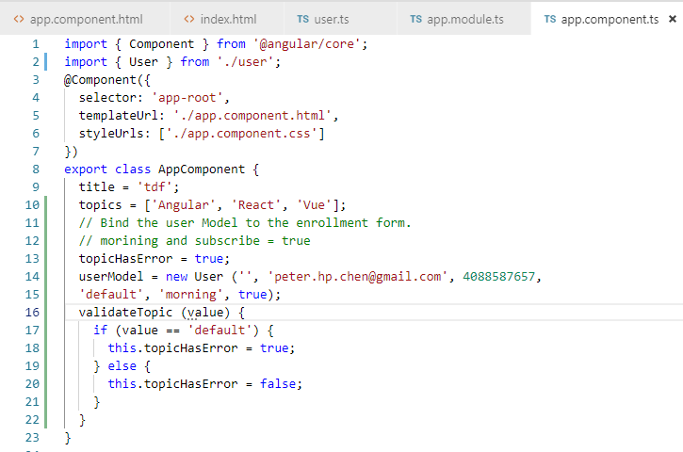
10 Validate Select Control
https://www.youtube.com/watch?v=Ikn9eWLw3ys&list=PLC3y8-rFHvwhBRAgFinJR8KHIrCdTkZcZ&index=41
Add Callback validateTopic ()

Slide 6
End of Chapter

