Slide 1

1 Angular Form Introduction
Peter H. Chen

Slide 2
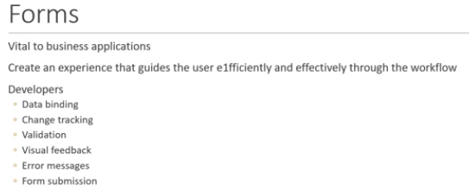
1 Angular Form Introduction
https://www.youtube.com/watch?v=nGr3C3wbh9c&list=PLC3y8-rFHvwhBRAgFinJR8KHIrCdTkZcZ&index=33
Forms is a vital part of business application. We use form to register, login, submit a request, place an order, schedule an appointment, and perform countless other tasks.
While developing forms, it is important to create an experience that guides the user efficiently and effectively though the workflow.
As developers, we need to handle data binding, change tracking, validation, visual feedback, error messages, and of course form submission.
In this section, we will see all of these in Angular.

Slide 3
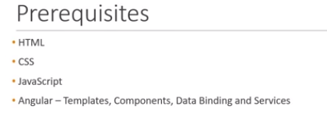
1 Angular Form Introduction
https://www.youtube.com/watch?v=nGr3C3wbh9c&list=PLC3y8-rFHvwhBRAgFinJR8KHIrCdTkZcZ&index=33
Pre-requisites knowledges in HTML, CSS, JavaScript, and Angular: Templates, components, Data Binding, and Services.
You do not have to be expert but basic knowledge is necessary.

Slide 4
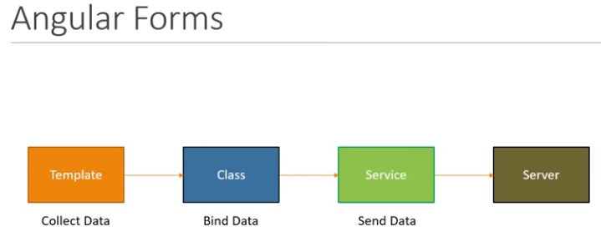
1 Angular Form Introduction
https://www.youtube.com/watch?v=nGr3C3wbh9c&list=PLC3y8-rFHvwhBRAgFinJR8KHIrCdTkZcZ&index=33
The concept of Angular Forms is very straightforward.
The component template contains the HTML to collect the user data.
The component class handles the data binding.
The collected data is sent to the server through a service.
To achieve this, Angular provides us with two approaches

Slide 5
1 Angular Form Introduction
https://www.youtube.com/watch?v=nGr3C3wbh9c&list=PLC3y8-rFHvwhBRAgFinJR8KHIrCdTkZcZ&index=33
The first approach is template driven forms and the second one is reactive Forms.
On a very high level, I can say that in Template driven form, most of the code is written in the component template.
With the reactive forms or model driven form, most of the code is written in component class.
Based on your requirements, you can choose one over the other.
We will of discuss more on that.
In the next section, we will get started with the first approach, i.e., template driven approach to building forms in Angular.

Slide 6
End of Chapter

