Slide 1

2 Template Driven Form (TDF)
Peter H. Chen

Slide 2
2 Template Driven Form (TDF)
https://www.youtube.com/watch?v=1Zx2xb7F-c8&list=PLC3y8-rFHvwhBRAgFinJR8KHIrCdTkZcZ&index=33
In this section, we will look at the Template Driven Form in Angular.
As the name indicates, in Template Driven Form (TDF), much of the code and logic business resides in the HTML Template.

Slide 3
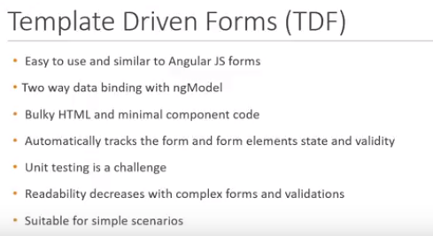
2 Template Driven Form (TDF)
https://www.youtube.com/watch?v=1Zx2xb7F-c8&list=PLC3y8-rFHvwhBRAgFinJR8KHIrCdTkZcZ&index=33
Let’s look at some of the key points related to Template Driven Forms (TDFs).
The TDF approach is easy to use and similar to Angular JS (Angular 1) form.
In this approach, we heavily rely o two-ways data binding. We do not have to keep track of input field values and react to change in the input field. Angular takes care of that with ngModel directive.
As a result, you are going to have a bulky HTML code and minimal component code. In TDF approach, Angular also provide the ngForm directive which along with ngModel directive, automatically tracks the forms and form elements state, and validity.

Slide 4
2 Template Driven Form (TDF)
https://www.youtube.com/watch?v=1Zx2xb7F-c8&list=PLC3y8-rFHvwhBRAgFinJR8KHIrCdTkZcZ&index=33
The first drawback of TDF approach is when it comes to Unit testing. The form validation logic cannot be Unit Tested. The only way to run and end-to-end test with a browser.
The second drawback of TDF approach is when it comes to handling complex forms as we add ore and more validations to a field or as we add Crossfield validation, the readability of the form decrease to a great extent.
So the question is when should you go with the TDF approach?
If you have to create a simple form for which Unit test can be handled with the browser, go with the TDF approach.

Slide 5
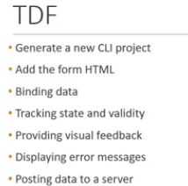
2 Template Driven Form (TDF)
https://www.youtube.com/watch?v=1Zx2xb7F-c8&list=PLC3y8-rFHvwhBRAgFinJR8KHIrCdTkZcZ&index=33
For Complex forms which complex validations and where unit testing is absolutely necessary, go with reactive forms.
Now, we have a brief insight into the TDF approach.
Let’s take a look at how we will be proceeding with the codes.
We are going to generate a new CLI project.
We will add the HTML that represents the form we will be working with.
After that, we will look at data binding that is followed by tracking form state and validity, providing visual feedback, and displaying error messages.
Finally, we will windup the TDF approach by creating an express server and posting data from our Angular application to the Express Server.
We will generate the new CLI project in the next section.

Slide 6
End of Chapter

