Slide 1

3 Setup
Peter H. Chen

Slide 2
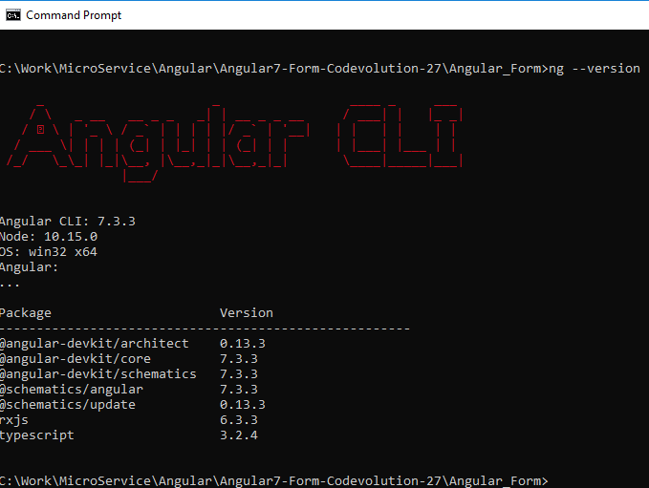
3 Setup
https://www.youtube.com/watch?v=GKU0LtH8bzU&list=PLC3y8-rFHvwhBRAgFinJR8KHIrCdTkZcZ&index=34
In this section, we setup Angular Form Project by Angular/CLI.
> ng –version
You can see Angular version is 7.3.3.

Slide 3
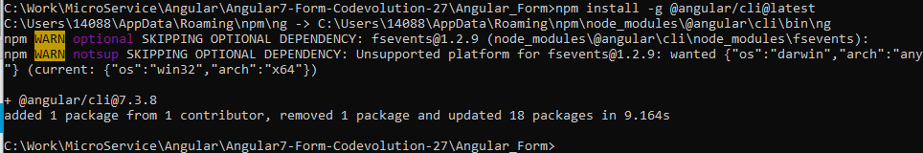
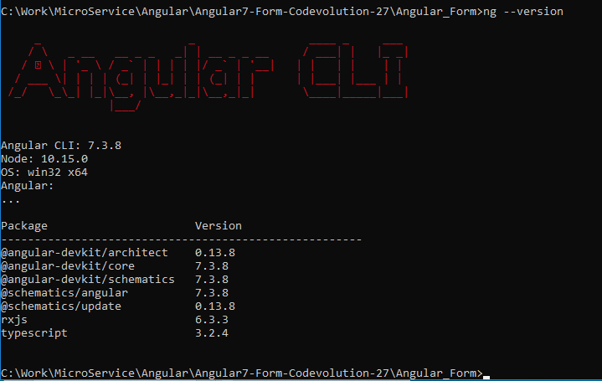
3 Setup
https://www.youtube.com/watch?v=GKU0LtH8bzU&list=PLC3y8-rFHvwhBRAgFinJR8KHIrCdTkZcZ&index=34
If you do not have Angular/CLI installed.
> npm install -g @angular/cli@latest
> ng --version

Slide 4
3.1 Update Angular/CLI

Slide 5
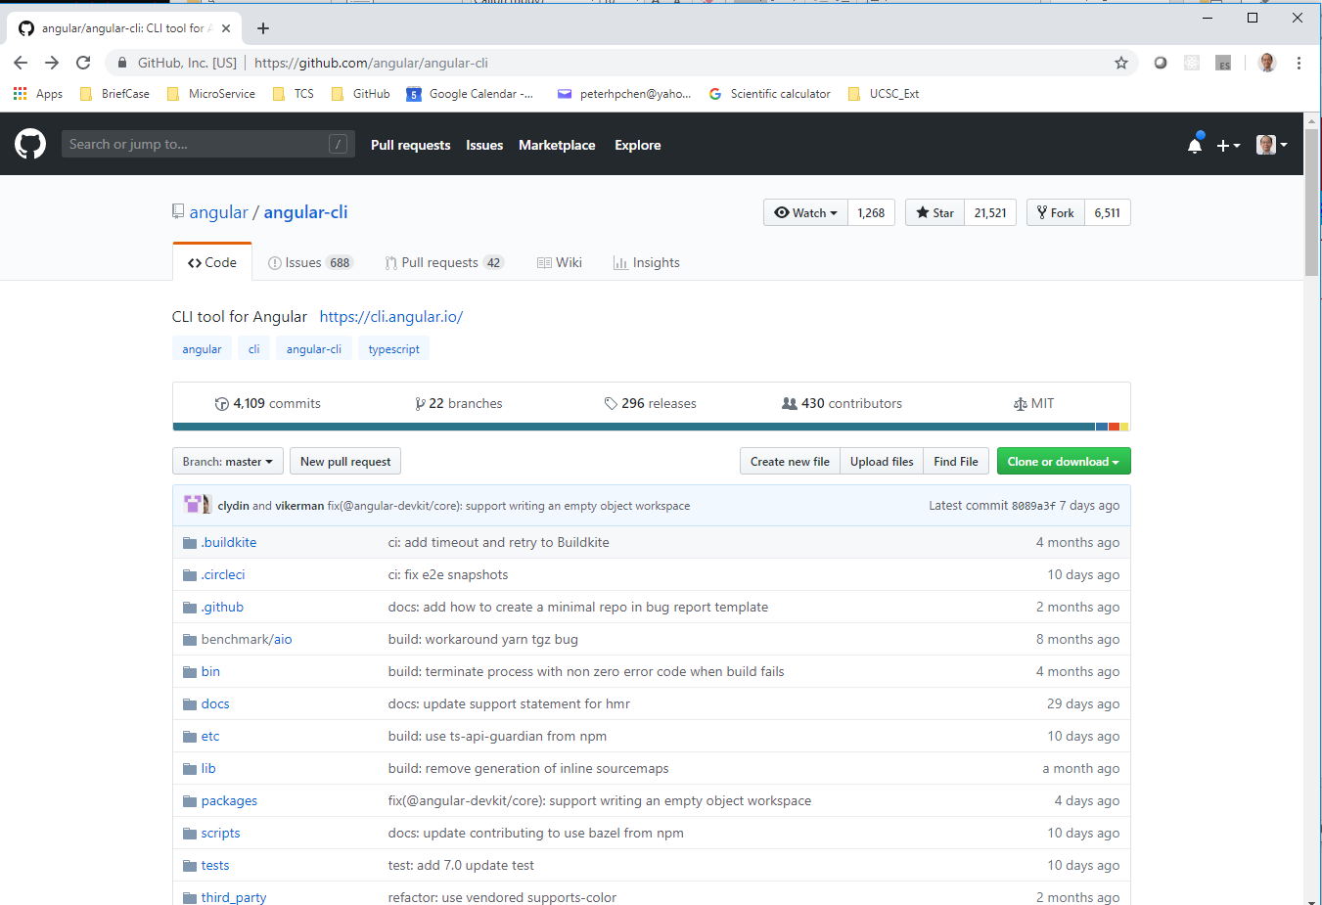
3.1 Update Angular/CLI
https://www.youtube.com/watch?v=GKU0LtH8bzU&list=PLC3y8-rFHvwhBRAgFinJR8KHIrCdTkZcZ&index=34
Go to Angular CLI github: https://github.com/angular/angular-cli

Slide 6
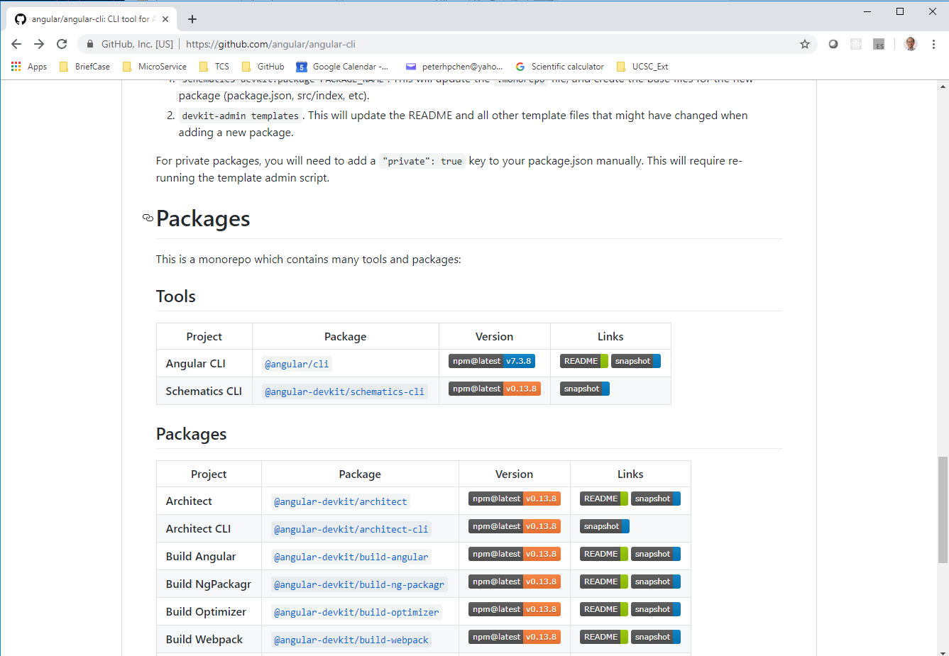
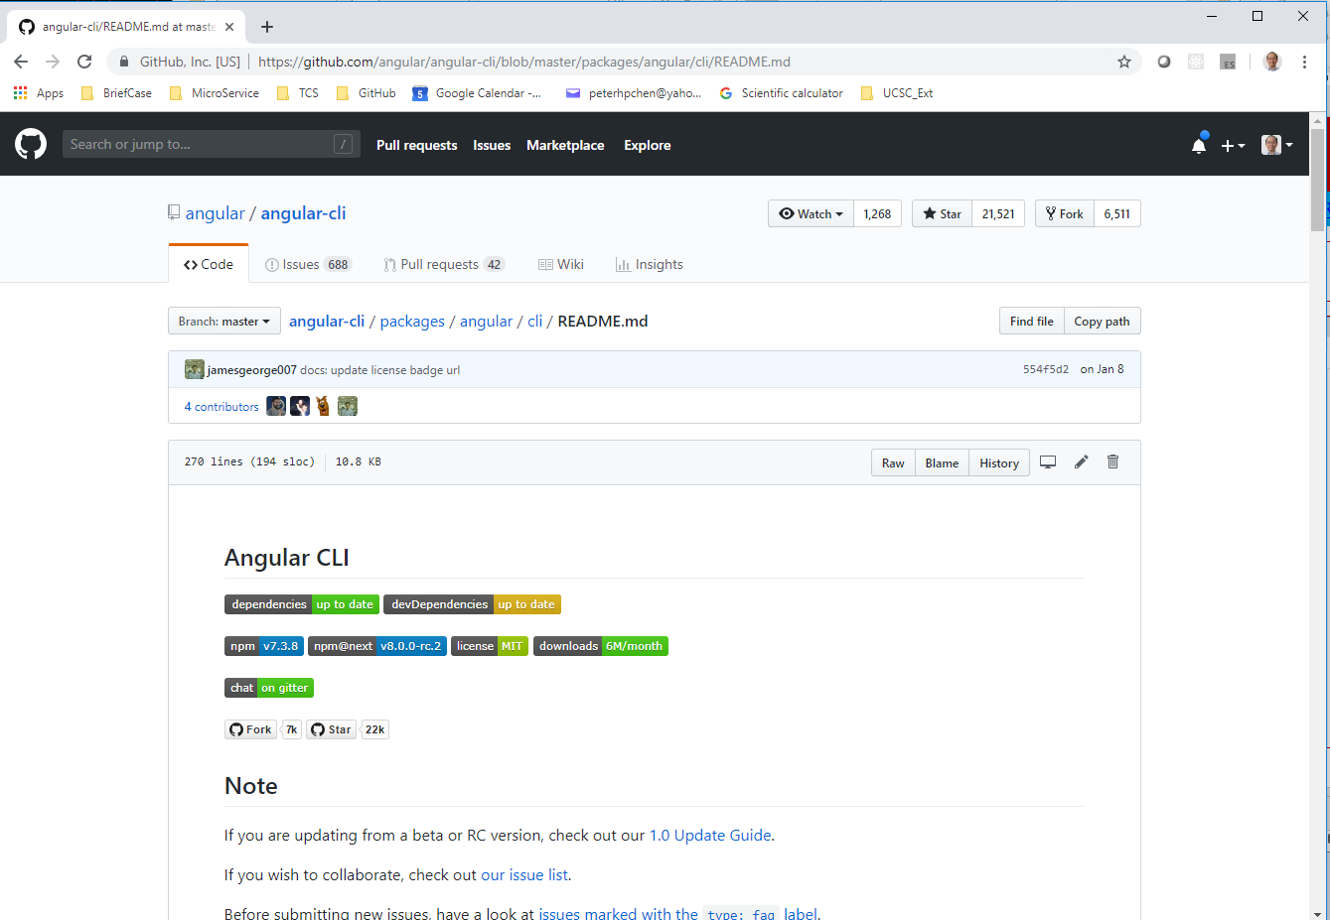
3.1 Update Angular/CLI
https://www.youtube.com/watch?v=GKU0LtH8bzU&list=PLC3y8-rFHvwhBRAgFinJR8KHIrCdTkZcZ&index=34
Scrolled down to the bottom. YOU should find the Tools > Angular CLI > Links > README
Click “README”

Slide 7
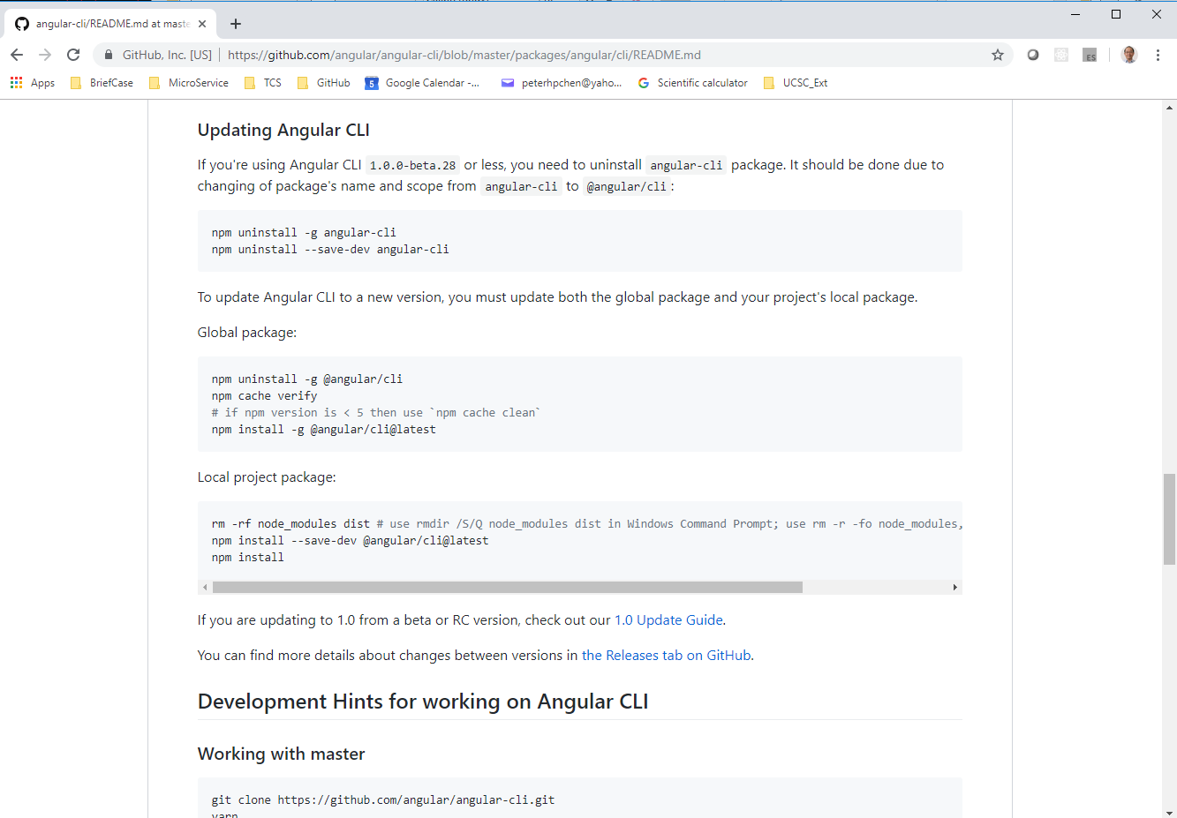
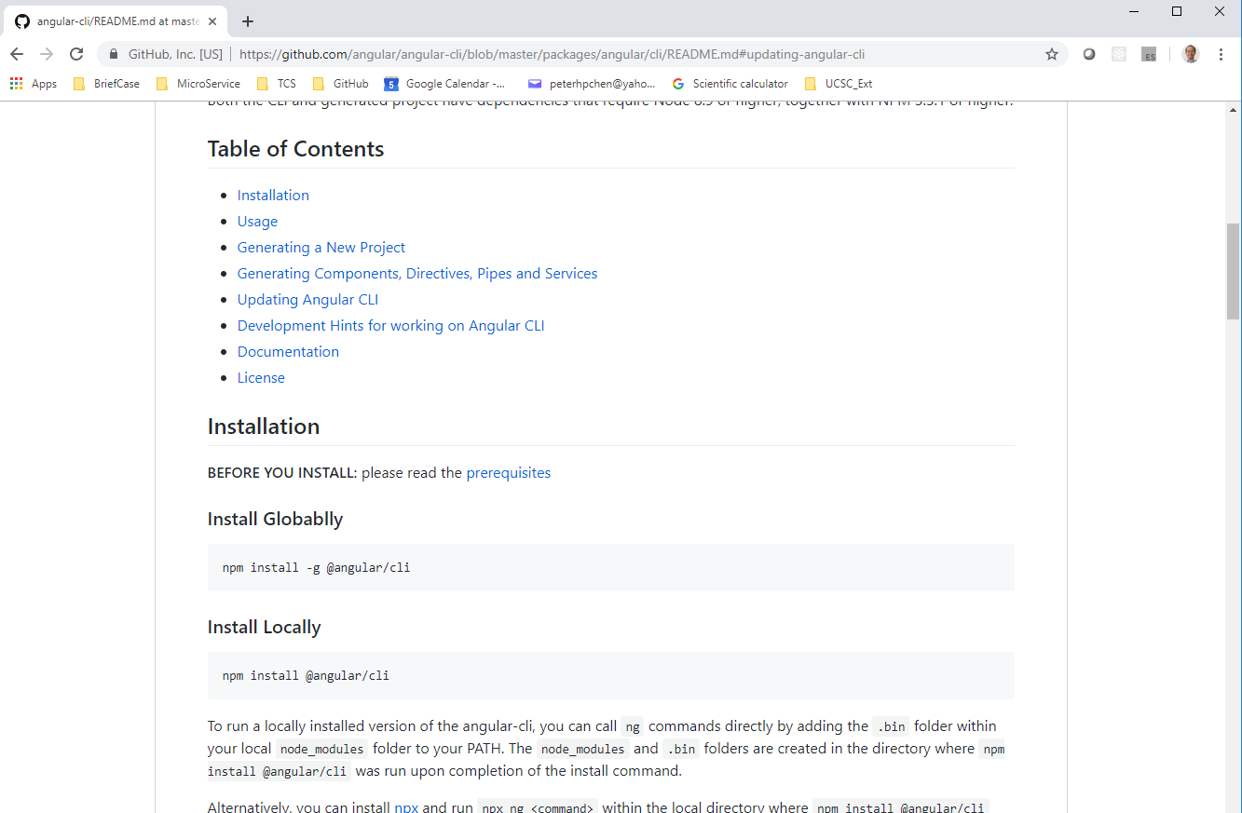
3.1 Update Angular/CLI
https://www.youtube.com/watch?v=GKU0LtH8bzU&list=PLC3y8-rFHvwhBRAgFinJR8KHIrCdTkZcZ&index=34
Scrolled Down to Table of Content and click “Updating Angular CLI”.
For updating Global Package, runt the following three commands:
> npm uninstall –g @angular/cli
> npm install -g @angular/cli@latest
> npm cache verify

Slide 8
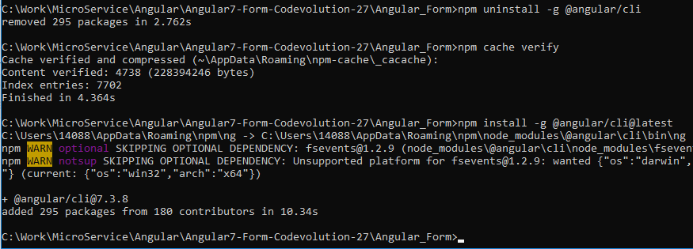
3.1 Update Angular/CLI
https://www.youtube.com/watch?v=GKU0LtH8bzU&list=PLC3y8-rFHvwhBRAgFinJR8KHIrCdTkZcZ&index=34
Scrolled Down to Table of Content and click “Updating Angular CLI”.
For updating Global Package, runt the following three commands:
> npm uninstall –g @angular/cli
> npm cache verify
> npm install -g @angular/cli@latest

Slide 9
3.2 Generate New Project

Slide 10
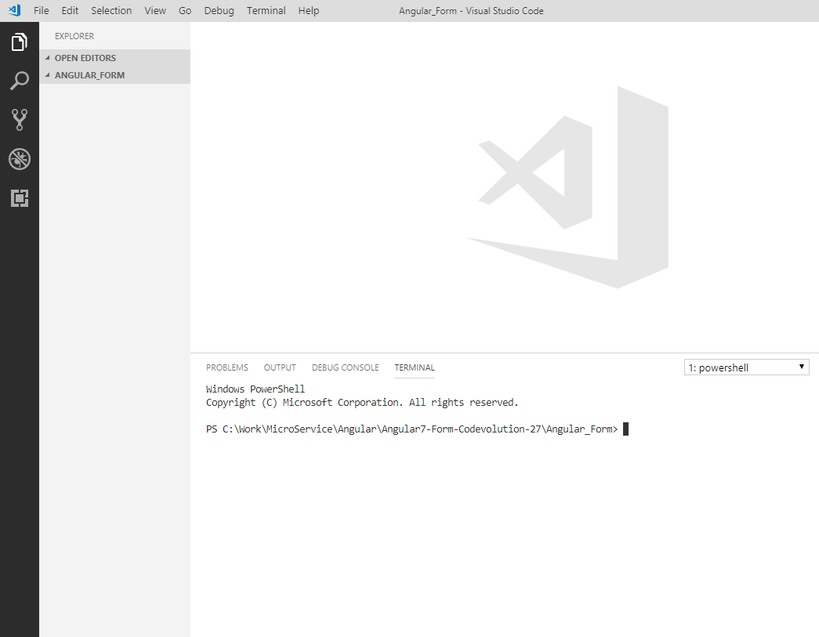
3.2 Generate New Project
https://www.youtube.com/watch?v=GKU0LtH8bzU&list=PLC3y8-rFHvwhBRAgFinJR8KHIrCdTkZcZ&index=34
Let’s generate the Angular Project.
Open Visual Studio Code.
Make sure we are inside the Angular_form folder.

Slide 11
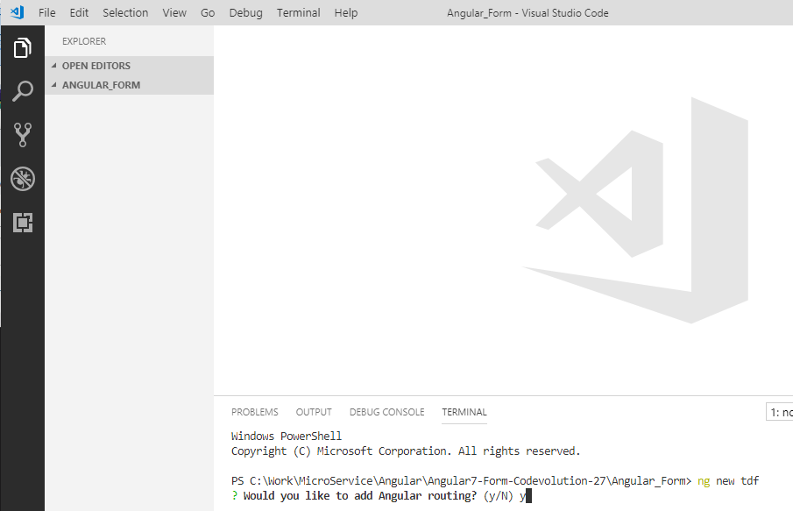
3.2 Generate New Project
https://www.youtube.com/watch?v=GKU0LtH8bzU&list=PLC3y8-rFHvwhBRAgFinJR8KHIrCdTkZcZ&index=34
> ng new tdf
Note: ng: Angular, new: new project, tdf: Template Driven Form

Slide 12
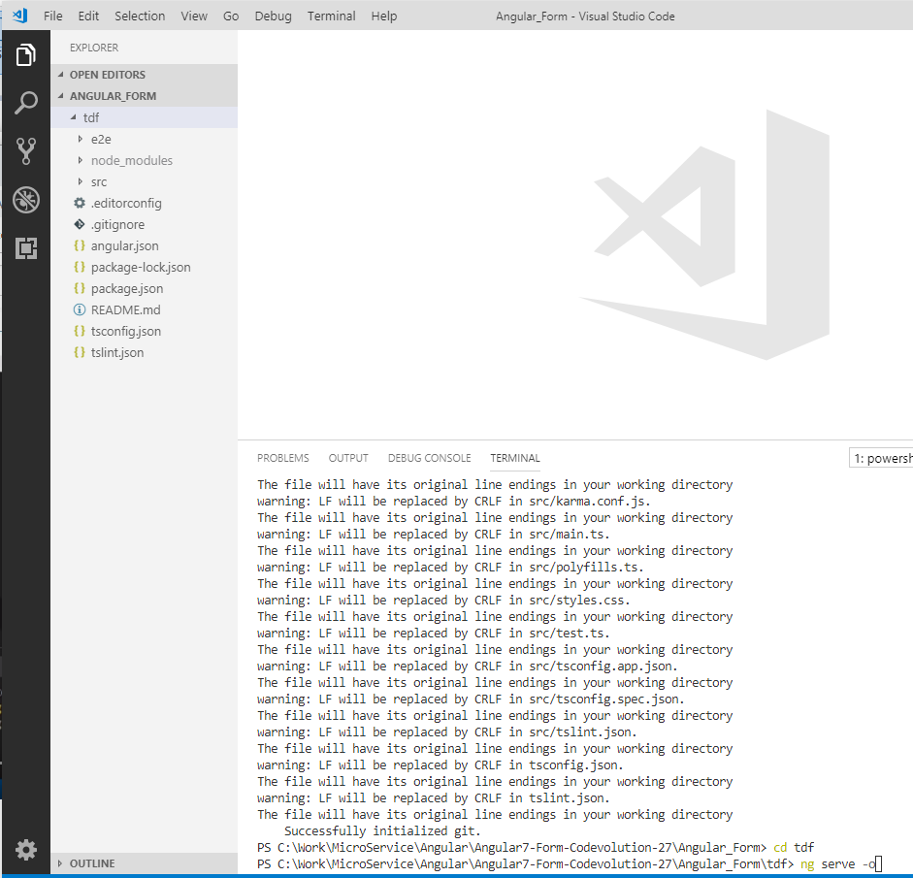
3.2 Generate New Project
https://www.youtube.com/watch?v=GKU0LtH8bzU&list=PLC3y8-rFHvwhBRAgFinJR8KHIrCdTkZcZ&index=34
> cd tdf
> ng serve -o
Note: serve: Angular server, -o: Open browser

Slide 13
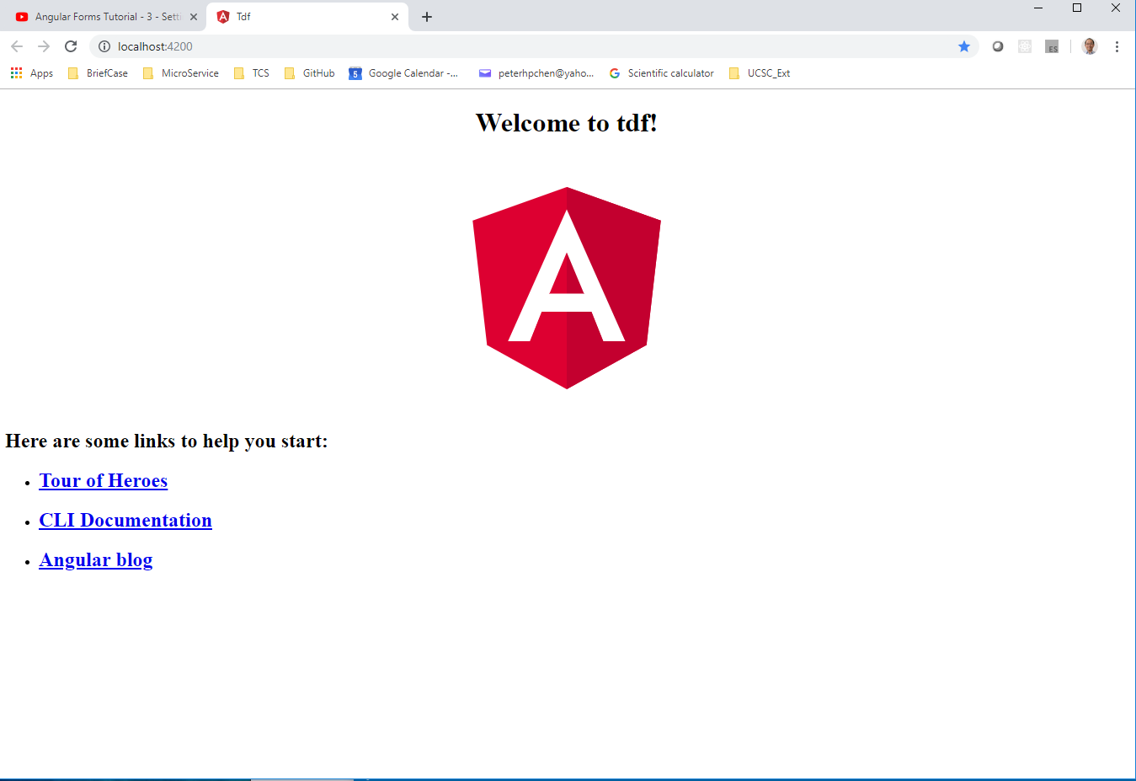
3.2 Generate New Project
https://www.youtube.com/watch?v=GKU0LtH8bzU&list=PLC3y8-rFHvwhBRAgFinJR8KHIrCdTkZcZ&index=34
We should have the application up and running.

Slide 14
3.3 Bootstrap Style

Slide 15
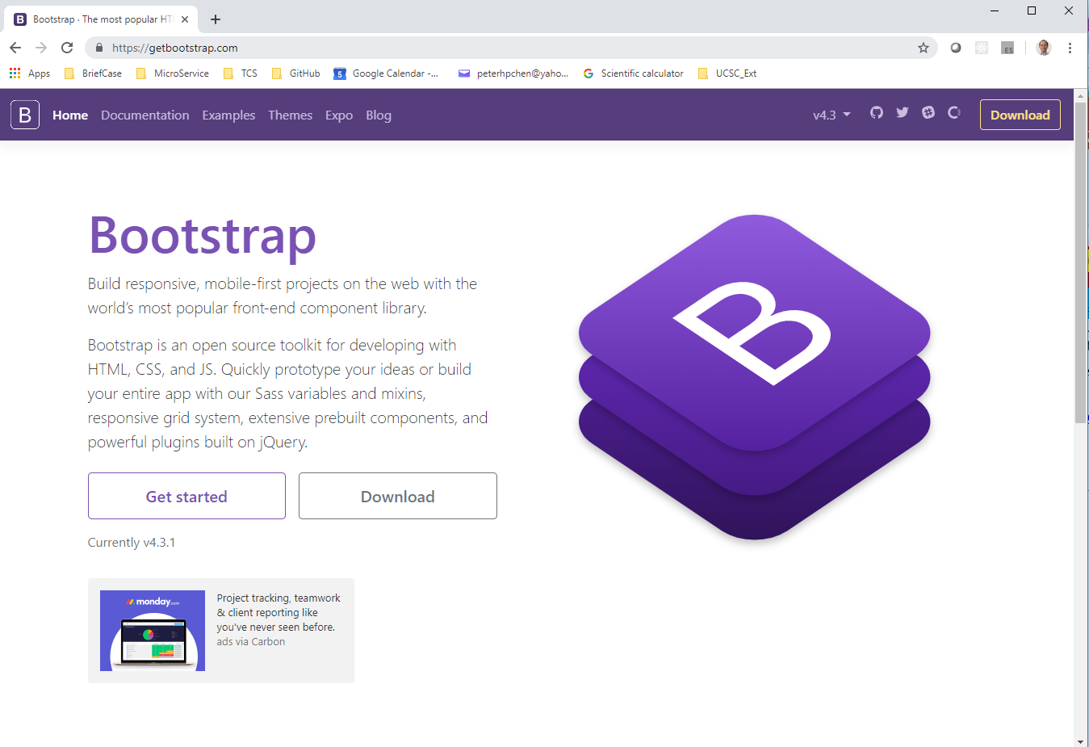
3.2 Generate New Project
https://www.youtube.com/watch?v=GKU0LtH8bzU&list=PLC3y8-rFHvwhBRAgFinJR8KHIrCdTkZcZ&index=34
The final step is to bootstrap styling to our project.
Bootstrap is a CSS framework that gives us a variety of classes that can be applied to make our HTML look better.
To add bootstrap CSS, go to https://getbootstrap.com
Click “Get Started”.

Slide 16
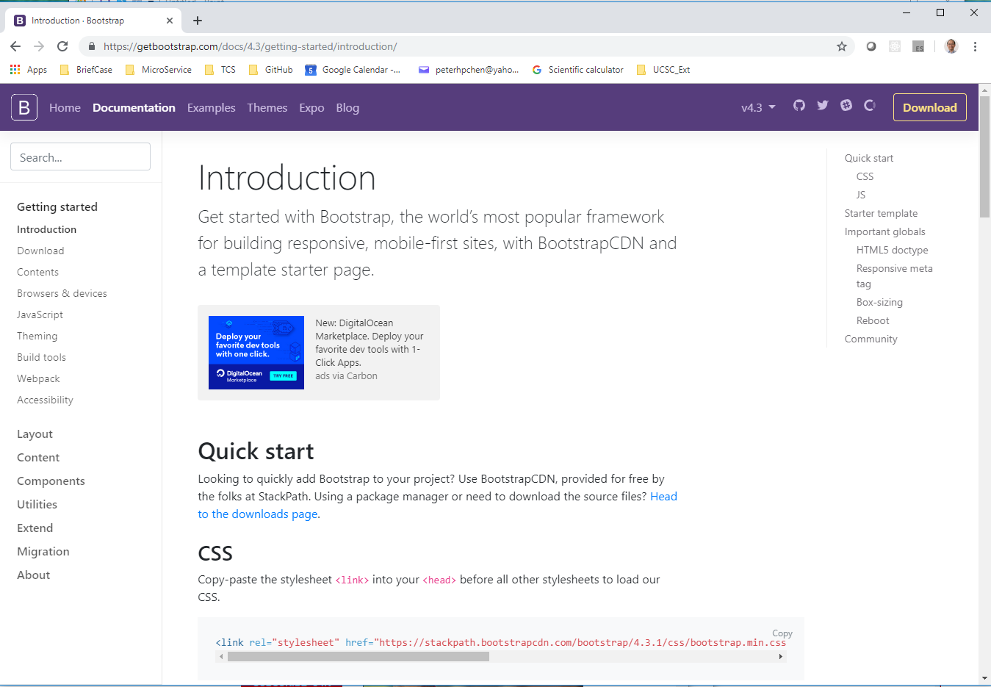
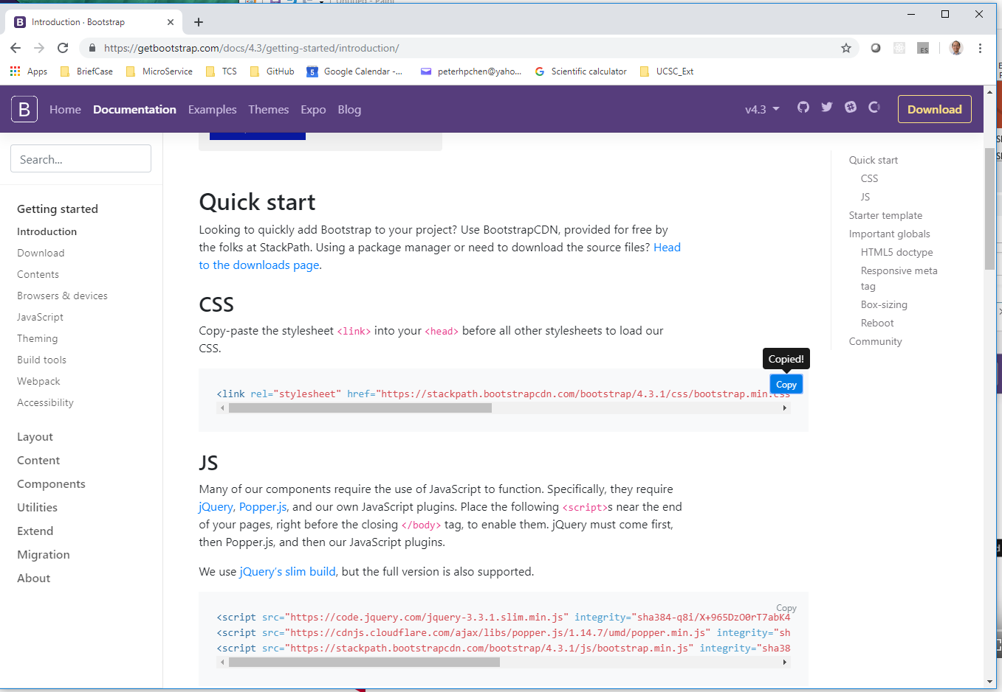
3.2 Generate New Project
https://www.youtube.com/watch?v=GKU0LtH8bzU&list=PLC3y8-rFHvwhBRAgFinJR8KHIrCdTkZcZ&index=34
Scroll down to CDN and click “copy”.

Slide 17
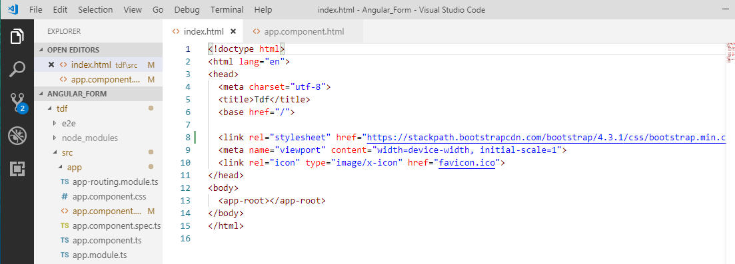
3.2 Generate New Project
https://www.youtube.com/watch?v=GKU0LtH8bzU&list=PLC3y8-rFHvwhBRAgFinJR8KHIrCdTkZcZ&index=34
Go back the Visual Studio Code.
Open inde.html.
Add the reference before other link in the head section as below.

Slide 18
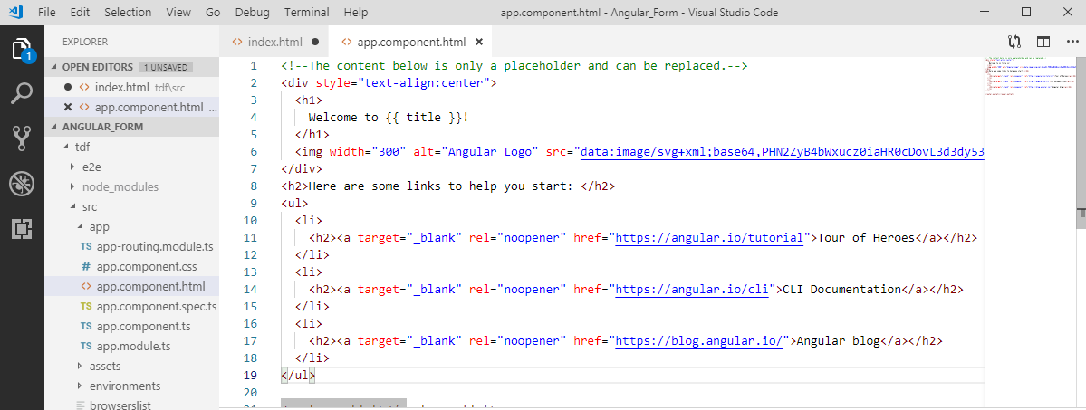
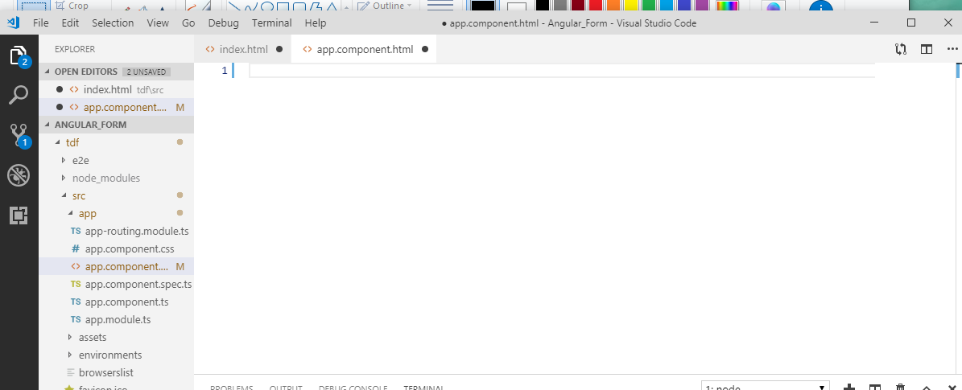
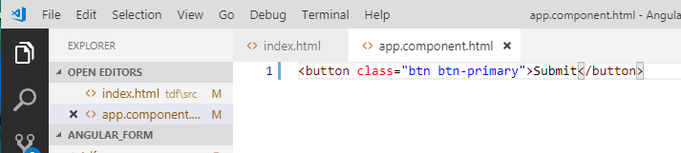
3.2 Generate New Project
https://www.youtube.com/watch?v=GKU0LtH8bzU&list=PLC3y8-rFHvwhBRAgFinJR8KHIrCdTkZcZ&index=34
Now, test the bootstrap and make sure the bootstrap classes work.
Open app.component.html, removed all HTML that is prefilled and add the button
Type “button.btn.btn-primary” => <button class=“btn btn-primary”>Submit</button>

Slide 19
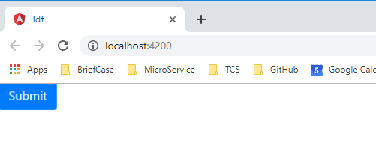
3.2 Generate New Project
https://www.youtube.com/watch?v=GKU0LtH8bzU&list=PLC3y8-rFHvwhBRAgFinJR8KHIrCdTkZcZ&index=34
Refresh the chrome application, if the Bootstrap work, the button should be displayed as blue color.

Slide 20
3.2 Generate New Project
https://www.youtube.com/watch?v=GKU0LtH8bzU&list=PLC3y8-rFHvwhBRAgFinJR8KHIrCdTkZcZ&index=34
This is the project setup.
We used Angular CLI version 7.3.8 to generate a new project and add Bootstrap Styling.

Slide 21
End of Chapter

