Slide 1

4 HTML Form
Peter H. Chen

Slide 2
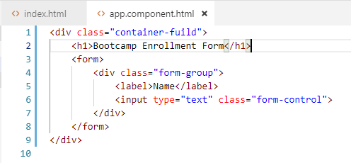
4 HTML Form
https://www.youtube.com/watch?v=xqqCPoEyoE0&list=PLC3y8-rFHvwhBRAgFinJR8KHIrCdTkZcZ&index=35
In this section, we add HTML Form.
In the app.component.html, type “div.container-fuild” => <div class=“container-fluid”></div>
Within the div tag, a heading that says bootcamp enrollment form.
A form Label with User to enter their name.

Slide 3
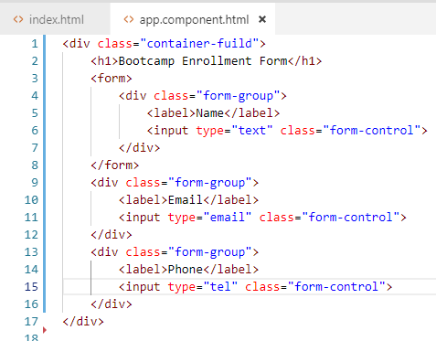
4 HTML Form
https://www.youtube.com/watch?v=xqqCPoEyoE0&list=PLC3y8-rFHvwhBRAgFinJR8KHIrCdTkZcZ&index=35
Here, the form-group and form-control are bootstrap classes.
The next form-control is to enter the email.
Similarly, we have form-control for telephone number.

Slide 4
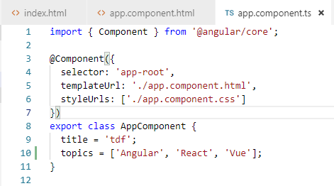
4 HTML Form
https://www.youtube.com/watch?v=xqqCPoEyoE0&list=PLC3y8-rFHvwhBRAgFinJR8KHIrCdTkZcZ&index=35
The next is the tag for user to choose the topic that they are interested in.
First, we create an array of topics in app.component.ts.
In app.component.ts, we create an array to have three elements
topics = [‘Angular’, ‘React’, ‘Vue’];

Slide 5
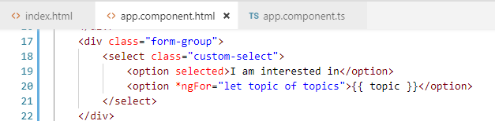
4 HTML Form
https://www.youtube.com/watch?v=xqqCPoEyoE0&list=PLC3y8-rFHvwhBRAgFinJR8KHIrCdTkZcZ&index=35
Next, let’s bind array topics to the select drop-down in the HTML.
This is slightly different.
Again, we are going to have a “class form-group“ and within the div tag, we are going to have a select tag with the class custom select.
The first option which will be selected is I am interested in and we use *ngFor structure directive to iterate through the list of topics and then display the topic name.
The select drop-down is going to be populated with the values of the topics array [Angular, React, Vue].

Slide 6
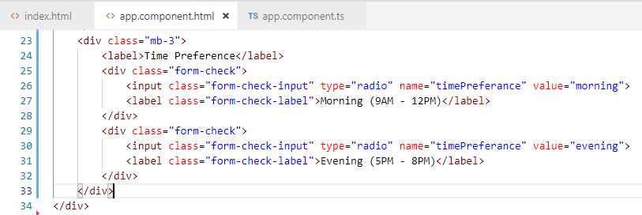
4 HTML Form
https://www.youtube.com/watch?v=xqqCPoEyoE0&list=PLC3y8-rFHvwhBRAgFinJR8KHIrCdTkZcZ&index=35
Here, time-preference, both have the same time, the value, however, one is for morning, one is for evening.
The morning label, we have is Morning (9AM – 12PM) and for value evening, we have the label Evening (5:00PM – 8PM).
That is our time preference radio button.

Slide 7
4 HTML Form
https://www.youtube.com/watch?v=xqqCPoEyoE0&list=PLC3y8-rFHvwhBRAgFinJR8KHIrCdTkZcZ&index=35
Now, once the user has selected their topic of preference, they can select the timeslot, morning, or evening.
So the tie preference is a radio button group.
The time preference we have two possible values: morning or evening.
The class=“form-check” is also provided by bootstrap.
The input element, we have to provide the class=“form-check-input”.
The label class=“form-check-lable”
Note: mb-3: m: margin, b: bottom, 3: 1rem (16px)
https://getbootstrap.com/docs/4.0/components/forms/

Slide 8

4 HTML Form
https://www.youtube.com/watch?v=xqqCPoEyoE0&list=PLC3y8-rFHvwhBRAgFinJR8KHIrCdTkZcZ&index=35
The last control is a checkbox for the user to subscribe to promotional offers.
We will have the div tag with a class =“form-check mb-3”
The type=“checkbox” and the label is “Send me promotional offers”. That is the checkbox for promotional offers.

Slide 9
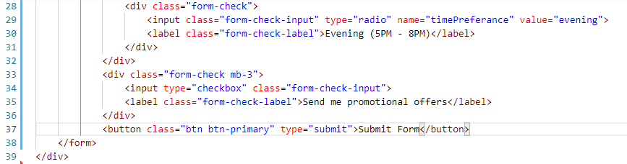
4 HTML Form
https://www.youtube.com/watch?v=xqqCPoEyoE0&list=PLC3y8-rFHvwhBRAgFinJR8KHIrCdTkZcZ&index=35
Finally, we have the submit button to submit the form.
We have a class of button and button primary and of type submit.
Text is Submit form.

Slide 10
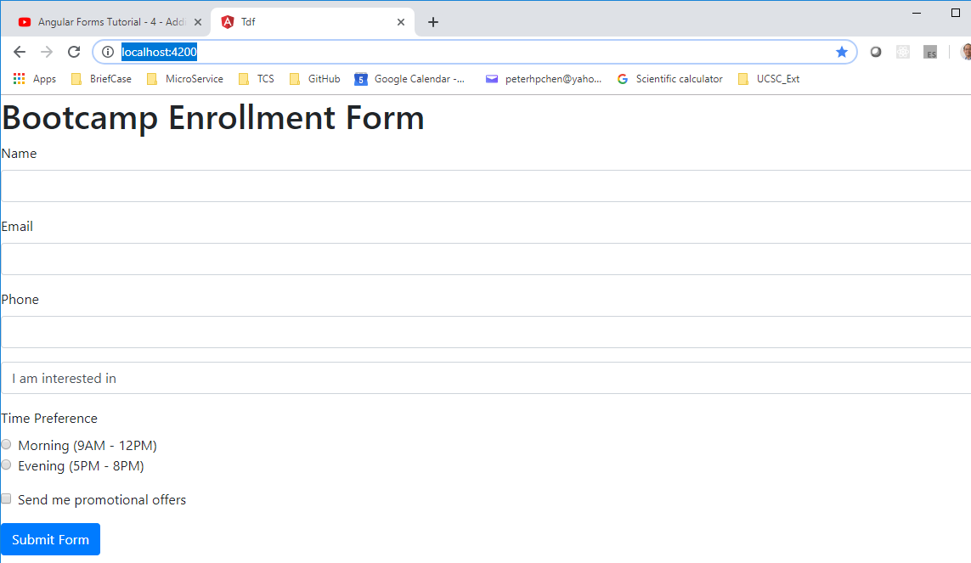
4 HTML Form
https://www.youtube.com/watch?v=xqqCPoEyoE0&list=PLC3y8-rFHvwhBRAgFinJR8KHIrCdTkZcZ&index=35
Save. It and take a look in the browser.
We have “Bootcamp Enrollment Form”.
We have inputs for Name, Email, and Phone number.

Slide 11
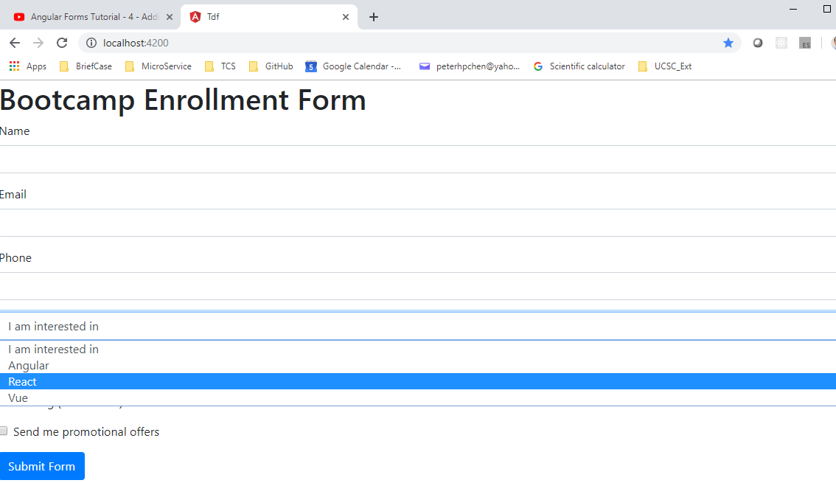
4 HTML Form
https://www.youtube.com/watch?v=xqqCPoEyoE0&list=PLC3y8-rFHvwhBRAgFinJR8KHIrCdTkZcZ&index=35
A select drop-down for the topic angular, React, and Vue.

Slide 12
4 HTML Form
https://www.youtube.com/watch?v=xqqCPoEyoE0&list=PLC3y8-rFHvwhBRAgFinJR8KHIrCdTkZcZ&index=35
Exclusive Radio button for morning or evening.
A Checkbox to subscribe to the promotional offers.
And Finally, a Submit form to be able to submit the bootcamp0
Now the form is complete. The next step is how to capture the data from the form and submit to the server.

Slide 13
End of Chapter

