Slide 1

5 Data Binding with Form
Peter H. Chen

Slide 2
5 Data Binding with Form
https://www.youtube.com/watch?v=iyabqUWYsz4&list=PLC3y8-rFHvwhBRAgFinJR8KHIrCdTkZcZ&index=36
In this section, we will see how the data binding with the form field.
So far, we just created a HTML form, nothing to do with the Angular.

Slide 3
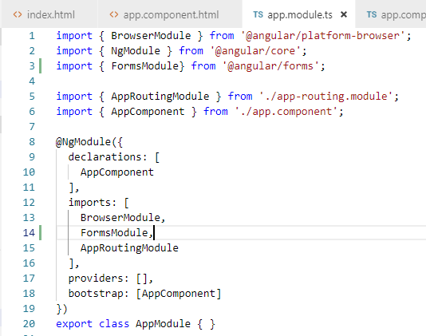
5 Data Binding with Form
https://www.youtube.com/watch?v=iyabqUWYsz4&list=PLC3y8-rFHvwhBRAgFinJR8KHIrCdTkZcZ&index=36
The first step with the Angular Form is to import the form module.
Open app.module.ts.
Add “import { FormsModule } from ‘@angular/forms’;”.
Add FormsModule to the imports array.

Slide 4
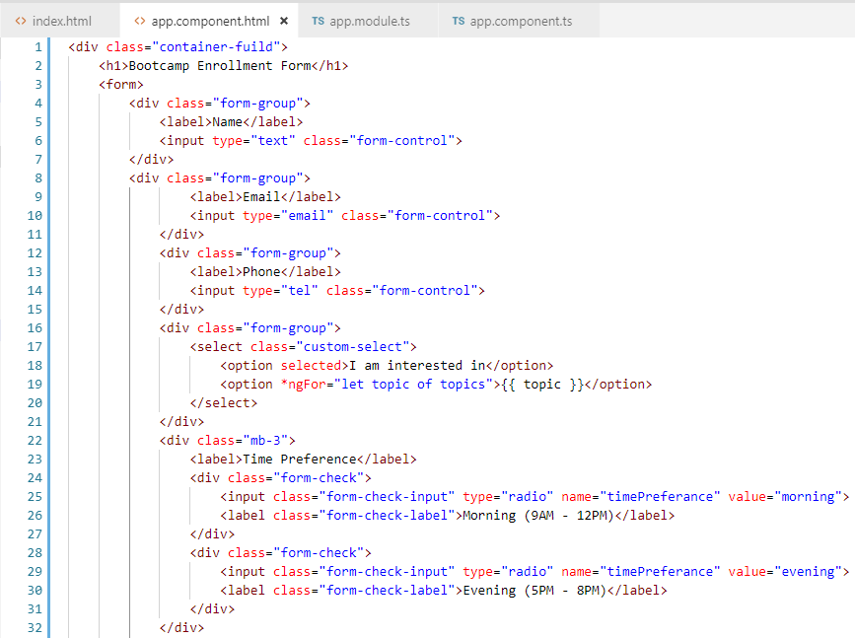
5 Data Binding with Form
https://www.youtube.com/watch?v=iyabqUWYsz4&list=PLC3y8-rFHvwhBRAgFinJR8KHIrCdTkZcZ&index=36
Go back to app.component.html. We have the same basic HTML form but behind the scenes, the Angular magic is already happening.
Any time, we use a form tag, Angular attaches an ngForm directive to the form tag which gives us a valuable information about that particular form.
It tells us what the values of different forms control are and whether the values are valid or invalid.

Slide 5
5 Data Binding with Form
https://www.youtube.com/watch?v=iyabqUWYsz4&list=PLC3y8-rFHvwhBRAgFinJR8KHIrCdTkZcZ&index=36
How do we get a hold of a reference to this ngForm directives using a template reference variable?
To the for tag, we are going to add a template reference variable. We call it userForm and assign it “ngForm” (#userForm=“ngForm”) the ngForm directive exports itself as the string ngForm and assign it to a reference variable. We have reference to the directive itself.
The directive gives us the access to the values of the form controls. It does so using the value property.
In HTML, we use interpolation to take a peek at the form control values. “{{ userForm.value | json }}”. userForm.value and then pass it through the Json pipe.

Slide 6
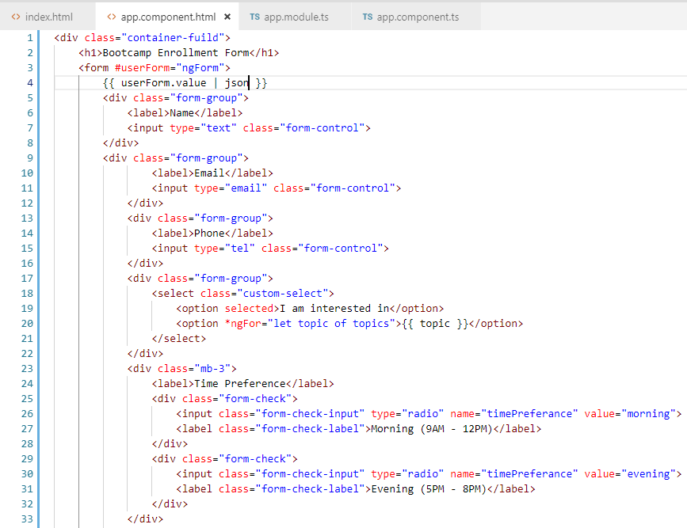
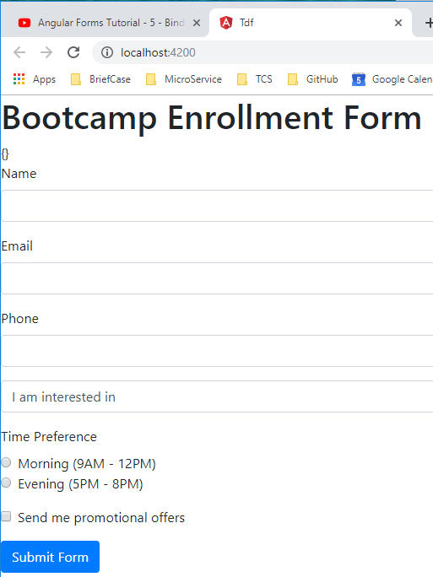
5 Data Binding with Form
https://www.youtube.com/watch?v=iyabqUWYsz4&list=PLC3y8-rFHvwhBRAgFinJR8KHIrCdTkZcZ&index=36
Check with the browser. We see the empty object.

Slide 7
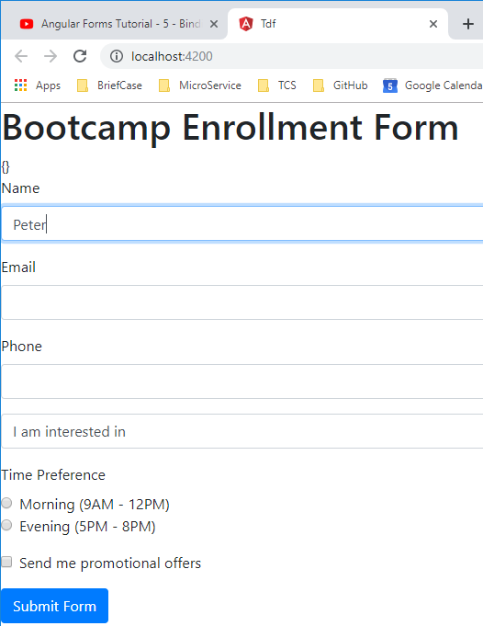
5 Data Binding with Form
https://www.youtube.com/watch?v=iyabqUWYsz4&list=PLC3y8-rFHvwhBRAgFinJR8KHIrCdTkZcZ&index=36
Check with the browser. We see the empty object.
When we type Name and etc., we did not see any object data captured.

Slide 8
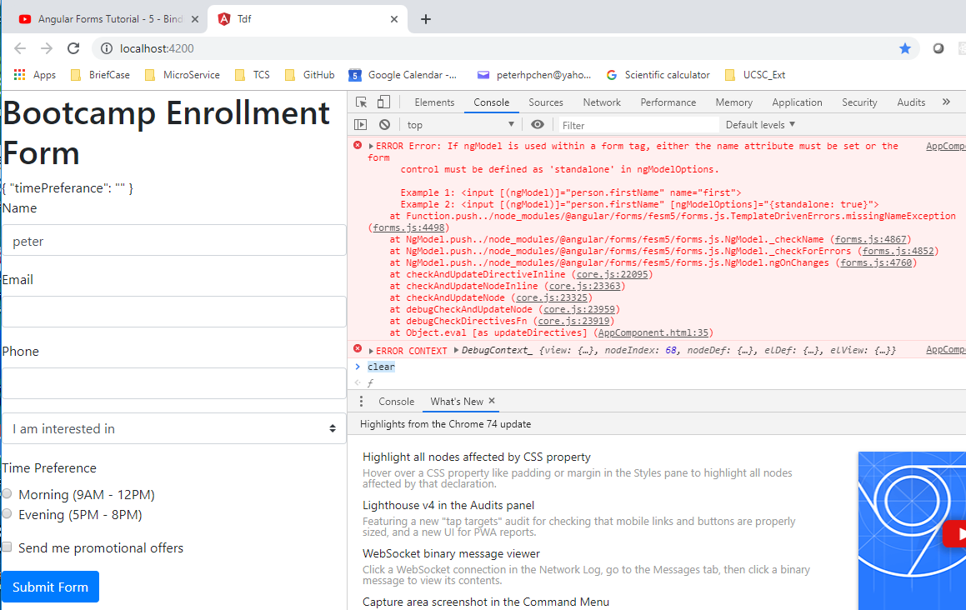
5 Data Binding with Form
https://www.youtube.com/watch?v=iyabqUWYsz4&list=PLC3y8-rFHvwhBRAgFinJR8KHIrCdTkZcZ&index=36
If we want to track the data we need to use ngModel directive to each of the form control.
We type string in Name. We only see the empty string. Check “F12” console.log.
There is an error message: “If ngModel is used within a form tag, either the name attribute must be set or the form control must be defined as ‘standalone’ in ngModelOptions..

Slide 9
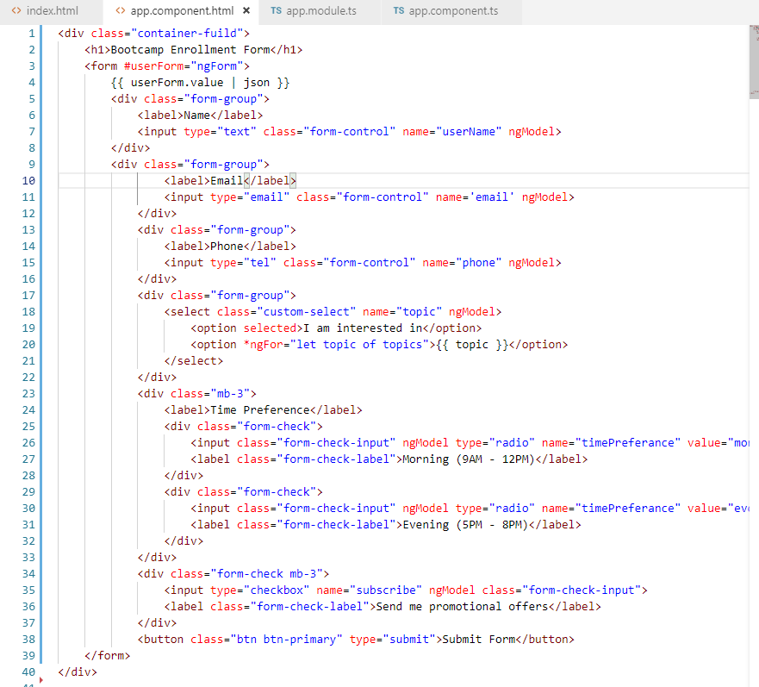
5 Data Binding with Form
https://www.youtube.com/watch?v=iyabqUWYsz4&list=PLC3y8-rFHvwhBRAgFinJR8KHIrCdTkZcZ&index=36
The name=“sting-name” must be defined in each of the input.

Slide 10
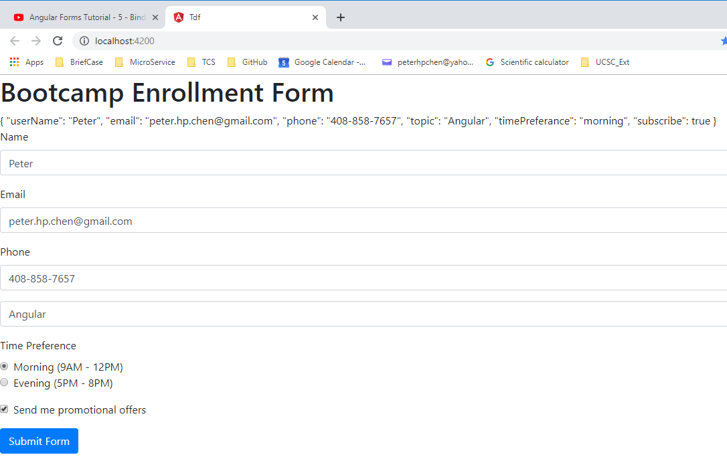
5 Data Binding with Form
https://www.youtube.com/watch?v=iyabqUWYsz4&list=PLC3y8-rFHvwhBRAgFinJR8KHIrCdTkZcZ&index=36
The input of form captured by the Angular. Check and unchecked are all responds correctly.

Slide 11
5 Data Binding with Form
https://www.youtube.com/watch?v=iyabqUWYsz4&list=PLC3y8-rFHvwhBRAgFinJR8KHIrCdTkZcZ&index=36
Now, in addition to ngModel, Angular also provide the ngModelGroup directive.
We use ngModelGroup directive if we would like to group or create a subgroup within a form.
For example, consider an address. The address can have Street, City, State, and Postal code.
We can group all of those fields into a address object using the ngModelGroup directive.

Slide 12
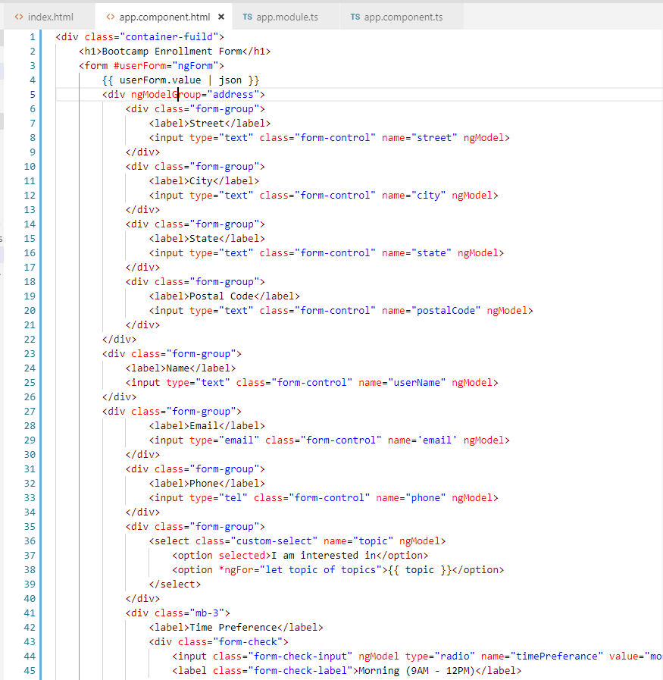
5 Data Binding with Form
https://www.youtube.com/watch?v=iyabqUWYsz4&list=PLC3y8-rFHvwhBRAgFinJR8KHIrCdTkZcZ&index=36
Use ngModelGroup to group the form. All the four elements, street, city, state, postal code are enclosed in a div tag that has the ngModelGroup directive and assign name “address”.
Note: the ngModelGroup is case sensitive, the “Group” started with Capital G, not g..

Slide 13
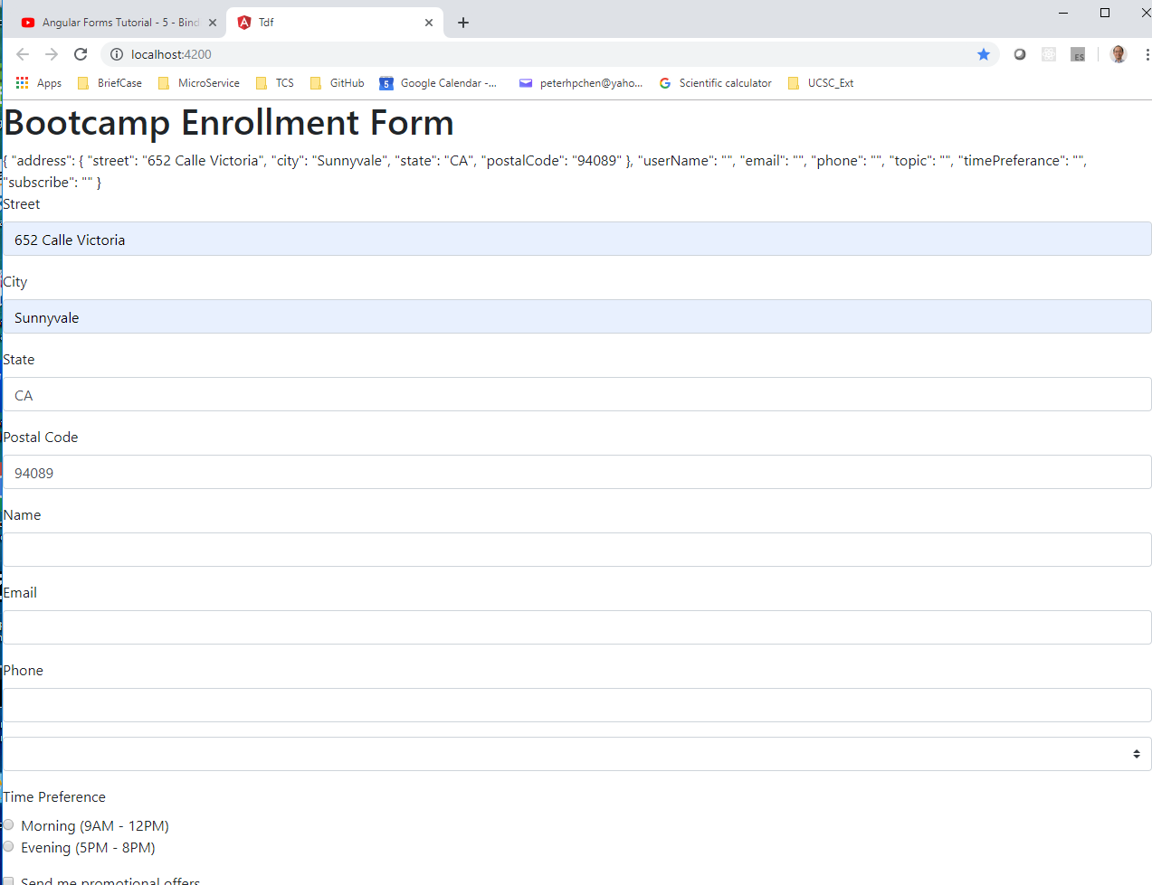
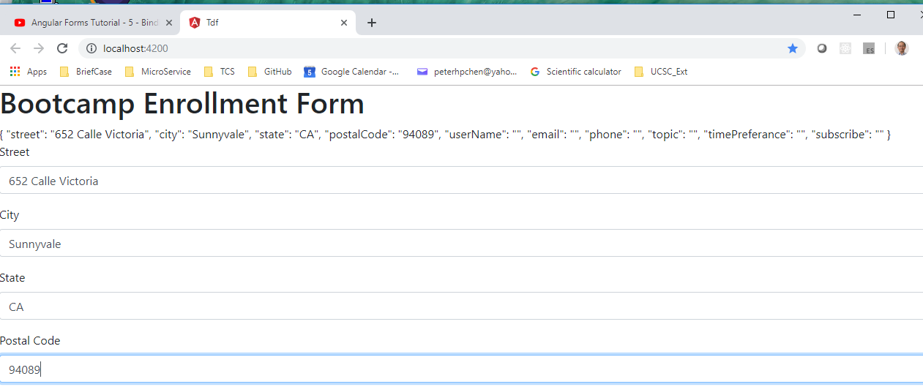
5 Data Binding with Form
https://www.youtube.com/watch?v=iyabqUWYsz4&list=PLC3y8-rFHvwhBRAgFinJR8KHIrCdTkZcZ&index=36
Typo in “ngModelgroup”, no group shown.
Correct typo “ngModelGroup”, grouping is shown. The address group four properties together.
We also see the individual properties.

Slide 14
5 Data Binding with Form
https://www.youtube.com/watch?v=iyabqUWYsz4&list=PLC3y8-rFHvwhBRAgFinJR8KHIrCdTkZcZ&index=36
Keep in mind, when we come to the data binding in template driven forms, we have three directives, ngForm, ngModel, and ngModelGroup.

Slide 15
End of Chapter

