Slide 1

21 HTTP Fetch Data
Peter H. Chen

Slide 2
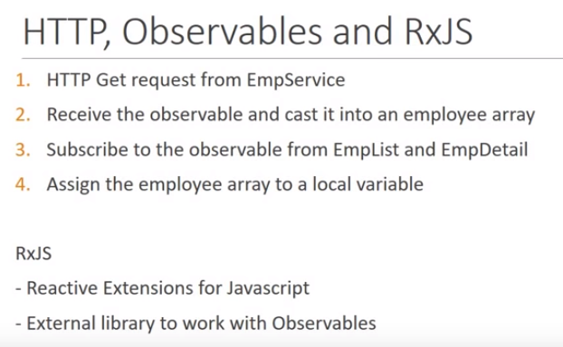
21 HTTP Fetch Data
https://www.youtube.com/watch?v=N8FBmB2jme8&index=6&list=PLC3y8-rFHvwhBRAgFinJR8KHIrCdTkZcZ
In this section, we implement HTTP with Angular Observable and RxJS Library.

Slide 3
21 HTTP Fetch Data
https://www.youtube.com/watch?v=N8FBmB2jme8&index=6&list=PLC3y8-rFHvwhBRAgFinJR8KHIrCdTkZcZ
The first step is to make a get request from the employee service.
In Angular 4, we were using the HTTP Module.
From version 5, we use the HTPP Client Module. In Angular 5, we see a change in the module responsible for HTTP.
The HTTP client modules provides a simplified API for HTTP functionality for use with angular application.
Let us go ahead and import it into our application.

Slide 4
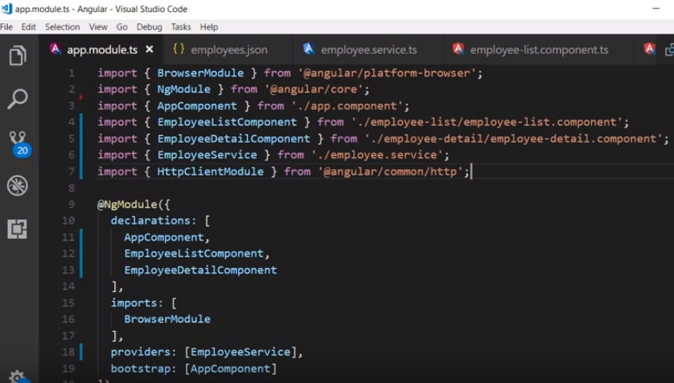
21 HTTP Fetch Data
https://www.youtube.com/watch?v=N8FBmB2jme8&index=6&list=PLC3y8-rFHvwhBRAgFinJR8KHIrCdTkZcZ
Import { HttpClientModule} from ‘@angular/common/http’.

Slide 5
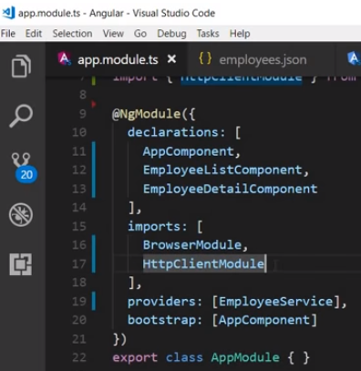
21 HTTP Fetch Data
https://www.youtube.com/watch?v=N8FBmB2jme8&index=6&list=PLC3y8-rFHvwhBRAgFinJR8KHIrCdTkZcZ
Add the imports array so that the HTTP client module is accessible within the app module.
The app.module now importing the HttpClientModule.
We also registering the service with Angular Injector. We do not have to explicitly register it by adding it to the providers metadata, the HttpCLientModule will do that for us.

Slide 6
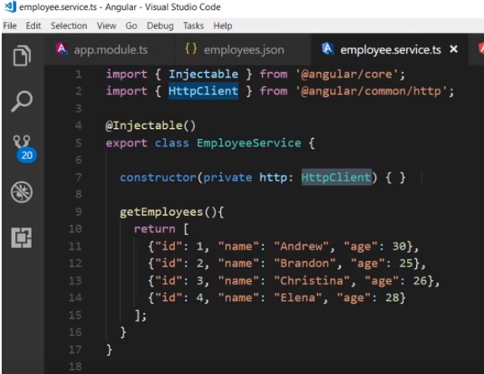
21 HTTP Fetch Data
https://www.youtube.com/watch?v=N8FBmB2jme8&index=6&list=PLC3y8-rFHvwhBRAgFinJR8KHIrCdTkZcZ
And now to use HTTP in our employee service class, we declare it as a dependency in the constructor.
In the employee service class, in the constructor, type private http: HttpClient {}
Make sure to import the { HttpClient } as well.
We now have a local variable HttpClient which we can use to refer to an instance of HTTP client. So we are ready to get a request to fetch data using HTTP.

Slide 7
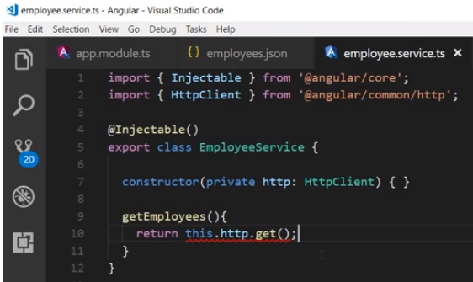
21 HTTP Fetch Data
https://www.youtube.com/watch?v=N8FBmB2jme8&index=6&list=PLC3y8-rFHvwhBRAgFinJR8KHIrCdTkZcZ
In the getEmployees() method, let’s make the request ‘return this.http.get()’
The get request takes in a URL as its argument.
We do not have have an action working webserver and it does not seem practical to start a web server to serve up four lines of employee for our example.

Slide 8
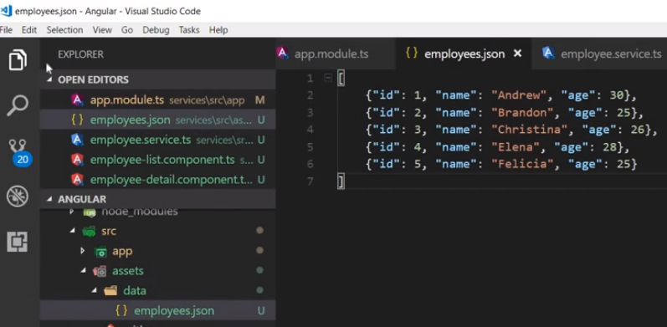
21 HTTP Fetch Data
https://www.youtube.com/watch?v=N8FBmB2jme8&index=6&list=PLC3y8-rFHvwhBRAgFinJR8KHIrCdTkZcZ
Let’s fetch the data from a file which we assume to be on a web server.
Within the project folder in the src/assets folder, create data folder and then create employees.json file as below.
We will serve the data from this file instead of actual web server.

Slide 9
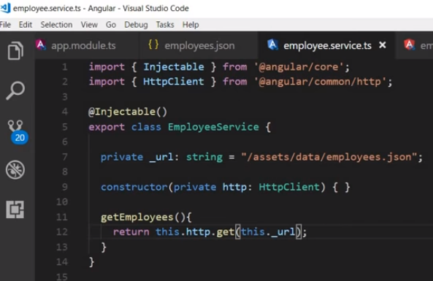
21 HTTP Fetch Data
https://www.youtube.com/watch?v=N8FBmB2jme8&index=6&list=PLC3y8-rFHvwhBRAgFinJR8KHIrCdTkZcZ
In the employee.service, we create a hew property which point the private _url with string format = “assets/data/employee.json”.
You can just replace the _url to any web server location in future.
The application will still working as expected.

Slide 10
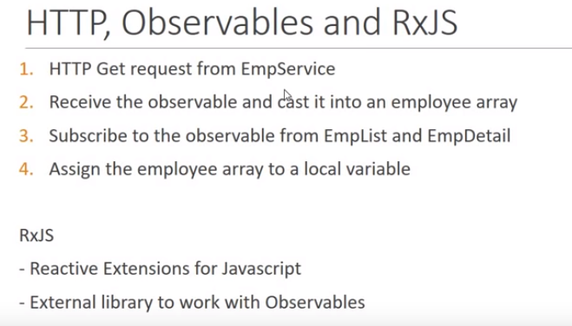
21 HTTP Fetch Data
https://www.youtube.com/watch?v=N8FBmB2jme8&index=6&list=PLC3y8-rFHvwhBRAgFinJR8KHIrCdTkZcZ
Now, we have completed the first step. We have made the request for employee.Service.
Next step is to cast the observable which we receive as response to an employee array.

Slide 11
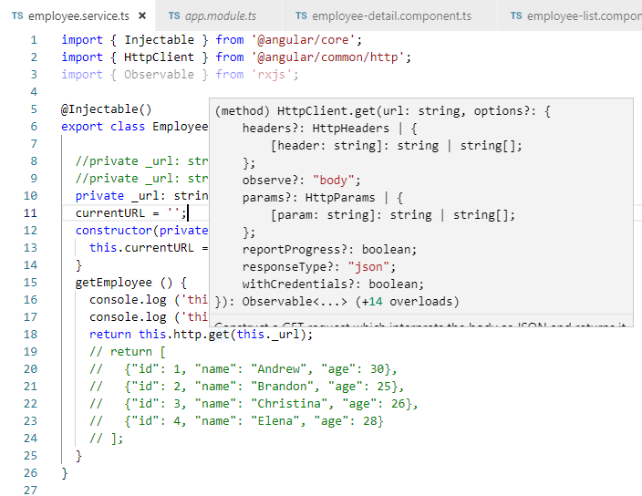
21 HTTP Fetch Data
https://www.youtube.com/watch?v=N8FBmB2jme8&index=6&list=PLC3y8-rFHvwhBRAgFinJR8KHIrCdTkZcZ
If you hover the get method, you can see that it returns an Observable but for our application, this observable needs to be cast into a format that represents an array of employees.

Slide 12
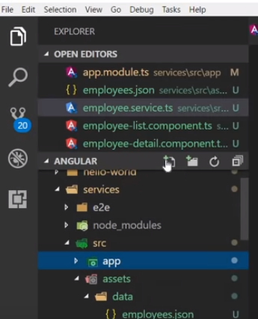
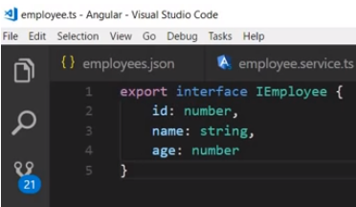
21 HTTP Fetch Data
https://www.youtube.com/watch?v=N8FBmB2jme8&index=6&list=PLC3y8-rFHvwhBRAgFinJR8KHIrCdTkZcZ
In the app folder, create a new file employee.ts.
Add the code for Employee interface.
Export interface Iemployee. Each employee has ID, Name, and age.
We now have the Employee type that Observable can be cast into.
Go back to employee service.

Slide 13
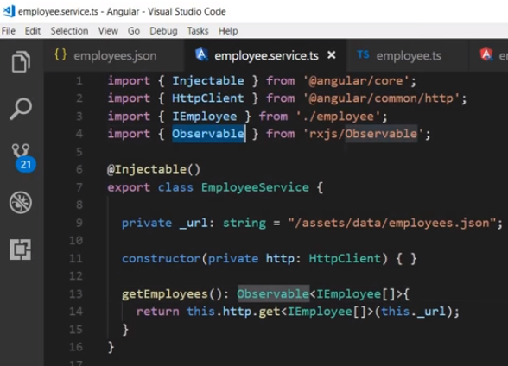
21 HTTP Fetch Data
https://www.youtube.com/watch?v=N8FBmB2jme8&index=6&list=PLC3y8-rFHvwhBRAgFinJR8KHIrCdTkZcZ
Add the type to get request. This is going to be an array of IEmployee and also make sure to import { IEmployee } from ‘./employee’
> npm install rxjs-compat --save # to solve the Obsverable not found problem
import {Observable} from ‘rxjs/Observable’;
getEmmployee: Observable<Iemployee[]> {
return this.http.get <Iemployee[]> (this._url);
}

Slide 14
21 HTTP Fetch Data
https://www.youtube.com/watch?v=N8FBmB2jme8&index=6&list=PLC3y8-rFHvwhBRAgFinJR8KHIrCdTkZcZ
This complete the second step. We have cast the Observable into Employee Array.
The third step is subscribe the Observable from employee-list and employee-detail.
The fourth step is to assign employee array to a local variable.

Slide 15
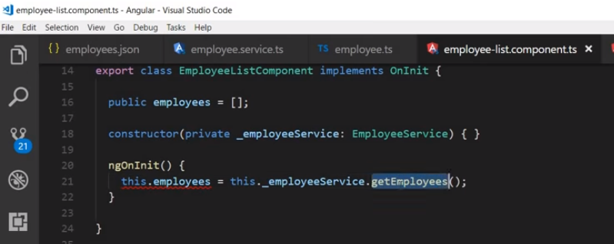
21 HTTP Fetch Data
https://www.youtube.com/watch?v=N8FBmB2jme8&index=6&list=PLC3y8-rFHvwhBRAgFinJR8KHIrCdTkZcZ
Let’s implement the third and fourth steps together.
Go to employee-list component and subscribe to the observable.
Here getEmployee() method then subscribe to the Observable.
Remove this.employees assignment, instead, we are going to have the subscribe to the observable returned by the get employees method.

Slide 16
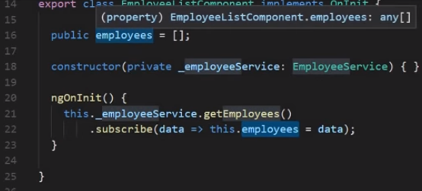
21 HTTP Fetch Data
https://www.youtube.com/watch?v=N8FBmB2jme8&index=6&list=PLC3y8-rFHvwhBRAgFinJR8KHIrCdTkZcZ
The first argument to the subscribe method is going to be a flat arrow function that assign the data received from the observable to this local employees property.
The argument is going to be (data => this.employees = data);
The left hand side is the argument to the function, and the right hand side is the body of the function.
We are assigning the employee data to the employees property.

Slide 17
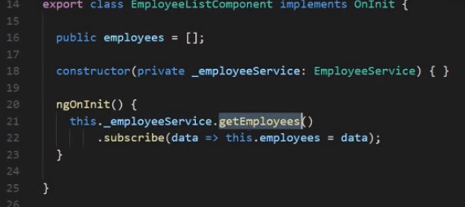
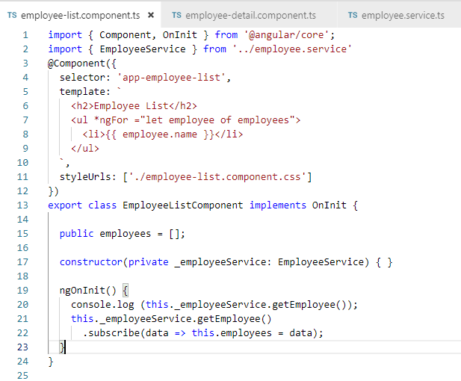
21 HTTP Fetch Data
https://www.youtube.com/watch?v=N8FBmB2jme8&index=6&list=PLC3y8-rFHvwhBRAgFinJR8KHIrCdTkZcZ
We explain what exactly going on in the EmployeeListComponent.
We have instance of _employeeService. We use _employeeService to call getEmployees() method. This method return an Observable.
To receive data, we need to subscribe to it. Once we subscribe the observable, the employee data arrive asynchronously. We assign the data to the class property employees using the flat arrow syntax.

Slide 18
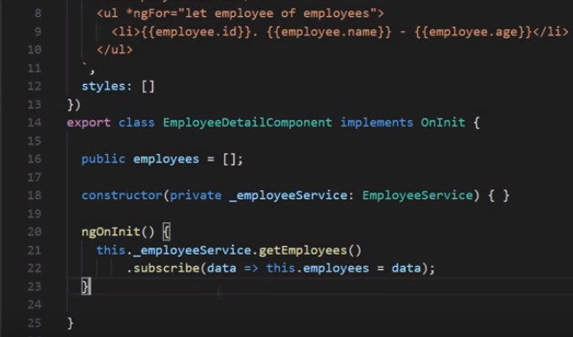
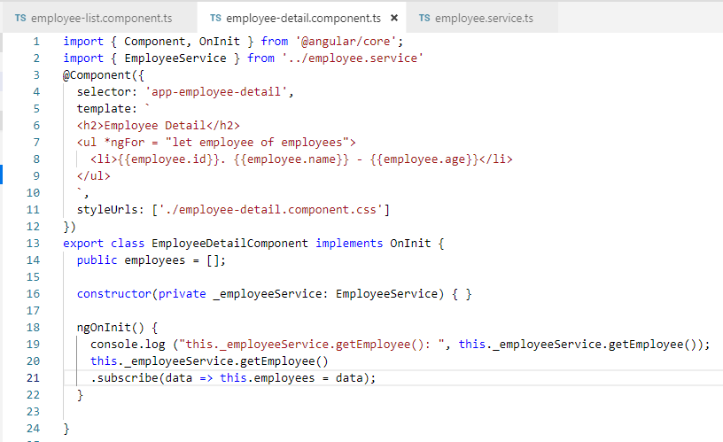
21 HTTP Fetch Data
https://www.youtube.com/watch?v=N8FBmB2jme8&index=6&list=PLC3y8-rFHvwhBRAgFinJR8KHIrCdTkZcZ
Let do it in EmployeeDetailComponent as well.

Slide 19
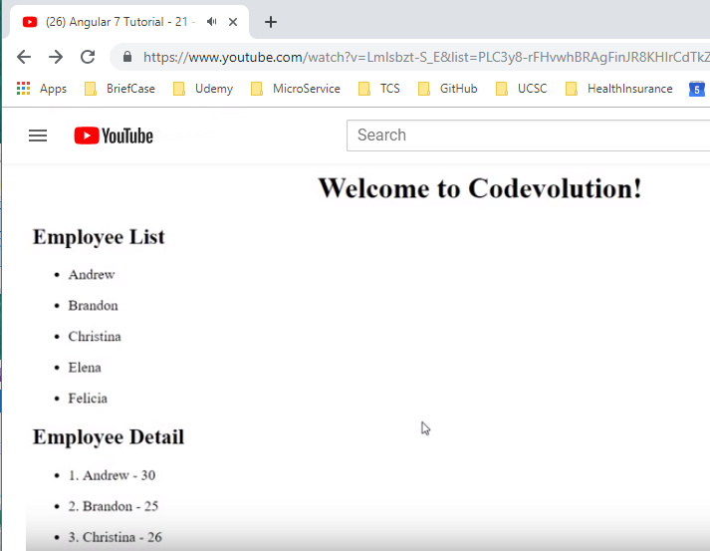
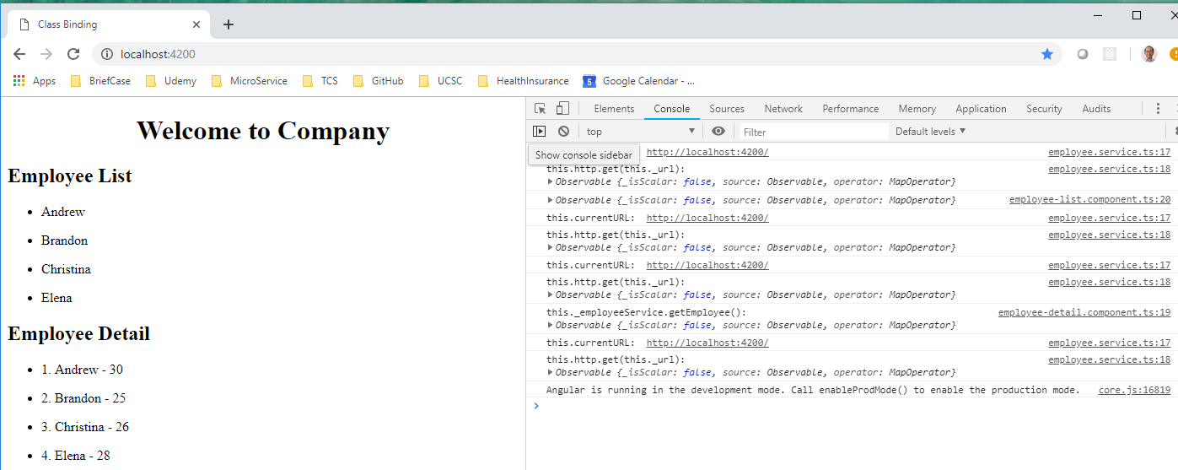
21 HTTP Fetch Data
https://www.youtube.com/watch?v=N8FBmB2jme8&index=6&list=PLC3y8-rFHvwhBRAgFinJR8KHIrCdTkZcZ
Save it and refresh.

Slide 20
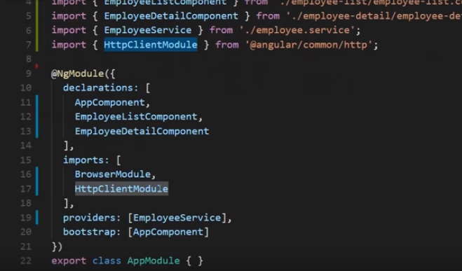
21 HTTP Fetch Data
https://www.youtube.com/watch?v=N8FBmB2jme8&index=6&list=PLC3y8-rFHvwhBRAgFinJR8KHIrCdTkZcZ
Summary (1):
First, we include the http client module

Slide 21
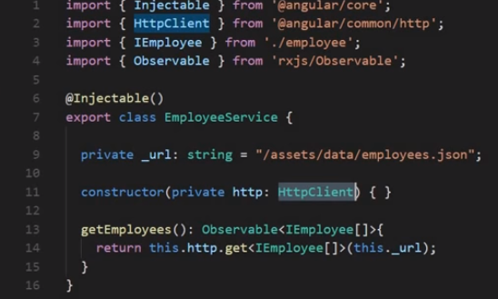
21 HTTP Fetch Data
https://www.youtube.com/watch?v=N8FBmB2jme8&index=6&list=PLC3y8-rFHvwhBRAgFinJR8KHIrCdTkZcZ
Summary (2):
Next, we inject it as a dependency in the employee service.
We have the http instance which we use it to refer to the HTTP variable. We invoke the get function and passing the URL address. Here we pass the file employees.json.

Slide 22
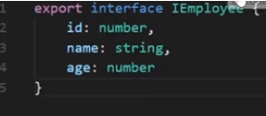
21 HTTP Fetch Data
https://www.youtube.com/watch?v=N8FBmB2jme8&index=6&list=PLC3y8-rFHvwhBRAgFinJR8KHIrCdTkZcZ
Summary (3):
We return the Observable but we need to convert into the type usable in our application. We create an interface and cast the Observable into array.

Slide 23
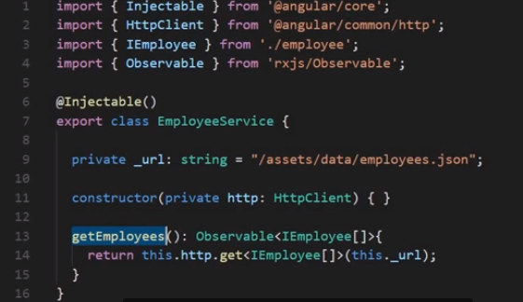
21 HTTP Fetch Data
https://www.youtube.com/watch?v=N8FBmB2jme8&index=6&list=PLC3y8-rFHvwhBRAgFinJR8KHIrCdTkZcZ
Summary (4):
Now, we got the data in Observable format.

Slide 24
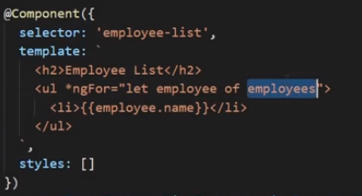
21 HTTP Fetch Data
https://www.youtube.com/watch?v=N8FBmB2jme8&index=6&list=PLC3y8-rFHvwhBRAgFinJR8KHIrCdTkZcZ
Summary (5):
Then bind the employees to the HTML element.

Slide 25
End of Chapter

