Slide 1

22 HTTP Error Handle
Peter H. Chen

Slide 2
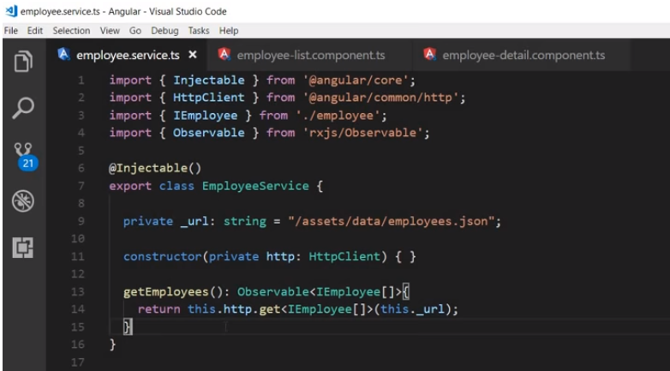
22 HTTP Error Handle
https://www.youtube.com/watch?v=N8FBmB2jme8&index=6&list=PLC3y8-rFHvwhBRAgFinJR8KHIrCdTkZcZ
In this section, we handle HTTP Error in Angular application.
We know the observable it return as result of HTTP call.
To handle exception of an observable, we make use of catch operator.

Slide 3
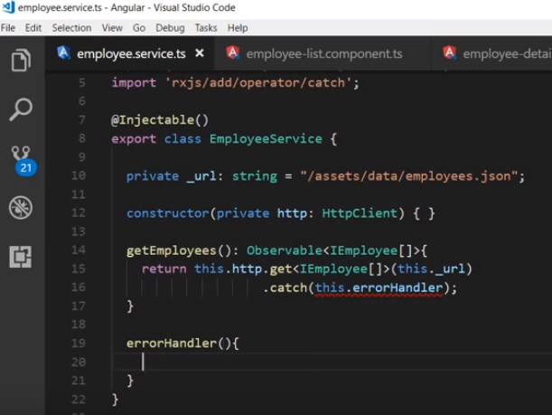
22 HTTP Error Handle
https://www.youtube.com/watch?v=N8FBmB2jme8&index=6&list=PLC3y8-rFHvwhBRAgFinJR8KHIrCdTkZcZ
Let ‘s first import the catch operator. import ‘rxjs/add/operator/catch’;
Then we add the catch operator on our observable dot catch. The catch operator takes in an method named as an argument called this.errorHandler.
The catch is the method gets called whenever there is an exception.
So let’s go ahead and define the error Handler method.

Slide 4
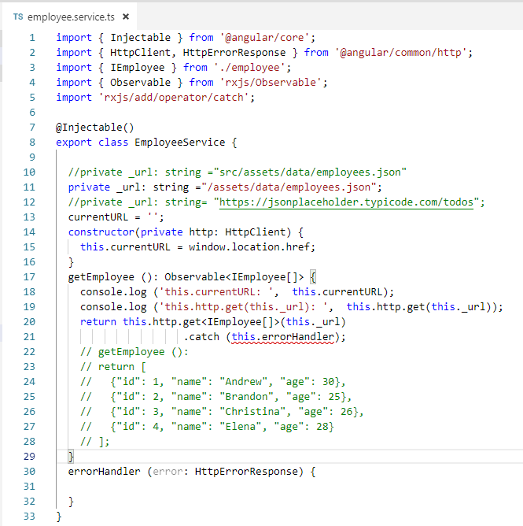
22 HTTP Error Handle
https://www.youtube.com/watch?v=N8FBmB2jme8&index=6&list=PLC3y8-rFHvwhBRAgFinJR8KHIrCdTkZcZ
The errorHandler method as a parameter. Let’s call it error and this is of type HttpErrorResponse.
Make sure HttpErrorReponse import from angular as well.

Slide 5
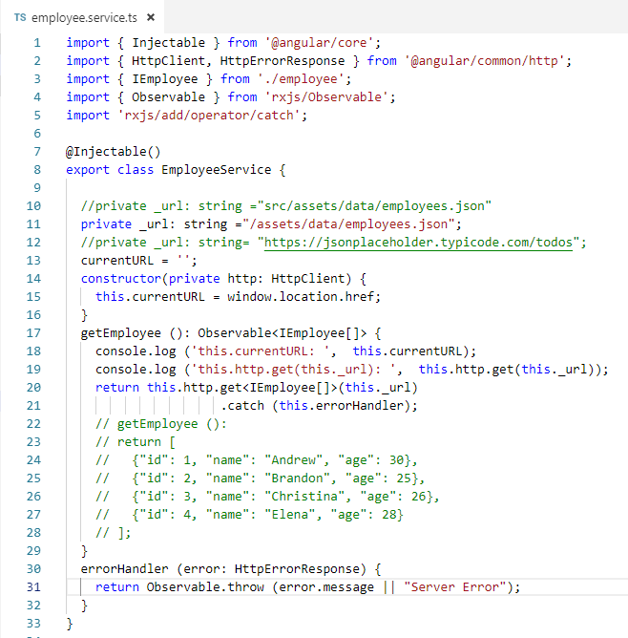
22 HTTP Error Handle
https://www.youtube.com/watch?v=N8FBmB2jme8&index=6&list=PLC3y8-rFHvwhBRAgFinJR8KHIrCdTkZcZ
If you notice, the employee service does not have a view of its own.
It is important that our users be informed of any exceptions that occurs.
If not they just end up staring at the blank screen which is poor user experience.
What error handler method does is that it throws out the error message so that any component that subscribed to the observable can make use of it and display the error in the view.
In the method body, we return Observable.throw (error.message || “Server Error”).

Slide 6
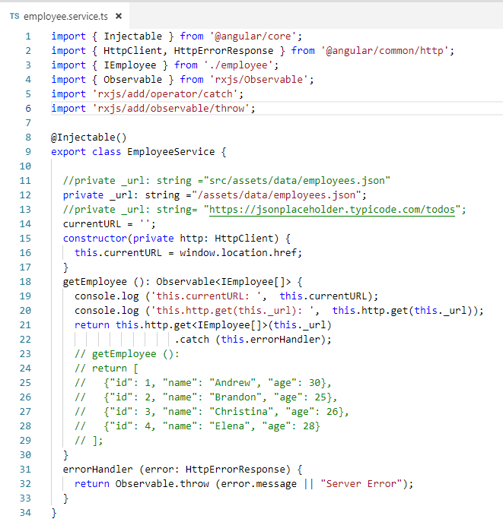
22 HTTP Error Handle
https://www.youtube.com/watch?v=N8FBmB2jme8&index=6&list=PLC3y8-rFHvwhBRAgFinJR8KHIrCdTkZcZ
Make sure import throw as well.

Slide 7
22 HTTP Error Handle
https://www.youtube.com/watch?v=N8FBmB2jme8&index=6&list=PLC3y8-rFHvwhBRAgFinJR8KHIrCdTkZcZ
We have done the first half of error handling.
We have caught the exception on the observable and we have thrown it to the component that has subscribed to the observable.
The second half is displaying the error message in the component that have subscribed.

Slide 8
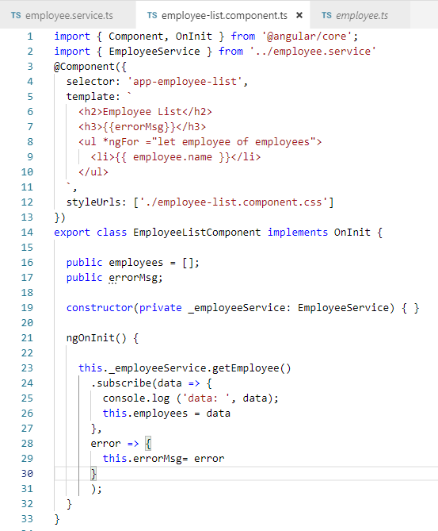
22 HTTP Error Handle
https://www.youtube.com/watch?v=N8FBmB2jme8&index=6&list=PLC3y8-rFHvwhBRAgFinJR8KHIrCdTkZcZ
In the employee-list component, just like how we get the data.
They can also get an error.
The second argument to the subscriber method is also a fat error function.
Then, we add errorMsg as the public property.
Then bind the public errorMsg property to the view using the interpolation {{ errorMsg }}.
Note: The Arrow Function is also called fat arrow function or lambda functions. The arrow function are concise way of writing functions that do not rebind context (this) within other functions.

Slide 9
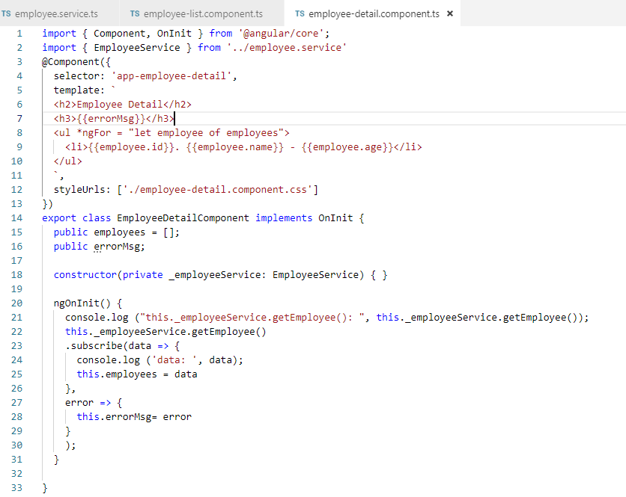
22 HTTP Error Handle
https://www.youtube.com/watch?v=N8FBmB2jme8&index=6&list=PLC3y8-rFHvwhBRAgFinJR8KHIrCdTkZcZ
Do the same thing for employee-detail.component

Slide 10
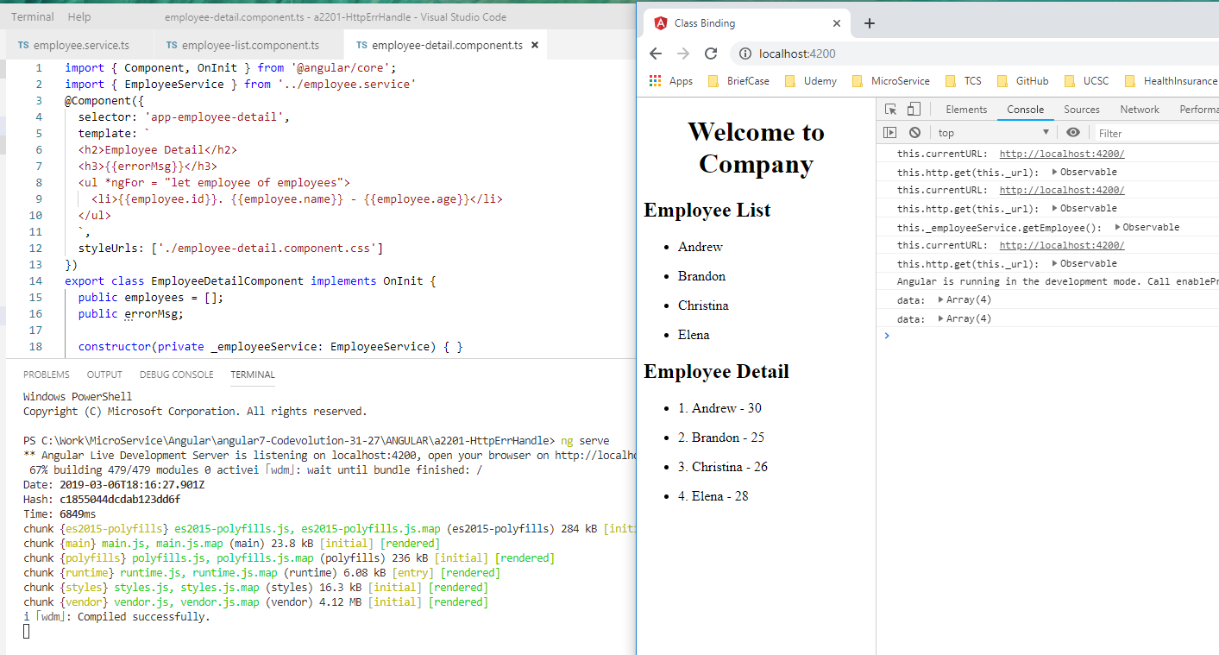
22 HTTP Error Handle
https://www.youtube.com/watch?v=N8FBmB2jme8&index=6&list=PLC3y8-rFHvwhBRAgFinJR8KHIrCdTkZcZ
> ng serve

Slide 11
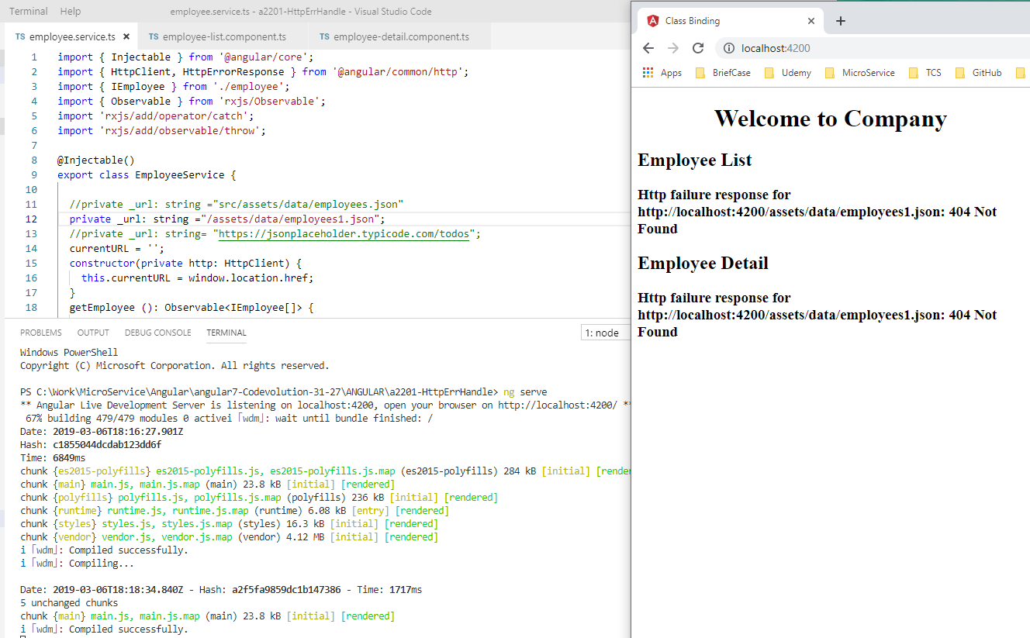
22 HTTP Error Handle
https://www.youtube.com/watch?v=N8FBmB2jme8&index=6&list=PLC3y8-rFHvwhBRAgFinJR8KHIrCdTkZcZ
Change “employees.json” into “employees1.json”, you should able to see the error message.
> ng serve

Slide 12
22 HTTP Error Handle
https://www.youtube.com/watch?v=N8FBmB2jme8&index=6&list=PLC3y8-rFHvwhBRAgFinJR8KHIrCdTkZcZ
The error message:
http failure response for http://localhost:4200/assets/data/employee1.json: 404 Not Found
That is what is displayed in out UI.
This is the basic idea how to handle HTTP errors in your Angular application.

Slide 13
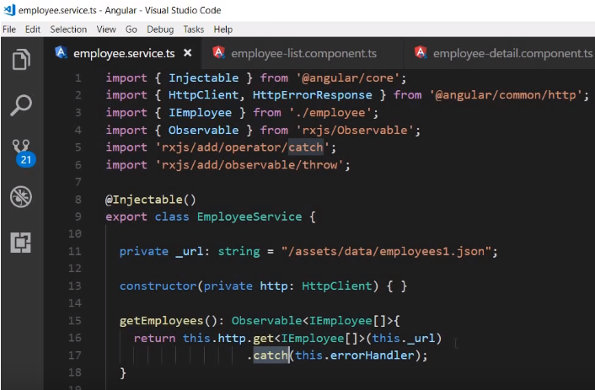
22 HTTP Error Handle
https://www.youtube.com/watch?v=N8FBmB2jme8&index=6&list=PLC3y8-rFHvwhBRAgFinJR8KHIrCdTkZcZ
Summary (1):
First step is to use catch operator on the observable.
If there is an error, the error handler method which is the argument to the catch operator is executed.

Slide 14
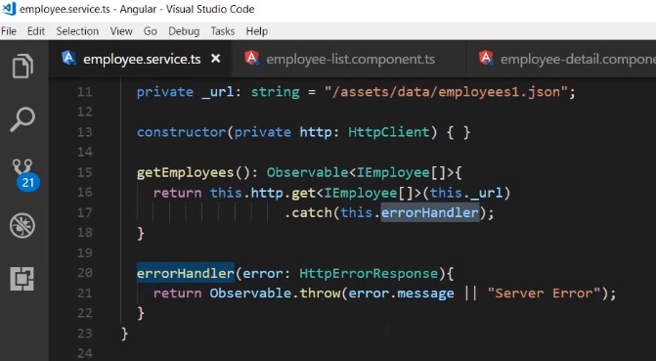
22 HTTP Error Handle
https://www.youtube.com/watch?v=N8FBmB2jme8&index=6&list=PLC3y8-rFHvwhBRAgFinJR8KHIrCdTkZcZ
Summary (2):
From the error handle method, we throw the exception out.

Slide 15
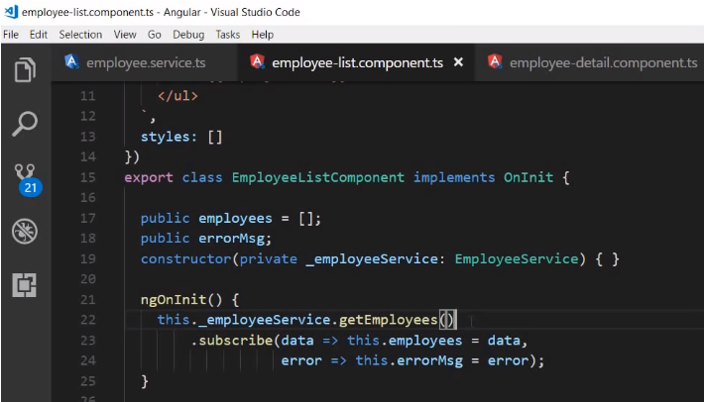
22 HTTP Error Handle
https://www.youtube.com/watch?v=N8FBmB2jme8&index=6&list=PLC3y8-rFHvwhBRAgFinJR8KHIrCdTkZcZ
Summary (3):
In the component that have subscribed to the observable, we get access to the data and error.
if there is no error, we get the data assign to the employee array and the list of the employees.
However, if there is an error, we get the error instead assign it to the erorr message property and then display the error message in the view.

Slide 16
End of Chapter

