Slide 1

28 Relative Navigation
Peter H. Chen

Slide 2
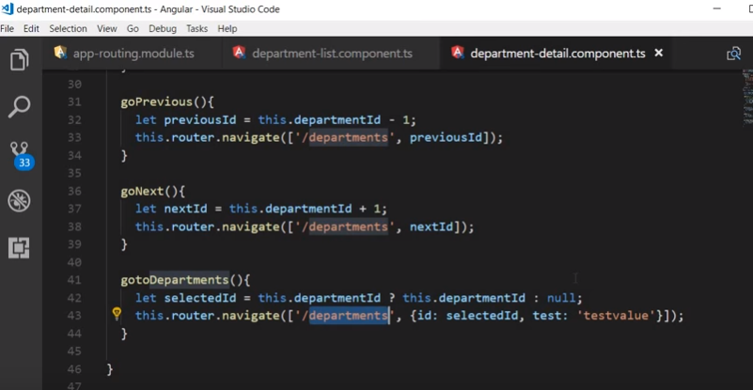
28 Relative Navigation
https://www.youtube.com/watch?v=gnTFkl2AF-w&list=PLC3y8-rFHvwhBRAgFinJR8KHIrCdTkZcZ&index=27
In this section, we discuss the Relative Navigation.
So far, we use absolute path for navigation.
We begin with a forward path. We all use absolute path.

Slide 3
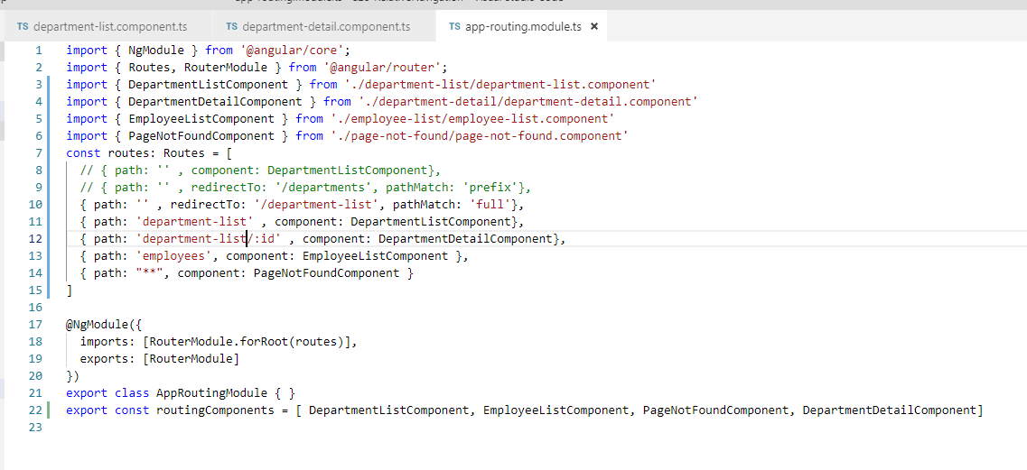
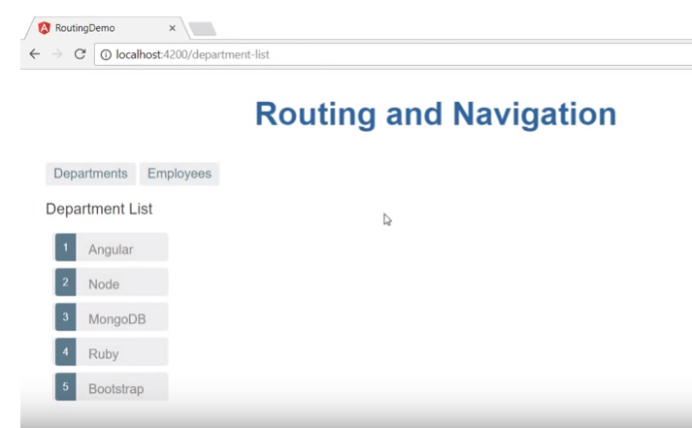
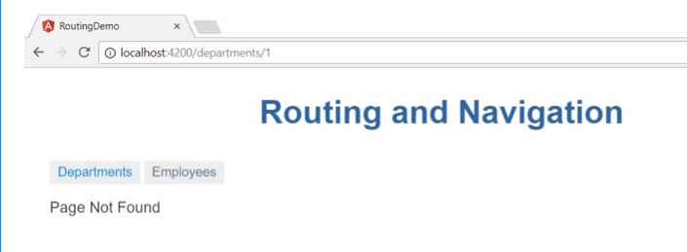
28 Relative Navigation
https://www.youtube.com/watch?v=gnTFkl2AF-w&list=PLC3y8-rFHvwhBRAgFinJR8KHIrCdTkZcZ&index=27
When we use absolute path, we have a small disadvantage.
That is the inflexibility of our route.
Let’s say, we change the departments to department-list in the app-routing-module.ts.
Then, you have to change in routing modules. But you forgot to change other modules, however, you Click the Angular button will get page not found.

Slide 4
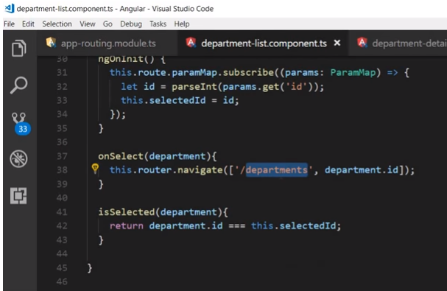
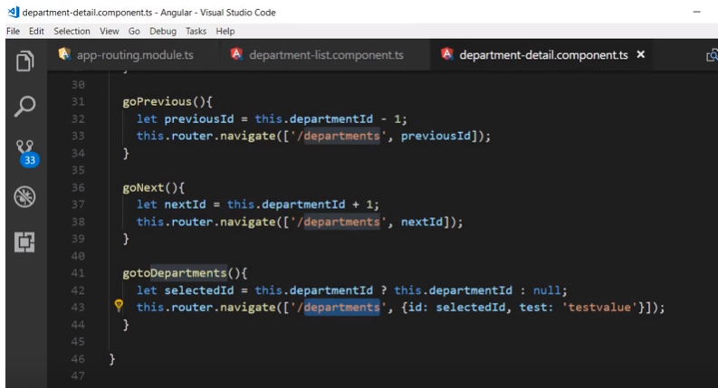
28 Relative Navigation
https://www.youtube.com/watch?v=gnTFkl2AF-w&list=PLC3y8-rFHvwhBRAgFinJR8KHIrCdTkZcZ&index=27
In the department.list component, I would have to change all “departments” into “department-list”.
In the department.detail component, I would need to change all “departments” to “department-list” as well.

Slide 5
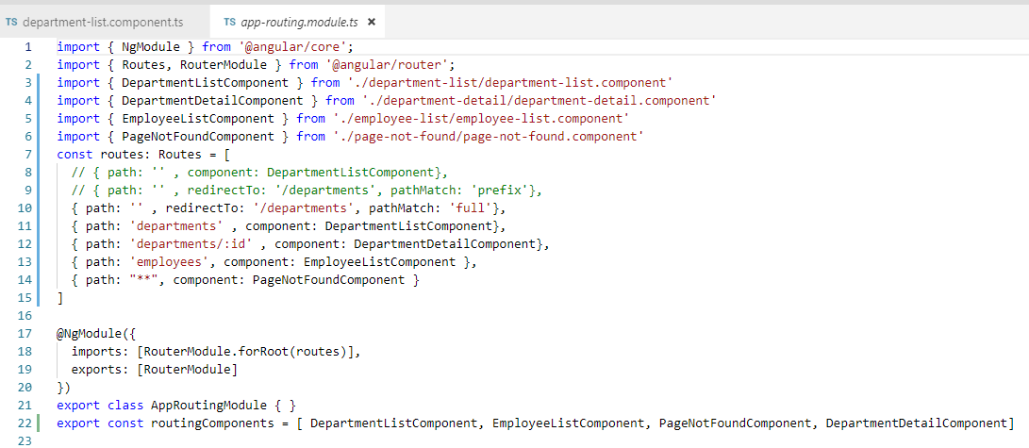
28 Relative Navigation
https://www.youtube.com/watch?v=gnTFkl2AF-w&list=PLC3y8-rFHvwhBRAgFinJR8KHIrCdTkZcZ&index=27
You can see, our routing is good but not flexible enough.
With the flexibility, we can use relative navigation.
Keep the app-routing.modules unchanged.

Slide 6
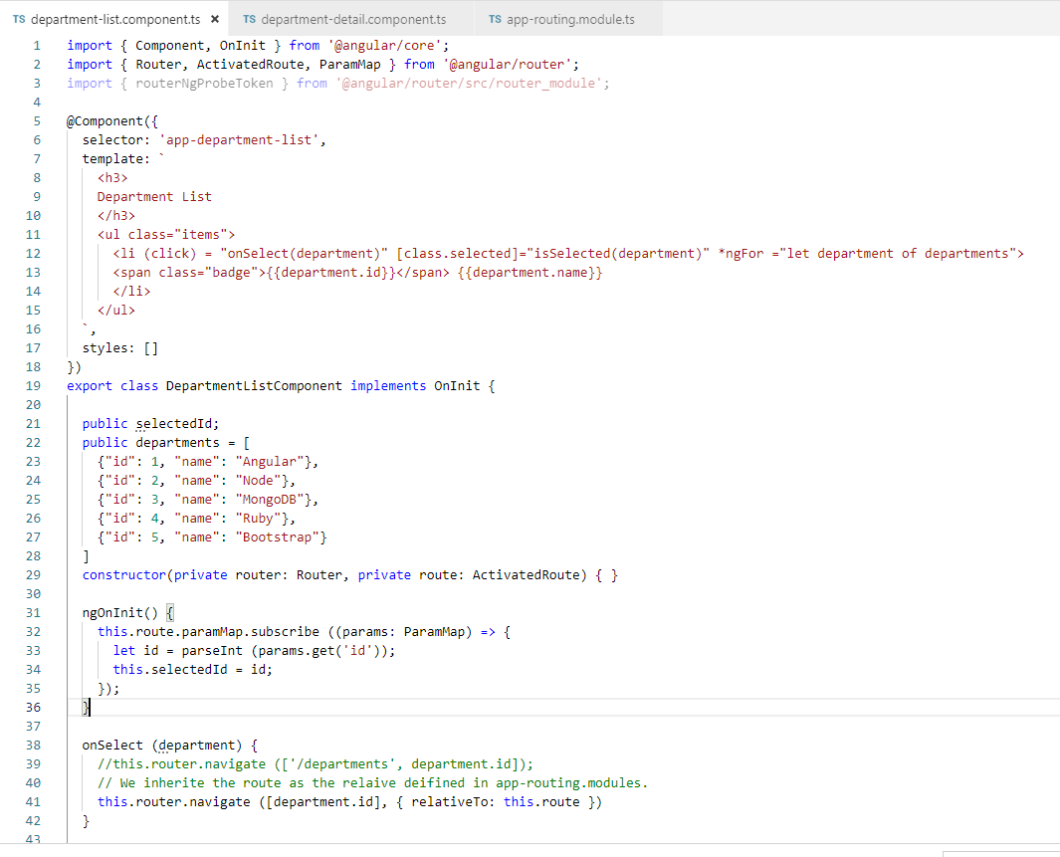
28 Relative Navigation
https://www.youtube.com/watch?v=gnTFkl2AF-w&list=PLC3y8-rFHvwhBRAgFinJR8KHIrCdTkZcZ&index=27
Let’s start with department-list component. For relative path, we need two parameters, one is array for department.id and the other is relativeTo: this.route defined in app-routing.modle.ts.
It uses the whatever existing path ‘departments-list’ and id.

Slide 7
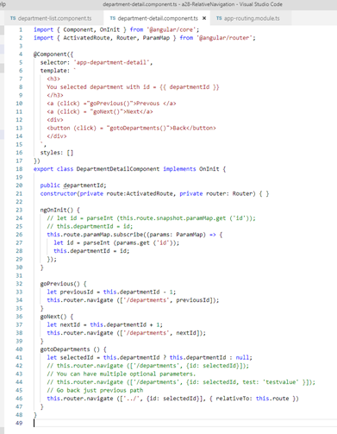
28 Relative Navigation
https://www.youtube.com/watch?v=gnTFkl2AF-w&list=PLC3y8-rFHvwhBRAgFinJR8KHIrCdTkZcZ&index=27
Do same thing with department-detail component. For relative path, we need two parameters, one is array for [‘../’, department.id] and the other is relativeTo: this.route defined in app-routing.modle.ts.

Slide 8
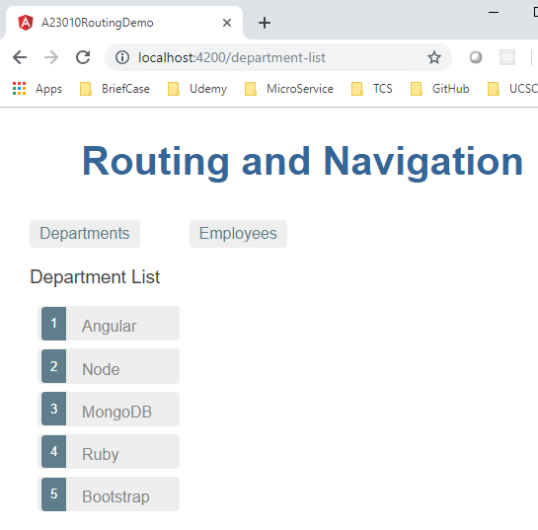
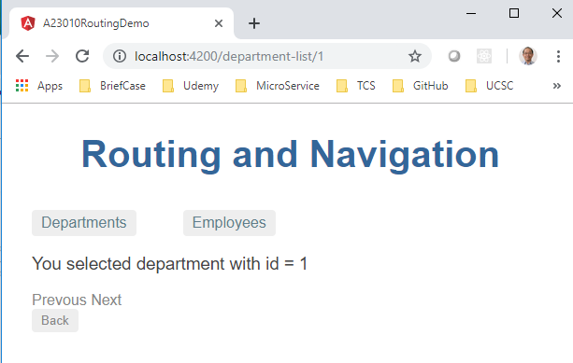
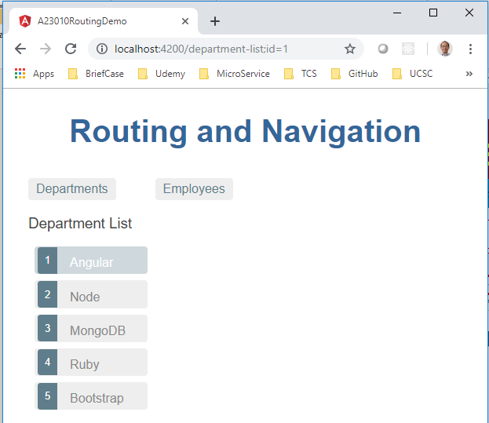
28 Relative Navigation
https://www.youtube.com/watch?v=gnTFkl2AF-w&list=PLC3y8-rFHvwhBRAgFinJR8KHIrCdTkZcZ&index=27
Refresh browser.
The department-list component will use whatever exiting path and id to route.
The department-details component will go up ‘..’ path and id go back to department-list component.

Slide 9
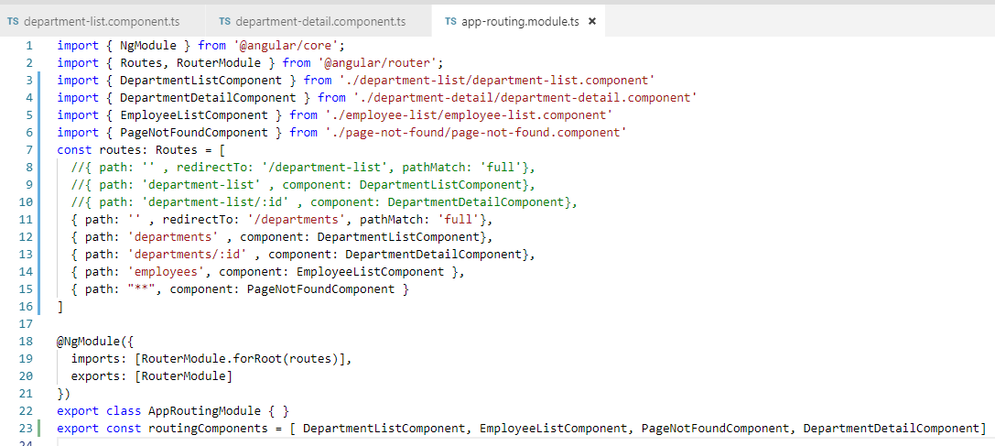
28 Relative Navigation
https://www.youtube.com/watch?v=gnTFkl2AF-w&list=PLC3y8-rFHvwhBRAgFinJR8KHIrCdTkZcZ&index=27
If the future, if you want to change the department-list back to departments, just change the in the app-routing.mdoules.ts.

Slide 10
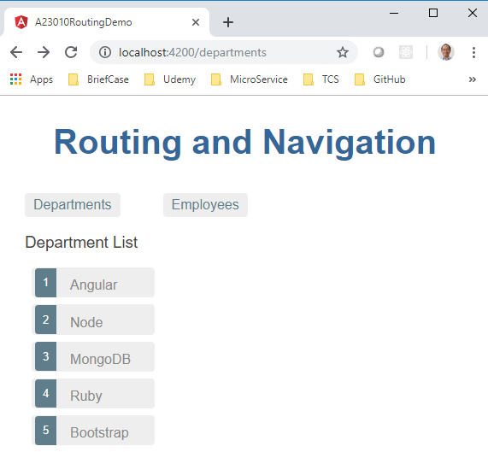
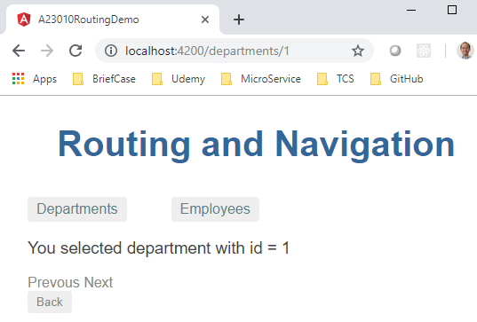
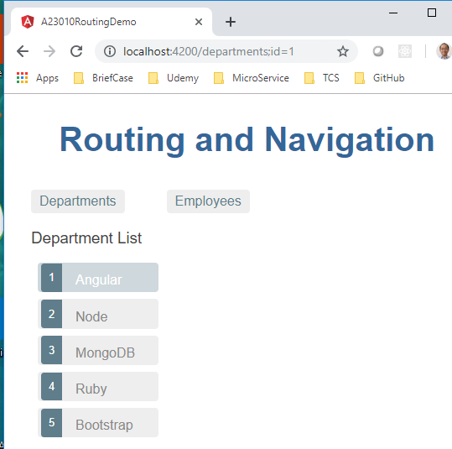
28 Relative Navigation
https://www.youtube.com/watch?v=gnTFkl2AF-w&list=PLC3y8-rFHvwhBRAgFinJR8KHIrCdTkZcZ&index=27
The result still the same for relative path routing.

Slide 11
End of Chapter

