Slide 1

29 Child Route
Peter H. Chen

Slide 2
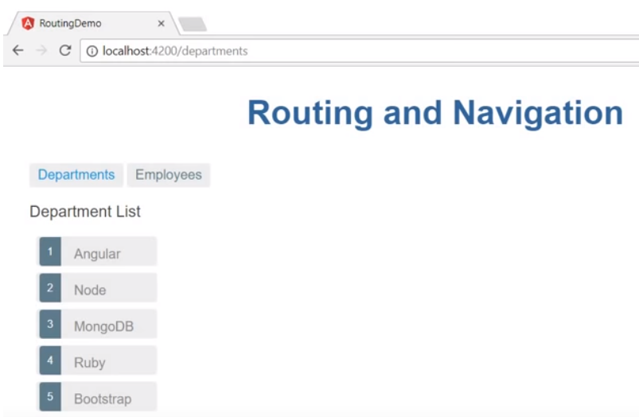
29 Child Route
https://www.youtube.com/watch?v=gnTFkl2AF-w&list=PLC3y8-rFHvwhBRAgFinJR8KHIrCdTkZcZ&index=27
In this section, we discuss the child route.
In Angular application, some route may only be used for other route. In this scenario, we need the child route.

Slide 3
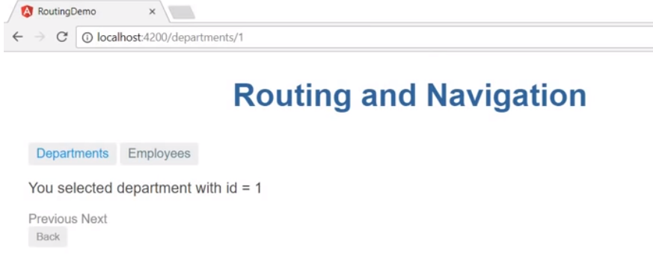
29 Child Route
https://www.youtube.com/watch?v=gnTFkl2AF-w&list=PLC3y8-rFHvwhBRAgFinJR8KHIrCdTkZcZ&index=27
Let’s understand what is child route.
In our application, we have department detail requirement. In this component, we want to display the overview and also contact information of the select id.
The overview and contact information of each department. It should be viewable after navigating to this department detail.

Slide 4
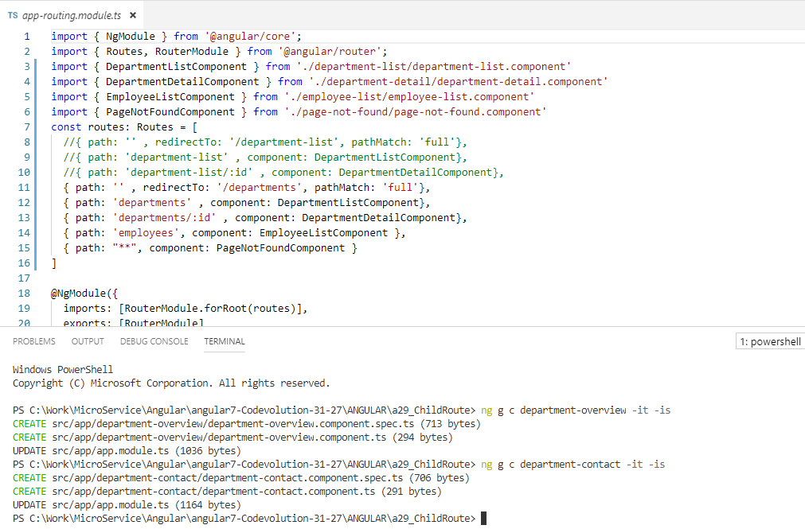
29 Child Route
https://www.youtube.com/watch?v=gnTFkl2AF-w&list=PLC3y8-rFHvwhBRAgFinJR8KHIrCdTkZcZ&index=27
Let’s generate two new components.
>ng g c department-overview -it –is
> ng g c department-contact –it -is
Note: g: Generate, c: Component, -it: inline template, -is: inline style

Slide 5
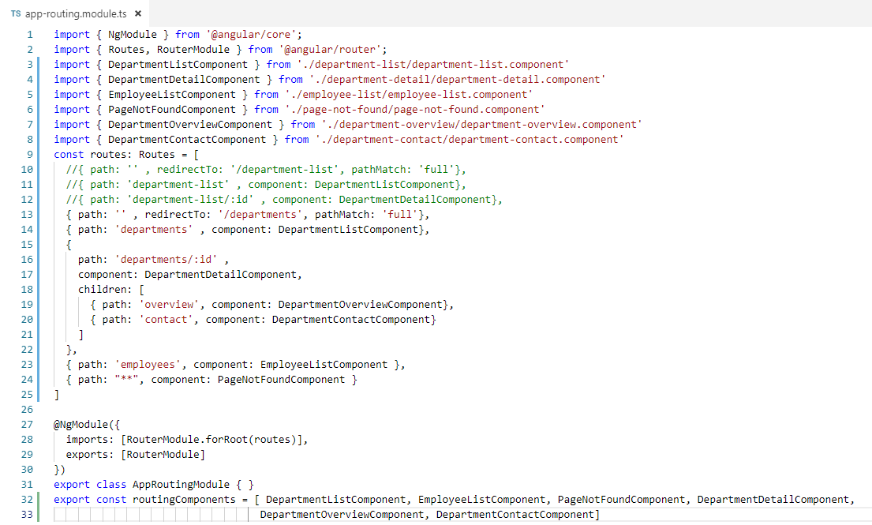
29 Child Route
https://www.youtube.com/watch?v=gnTFkl2AF-w&list=PLC3y8-rFHvwhBRAgFinJR8KHIrCdTkZcZ&index=27
In the app-routing.module.ts, add two children overview and contact for department-detail component.
Import two children components add routingComponents array.

Slide 6
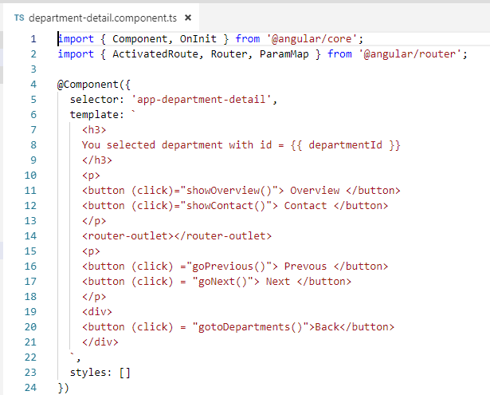
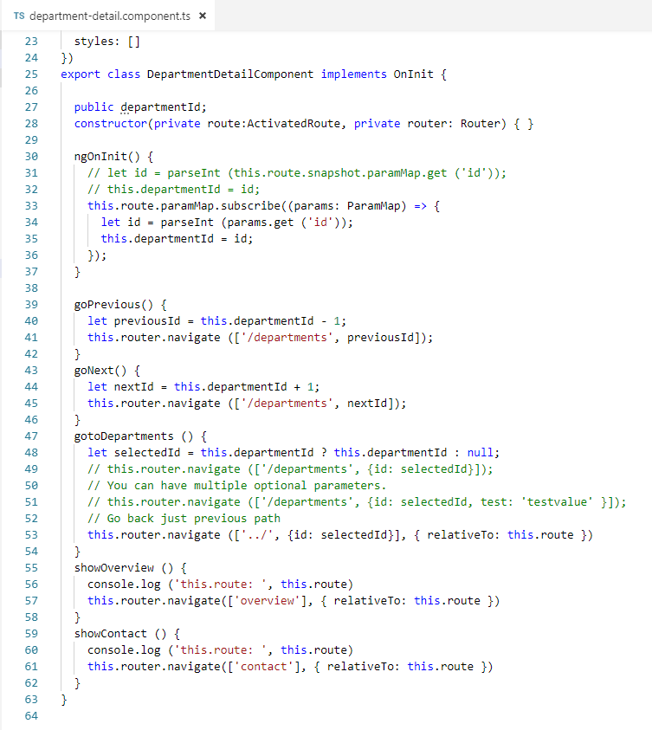
29 Child Route
https://www.youtube.com/watch?v=gnTFkl2AF-w&list=PLC3y8-rFHvwhBRAgFinJR8KHIrCdTkZcZ&index=27
In the department-detail component, .

Slide 7
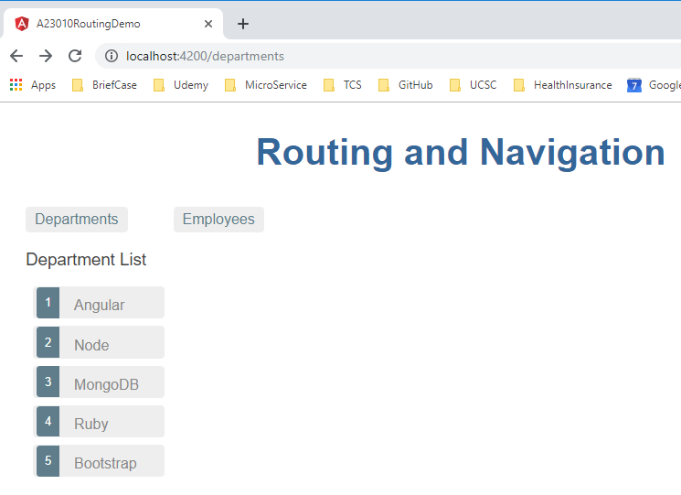
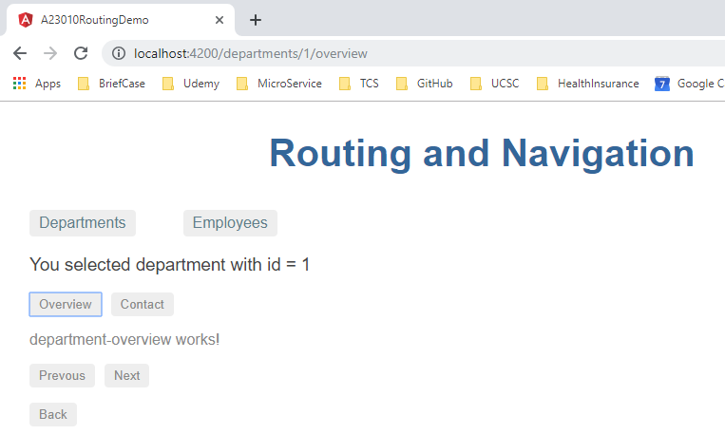
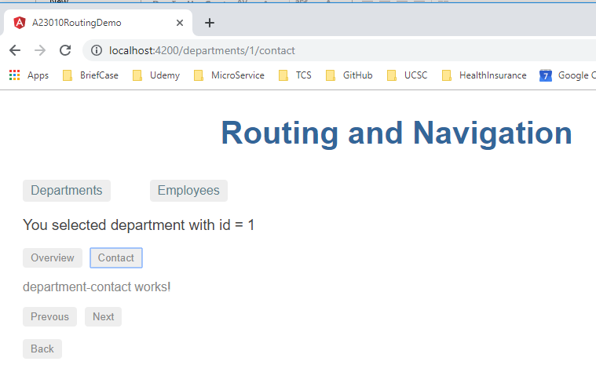
29 Child Route
https://www.youtube.com/watch?v=gnTFkl2AF-w&list=PLC3y8-rFHvwhBRAgFinJR8KHIrCdTkZcZ&index=27
Refresh.

Slide 8
29.1 <router-outlet> Location
Peter H. Chen

Slide 9
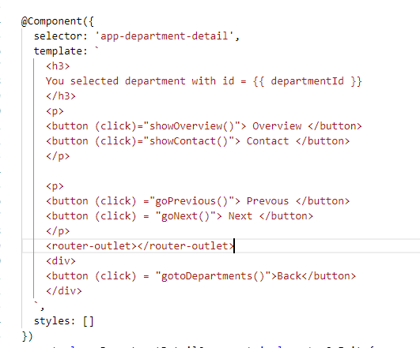
29.1 <router-outlet> Location
https://www.youtube.com/watch?v=gnTFkl2AF-w&list=PLC3y8-rFHvwhBRAgFinJR8KHIrCdTkZcZ&index=27
Note: the <outer-outlet> is the display position of display message of showOverview() and showContact().

Slide 10
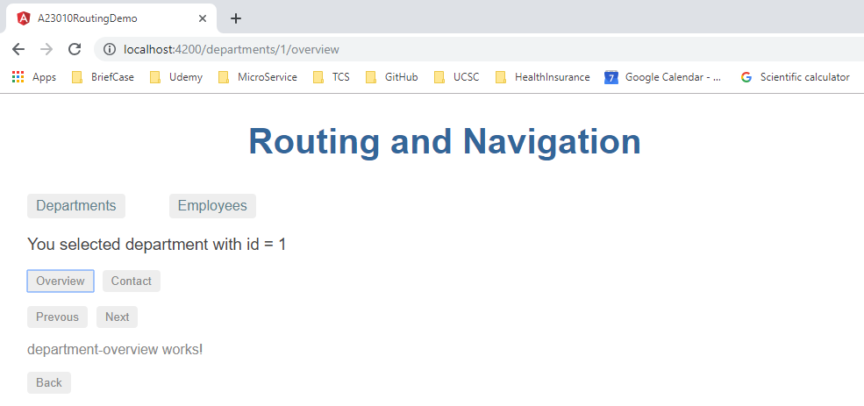
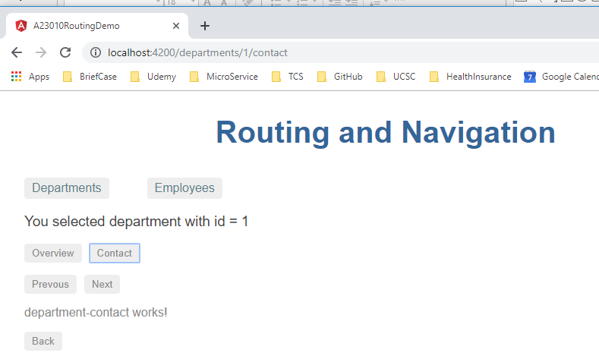
29.1 <router-outlet> Location
https://www.youtube.com/watch?v=gnTFkl2AF-w&list=PLC3y8-rFHvwhBRAgFinJR8KHIrCdTkZcZ&index=27
Refresh.

Slide 11
End of Chapter

