Slide 1

30 Angular 6 New Feature
Peter H. Chen

Slide 2
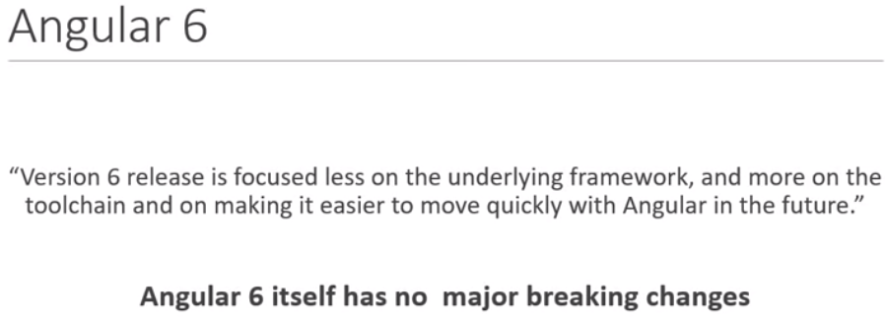
30 Angular 6 New Feature
https://www.youtube.com/watch?v=gnTFkl2AF-w&list=PLC3y8-rFHvwhBRAgFinJR8KHIrCdTkZcZ&index=27
Angular 6 has no break through change. However, Angular 6 is based on rxjs version 6 which has breaking through changes.

Slide 3
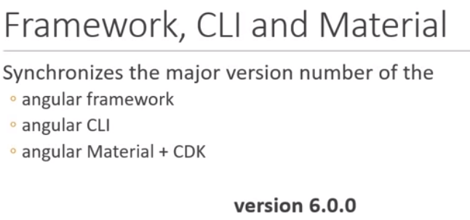
30 Angular 6 New Feature
https://www.youtube.com/watch?v=gnTFkl2AF-w&list=PLC3y8-rFHvwhBRAgFinJR8KHIrCdTkZcZ&index=27
Angular 6:

Slide 4
30.1 Angular Framework
Peter H. Chen

Slide 5
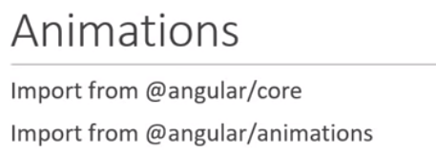
30.1 Angular Framework
https://www.youtube.com/watch?v=gnTFkl2AF-w&list=PLC3y8-rFHvwhBRAgFinJR8KHIrCdTkZcZ&index=27
First, animation, before we import from @angular/core.
Angular 6 has to import from @angular/animation.

Slide 6
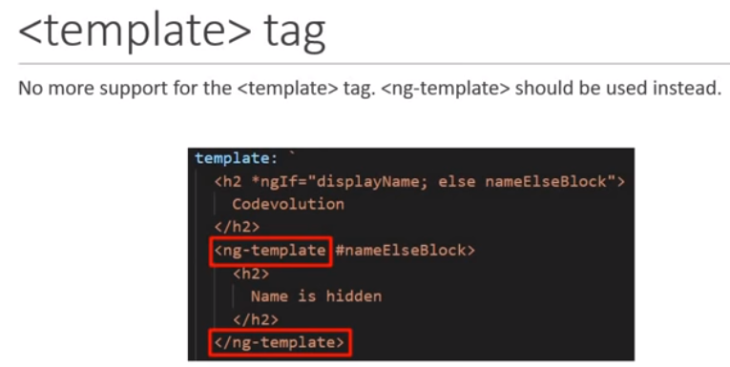
30.1 Angular Framework
https://www.youtube.com/watch?v=gnTFkl2AF-w&list=PLC3y8-rFHvwhBRAgFinJR8KHIrCdTkZcZ&index=27
Version 6 must use <np-template>.
We are not talking the template in component.
We are talking about the template in HTML.

Slide 7
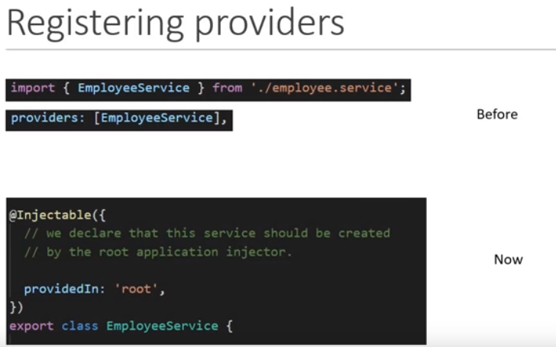
30.1 Angular Framework
https://www.youtube.com/watch?v=gnTFkl2AF-w&list=PLC3y8-rFHvwhBRAgFinJR8KHIrCdTkZcZ&index=27
Services from @Injectable {}
The root injector is responsible for creating an instance of the service.
This way is made available to the entire application and do not need to be listed in any particular module.
Next time, if you provide the services, you can do in this particular way.

Slide 8
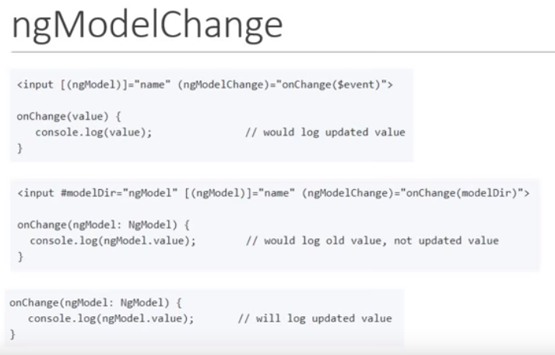
30.1 Angular Framework
https://www.youtube.com/watch?v=gnTFkl2AF-w&list=PLC3y8-rFHvwhBRAgFinJR8KHIrCdTkZcZ&index=27
onChange will always update the value.

Slide 9
30.2 Angular CLI
Peter H. Chen

Slide 10
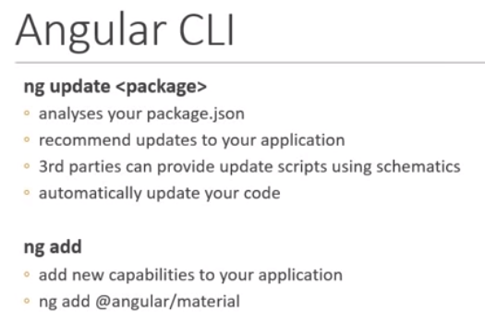
30.2 Angular CLI
https://www.youtube.com/watch?v=gnTFkl2AF-w&list=PLC3y8-rFHvwhBRAgFinJR8KHIrCdTkZcZ&index=27
Angular CLI change:

Slide 11
30.3 CLI + Material Starter Template
Peter H. Chen

Slide 12
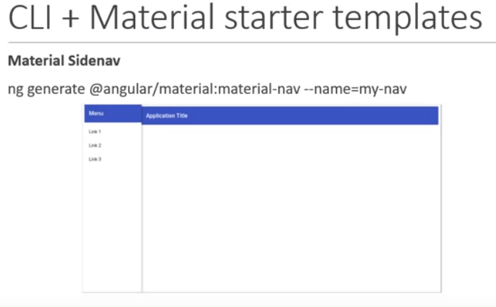
30.3 CLI + Material Starter Template
https://www.youtube.com/watch?v=gnTFkl2AF-w&list=PLC3y8-rFHvwhBRAgFinJR8KHIrCdTkZcZ&index=27
Material Starter Change:

Slide 13
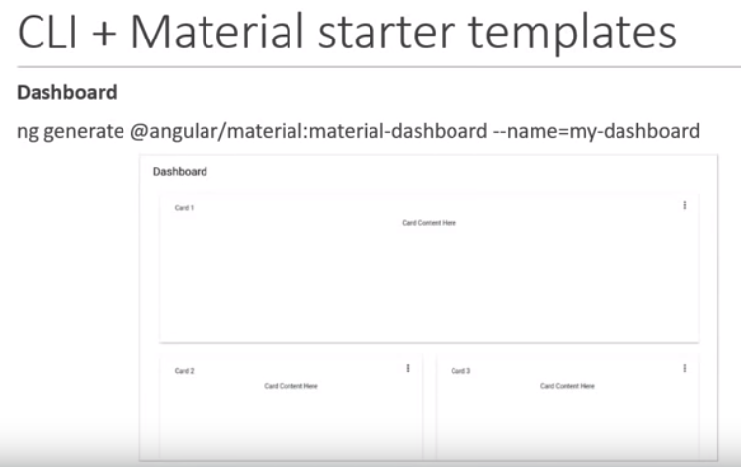
30.3 CLI + Material Starter Template
https://www.youtube.com/watch?v=gnTFkl2AF-w&list=PLC3y8-rFHvwhBRAgFinJR8KHIrCdTkZcZ&index=27
Material Dsahboard Change:

Slide 14
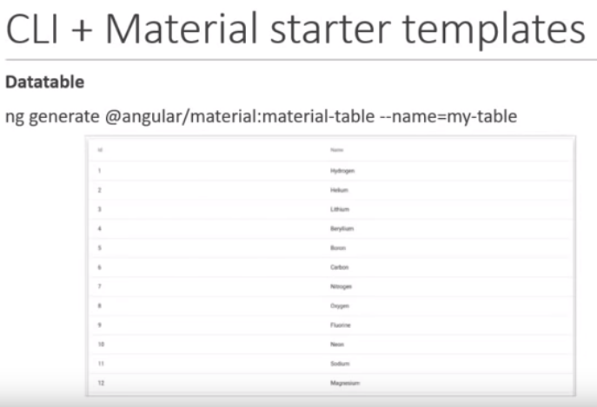
30.3 CLI + Material Starter Template
https://www.youtube.com/watch?v=gnTFkl2AF-w&list=PLC3y8-rFHvwhBRAgFinJR8KHIrCdTkZcZ&index=27
Material Datatable Change:

Slide 15
30.4 Angular CLI
Peter H. Chen

Slide 16
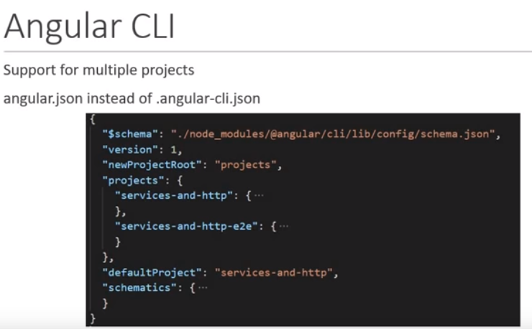
30.4 Angular CLI
https://www.youtube.com/watch?v=gnTFkl2AF-w&list=PLC3y8-rFHvwhBRAgFinJR8KHIrCdTkZcZ&index=27
Angular CLI Multiple Projects:

Slide 17
30.5 Angular Element
Peter H. Chen

Slide 18
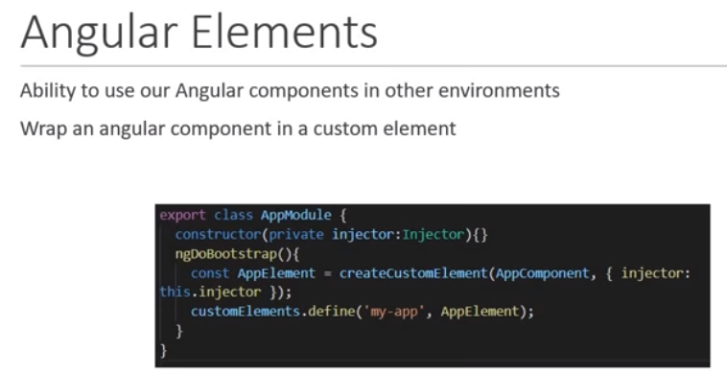
30.5 Angular Element
https://www.youtube.com/watch?v=gnTFkl2AF-w&list=PLC3y8-rFHvwhBRAgFinJR8KHIrCdTkZcZ&index=27
Angular Element

Slide 19
30.6 Ivy
Peter H. Chen

Slide 20
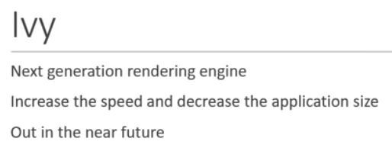
30.6 Ivy
https://www.youtube.com/watch?v=gnTFkl2AF-w&list=PLC3y8-rFHvwhBRAgFinJR8KHIrCdTkZcZ&index=27
Ivy

Slide 21
End of Chapter

