Slide 1

6 Property Binding
Peter H. Chen

Slide 2
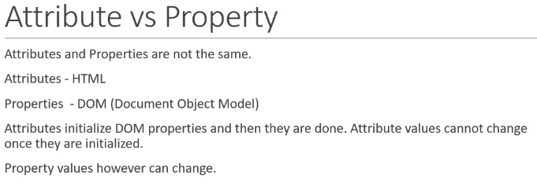
6 Property Binding
https://www.youtube.com/watch?v=N8FBmB2jme8&list=PLC3y8-rFHvwhBRAgFinJR8KHIrCdTkZcZ&index=6
It is important to understand the difference between the attribute and property.
What is difference between the attribute and property?
Attribute vs. Property:
Attributes are defined by HTML
Properties are defined by DOM (Document Object Model)
Attributes initialize DOM properties and then they are done.
Attribute value cannot change once they are initialized.
Property values can change.

Slide 3
6.1 Attribute vs. Property
Peter H. Chen

Slide 4
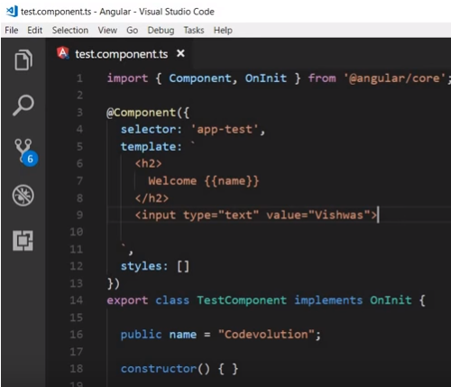
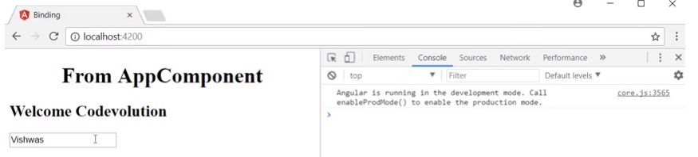
6.1 Attribute vs. Property
https://www.youtube.com/watch?v=N8FBmB2jme8&list=PLC3y8-rFHvwhBRAgFinJR8KHIrCdTkZcZ&index=6
In the template, we set the template: ‘<input type = “text” value=“Vishwas”>
In the bowser, we have text box display “Vishwas”.

Slide 5
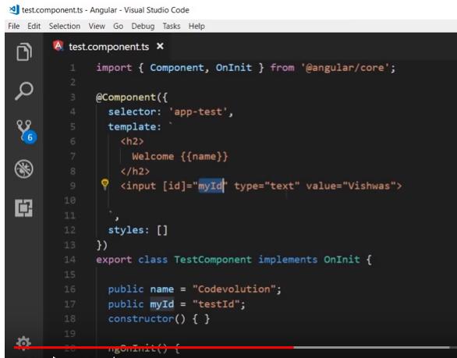
6.1 Attribute vs. Property
https://www.youtube.com/watch?v=N8FBmB2jme8&list=PLC3y8-rFHvwhBRAgFinJR8KHIrCdTkZcZ&index=6
In the template, the [] is used for template to class binding: ‘<input [id]=“myId”>

Slide 6
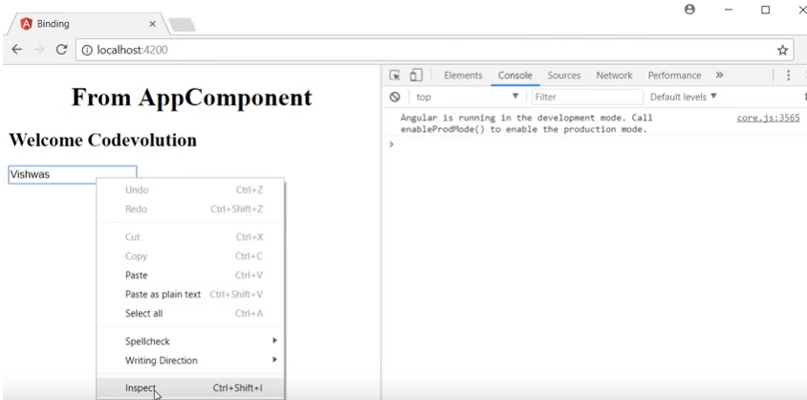
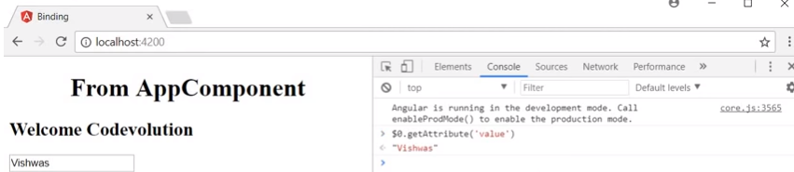
6.1 Attribute vs. Property
https://www.youtube.com/watch?v=N8FBmB2jme8&list=PLC3y8-rFHvwhBRAgFinJR8KHIrCdTkZcZ&index=6
If we inspect this element, in the console,
> $0.getAttribute (‘value’) # $0 is the current element which is the input element.
>> ‘Vishwas”

Slide 7
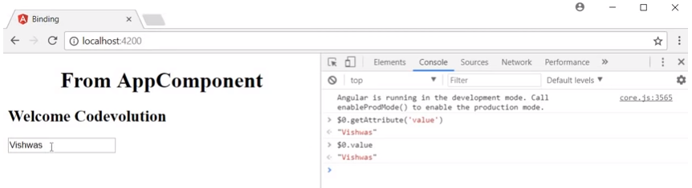
6.1 Attribute vs. Property
https://www.youtube.com/watch?v=N8FBmB2jme8&list=PLC3y8-rFHvwhBRAgFinJR8KHIrCdTkZcZ&index=6
Similarly,
> $0.value # $0 is the current element which is the input element.
>> ‘Vishwas”

Slide 8
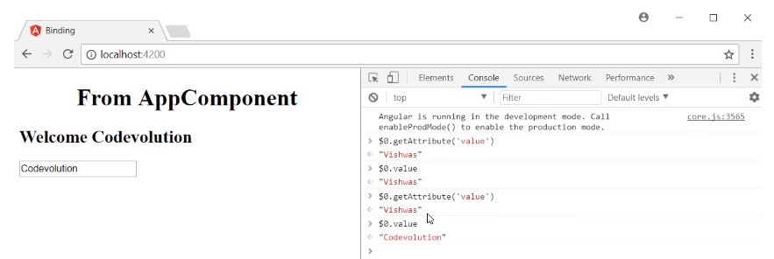
6.1 Attribute vs. Property
https://www.youtube.com/watch?v=N8FBmB2jme8&list=PLC3y8-rFHvwhBRAgFinJR8KHIrCdTkZcZ&index=6
If we can the “Vishwa” into “Codevolution” and check again.
> $0.getAttribue (‘value’)
>> Vishwa
$0.value
“Codevolution”

Slide 9
6.1 Attribute vs. Property
https://www.youtube.com/watch?v=N8FBmB2jme8&list=PLC3y8-rFHvwhBRAgFinJR8KHIrCdTkZcZ&index=6
The attribute do not change but the value change to current value.

Slide 10
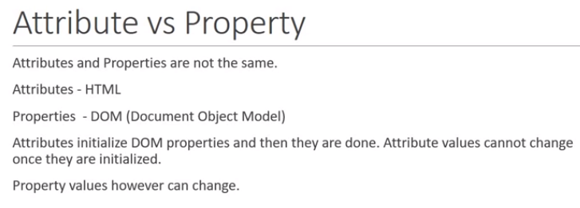
6.1 Attribute vs. Property
https://www.youtube.com/watch?v=N8FBmB2jme8&list=PLC3y8-rFHvwhBRAgFinJR8KHIrCdTkZcZ&index=6
Attribute and property are not the same.
Attribute is defined by HTML but properties (or property values) are defined by Document Object Model.
Attributes initializes the DOM properties (values) and then, they are done. Attribute values cannot change once they are initialized.
Property values can change.
In out example, the HTML attributes value specifies the initial value.
To be clarify, we will use examples for attribute vs property.

Slide 11
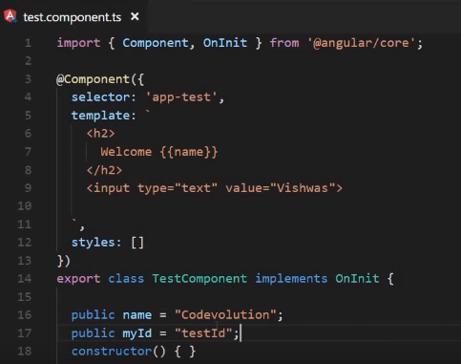
6 Property Binding
https://www.youtube.com/watch?v=N8FBmB2jme8&list=PLC3y8-rFHvwhBRAgFinJR8KHIrCdTkZcZ&index=6
To be clarify, we will use examples for attribute vs property.
The property binging in angular, we actually binding the property of the DOM element.
Let’s look at an example:
Let create a new property call “public myId” with value “testId”

Slide 12
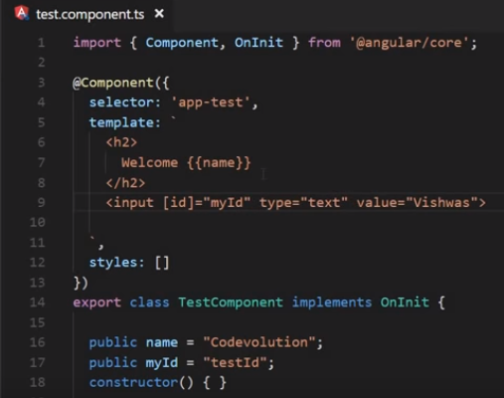
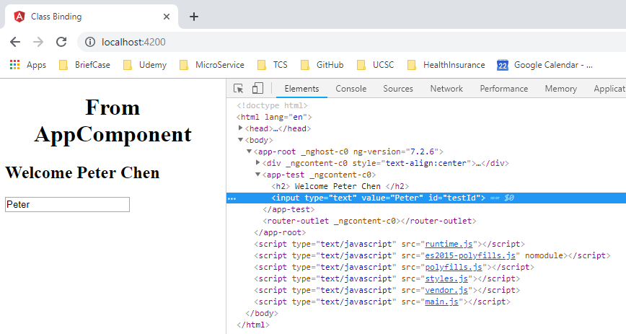
6 Property Binding
https://www.youtube.com/watch?v=N8FBmB2jme8&list=PLC3y8-rFHvwhBRAgFinJR8KHIrCdTkZcZ&index=6
We need to bind myId to this input element with [id]=“myId”.
We are binding myId property to this input element.
Id is set to “testId”

Slide 13
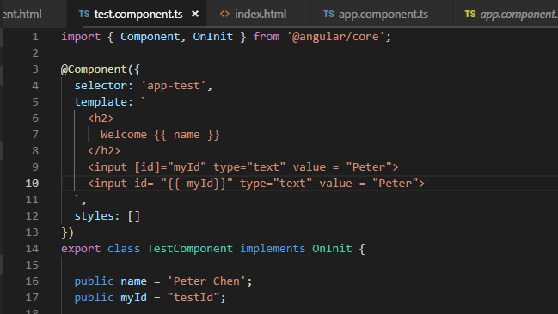
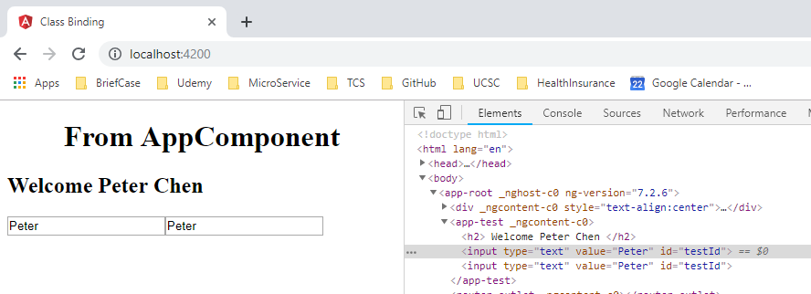
6 Property Binding
https://www.youtube.com/watch?v=N8FBmB2jme8&list=PLC3y8-rFHvwhBRAgFinJR8KHIrCdTkZcZ&index=6
Property Binding
Can I use interpolation to bind the id of element, the answer is Yes.
Instead of square bracket (property binding) instead of [].
Id is set to “testId” (Same result)

Slide 14
6 Property Binding
https://www.youtube.com/watch?v=N8FBmB2jme8&list=PLC3y8-rFHvwhBRAgFinJR8KHIrCdTkZcZ&index=6
Property Binding
Why do we need property binding?
Well, there is a limitation to interpolation. Interpolation only work for string value.
There are HTML properties that are boolean properties that we may need to bind.

Slide 15
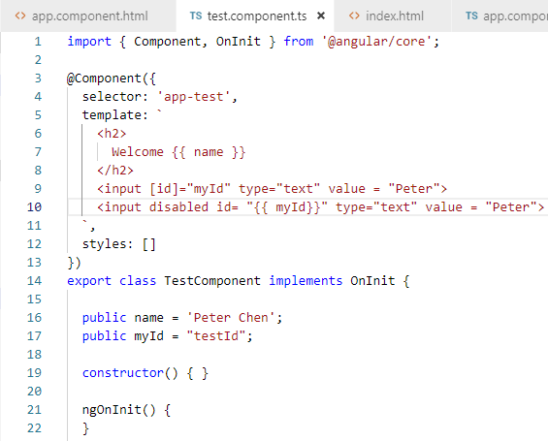
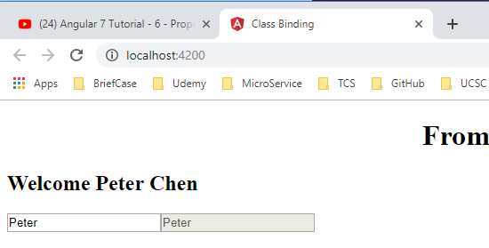
6 Property Binding
https://www.youtube.com/watch?v=N8FBmB2jme8&list=PLC3y8-rFHvwhBRAgFinJR8KHIrCdTkZcZ&index=6
Property Binding
Le us look at a Boolean property binding example.
Consider the disabled attribute of an input element by default, it is always set to false. So the input is always enabled. Now let use disable the attributed.

Slide 16
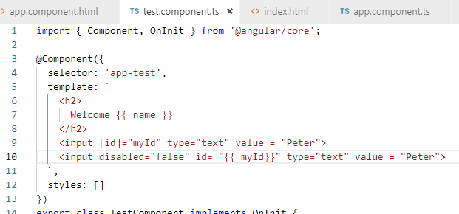
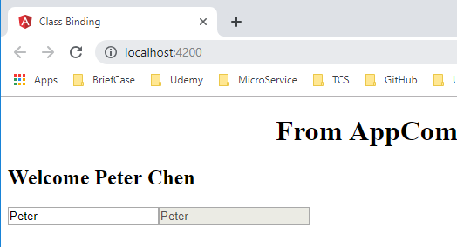
6 Property Binding
https://www.youtube.com/watch?v=N8FBmB2jme8&list=PLC3y8-rFHvwhBRAgFinJR8KHIrCdTkZcZ&index=6
Property Binding
If you set the disabled=“false”, back to the browser, you still see the input still disabled.

Slide 17
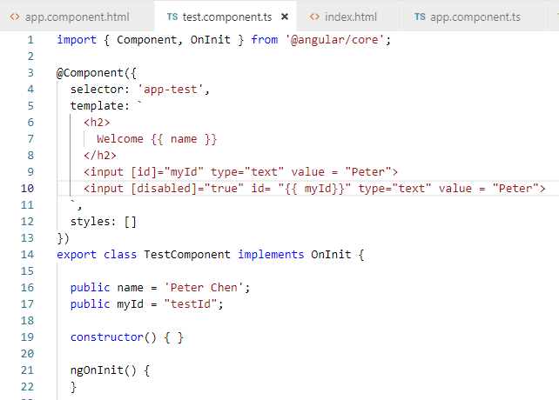
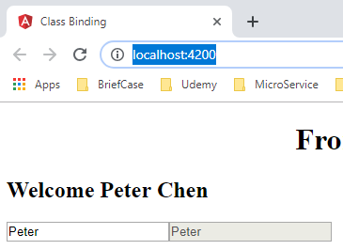
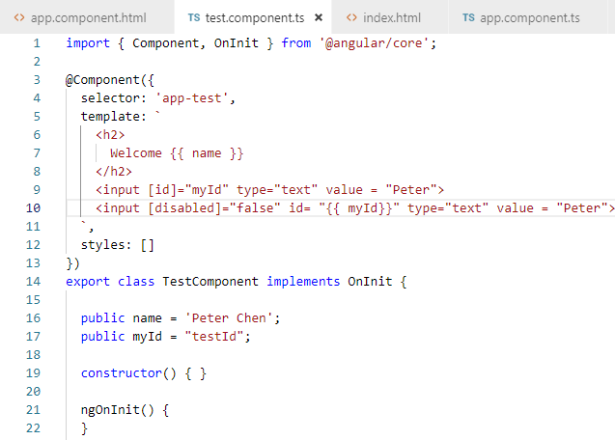
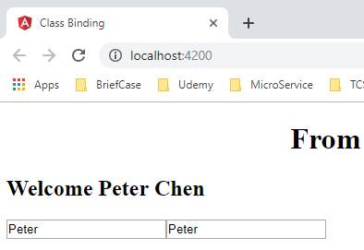
6 Property Binding
https://www.youtube.com/watch?v=N8FBmB2jme8&list=PLC3y8-rFHvwhBRAgFinJR8KHIrCdTkZcZ&index=6
Property Binding
So, this is the problem of interpolation when the Boolean is disabled.
Disabled to true work but disabled to false, interpolation does not work for booelan true or false.
So the solution here is to use property binding.
Instead of using disabled= “false”, we use property binding: [disabled] = “true” or “false”

Slide 18
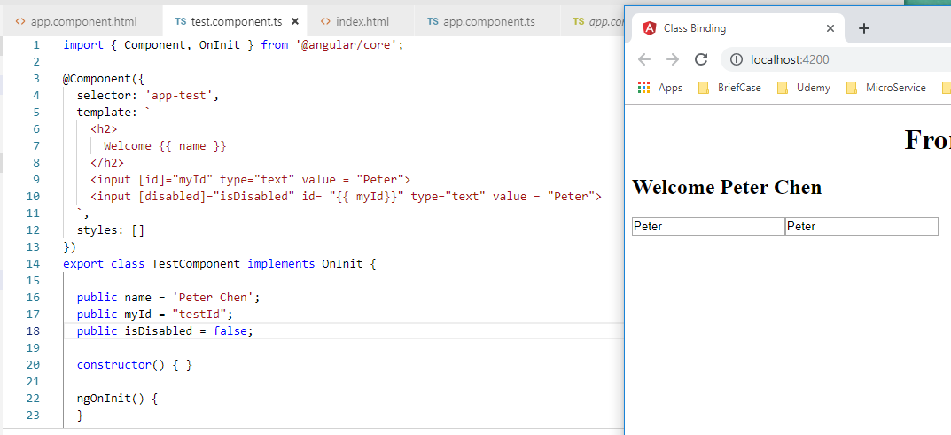
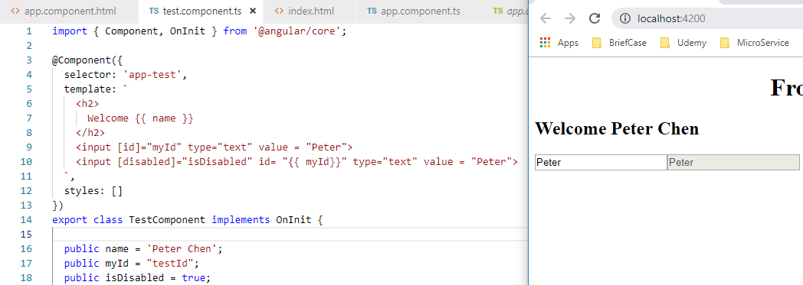
6 Property Binding
https://www.youtube.com/watch?v=N8FBmB2jme8&list=PLC3y8-rFHvwhBRAgFinJR8KHIrCdTkZcZ&index=6
Property Binding
Hardcode property to true or false are not much for use.
Let us create a property in the class and then bind it.
In TestCompoonent class Create a “public isDisabled = true”.
Now instead of [disabled] = “true” or “false”, we set [disabled] = “isDiabled”

Slide 19
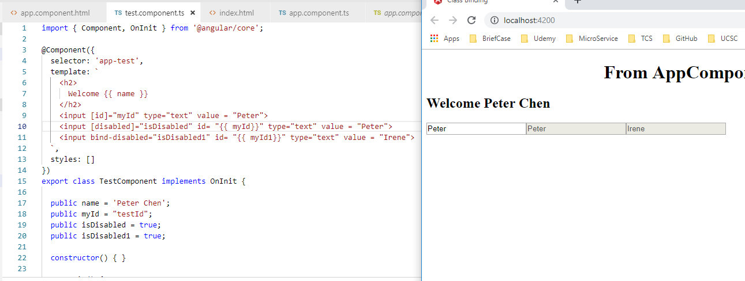
6 Property Binding
https://www.youtube.com/watch?v=N8FBmB2jme8&list=PLC3y8-rFHvwhBRAgFinJR8KHIrCdTkZcZ&index=6
Property Binding
Here, we set the property values manually, in the code, we actually can control by the boolean.
You can toggle the disabled property of an input or a button based on a mouse click and the user perform while filing out a form.
Finally, there is an alternate syntax for property binding.
Instead of square bracket, you can use “bind –” with attribute name.
Use bind-disabled=“isDiabled1”

Slide 20
End of Chapter

