Slide 1

7 Class Binding
Peter H. Chen

Slide 2
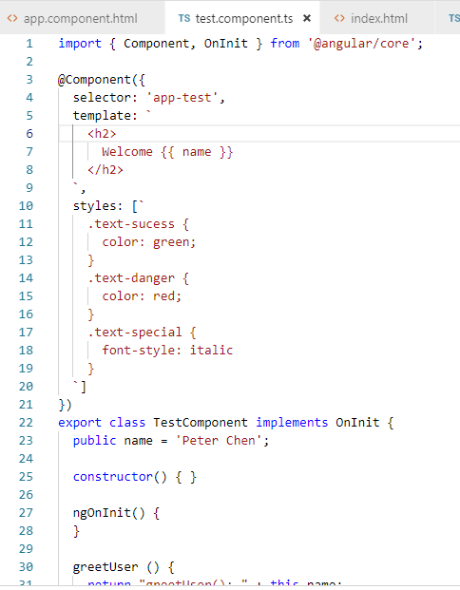
7 Class Binding
https://www.youtube.com/watch?v=N8FBmB2jme8&index=6&list=PLC3y8-rFHvwhBRAgFinJR8KHIrCdTkZcZ
Class Binding
We discuss the class binding in this section.
To do that, we create several class in the styles section.

Slide 3
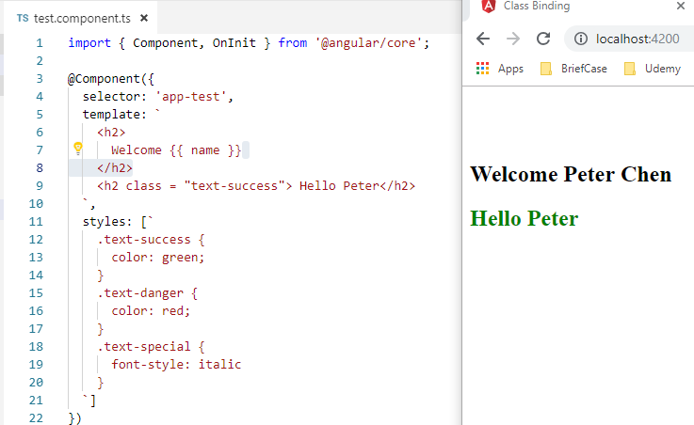
7 Class Binding
https://www.youtube.com/watch?v=N8FBmB2jme8&index=6&list=PLC3y8-rFHvwhBRAgFinJR8KHIrCdTkZcZ
Class Binding
We can set the text color by class.

Slide 4
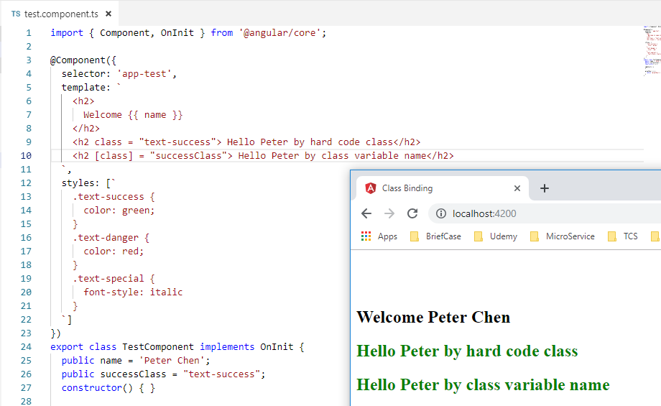
7 Class Binding
https://www.youtube.com/watch?v=N8FBmB2jme8&index=6&list=PLC3y8-rFHvwhBRAgFinJR8KHIrCdTkZcZ
Class attribute cannot change. We use class property binding the change the class property value.
We can replace the class name with variable successClass = “class-name” and use class variable to bind the class property [class].

Slide 5
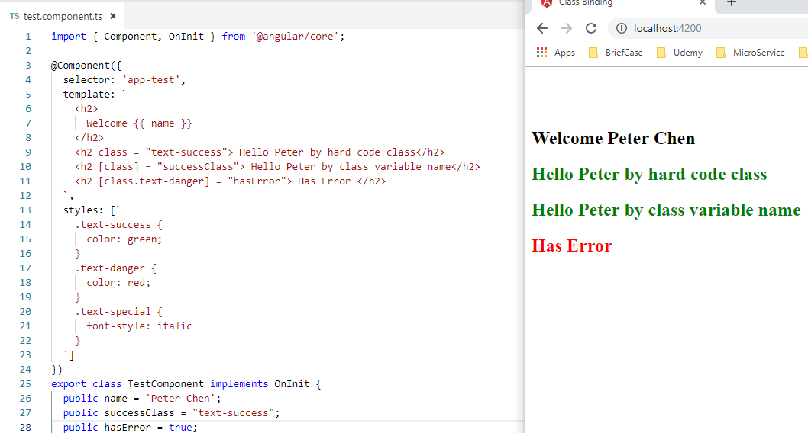
7 Class Binding
https://www.youtube.com/watch?v=N8FBmB2jme8&index=6&list=PLC3y8-rFHvwhBRAgFinJR8KHIrCdTkZcZ
We can have [class.text-danger] depending on the flag of “hasError”.
So, it is possible to change the text color by changing the boolean to true or false.

Slide 6
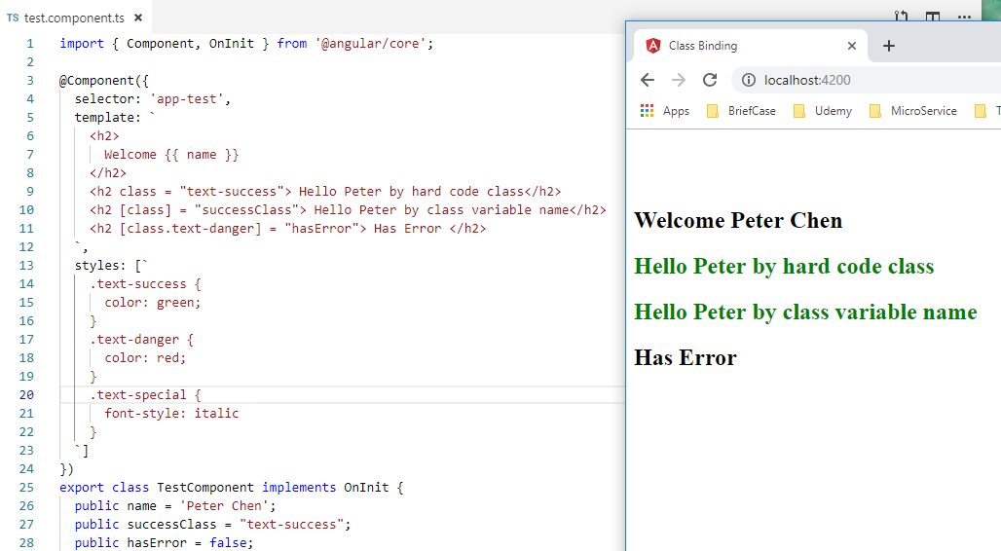
7 Class Binding
https://www.youtube.com/watch?v=N8FBmB2jme8&index=6&list=PLC3y8-rFHvwhBRAgFinJR8KHIrCdTkZcZ
Change the text color by changing the boolean to true or false.

Slide 7
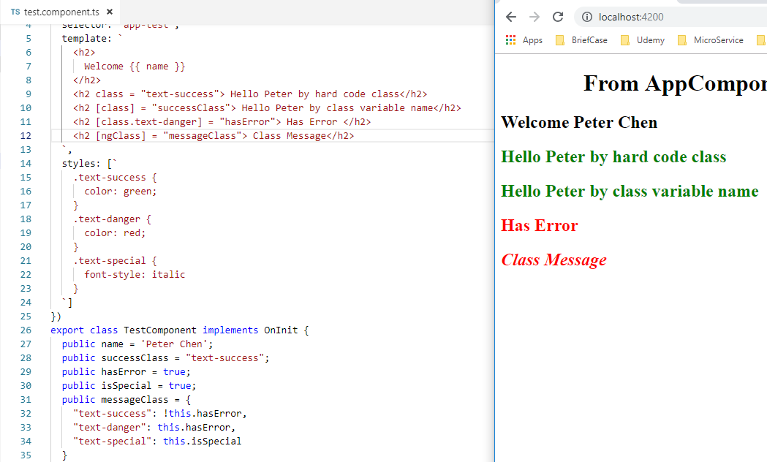
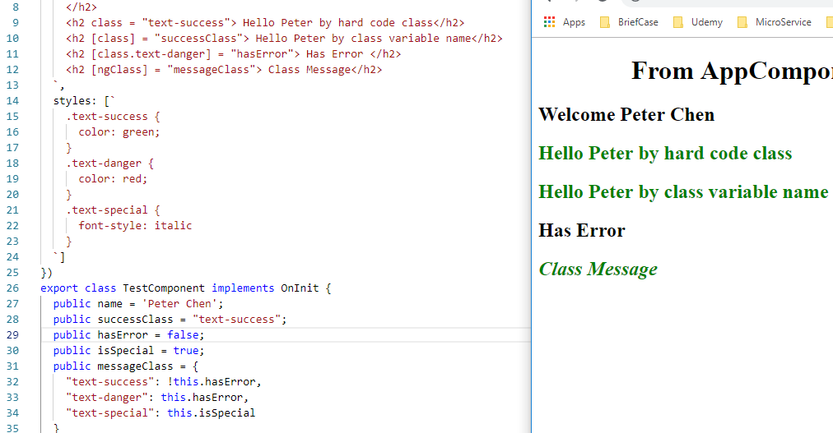
7 Class Binding
https://www.youtube.com/watch?v=N8FBmB2jme8&index=6&list=PLC3y8-rFHvwhBRAgFinJR8KHIrCdTkZcZ
ngClass
We can use ngClass to bind variable with several property values.
We can display text with Red color and Italic style together by set a set of booelan to control the color and italic.

Slide 8
7 Class Binding
https://www.youtube.com/watch?v=N8FBmB2jme8&index=6&list=PLC3y8-rFHvwhBRAgFinJR8KHIrCdTkZcZ
Summary
We can control the text color in HTML element by change the boolean in the class.s

Slide 9
End of Chapter

