Slide 1

8 Style Binding
Peter H. Chen

Slide 2
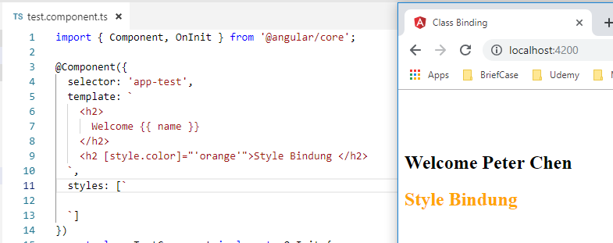
8 Style Binding
https://www.youtube.com/watch?v=N8FBmB2jme8&index=6&list=PLC3y8-rFHvwhBRAgFinJR8KHIrCdTkZcZ
Style Binding
In angular, style binding is similar to class binding.
We are going to create a h2 element and bind to style binding.
Create <h2> and have [style.color]=“’orange’” as follow.

Slide 3
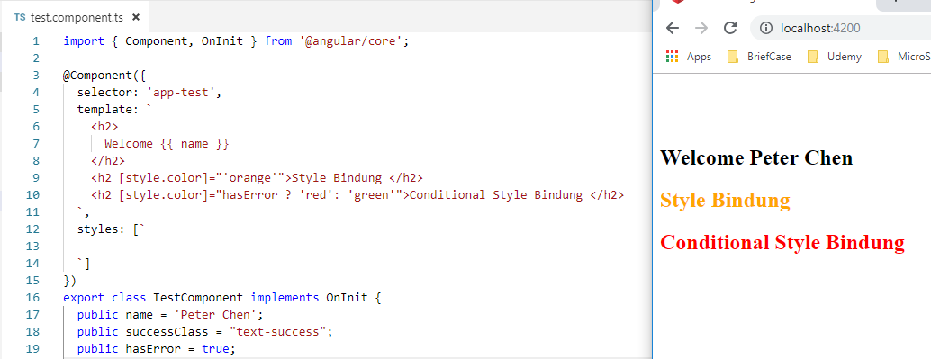
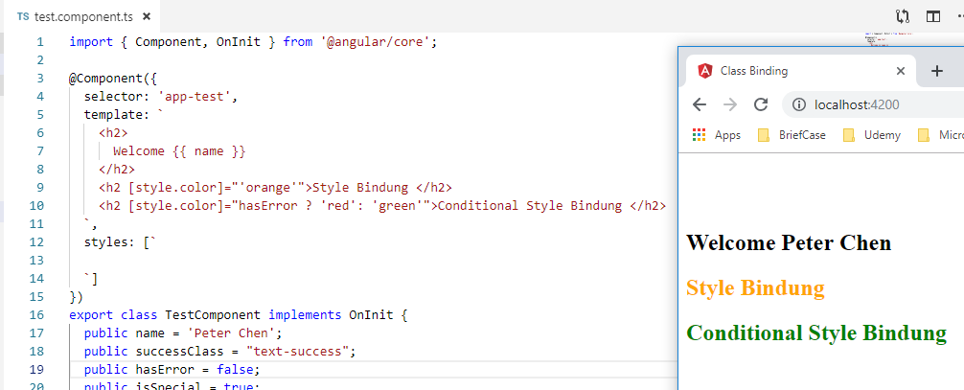
8 Style Binding
https://www.youtube.com/watch?v=N8FBmB2jme8&index=6&list=PLC3y8-rFHvwhBRAgFinJR8KHIrCdTkZcZ
Style Binding
We can change the ‘orange’ into a conditional expression.

Slide 4
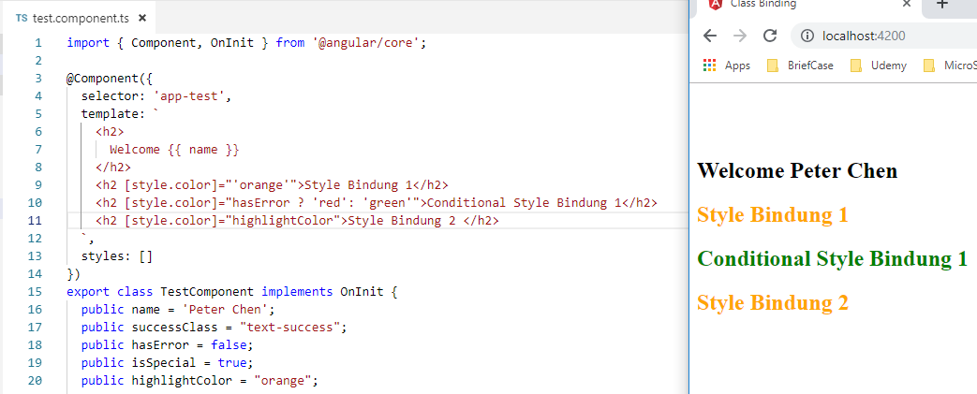
8 Style Binding
https://www.youtube.com/watch?v=N8FBmB2jme8&index=6&list=PLC3y8-rFHvwhBRAgFinJR8KHIrCdTkZcZ
Style Binding
We can assign the component class properties during binding.
Let us create a property highlightColor = “orange”
Let bind this hihglightColor property to CSS property [style.color] to h2 element.

Slide 5
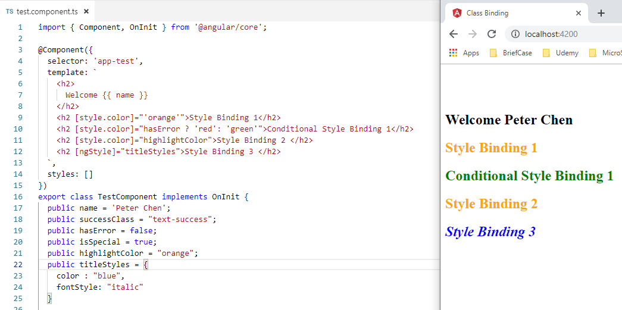
8 Style Binding
https://www.youtube.com/watch?v=N8FBmB2jme8&index=6&list=PLC3y8-rFHvwhBRAgFinJR8KHIrCdTkZcZ
Style Binding
We can control the CSS property by the public property in the component.
This give you a lot of control.
Finally, to apply the multiple style, we need to have ngStyle.
The ngStyle is just like ngClass directive.

Slide 6
8 Style Binding
https://www.youtube.com/watch?v=N8FBmB2jme8&index=6&list=PLC3y8-rFHvwhBRAgFinJR8KHIrCdTkZcZ
Style Binding
The ngStyle gives you multiple styles with both blue and italic styling.
This is the style binding in Angular.

Slide 7
End of Chapter

