Slide 1

9 Event Binding
Peter H. Chen

Slide 2
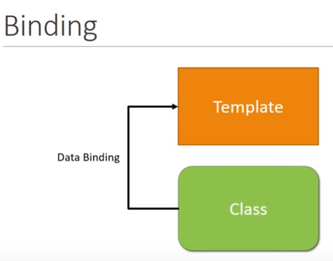
9 Event Binding
https://www.youtube.com/watch?v=N8FBmB2jme8&index=6&list=PLC3y8-rFHvwhBRAgFinJR8KHIrCdTkZcZ
Event Binding
So far, we have looked at data binding where the data flow from the component class to the component template.
Any update to the class property. The view got updated as well.

Slide 3
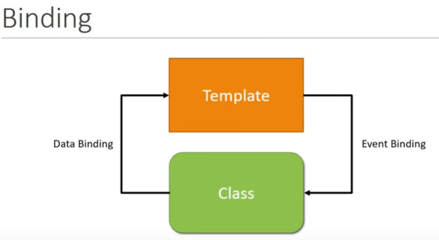
9 Event Binding
https://www.youtube.com/watch?v=N8FBmB2jme8&index=6&list=PLC3y8-rFHvwhBRAgFinJR8KHIrCdTkZcZ
Event Binding
Sometimes, user mouse event or keyboard event. We need the data flow in the other direction as well. That is from template to the class.

Slide 4
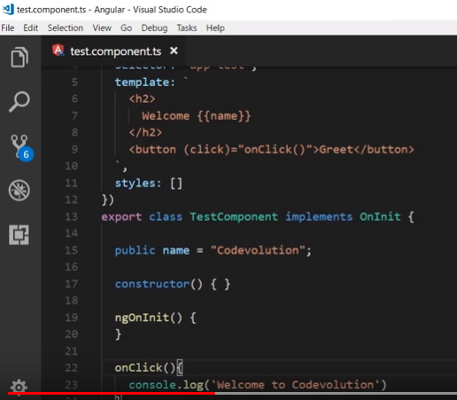
9 Event Binding
https://www.youtube.com/watch?v=N8FBmB2jme8&index=6&list=PLC3y8-rFHvwhBRAgFinJR8KHIrCdTkZcZ
Event Binding
Let’s understand with code. The () is used for Event binding from template to class.
<button (click)=“onClick()”>

Slide 5
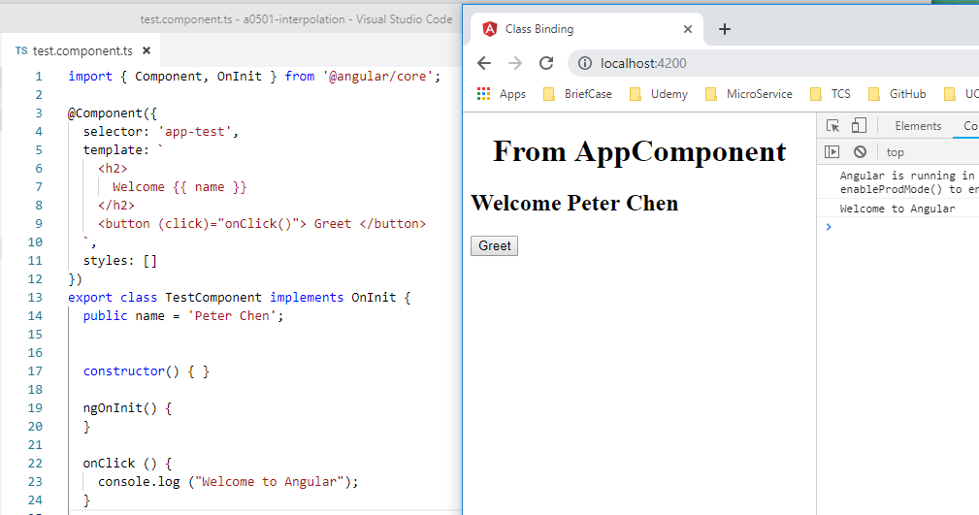
9 Event Binding
https://www.youtube.com/watch?v=N8FBmB2jme8&index=6&list=PLC3y8-rFHvwhBRAgFinJR8KHIrCdTkZcZ
Event Binding
Let’s say we have text button “greet”. After we click, we want to see “Welcome to Angular”.
We need a click event for this button. Here is the syntax.
Within the open bracket, put the (click) and event handler.
We are binding the click event to the display of “Welcome to Angular”

Slide 6
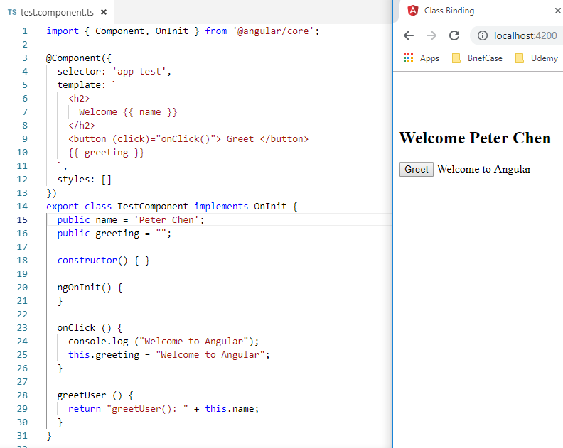
9 Event Binding
https://www.youtube.com/watch?v=N8FBmB2jme8&index=6&list=PLC3y8-rFHvwhBRAgFinJR8KHIrCdTkZcZ
Event Binding
Next, it is possible to set the property values on the mouse click.
We are going to add a new property.
The {{ greeting }} is displayed because of the interpolation.

Slide 7
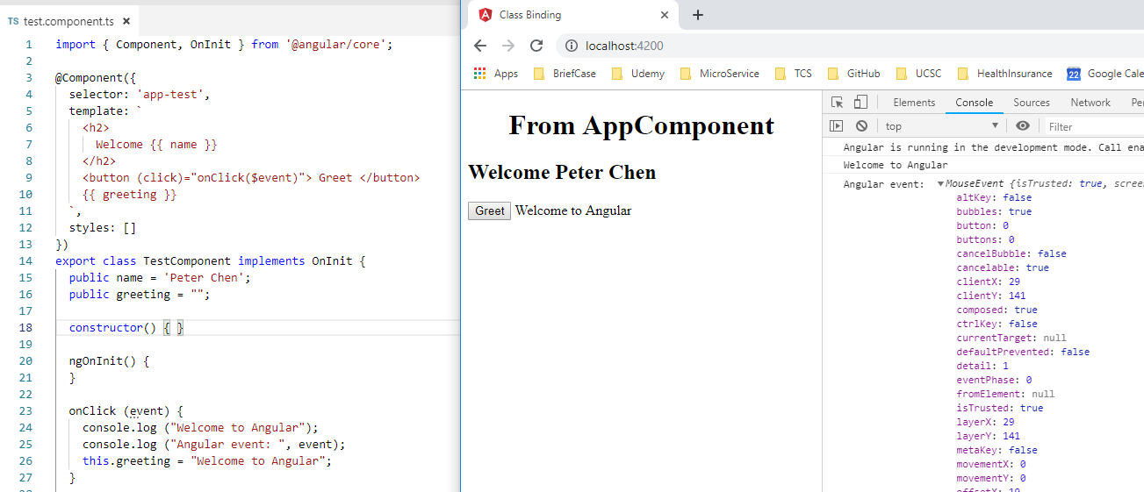
9 Event Binding
https://www.youtube.com/watch?v=N8FBmB2jme8&index=6&list=PLC3y8-rFHvwhBRAgFinJR8KHIrCdTkZcZ
Event Binding
Sometimes, we wan to see the event itself in the event handler. The event is $event and this is special variable for Angular. The $event gives you all the information about the DOM event that was raised.
So, now we are passing the parameter to the onClick() method.

Slide 8
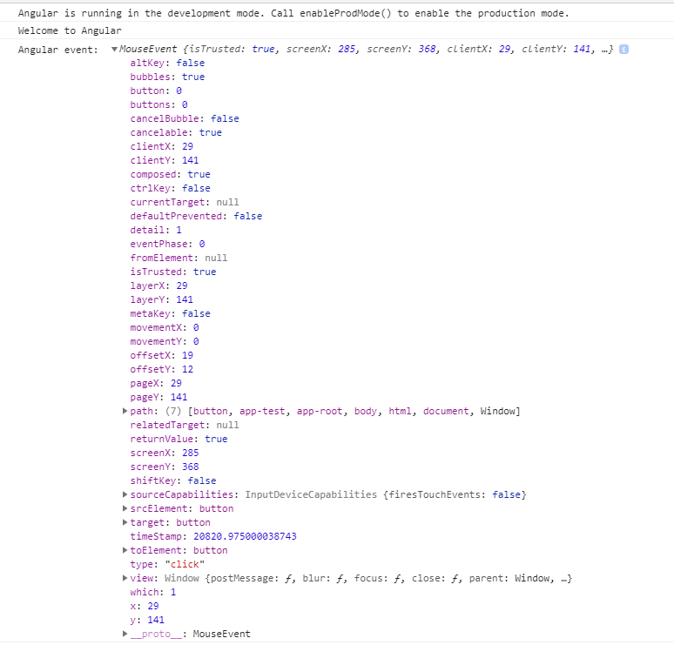
9 Event Binding
https://www.youtube.com/watch?v=N8FBmB2jme8&index=6&list=PLC3y8-rFHvwhBRAgFinJR8KHIrCdTkZcZ
Event Binding
Click is the mouse event, you expand the MosueEvent on console, you can see all the information in the event that was captured, the x and y coordinate, the target, the type of event, for example, the click event and so on.

Slide 9
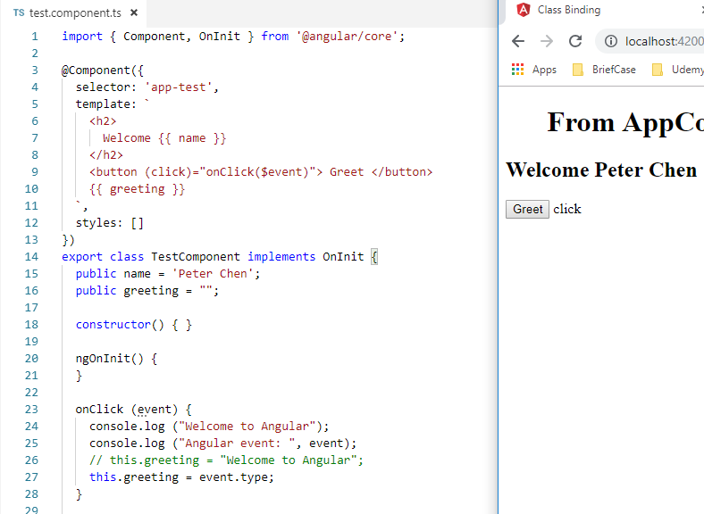
9 Event Binding
https://www.youtube.com/watch?v=N8FBmB2jme8&index=6&list=PLC3y8-rFHvwhBRAgFinJR8KHIrCdTkZcZ
Event Binding
You can use any of this in your application, for example, you can set the greeting to be the event type.

Slide 10
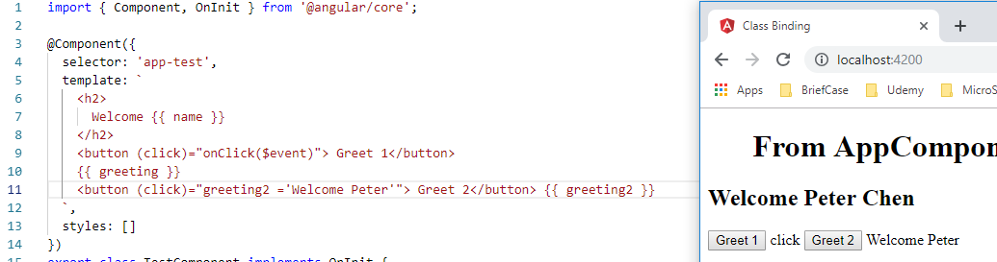
9 Event Binding
https://www.youtube.com/watch?v=N8FBmB2jme8&index=6&list=PLC3y8-rFHvwhBRAgFinJR8KHIrCdTkZcZ
Event Binding
By using the $event, you can get all the event property of the DOM event.
Finally, sometimes when you work with event binding. A separate event handler may not be necessary, for example, the method body is very small.
So, you can have template statement right in the HTML itself.
Let’s add a new button, this time, instead of assigning an event handler, we add a template statement.
We did not assign a handler, instead, we use the code in the HTML element.

Slide 11
End of Chapter

