Slide 1

10 Template Reference Variable
Peter H. Chen

Slide 2
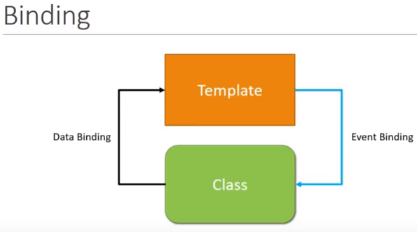
10 Template Reference Variable
https://www.youtube.com/watch?v=N8FBmB2jme8&index=6&list=PLC3y8-rFHvwhBRAgFinJR8KHIrCdTkZcZ
Template Reference Variable
This section discusses the template reference variable.
Now, when there is a user interaction, we might want some data to flow from the view to the class to perform an operation, for example, we may require the value in the input field to perform some validation.
So, to easily access the DOM element and their properties, Angular provides us with template reference variables.

Slide 3
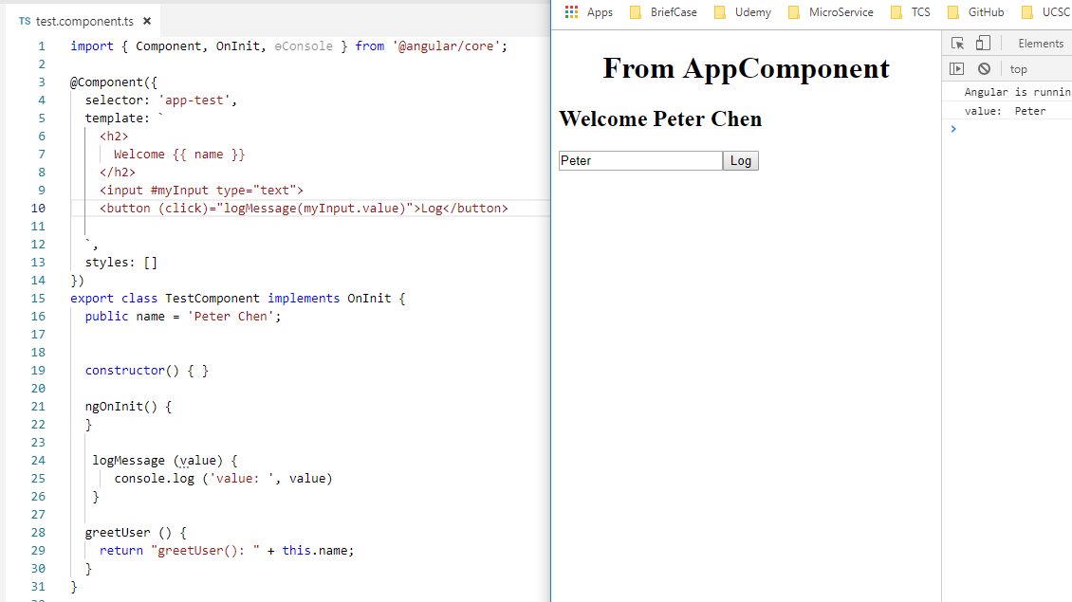
10 Template Reference Variable
https://www.youtube.com/watch?v=N8FBmB2jme8&index=6&list=PLC3y8-rFHvwhBRAgFinJR8KHIrCdTkZcZ
Template Reference Variable
Let’s look at an example. We have s text box and button.
First, we need to bind the click event to the input button.
We will pass the value of the input elements as an argument and the way we do that is using the template reference variable and syntax is pretty simple.
You wan the opening tag of the element you want a reference to, for example, #myInput.
Pass myInput.value to the onclick method, you can see the “peter” on the console.

Slide 4
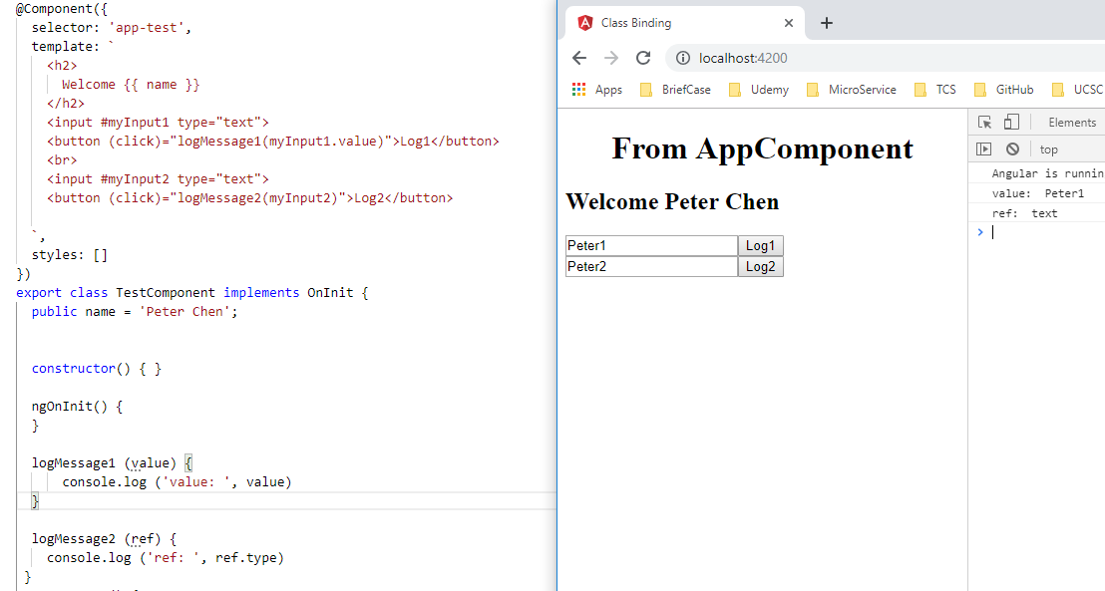
10 Template Reference Variable
https://www.youtube.com/watch?v=N8FBmB2jme8&index=6&list=PLC3y8-rFHvwhBRAgFinJR8KHIrCdTkZcZ
Template Reference Variable
Now, if we pass the template reference variable logMessage2 (myInput), you can check the type is text.

Slide 5
End of Chapter

