Slide 1

1 Angular Introduction
Peter H. Chen

Slide 2
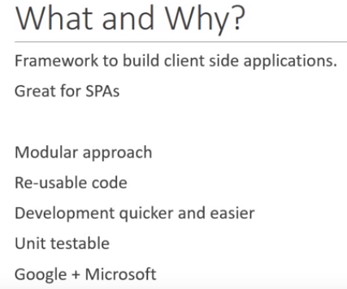
1 Angular Introduction
https://www.youtube.com/watch?v=0eWrpsCLMJQ&list=PLC3y8-rFHvwhBRAgFinJR8KHIrCdTkZcZ
This documents discussed angular 7.
Angular is a framework for client side application. It is especially great for Single Page Applications (SPAs) where part of views get refreshed asynchronously without having reload the entire page. Any application rely on JavaScript, Angular is a great choice.

Slide 3
1 Angular Introduction
https://www.youtube.com/watch?v=0eWrpsCLMJQ&list=PLC3y8-rFHvwhBRAgFinJR8KHIrCdTkZcZ
Why you use Angular instead of other framework library?
There are couple of points:
The first one is by design, Angular promotes Modular approach, therefore, the application you build up will have a clear structure.
By making use of components which is a feature of Angular, we can have a lot of re-useable code.
Angular has a lot of built-in capabilities, such as, validation, routing, and etc. which makes development quicker and easier.
Angular have unit testable and easily maintainable code.
Finally, Angular is a product of Google Team and make use of TypeScript Language from Microsoft. It is safe to stay with Angular.

Slide 4
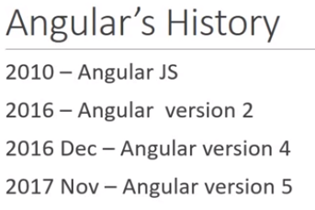
1 Angular Introduction
https://www.youtube.com/watch?v=0eWrpsCLMJQ&list=PLC3y8-rFHvwhBRAgFinJR8KHIrCdTkZcZ
The first well know of Angular JS which is released in 2010.
This was a huge hit and a lot of organization started to use Angular JS to build their enterprise applications.
But then in 2016, Angular version 2 which was just called as Angular was released. It was announced that Angular JS will refer to 1.x versions and Angular without JS will refer to version2 and up.
In December of 2016, Angular 4 was announced. Version 3 was skipped to avoid confusion due to the misalignment of the routers package version which was already distributed as version 3.3.0. But you do not need to worry about that.
Then, there is Angular 5 was released on November first of 2017.
Right now, the Angular 7 is the latest version.

Slide 5
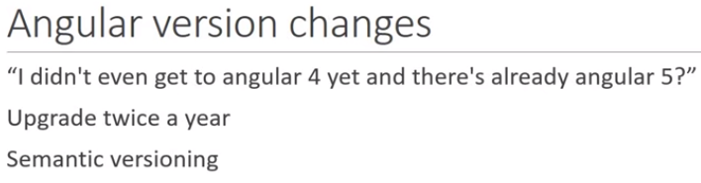
1 Angular Introduction
https://www.youtube.com/watch?v=0eWrpsCLMJQ&list=PLC3y8-rFHvwhBRAgFinJR8KHIrCdTkZcZ
Angular Version:

Slide 6
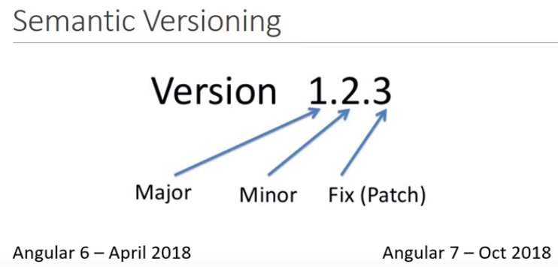
1 Angular Introduction
https://www.youtube.com/watch?v=0eWrpsCLMJQ&list=PLC3y8-rFHvwhBRAgFinJR8KHIrCdTkZcZ
Angular Version:
Release twice a year
Break the functionality
Does not break the functionality

Slide 7
End of Chapter

