Slide 1

2 Get Started
Peter H. Chen

Slide 2
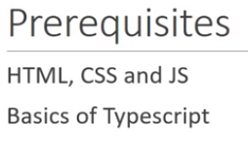
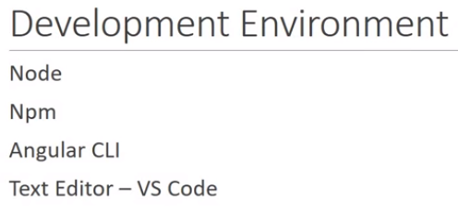
2 Get Started
https://www.youtube.com/watch?v=0eWrpsCLMJQ&list=PLC3y8-rFHvwhBRAgFinJR8KHIrCdTkZcZ
Get Started.
This document discusses the complete code development of Angular from the very beginning to the end.

Slide 3
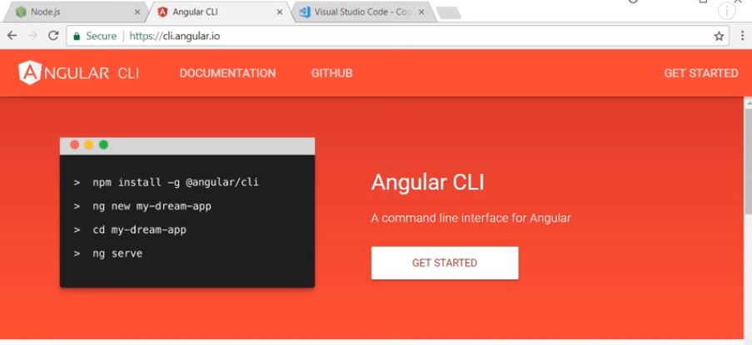
2 Get Started
https://www.youtube.com/watch?v=0eWrpsCLMJQ&list=PLC3y8-rFHvwhBRAgFinJR8KHIrCdTkZcZ
Install node JS.
> npm install –g @a gular/cli
> ng --version
> ng new my-app
> cd my-app
> ng serve

Slide 4
End of Chapter

