Slide 1

3 Hello World
Peter H. Chen

Slide 2
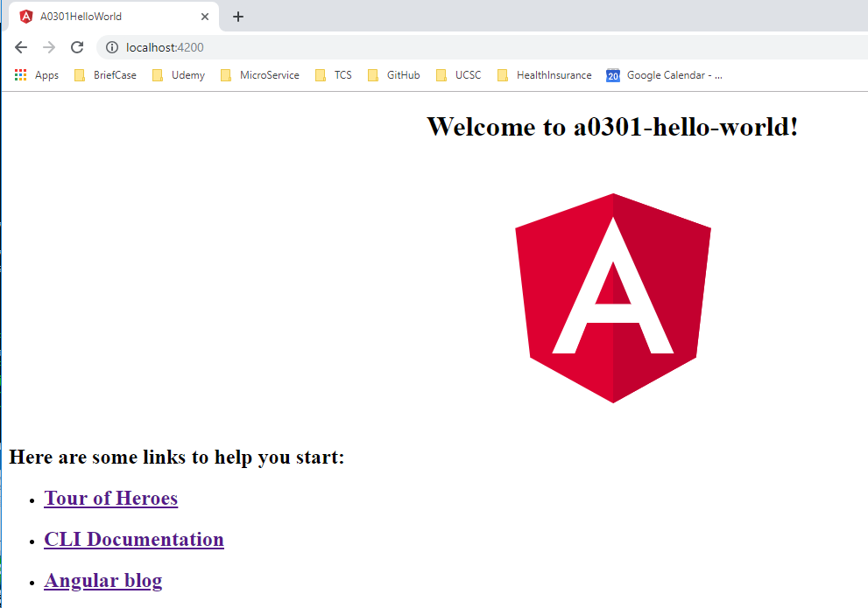
3 Hello World
https://www.youtube.com/watch?v=mDoHtD1hI3I&list=PLC3y8-rFHvwhBRAgFinJR8KHIrCdTkZcZ&index=3
In this section, we discuss the Architecture of Hello World
To create the Hollo World application,
> ng new a0301-hello-world
> cd a0301-hello-world
> ng serve –open # open web browser at port: 4200

Slide 3
3.1 Architecture

Slide 4
3.1 Architecture
https://www.youtube.com/watch?v=mDoHtD1hI3I&list=PLC3y8-rFHvwhBRAgFinJR8KHIrCdTkZcZ&index=3
Architecture: Let go through the Angular Architecture.
The first building block of Architecture is the Modules.
Modules contains the components and services
Module
Components
Services

Slide 5
3.2 Module

Slide 6
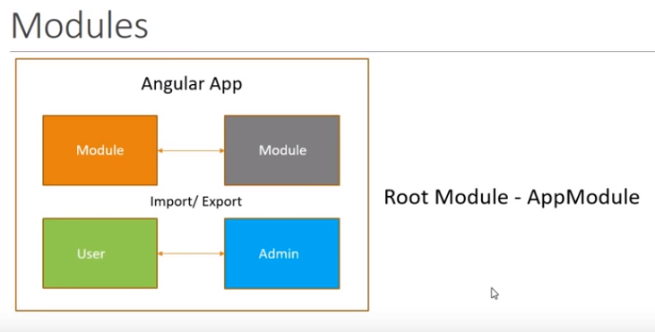
3.2 Module
https://www.youtube.com/watch?v=mDoHtD1hI3I&list=PLC3y8-rFHvwhBRAgFinJR8KHIrCdTkZcZ&index=3
Angular applications are modules in nature. Agular applications are a collection of many individual modules.
Every module represents a feature area in your application.

Slide 7
3.2 Module
https://www.youtube.com/watch?v=mDoHtD1hI3I&list=PLC3y8-rFHvwhBRAgFinJR8KHIrCdTkZcZ&index=3
For example, we can have a user module that is related to application users and an admin module that is related to the application administrators.
An angular module is just line o f code that can be imported or exported.
Keep in mind that Angular application has at least one module which is the root module.
By Convention, the root module is called AppModule.

Slide 8
3.3 Component

Slide 9
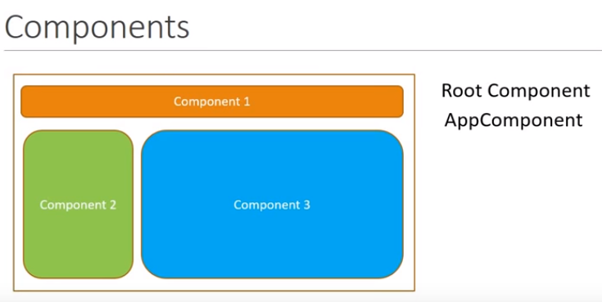
3.3 Component
https://www.youtube.com/watch?v=mDoHtD1hI3I&list=PLC3y8-rFHvwhBRAgFinJR8KHIrCdTkZcZ&index=3
Each module is composed of components and services.
A component controls a portion of the view on the browser.
For example, you can have one navigation bar, one sidebar, and one main content.
In Angular application, we have at least one component which is Root Component in our application.
By convention, the Root Component is called AppComponent.

Slide 10
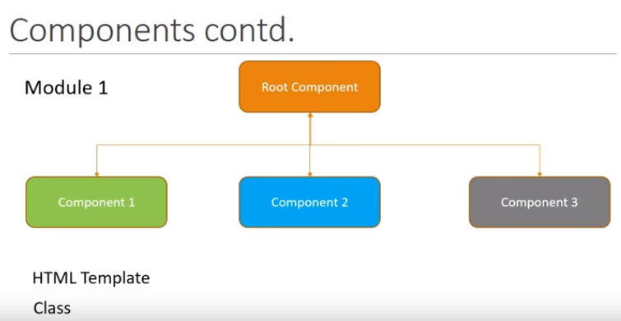
3.3 Component
https://www.youtube.com/watch?v=mDoHtD1hI3I&list=PLC3y8-rFHvwhBRAgFinJR8KHIrCdTkZcZ&index=3
All the components can be nested inside the root component.
Each component will have ah HTML template to represent the view in the browser and a class to control the logic of that particular view.

Slide 11
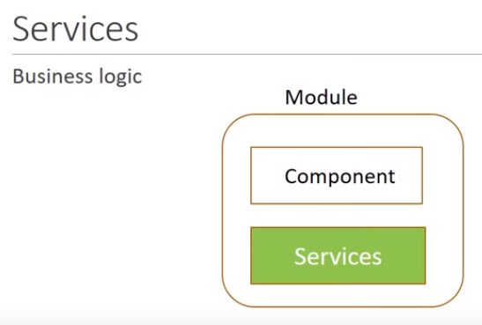
3.3 Component
https://www.youtube.com/watch?v=mDoHtD1hI3I&list=PLC3y8-rFHvwhBRAgFinJR8KHIrCdTkZcZ&index=3
Module will also have services which is basically a class that contains the business logic of your application.
In addition to components and services, module can contain a few more pieces of your angular application. But now, component and services will something will be focusing a lot in this section.

Slide 12
3.4 Summary of Architecture

Slide 13
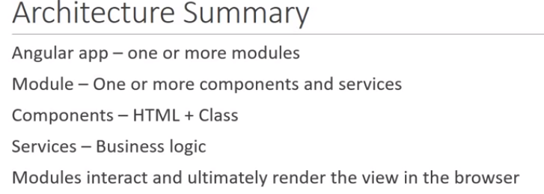
3.4 Summary of Architecture
https://www.youtube.com/watch?v=mDoHtD1hI3I&list=PLC3y8-rFHvwhBRAgFinJR8KHIrCdTkZcZ&index=3
Angular application contains one or more modules.
Each module contains one or more components and services.
Each component contains HTML and Class to control the logic for that particular view.
Modules can have services which contains the business logic of your application.
The modules can be export or import code as when required and finally render the view in the and finally render the view in the browser.

Slide 14
3.5 Pcakage.json

Slide 15
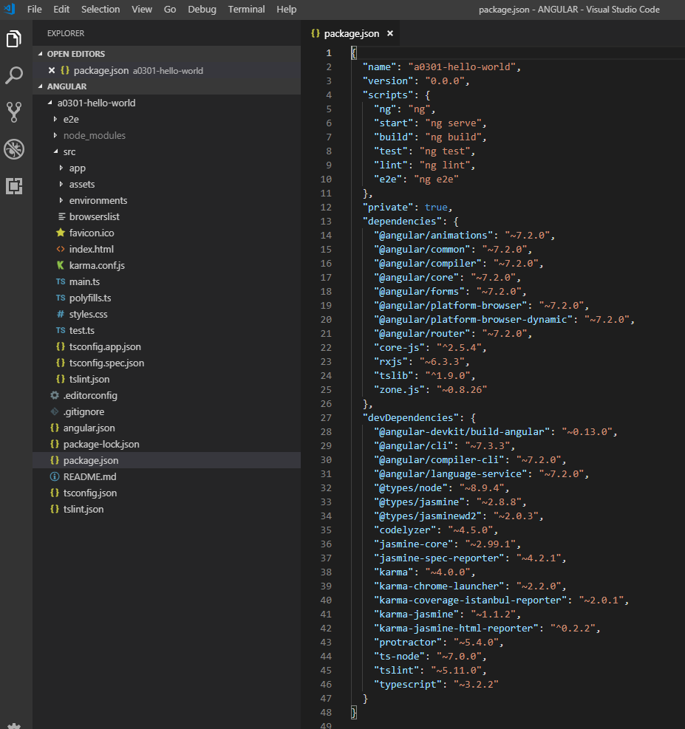
3.5 Package.json
https://www.youtube.com/watch?v=mDoHtD1hI3I&list=PLC3y8-rFHvwhBRAgFinJR8KHIrCdTkZcZ&index=3
Visual Studio Code IDE from Microsoft can be used for Angular development.
The first one is the Package.json file.
This file contains the dependencies and DevDependencies which are libraries and modules are required by your angular application to work.
The packages get installed when you run the command “ng new hello-world”.

Slide 16
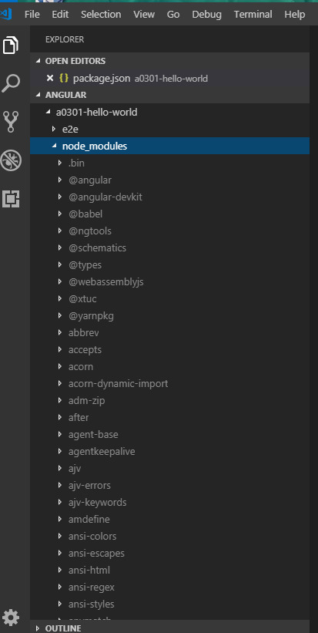
3.5 Package.json
https://www.youtube.com/watch?v=mDoHtD1hI3I&list=PLC3y8-rFHvwhBRAgFinJR8KHIrCdTkZcZ&index=3
All the packages are installed in the node_modules folder.

Slide 17
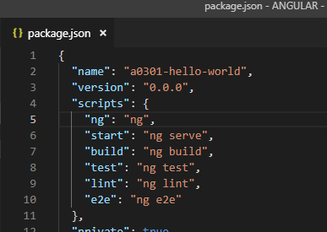
3.5 Package.json
https://www.youtube.com/watch?v=mDoHtD1hI3I&list=PLC3y8-rFHvwhBRAgFinJR8KHIrCdTkZcZ&index=3
There are some scripts to start the angular application.
The “ng serve” is one of them which runs our application.
You can also execute “npm start” which will internally call the “ng serve” command.
You can use “npm start”, this will internally call “ng serve”.

Slide 18
3.6 src Folder

Slide 19
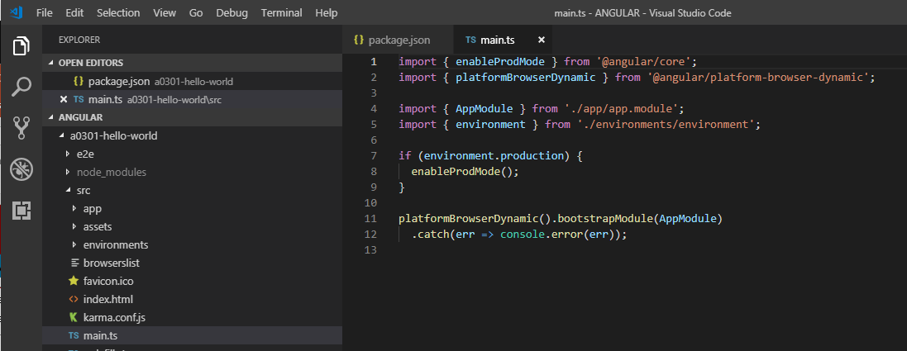
3.6 src Folder
https://www.youtube.com/watch?v=mDoHtD1hI3I&list=PLC3y8-rFHvwhBRAgFinJR8KHIrCdTkZcZ&index=3
The src folder is the folder we concerned most of the time.
The main.js is the entry point to our Angular application.

Slide 20
3.7 app Folder

Slide 21
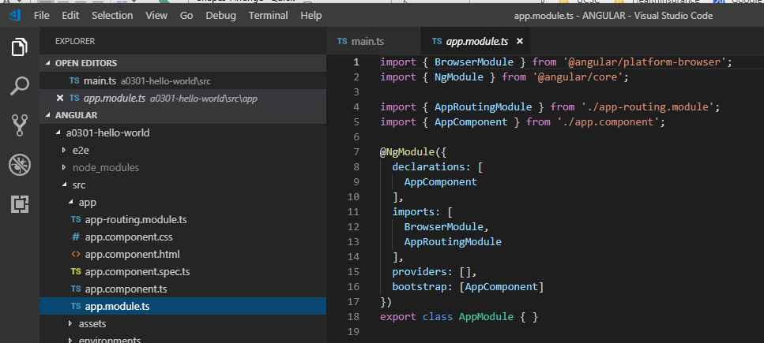
3.7 app Folder
https://www.youtube.com/watch?v=mDoHtD1hI3I&list=PLC3y8-rFHvwhBRAgFinJR8KHIrCdTkZcZ&index=3
We also have src/app folder contains the app.module.ts which is the Root Module of application.

Slide 22
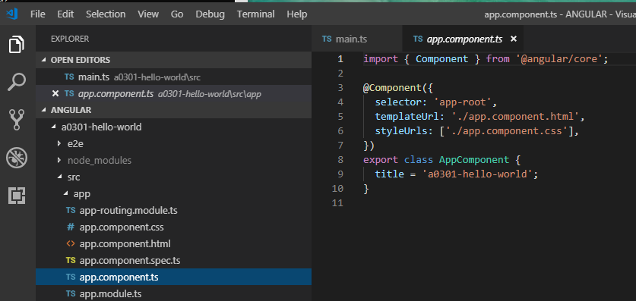
3.7 app Folder
https://www.youtube.com/watch?v=mDoHtD1hI3I&list=PLC3y8-rFHvwhBRAgFinJR8KHIrCdTkZcZ&index=3
The src/app folder contains the app.compoent.ts which is the Root Component of application.

Slide 23
3.8 main.js Bootstrap AppModule

Slide 24
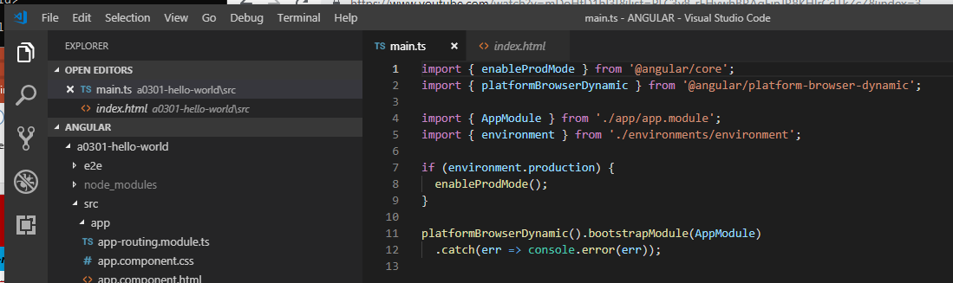
3.8 main.js Bootstrap AppModule
https://www.youtube.com/watch?v=mDoHtD1hI3I&list=PLC3y8-rFHvwhBRAgFinJR8KHIrCdTkZcZ&index=3
When we start to run the command “ng serve”, the execution comes to the main.ts file.
Over here, we bootstrap or kick start the AppModule.

Slide 25
3.9 AppModule Start AppComponent

Slide 26
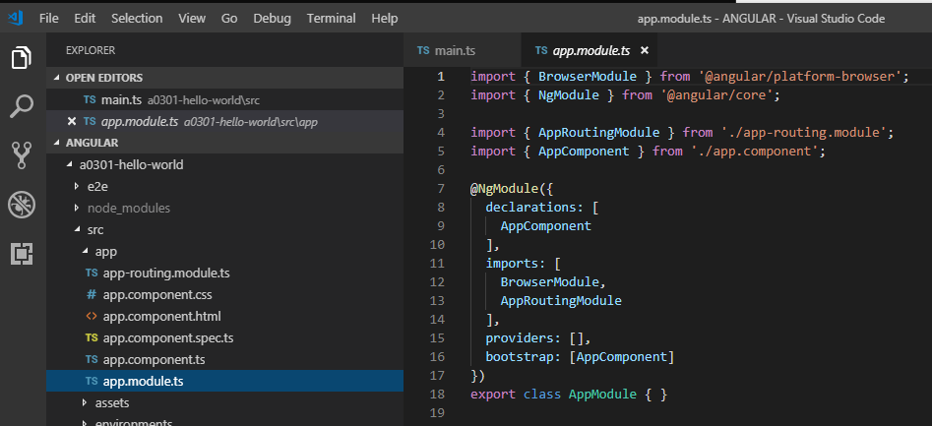
3.9 AppModule Start AppComponent
https://www.youtube.com/watch?v=mDoHtD1hI3I&list=PLC3y8-rFHvwhBRAgFinJR8KHIrCdTkZcZ&index=3
In the app.module.ts, we in turn bootstrap the AppCompoinent.
Again, kick start the AppComponent.
This AppCompoent contains two things: The HTML template and the class to control the view logic.

Slide 27
3.10 AppComponent

Slide 28
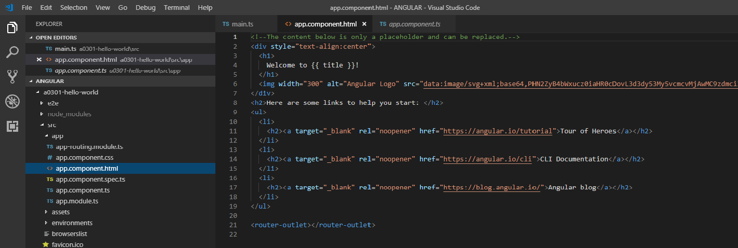
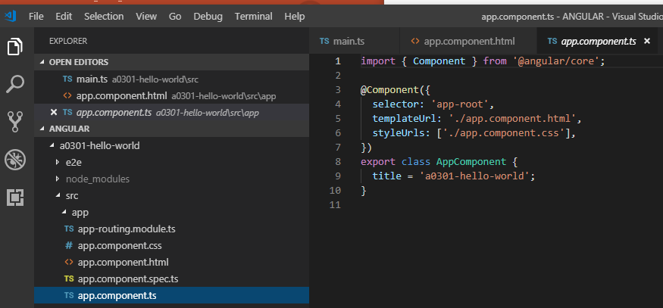
3.10 AppComponent
https://www.youtube.com/watch?v=mDoHtD1hI3I&list=PLC3y8-rFHvwhBRAgFinJR8KHIrCdTkZcZ&index=3
We have app.component.html template here and TypeScript file app.component.ts which contains the logic of data for the view.

Slide 29
3.10 AppComponent
https://www.youtube.com/watch?v=mDoHtD1hI3I&list=PLC3y8-rFHvwhBRAgFinJR8KHIrCdTkZcZ&index=3
In the AppComponent class, we have the title as the property equal to a string “a0301-hello-world” and inside HTML, we have Welcome to {{ title }}.
At runtime, this title is replaced by this property.
We also have other HTML element that get rendered in the browser.

Slide 30
3.11 Hello World App

Slide 31
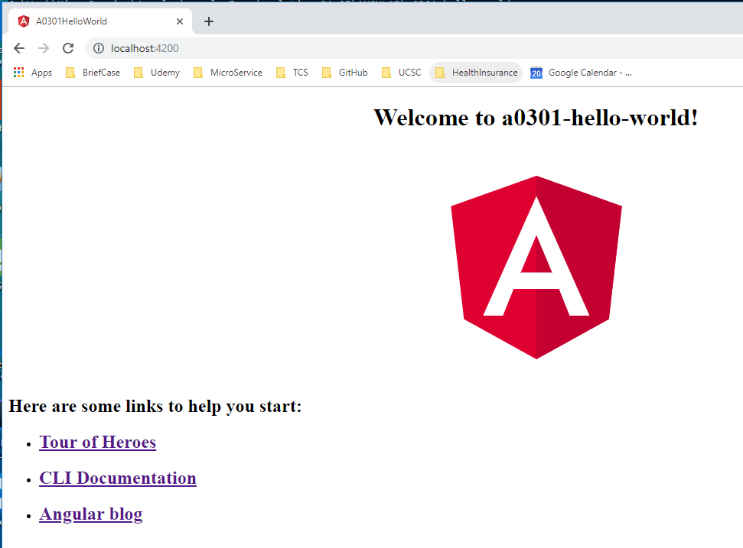
3.11 Hello World App
https://www.youtube.com/watch?v=mDoHtD1hI3I&list=PLC3y8-rFHvwhBRAgFinJR8KHIrCdTkZcZ&index=3
We have Welcome to {{title}} . Title is equal to “a0301-hello-world!”.
The property in the class hat gets bound to HTML template.
So have Welcome to a3010-hello-wolrd and rest are the HTML elements.

Slide 32
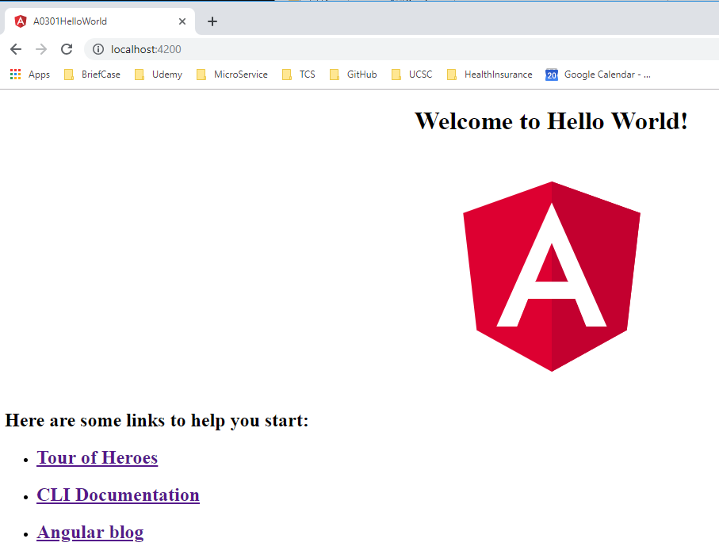
3.11 Hello World App
https://www.youtube.com/watch?v=mDoHtD1hI3I&list=PLC3y8-rFHvwhBRAgFinJR8KHIrCdTkZcZ&index=3
The AppComponent class contains the property title.
If I change title to “Hello World”, we will get the following.

Slide 33
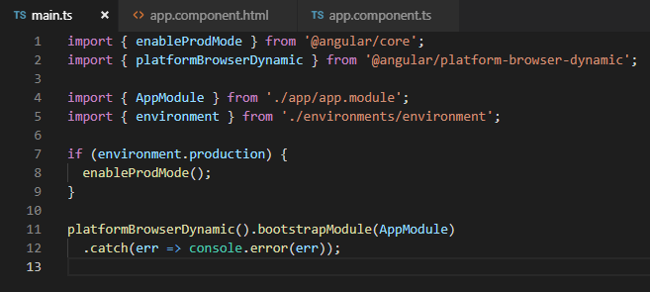
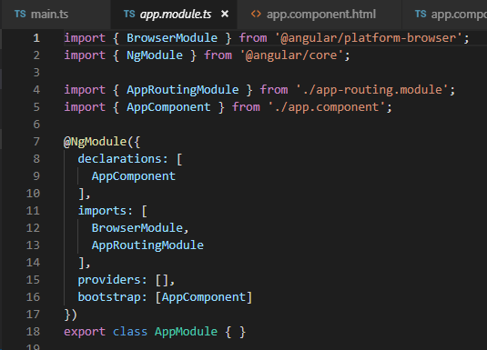
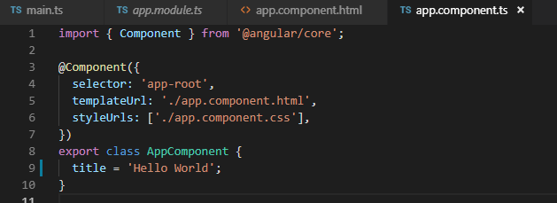
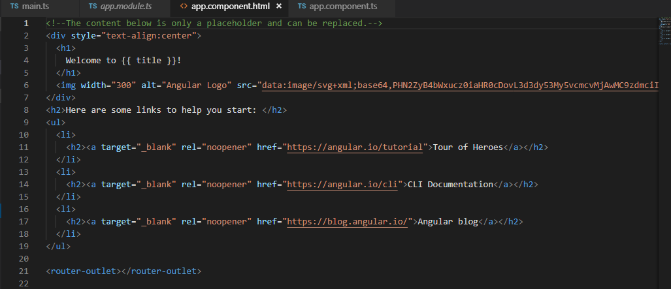
3.11 Hello World App
https://www.youtube.com/watch?v=mDoHtD1hI3I&list=PLC3y8-rFHvwhBRAgFinJR8KHIrCdTkZcZ&index=3
Summary
Start with “ng serve”. It starts the main.js, goes to AppModule, then goes to AppComponent.
The data property title gets rendered in the HTML which what you will see in the browser.

Slide 34
3.11 Hello World App
https://www.youtube.com/watch?v=mDoHtD1hI3I&list=PLC3y8-rFHvwhBRAgFinJR8KHIrCdTkZcZ&index=3
Summary
Architecture components represents different portions of view in the browser.
They make up for a major portion of your angular application.
In the next couple of sections, we will look more details of components.

Slide 35
End of Chapter

