Slide 1

4 Component
Peter H. Chen

Slide 2

4 Component
https://www.youtube.com/watch?v=16rQyEQtpyQ&list=PLC3y8-rFHvwhBRAgFinJR8KHIrCdTkZcZ&index=4
Component
In this section, we will understand what exactly make up a component and how can we add component to our angular application.

Slide 3
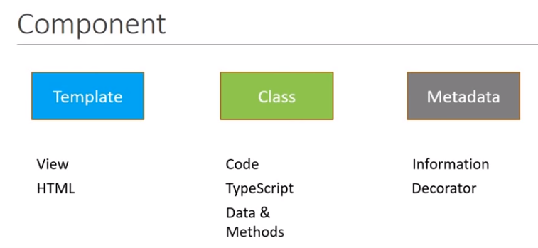
4 Component
https://www.youtube.com/watch?v=16rQyEQtpyQ&list=PLC3y8-rFHvwhBRAgFinJR8KHIrCdTkZcZ&index=4
Component
A component is made up of three parts: Template, Class, and Metadata.
The first one is a template which represents the view. This is created using HTML. It will be the user interface for your application.
The second one is the class which is nothing but code that supports the view. This is created using a TypeScript. The class is like any programming language contains data properties and method that can be used to control the logic of the view, for example, We can a method to show or hide an element based on the value of the property.
The third one is the Metadata: the component also has some metadata attached to the component. The metadata is the information that angular needs to decide if the particular class is an Angular component or just a regular class. The metadata is defined by using a decorator which is a feature in Typescript. A decorator is just a function that provides information about the class attached to it. For component, we use component decorator.

Slide 4
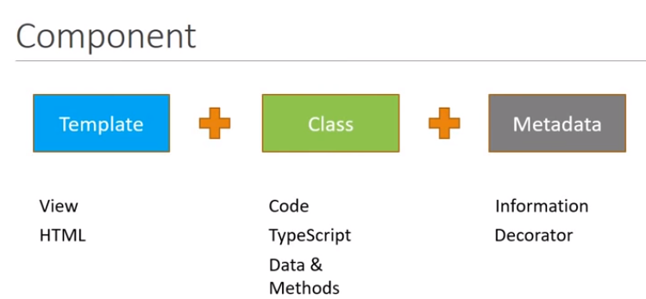
4 Component
https://www.youtube.com/watch?v=16rQyEQtpyQ&list=PLC3y8-rFHvwhBRAgFinJR8KHIrCdTkZcZ&index=4
Component
If we put Template, Class, and Metadata together, we got an Angular Component.

Slide 5
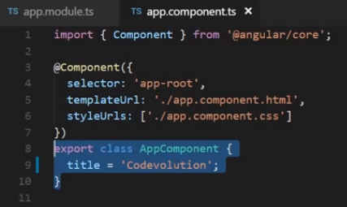
4 Component
https://www.youtube.com/watch?v=16rQyEQtpyQ&list=PLC3y8-rFHvwhBRAgFinJR8KHIrCdTkZcZ&index=4
Now, Let’s try to relate this to the app component that we have in Hello World application.
At the bottom of app.component.ts, we have the class AppComponent. The AppComponent class only contains the one property which is the title and does not contains any methods, keeping it simple to this class.
We have metadata attached in the form of a decorator and be more specific, the Component Decorator. The component decorator is basically a function that attached to the class which is right below the decorator.
In the case below, the AppCompoent is the class below the metadata @Component ({ … })
It is the decorator that tells Angular, hey, this is not a plain class. This is a component.

Slide 6
4 Component
https://www.youtube.com/watch?v=16rQyEQtpyQ&list=PLC3y8-rFHvwhBRAgFinJR8KHIrCdTkZcZ&index=4
The component decorator contains both the metadata and the template which represents the view.
The metadata have a selector, a template URL, and a styles.

Slide 7
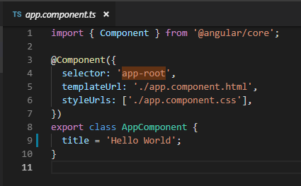
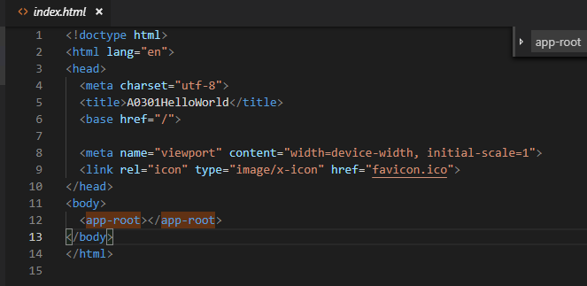
4 Component
https://www.youtube.com/watch?v=16rQyEQtpyQ&list=PLC3y8-rFHvwhBRAgFinJR8KHIrCdTkZcZ&index=4
The selector is basically a custom HTML tag that can be used to represent this component.
When you specify a selector in your HTML, Angular will render the components template in its place.
For our Hello World example, you can see the selector for app component is ‘app-root’ and in index.html file.
Selector is used as a custom HTML tag. The selector tag needs the opening and closing tag.
Angular render the app component template based on the ‘app-root’ selector.

Slide 8
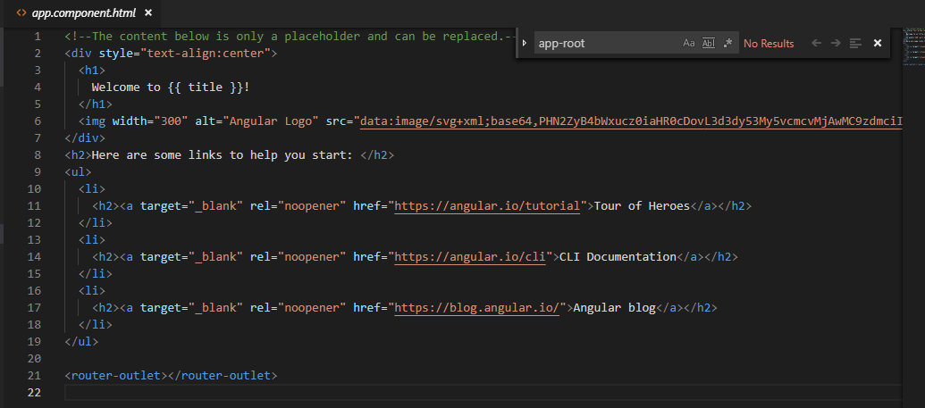
4 Component
https://www.youtube.com/watch?v=16rQyEQtpyQ&list=PLC3y8-rFHvwhBRAgFinJR8KHIrCdTkZcZ&index=4
What exactly of app-root? That is defined in the templateUrl. The templateUrl represents the view of this component.
If we take a look at app.component.html, we have “Welcome to {{ title}}”
The title property is “Hello World”. The title in app.component.html is replaced by title in app.component.ts.

Slide 9
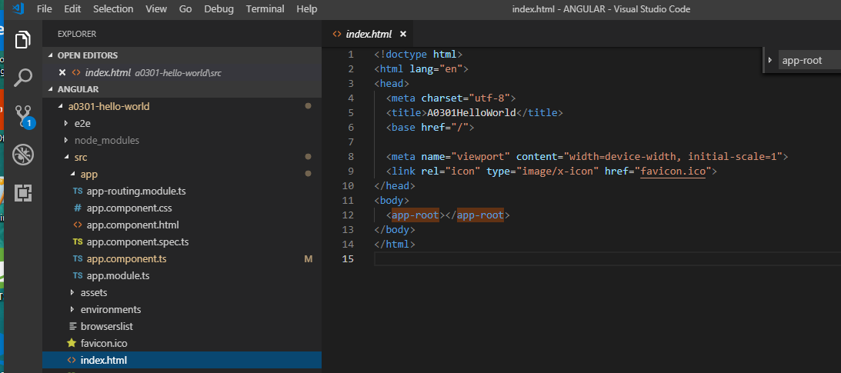
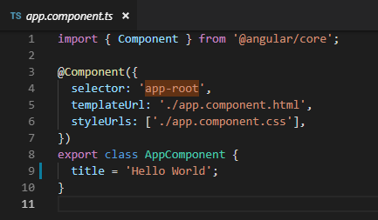
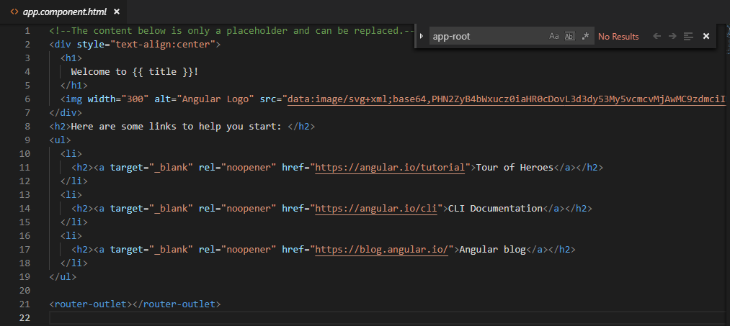
4 Component
https://www.youtube.com/watch?v=16rQyEQtpyQ&list=PLC3y8-rFHvwhBRAgFinJR8KHIrCdTkZcZ&index=4
In the index.html file, the id ‘app-root’ is replaced by the selector the ‘app-root’ and the app.component.html. That is how html template gets rendered in the browser.

Slide 10
4 Component
https://www.youtube.com/watch?v=16rQyEQtpyQ&list=PLC3y8-rFHvwhBRAgFinJR8KHIrCdTkZcZ&index=4
Finally, we can have styles that apply only to this App component.
Right now, app.component.css is empty. But you can specify the component using this app.component.css file.
That is basically the component structure.

Slide 11
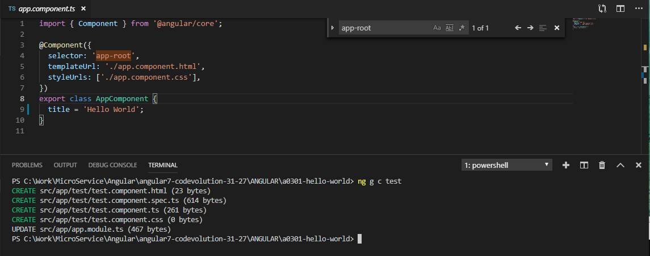
4 Component
https://www.youtube.com/watch?v=16rQyEQtpyQ&list=PLC3y8-rFHvwhBRAgFinJR8KHIrCdTkZcZ&index=4
To understand better in component, let us create a new component. Add it to your application and make some modification. To create a component, we will again use the Angular CLI. In the terminal below the project folder a0301_hello_world
> ng g c test
Command options:
g: generate, c: component, test: name of component

Slide 12
4 Component
https://www.youtube.com/watch?v=16rQyEQtpyQ&list=PLC3y8-rFHvwhBRAgFinJR8KHIrCdTkZcZ&index=4
Four new files are generated. One file is updated. There is an update to the app.module.
Let’s take a look and see what happens in the folder.

Slide 13
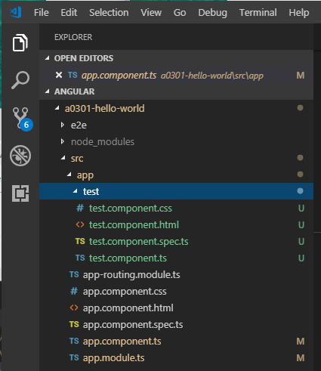
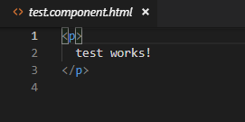
4 Component
https://www.youtube.com/watch?v=16rQyEQtpyQ&list=PLC3y8-rFHvwhBRAgFinJR8KHIrCdTkZcZ&index=4
In the app folder, the new test folder is created for this component.
The test folder contains the typescript, html, css, and a spec file for testing. We do not really need the spec file.
The component name is “test”

Slide 14
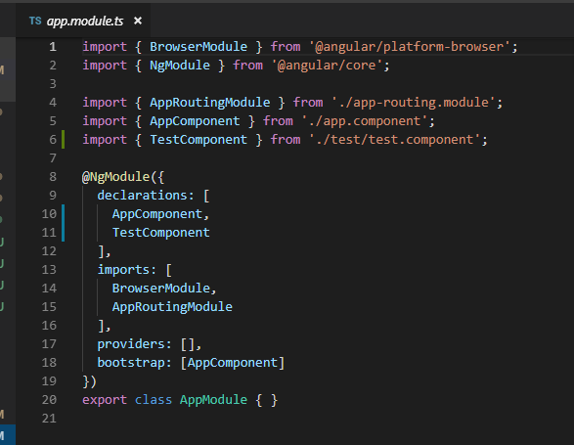
4 Component
https://www.youtube.com/watch?v=16rQyEQtpyQ&list=PLC3y8-rFHvwhBRAgFinJR8KHIrCdTkZcZ&index=4
In the app.module.ts, the TestComponent is added to our declaration array. The declaration array contains all the components used by the application.

Slide 15
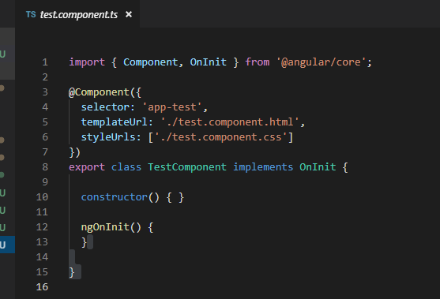
4 Component
https://www.youtube.com/watch?v=16rQyEQtpyQ&list=PLC3y8-rFHvwhBRAgFinJR8KHIrCdTkZcZ&index=4
To include the Test Component in our application. We use add a HTML tag that represent the selector.
Go back to test.component.ts, you can see the selector id is “app-test”. Where to put this “app-test”?
Note: “app-test” parent is app.component.html. “app-root” is put in index.html.
index.html
@Component ({
selector: ‘app-root‘
})
class TestComponent { … }
App.component.html
@Component ({
selector: ‘app-test‘
})
class TestComponent { … }

Slide 16
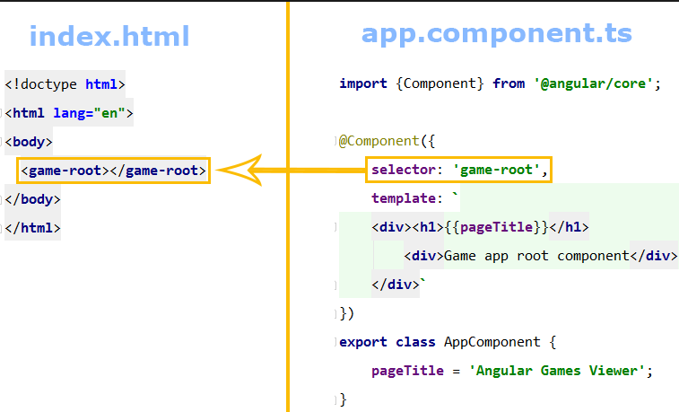
4 Component
https://www.youtube.com/watch?v=16rQyEQtpyQ&list=PLC3y8-rFHvwhBRAgFinJR8KHIrCdTkZcZ&index=4
Angular selector: Put component attached to their parent.
Each component has their parent component. Put the select in the parent.html.
For the root, the index.html is the parent.html.

Slide 17
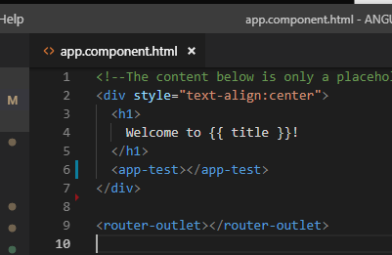
4 Component
https://www.youtube.com/watch?v=16rQyEQtpyQ&list=PLC3y8-rFHvwhBRAgFinJR8KHIrCdTkZcZ&index=4
Go back to the app.component.html which is the parent of the test.component.
Remember, our application has only one root component which is AppComponent.
All the other components are under the root component (AppComponent).
Open app.component.html.
Inside the app.component.html, put <app-test></app-test> below the Welcome to {{ title}}

Slide 18
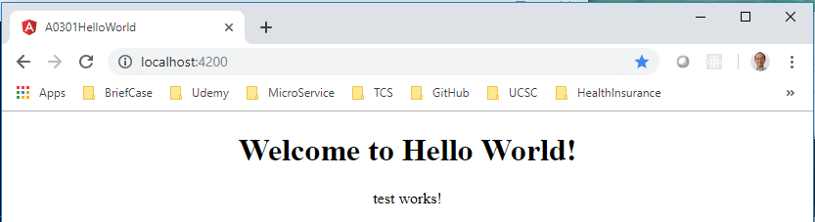
4 Component
https://www.youtube.com/watch?v=16rQyEQtpyQ&list=PLC3y8-rFHvwhBRAgFinJR8KHIrCdTkZcZ&index=4
> ng serve
Open chrome and enter “localhost:4200”

Slide 19
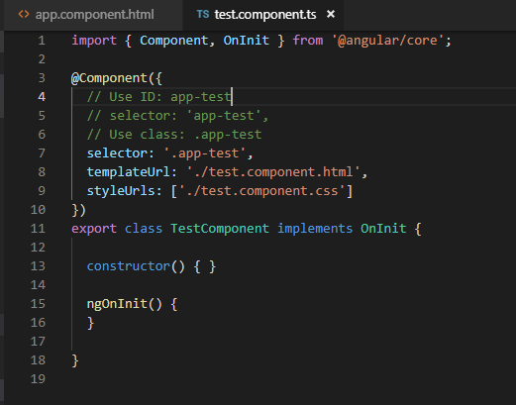
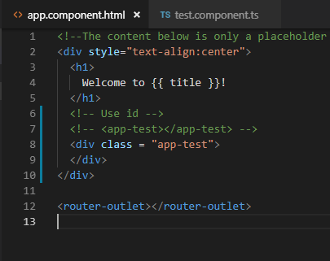
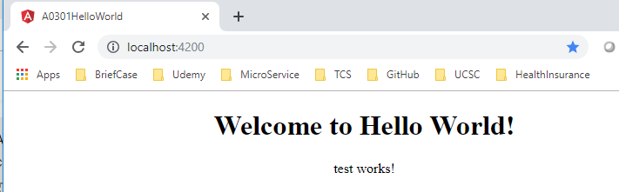
4 Component
https://www.youtube.com/watch?v=16rQyEQtpyQ&list=PLC3y8-rFHvwhBRAgFinJR8KHIrCdTkZcZ&index=4
Three ways to specify the components: using the selector. We already use the id way.
The second way, we can use the class name.
Change the selector to class ‘.app-test’
Change to <div class =“app-test”></div>

Slide 20
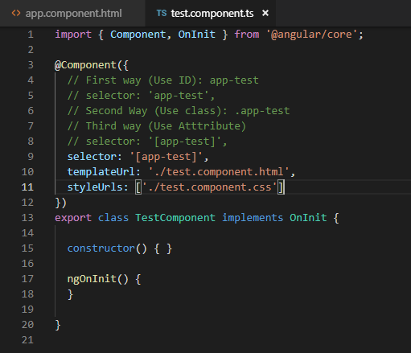
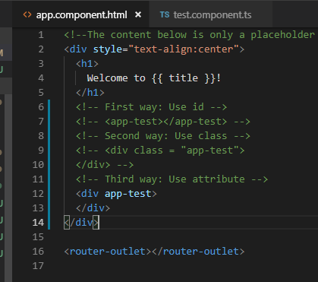
4 Component
https://www.youtube.com/watch?v=16rQyEQtpyQ&list=PLC3y8-rFHvwhBRAgFinJR8KHIrCdTkZcZ&index=4
The third way, we can use the attribute name.
Change the selector to attribute ‘[app-test]’
Change to <div app-test></div>

Slide 21
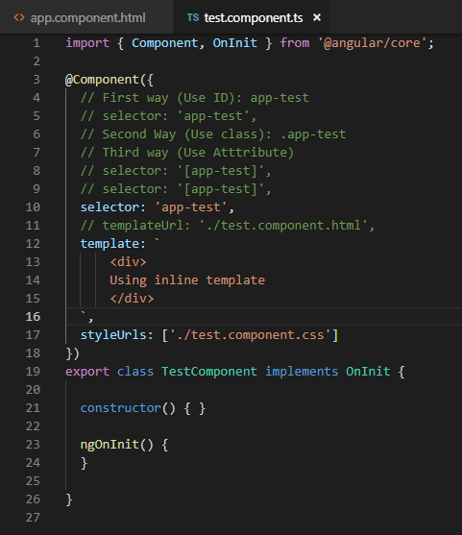
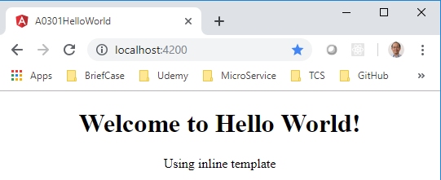
4 Component
https://www.youtube.com/watch?v=16rQyEQtpyQ&list=PLC3y8-rFHvwhBRAgFinJR8KHIrCdTkZcZ&index=4
You can change templateUrl into template
Use inline template.

Slide 22
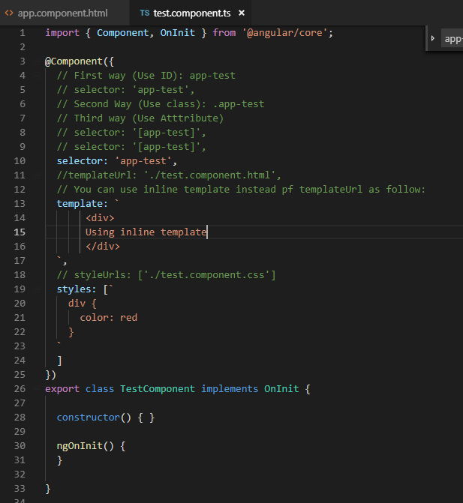
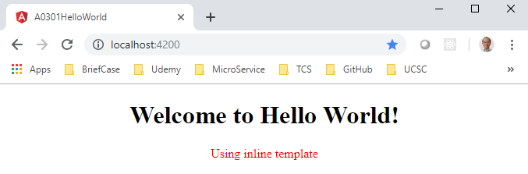
4 Component
https://www.youtube.com/watch?v=16rQyEQtpyQ&list=PLC3y8-rFHvwhBRAgFinJR8KHIrCdTkZcZ&index=4
You can change templateUrl into template
Use inline styles:

Slide 23
4 Component
https://www.youtube.com/watch?v=16rQyEQtpyQ&list=PLC3y8-rFHvwhBRAgFinJR8KHIrCdTkZcZ&index=4
Summary:
Components are building block of your application.
Component contains a class, a template, and a decorator.
Template represents the view.
Any new component has to be import and assed to the module in the declaration array.
You can then include the selector ID in your HTML either as a custom tag, as a class, or as an attribute.
The HTML and CSS can either be in a separate file or they can be inline in the TypeScript. You can use backtick to specify multiple lines of HTML and CSS. The component class contains data can be displayed in the view.
Finally, it is possible to nest components within other components also reuse them when required.

Slide 24
End of Chapter

