Slide 1

5 Interpolation
Peter H. Chen

Slide 2
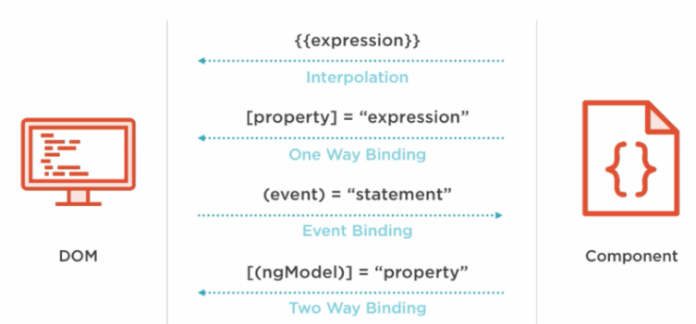
5 Interpolation
https://www.youtube.com/watch?v=0eWrpsCLMJQ&list=PLC3y8-rFHvwhBRAgFinJR8KHIrCdTkZcZ
Interpolation
Interpolation markup with embedded expressions used by Angular to provide data-binding to text nodes and attribute values.
An example of interpolation is shown below:
<a ng-href="img/{{username}}.jpg">Hello {{username}}!</a>

Slide 3
5 Interpolation
https://www.youtube.com/watch?v=0eWrpsCLMJQ&list=PLC3y8-rFHvwhBRAgFinJR8KHIrCdTkZcZ
We generate a test component and use test component to test interpolation/data binding by double curly bracket, {{ }}.
Generate a Test component
> ng g c test

Slide 4
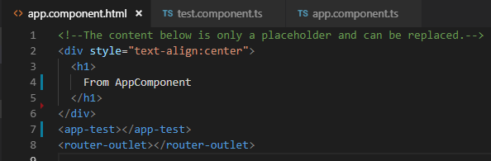
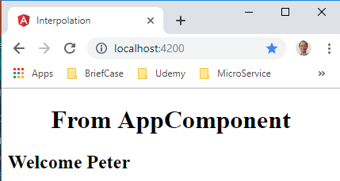
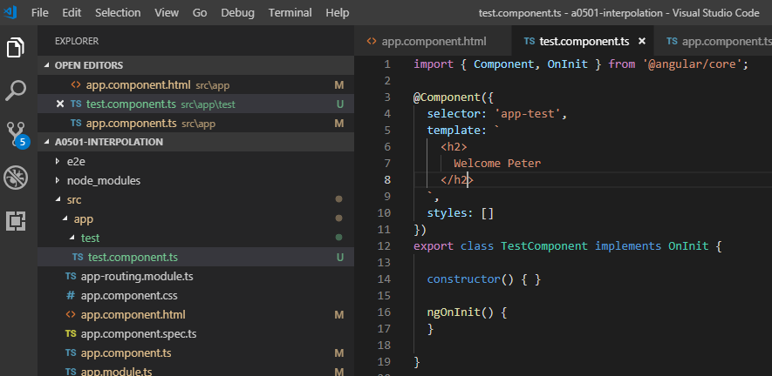
5 Interpolation
https://www.youtube.com/watch?v=0eWrpsCLMJQ&list=PLC3y8-rFHvwhBRAgFinJR8KHIrCdTkZcZ
How to display text to the browser in the test.component.ts? Use interpolation by template or tmeplateUrl.
template: `<h2> Welcome Peter </h2>`,
We wan to change the Text Dynamically

Slide 5
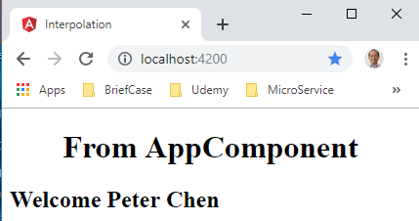
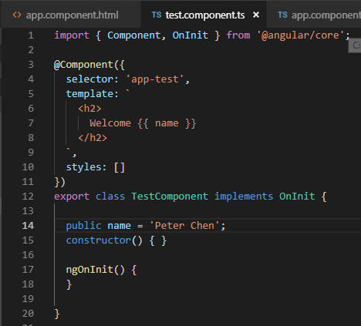
5 Interpolation
https://www.youtube.com/watch?v=0eWrpsCLMJQ&list=PLC3y8-rFHvwhBRAgFinJR8KHIrCdTkZcZ
Dynamic Data Biding with {{}}: If we have public name = ‘Peter Chen’, How to interpret the name in the template? The answer is to use {{}}.
template: `<h2> Welcome {{ name }} </h2>`.
{{ }} are the interpolation in Angular.
We are asking Angular to evaluate the content inside the curly braces and display the value when the component is rendered in the browser.

Slide 6
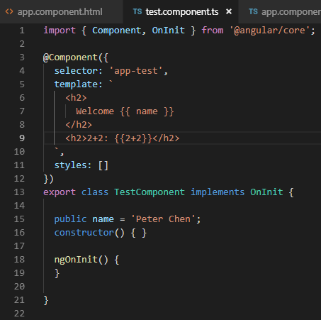
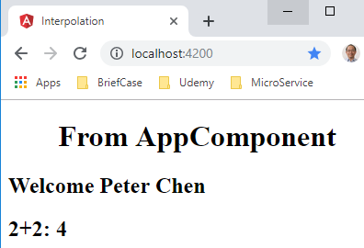
5 Interpolation
https://www.youtube.com/watch?v=0eWrpsCLMJQ&list=PLC3y8-rFHvwhBRAgFinJR8KHIrCdTkZcZ
How to evaluate the expression {{2 + 2}} in the interpolation and display the browser?
template: `<h2> Welcome {{ name }} </h2> 2+2: {{ 2 + 2 }}`.
Angular evaluate the expression and display the result.

Slide 7
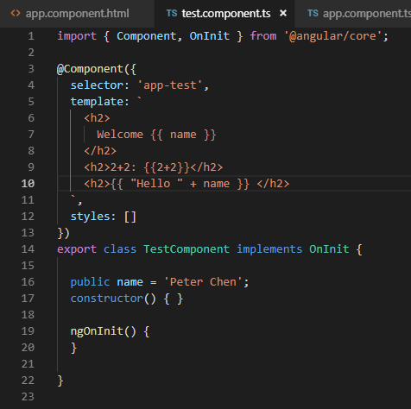
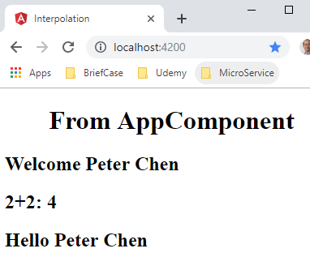
5 Interpolation
https://www.youtube.com/watch?v=0eWrpsCLMJQ&list=PLC3y8-rFHvwhBRAgFinJR8KHIrCdTkZcZ
This example shows the string concatenation. The string is concatenate and display to the browser as follow:
template: `<h2> {{ “Hello” + name }} </h2>`,
We concatenate “Hello” with name.

Slide 8
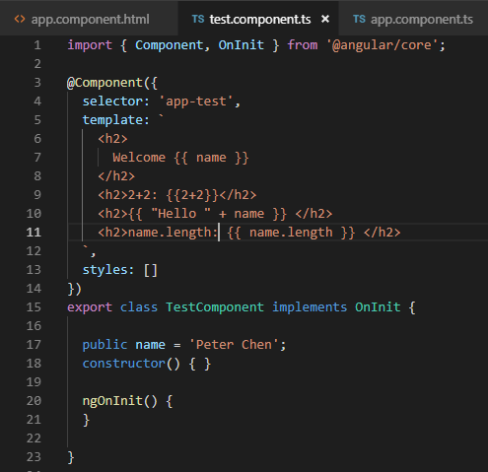
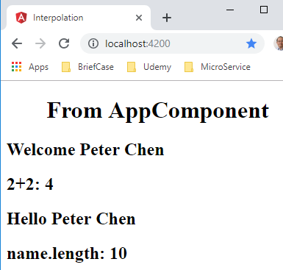
5 Interpolation
https://www.youtube.com/watch?v=0eWrpsCLMJQ&list=PLC3y8-rFHvwhBRAgFinJR8KHIrCdTkZcZ
This example shows the JavaScript interpolation as follow:
template: `<h2> name.length: {{ name.length }} </h2>`,
Evaluate the length of name.

Slide 9
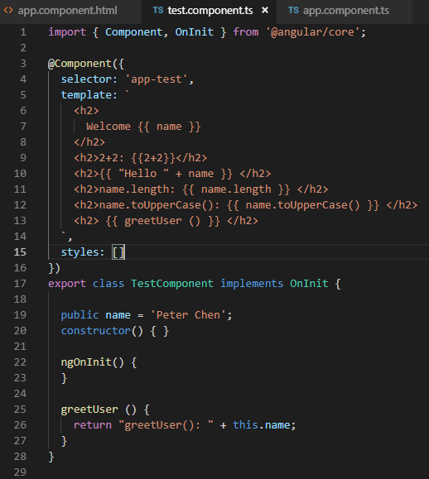
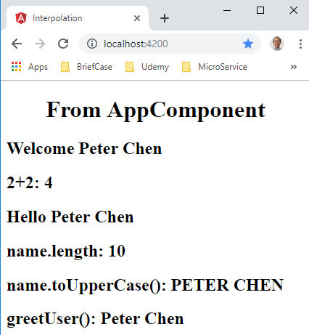
5 Interpolation
https://www.youtube.com/watch?v=0eWrpsCLMJQ&list=PLC3y8-rFHvwhBRAgFinJR8KHIrCdTkZcZ
How to use method() interpolation?
The template: `<h2> {{ greetUser()}} </h2>`,
Evaluate the method in class.

Slide 10
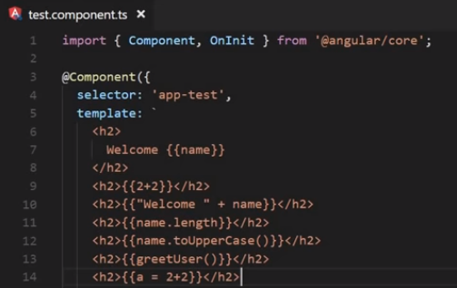
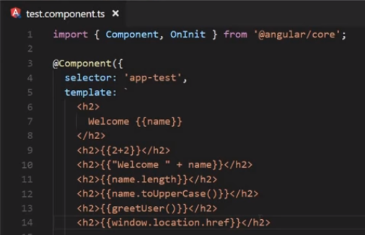
5 Interpolation
https://www.youtube.com/watch?v=0eWrpsCLMJQ&list=PLC3y8-rFHvwhBRAgFinJR8KHIrCdTkZcZ
We cannot user assignment in {{}}: will get an error.
We cannot access the global variables, such as, window screen and so on. For example, window.location.href will get an error.
Cannot use assignment in {{}}.
Cannot window.location.href in {{}}.

Slide 11
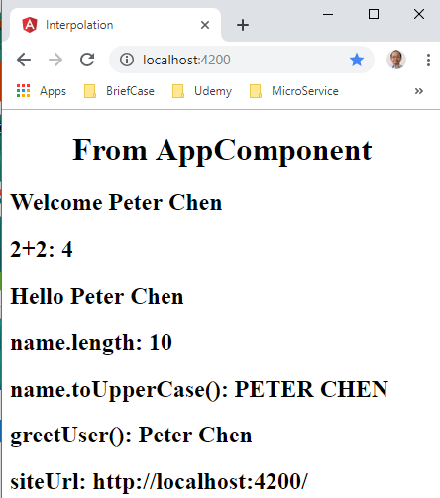
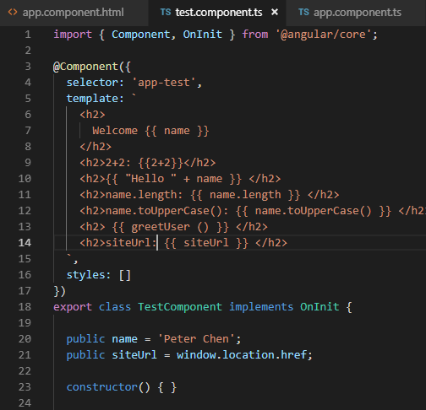
5 Interpolation
https://www.youtube.com/watch?v=0eWrpsCLMJQ&list=PLC3y8-rFHvwhBRAgFinJR8KHIrCdTkZcZ
Interpolation
If you want window.location.href, you can assign to the class JavaScript property and display it.
Assign to JavaScript property and display

Slide 12
End of Chapter

