Slide 1

11 Two-Way Binding
Peter H. Chen

Slide 2
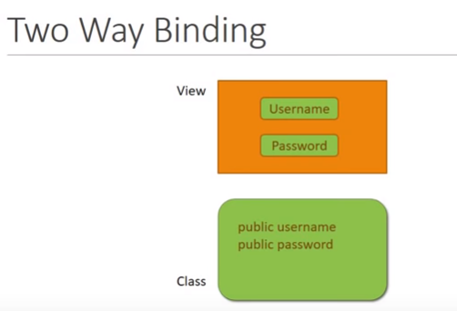
11 Two-Way Binding
https://www.youtube.com/watch?v=N8FBmB2jme8&index=6&list=PLC3y8-rFHvwhBRAgFinJR8KHIrCdTkZcZ
Two-Way Binding: Bind character-by –character immediately, i.e., When you type something character-by-character in the text box, you see the printed character-by-character on browser.
When you work with form inputs, it is essential that your model and view are always in sync; otherwise, the data might not be consistent, for example, consider the login form., this has a user name and password. The component class has the corresponding properties, the user name and password.

Slide 3
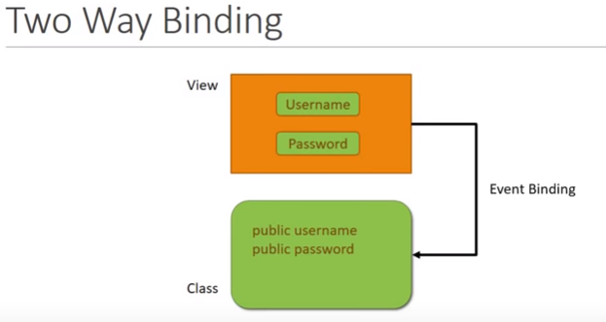
11 Two-Way Binding
https://www.youtube.com/watch?v=N8FBmB2jme8&index=6&list=PLC3y8-rFHvwhBRAgFinJR8KHIrCdTkZcZ
Two-Way Binding
Whenever the user updates these input controls, you model or properties should automatically receive.

Slide 4
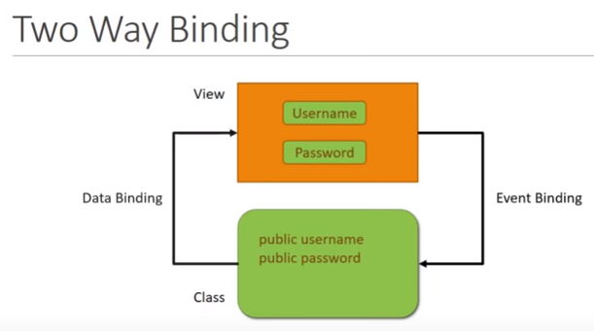
11 Two-Way Binding
https://www.youtube.com/watch?v=N8FBmB2jme8&index=6&list=PLC3y8-rFHvwhBRAgFinJR8KHIrCdTkZcZ
Two-Way Binding
When there is an update in the model or property value, your view should automatically reflect the updated values.

Slide 5
11 Two-Way Binding
https://www.youtube.com/watch?v=N8FBmB2jme8&index=6&list=PLC3y8-rFHvwhBRAgFinJR8KHIrCdTkZcZ
Two-Way Binding
We have learned about property binding and event binding.
We are in the position to write our own code for this. Angular help us out to provide us a cool feature which is tow way binding.
Two-Way Binding allow us to update a property and at the same time display the value of that property.
For Two-Way Binding, Angular provides another directive, namely, then ngModel directive.
Let’s see an example, so that things are more clear.

Slide 6
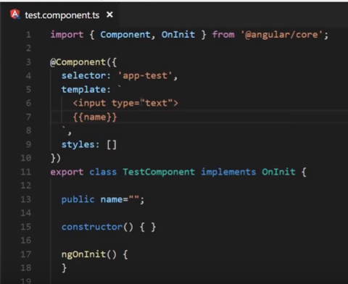
11 Two-Way Binding
https://www.youtube.com/watch?v=N8FBmB2jme8&index=6&list=PLC3y8-rFHvwhBRAgFinJR8KHIrCdTkZcZ
Two-Way Binding
Go back to the code. We add the property [public name = “”;]
We add the [template: `<input type=“text”> {{ name}}`]
When I type something in the box, we want the property update. We want to show in the interpolation.
The view and Model should be always in sync.

Slide 7
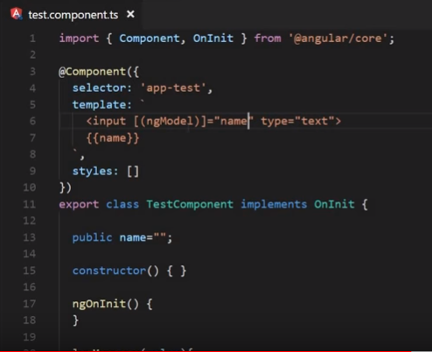
11 Two-Way Binding
https://www.youtube.com/watch?v=N8FBmB2jme8&index=6&list=PLC3y8-rFHvwhBRAgFinJR8KHIrCdTkZcZ
Two-Way Binding
To do that, we need ngModel directive. The [(ngModel)] = “name”
The [(ngModel)] is “banana in the box” as Angular team suggested.
The [] is for class property “name” to template.
The () is for event (ngModel) binding from the template to the class.

Slide 8
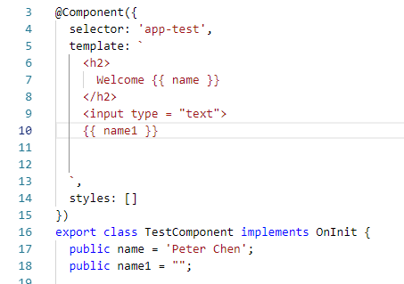
11 Two-Way Binding
https://www.youtube.com/watch?v=N8FBmB2jme8&index=6&list=PLC3y8-rFHvwhBRAgFinJR8KHIrCdTkZcZ
Two-Way Binding
We create a variable called name1 and put it in the {{ name1 }} by interpolation.
{{}} is used to bind the Model to HTML View. So the HTML will get updated.

Slide 9
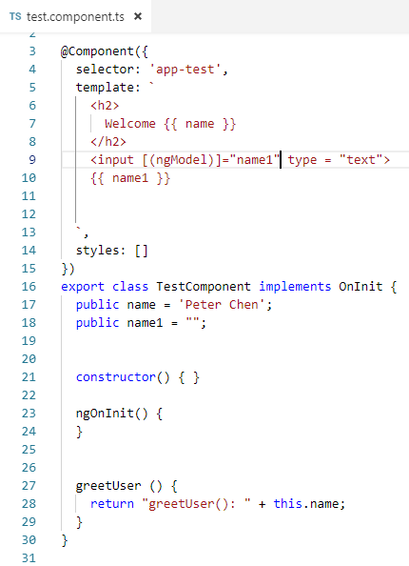
11 Two-Way Binding
https://www.youtube.com/watch?v=N8FBmB2jme8&index=6&list=PLC3y8-rFHvwhBRAgFinJR8KHIrCdTkZcZ
Two-Way Binding
So, we have two way data flow and hence called Two-Way Binding.

Slide 10
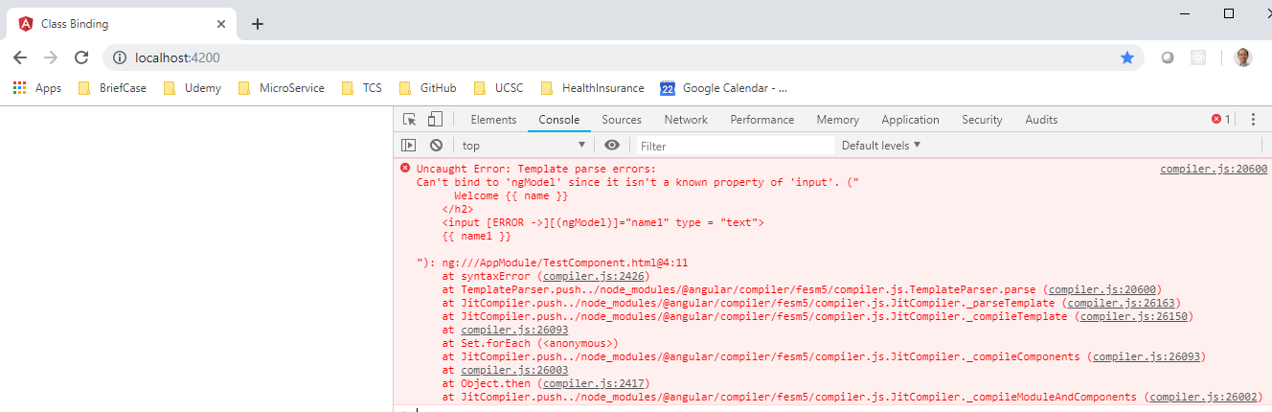
11 Two-Way Binding
https://www.youtube.com/watch?v=N8FBmB2jme8&index=6&list=PLC3y8-rFHvwhBRAgFinJR8KHIrCdTkZcZ
Two-Way Binding
We then have tow-way binding now. If we save this and head over to the browser.
There is a problem in the console. It does not know the property of the input.
Angular is not aware of ngModel directive because it is in separate module called the form module.

Slide 11
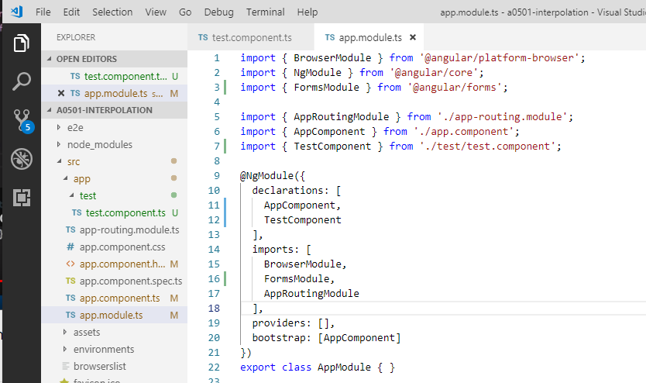
11 Two-Way Binding
https://www.youtube.com/watch?v=N8FBmB2jme8&index=6&list=PLC3y8-rFHvwhBRAgFinJR8KHIrCdTkZcZ
Two-Way Binding
So, let add the form module to our application.
Open app.modules.ts file and import the forms module.
Save app.modules.ts file.

Slide 12
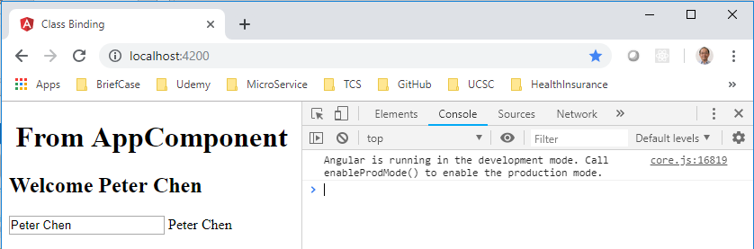
11 Two-Way Binding
https://www.youtube.com/watch?v=N8FBmB2jme8&index=6&list=PLC3y8-rFHvwhBRAgFinJR8KHIrCdTkZcZ
Two-Way Binding
Open browser and refresh it. Now, we do not have error message.
The input box which is empty. If I type in anything, you will see the HTML element is display on HTML right after you type in it.

Slide 13
11 Two-Way Binding
https://www.youtube.com/watch?v=N8FBmB2jme8&index=6&list=PLC3y8-rFHvwhBRAgFinJR8KHIrCdTkZcZ
Two-Way Binding
From the input, the data flows to the class property and from the class property, the value flows back to the template.
This will ensure our view and property values are always consistent.
Now, we will make use of Two-Way Binding when we learn about forms later on.

Slide 14
End of Chapter

