Slide 1

12 ngIf Directive
Peter H. Chen

Slide 2
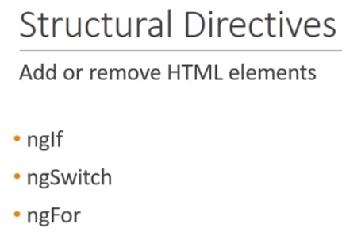
12 ngIf Directive
https://www.youtube.com/watch?v=N8FBmB2jme8&index=6&list=PLC3y8-rFHvwhBRAgFinJR8KHIrCdTkZcZ
ngIf Directive
Structure directive let you add or remove HTML elements from the DOM.
We will discuss three common built in structure directives, namely, ngIf, ngSwitch, and ngFor.
The first directives are ngIf and ngSwitch are used to conditionally render HTML elements whereas the ngFor is used to render a list of HTML elements.
Let us look at the ngIf directive in this section.

Slide 3
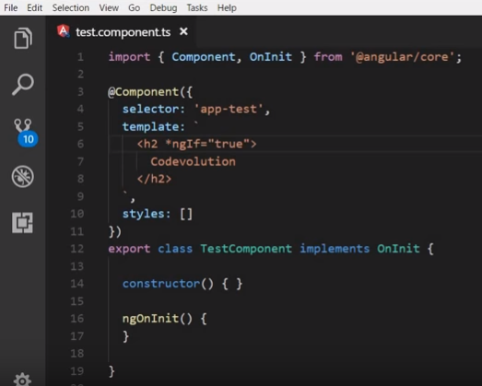
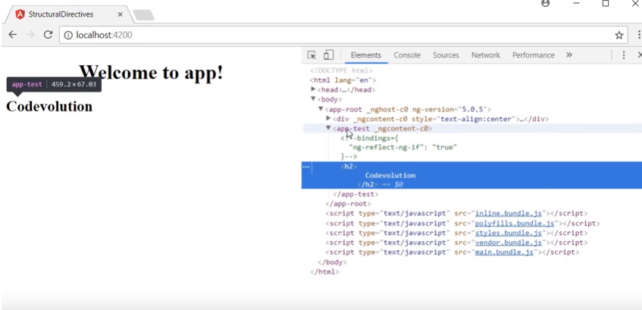
12 ngIf Directive
https://www.youtube.com/watch?v=N8FBmB2jme8&index=6&list=PLC3y8-rFHvwhBRAgFinJR8KHIrCdTkZcZ
ngIf Directive
*ngIf=“true” by default, *ngIf itself is set to “true”

Slide 4
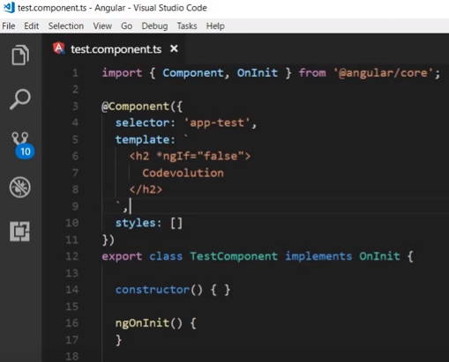
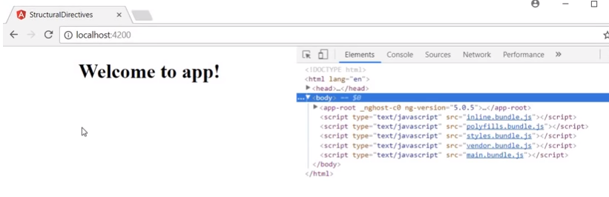
12 ngIf Directive
https://www.youtube.com/watch?v=N8FBmB2jme8&index=6&list=PLC3y8-rFHvwhBRAgFinJR8KHIrCdTkZcZ
ngIf Directive
*ngIf=“false”, the element is removed from the DOM.
*ngIf true or false has no much use. We need to use the property name to set true or false.

Slide 5
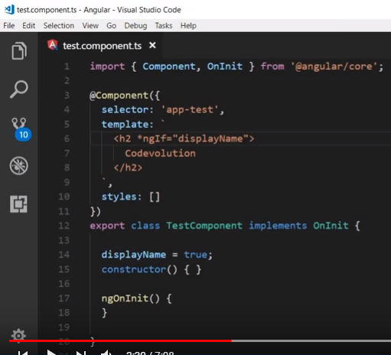
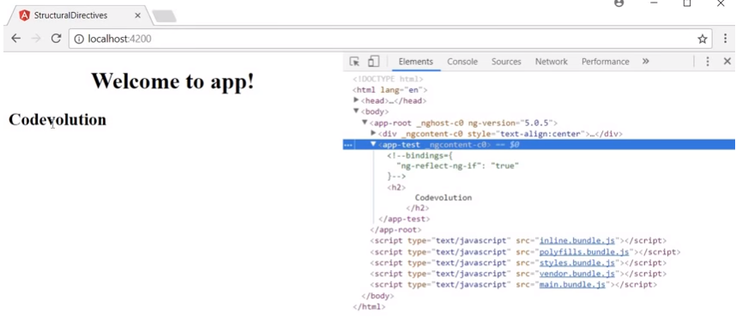
12 ngIf Directive
https://www.youtube.com/watch?v=N8FBmB2jme8&index=6&list=PLC3y8-rFHvwhBRAgFinJR8KHIrCdTkZcZ
ngIf Directive
Set property displayName = true.
*ngIf = “displayName” which is true = true. The element is in the DOM.

Slide 6
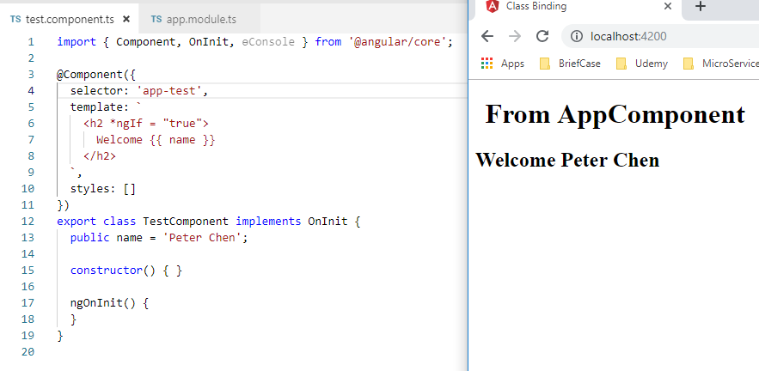
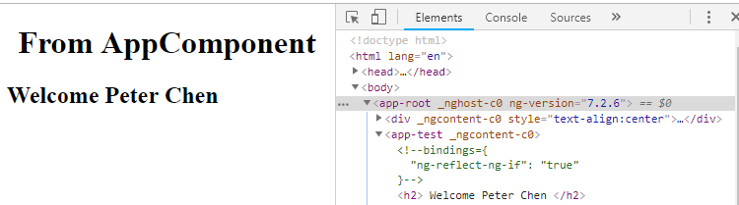
12 ngIf Directive
https://www.youtube.com/watch?v=N8FBmB2jme8&index=6&list=PLC3y8-rFHvwhBRAgFinJR8KHIrCdTkZcZ
ngIf Directive
Let use look at the code. If we want to have ngIf directive to true in the h2 tag, we can see the h2 element in the browser.

Slide 7
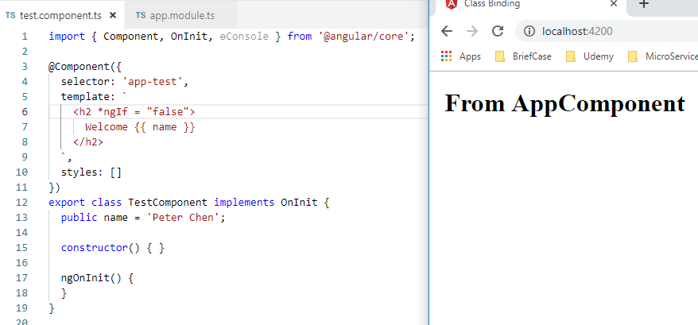
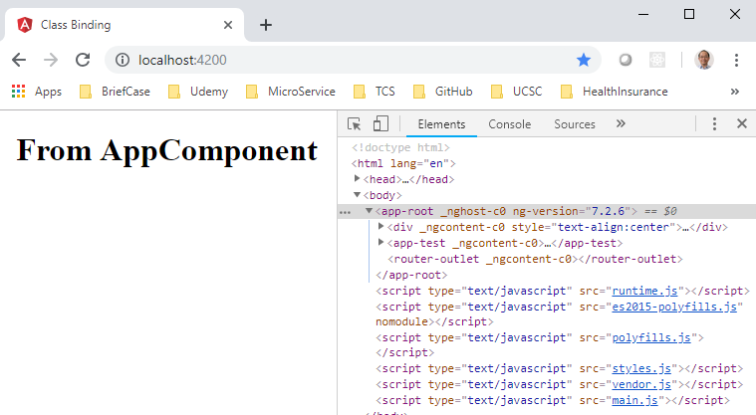
12 ngIf Directive
https://www.youtube.com/watch?v=N8FBmB2jme8&index=6&list=PLC3y8-rFHvwhBRAgFinJR8KHIrCdTkZcZ
ngIf Directive
If we want to have ngIf directive to false in the h2 tag, we cannot see the h2 element in the browser.

Slide 8
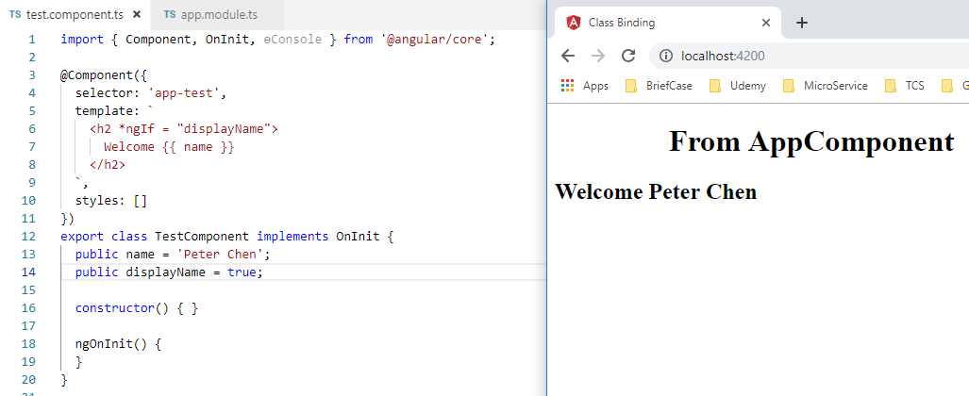
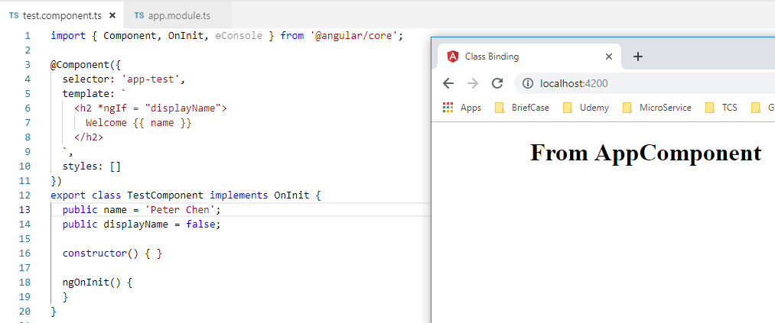
12 ngIf Directive
https://www.youtube.com/watch?v=N8FBmB2jme8&index=6&list=PLC3y8-rFHvwhBRAgFinJR8KHIrCdTkZcZ
ngIf Directive
Create a new property value “displayName” tand set to true to display the element.

Slide 9
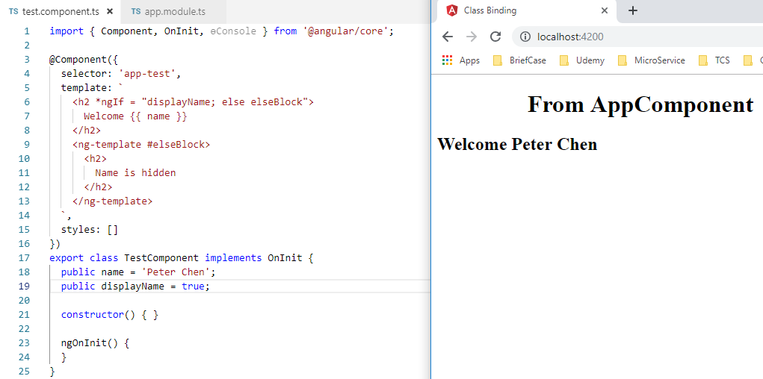
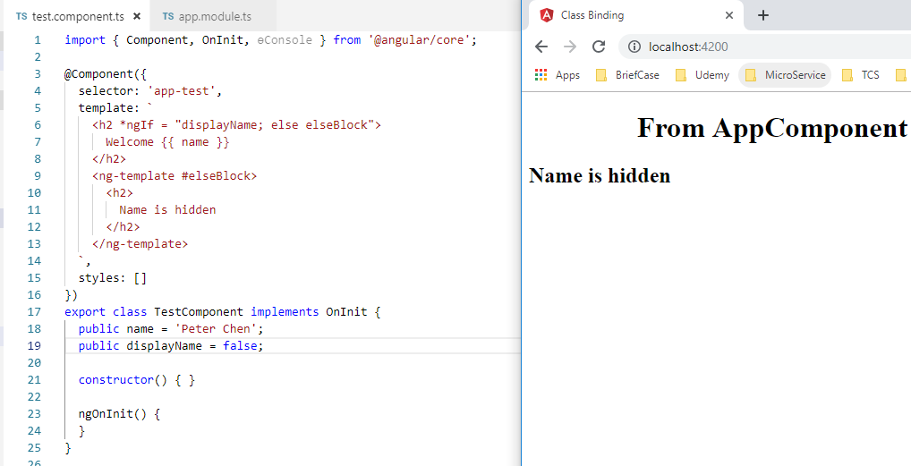
12 ngIf Directive
https://www.youtube.com/watch?v=N8FBmB2jme8&index=6&list=PLC3y8-rFHvwhBRAgFinJR8KHIrCdTkZcZ
ngIf Directive
We add the <ng-template #elseBlock> for *ngIf.
<ng-template> is a container which “*ngIf else” can use to properly add or remove from the DOM.

Slide 10
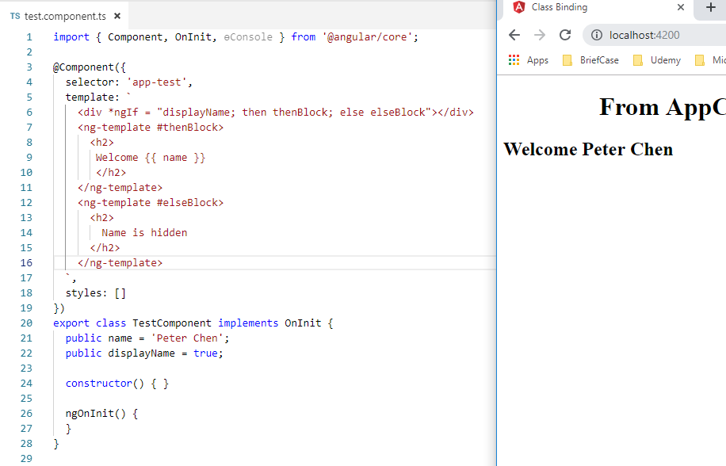
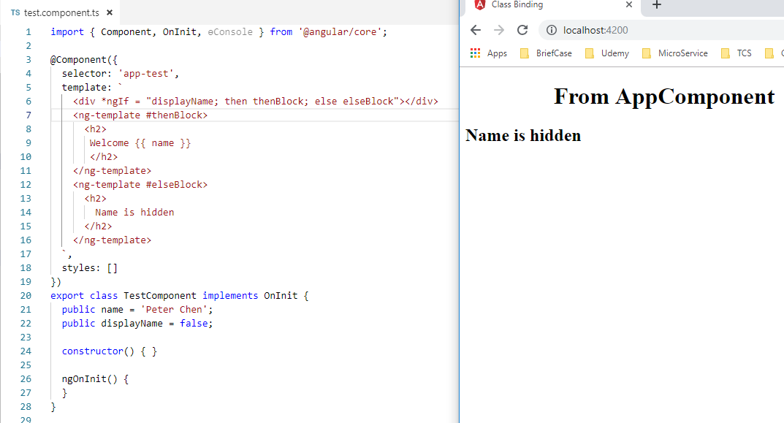
12 ngIf Directive
https://www.youtube.com/watch?v=N8FBmB2jme8&index=6&list=PLC3y8-rFHvwhBRAgFinJR8KHIrCdTkZcZ
ngIf Directive
Angular provide the alternative way for “*ngIf …; then thenBlcok; else elseBlock”

Slide 11
End of Chapter

