Slide 1

13 ngSwitch Directive
Peter H. Chen

Slide 2
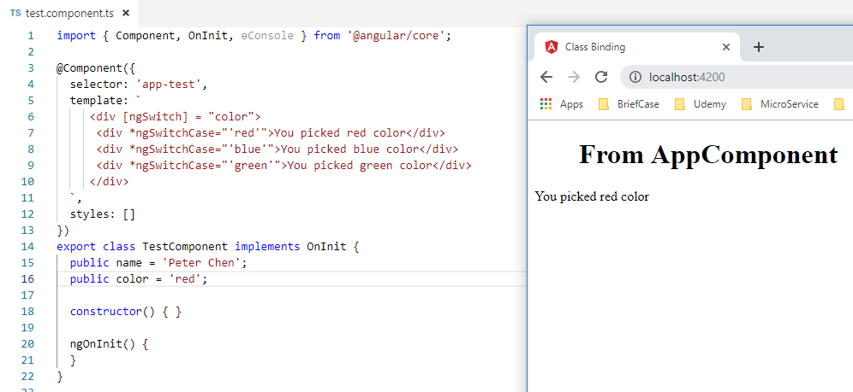
13 ngSwitch Directive
https://www.youtube.com/watch?v=N8FBmB2jme8&index=6&list=PLC3y8-rFHvwhBRAgFinJR8KHIrCdTkZcZ
ngSwitch Directive
The ngSwitch is pretty much like switch statement in any programming language.
The only difference here is that you render HTML instead of executing some logic.
You use ngSwitch to compare against multiple values.
The following example picks up color red, blue, or green.
Create color property and set it to “red” initially.
Then put the ngSwitch and *ngSwitchCase in the container <div></div>.

Slide 3
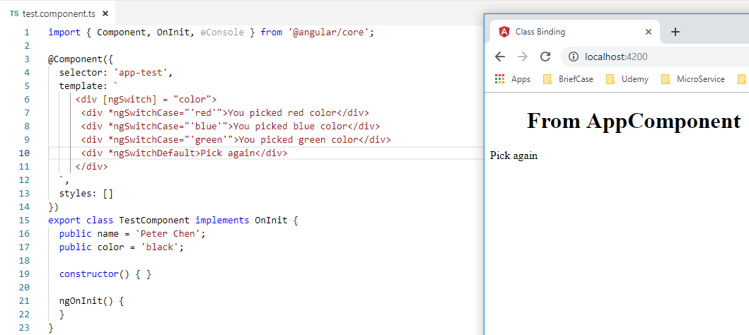
13 ngSwitch Directive
https://www.youtube.com/watch?v=N8FBmB2jme8&index=6&list=PLC3y8-rFHvwhBRAgFinJR8KHIrCdTkZcZ
ngSwitch Directive
Add *ngSwitchDefault to “Pick up again” if nothing match.

Slide 4
End of Chapter

