Slide 1

14 ngFor Directive
Peter H. Chen

Slide 2
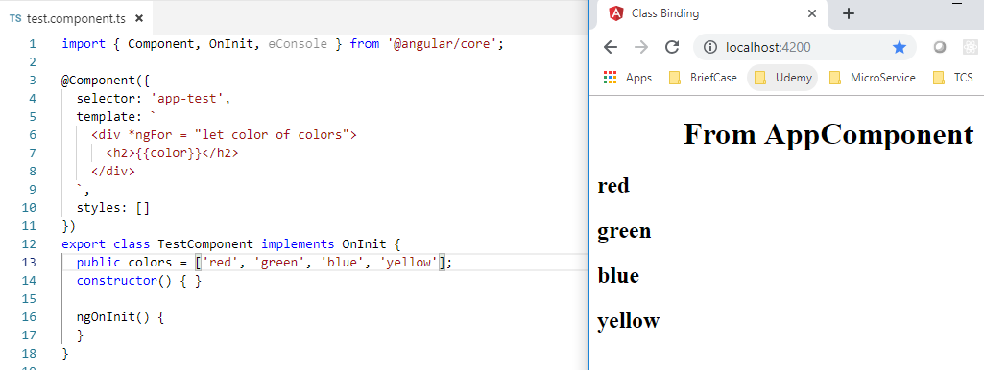
14 ngFor Directive
https://www.youtube.com/watch?v=N8FBmB2jme8&index=6&list=PLC3y8-rFHvwhBRAgFinJR8KHIrCdTkZcZ
ngFor Directive
The ngFor is similar to for loop in any programming language.
Create the property with array of colors.
Then use *ngFor = “let color of colors”
Then, we use interpolation <h2>{{ color }} </h2> to render on <h2> tag.

Slide 3
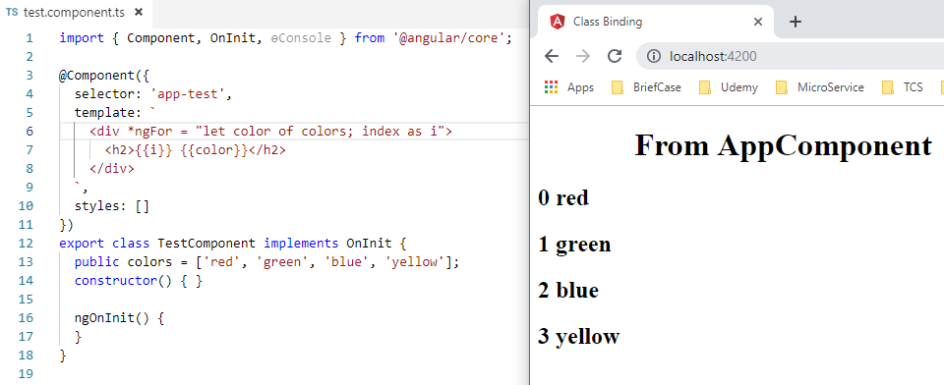
14 ngFor Directive
https://www.youtube.com/watch?v=N8FBmB2jme8&index=6&list=PLC3y8-rFHvwhBRAgFinJR8KHIrCdTkZcZ
ngFor Directive: index
We can add “*ngFor = let color of colors; index as i” and {{i}} {{ color }} in <h2> tag.

Slide 4
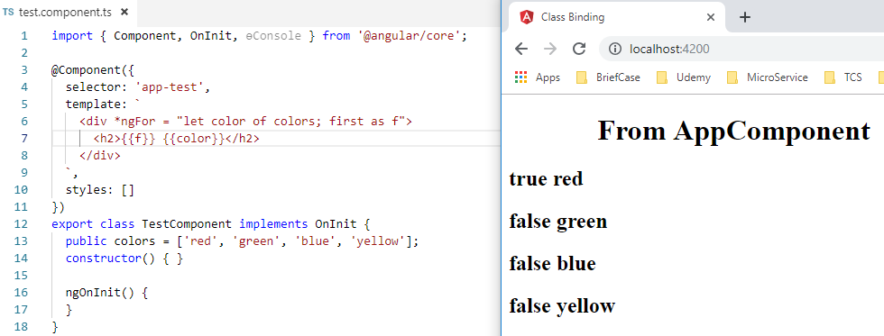
14 ngFor Directive
https://www.youtube.com/watch?v=N8FBmB2jme8&index=6&list=PLC3y8-rFHvwhBRAgFinJR8KHIrCdTkZcZ
ngFor Directive
Some ngFor options: first
We can add “*ngFor = let color of colors; first as f” and {{ f }} {{ color }} in <h2> tag.

Slide 5
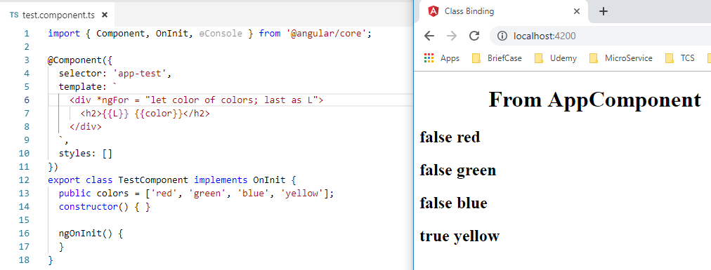
14 ngFor Directive
https://www.youtube.com/watch?v=N8FBmB2jme8&index=6&list=PLC3y8-rFHvwhBRAgFinJR8KHIrCdTkZcZ
ngFor Directive
Some ngFor options: last
We can add “*ngFor = let color of colors; last as L” and {{ L }} {{ color }} in <h2> tag.

Slide 6
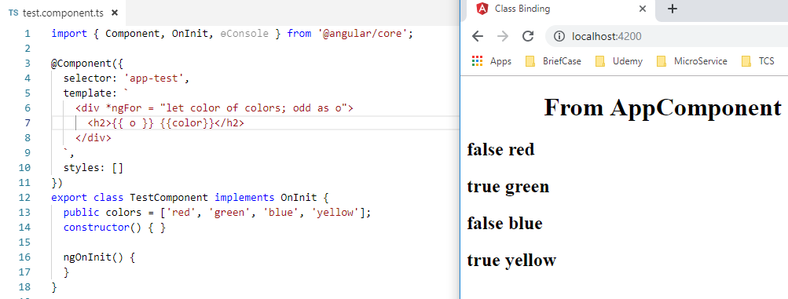
14 ngFor Directive
https://www.youtube.com/watch?v=N8FBmB2jme8&index=6&list=PLC3y8-rFHvwhBRAgFinJR8KHIrCdTkZcZ
ngFor Directive
Some ngFor options: odd
We can add “*ngFor = let color of colors; odd as o” and {{ o }} {{ color }} in <h2> tag.

Slide 7
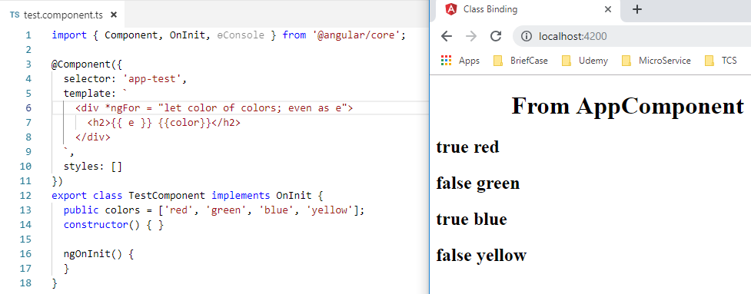
14 ngFor Directive
https://www.youtube.com/watch?v=N8FBmB2jme8&index=6&list=PLC3y8-rFHvwhBRAgFinJR8KHIrCdTkZcZ
ngFor Directive
Some ngFor options: even
We can add “*ngFor = let color of colors; even as e” and {{ e }} {{ color }} in <h2> tag.

Slide 8
End of Chapter

