Slide 1

15 Component Interaction
Peter H. Chen

Slide 2
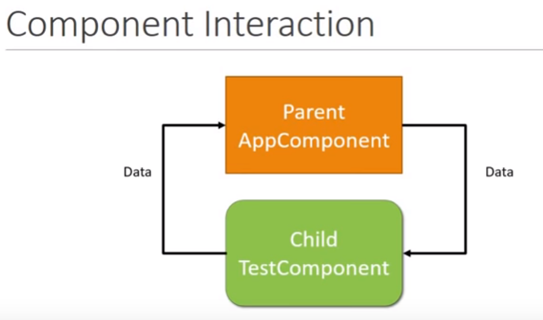
15 Component Interaction
https://www.youtube.com/watch?v=N8FBmB2jme8&index=6&list=PLC3y8-rFHvwhBRAgFinJR8KHIrCdTkZcZ
We discuss the component interaction in this section.
We worked on test.component.ts in the previous sections.
The test.component is nested inside the app component.
The app.component is the parent component and the test.component is the child component. So far, they worked independently.
In Angular, we need components to interact or communicate with each other.
The parent component might send data to the child component and the child component might send data to the parent component.

Slide 3
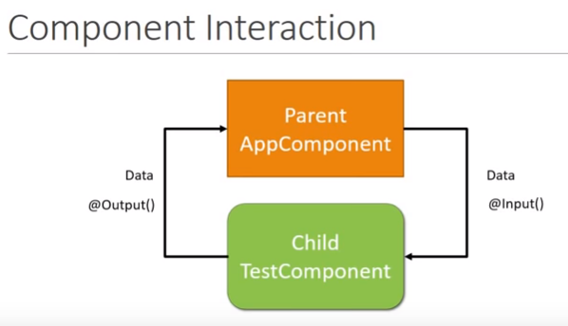
15 Component Interaction
https://www.youtube.com/watch?v=N8FBmB2jme8&index=6&list=PLC3y8-rFHvwhBRAgFinJR8KHIrCdTkZcZ
How to interact between the parent and child components? The answer is using input and output decorator.
Using the input decorator, the child can get the data from parent component.
Using the output decorator, the child will send out events the parent to indicate something.

Slide 4
15 Component Interaction
https://www.youtube.com/watch?v=N8FBmB2jme8&index=6&list=PLC3y8-rFHvwhBRAgFinJR8KHIrCdTkZcZ
How to interact between the parent and child components? The answer is using input and output decorator.
Using the input decorator, the child can get the data from parent component.
Using the output decorator, the child will send out events the parent to indicate something.
Hi Dad
AppComponent
Hi Dad
Hi Child
Hi Child
TestComponent

Slide 5
15 Component Interaction
https://www.youtube.com/watch?v=N8FBmB2jme8&index=6&list=PLC3y8-rFHvwhBRAgFinJR8KHIrCdTkZcZ
How to interact between the parent and child components? The answer is using input and output decorator.
Using the input decorator, the child can get the data from parent component.
Using the output decorator, the child will send out events the parent to indicate something.
Hi Dad
AppComponent
Hi Dad
Hi Child
Hi Child
TestComponent

Slide 6
15.1 Parent Send Data to Child
Peter H. Chen

Slide 7
15.1 Parent Send Data to Child
https://www.youtube.com/watch?v=N8FBmB2jme8&index=6&list=PLC3y8-rFHvwhBRAgFinJR8KHIrCdTkZcZ
First, we send data from parent to child, i.e., from AppComponent to the TestComponent.
In parent app.component, we declare public str = “Childs”
In HTML, we bind the property called [parentData] with the str property that we declared in the app.component parent class.
In HTML, we send the data to the test.component.
In the child test.compone, we @input() public parentData; the decorator @input tell the Angular Server, “Hey, this is not a normal property. This property is from parent”. You will receive the value from the parent.
In the template, we add the <h2> and interpolation {{ parentData }} to render the HTML element.

Slide 8
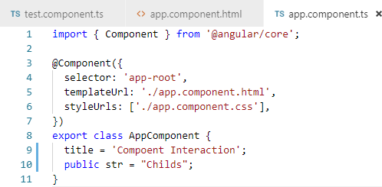
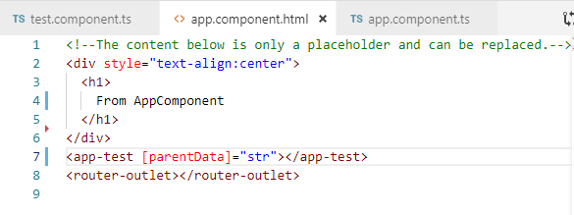
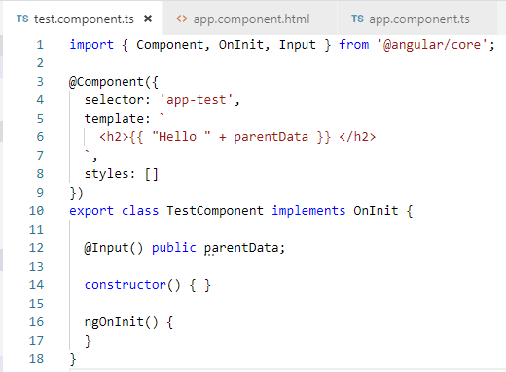
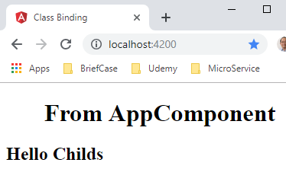
15.1 Parent Send Data to Child
https://www.youtube.com/watch?v=N8FBmB2jme8&index=6&list=PLC3y8-rFHvwhBRAgFinJR8KHIrCdTkZcZ
First, we send data from parent to child, i.e., from AppComponent to the TestComponent
AppComponent
Childs
Hello Childs
TestComponent

Slide 9
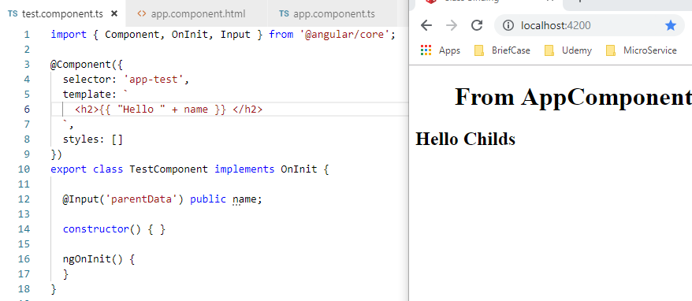
15.1 Parent Send Data to Child
https://www.youtube.com/watch?v=N8FBmB2jme8&index=6&list=PLC3y8-rFHvwhBRAgFinJR8KHIrCdTkZcZ
You can give the alias ‘name’ and put the alias into the interpolation {{ name }}

Slide 10
15.2 Child Send Data to Parent
Peter H. Chen

Slide 11
15.2 Child Send Data to Parent
https://www.youtube.com/watch?v=N8FBmB2jme8&index=6&list=PLC3y8-rFHvwhBRAgFinJR8KHIrCdTkZcZ
We have successfully send the data from parent component to the child component.
Now, we want to send the data from child component to the parent component.
Child component send to parent is quite different.
In app.component.html, we do not have child component selector <app-test>. We can have easy way to bind the data to the child.
In the child component, we do not have parent component selector. We cannot send the data the same way.
The way the child component send to parent component is using event. We will send “Hi Dad” from child component to the parent app component and display in the parent app component.
Hi Dad
AppComponent
Hi Dad
TestComponent

Slide 12
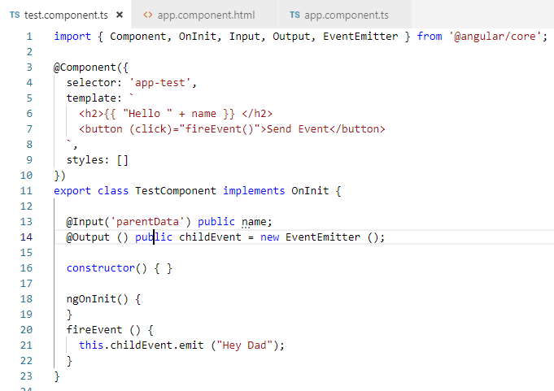
15.2 Child Send Data to Parent
https://www.youtube.com/watch?v=N8FBmB2jme8&index=6&list=PLC3y8-rFHvwhBRAgFinJR8KHIrCdTkZcZ
We need to create a new instance of the event emitter by declaring “public childEvent = new EventEMitter()”.
The childEvent will use the @output decorator to send to parent.
Create the button to trigger the event.
Hi Dad
AppComponent
Hi Dad
TestComponent

Slide 13
15.2 Child Send Data to Parent
https://www.youtube.com/watch?v=N8FBmB2jme8&index=6&list=PLC3y8-rFHvwhBRAgFinJR8KHIrCdTkZcZ
We need to create a new instance of the event emitter by declaring “public childEvent = new EventEMitter()”.
The childEvent will use the @output decorator to send to parent.
Create the button to trigger the event.
Use button to trigger a callback and emit a message.

Slide 14
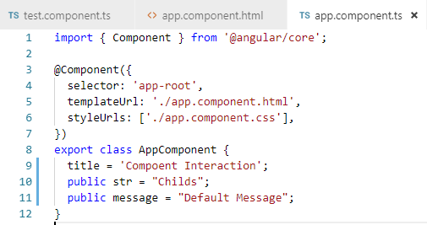
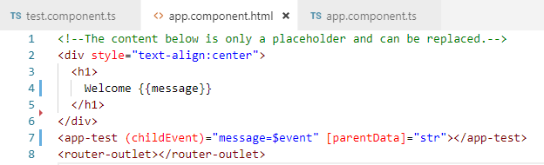
15.2 Child Send Data to Parent
https://www.youtube.com/watch?v=N8FBmB2jme8&index=6&list=PLC3y8-rFHvwhBRAgFinJR8KHIrCdTkZcZ
In the HTML, we capture the childEvent. Once the event is captured, we can assign the $event variable to a property called message “(childEvent) =“message=$event”).
The $event variable corresponds to string in the emit (“Hey Dad”) which we want to send the parent.
In the app.component, we declare the public message property.
Use interpolation {{ message }} display the property to HTML.
Default display
1. The childEvent property passed from child to parent compoent
2. The child $event and assign message.
3. Use interpolation {{message}} to display the property.

Slide 15
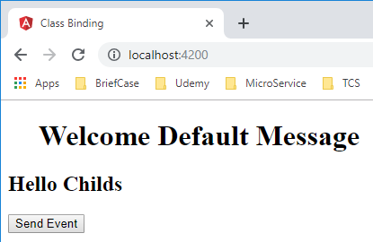
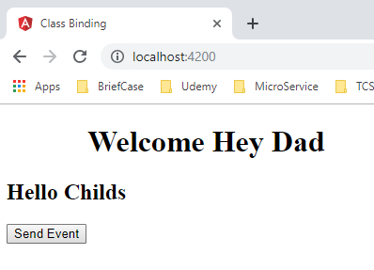
15.2 Child Send Data to Parent
https://www.youtube.com/watch?v=N8FBmB2jme8&index=6&list=PLC3y8-rFHvwhBRAgFinJR8KHIrCdTkZcZ
Open browser and click the button “Send Event”.
Default display
Trigger to display child to parent message

Slide 16
15.3 Summary
Peter H. Chen

Slide 17
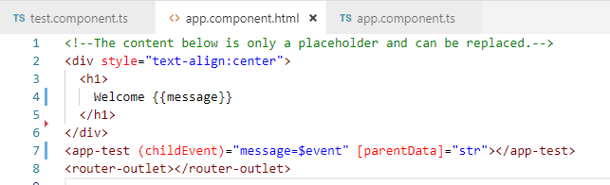
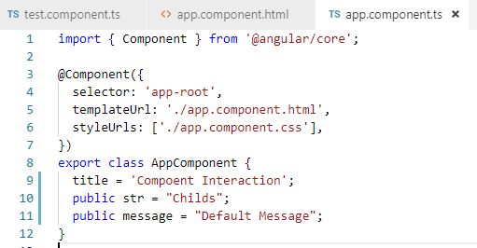
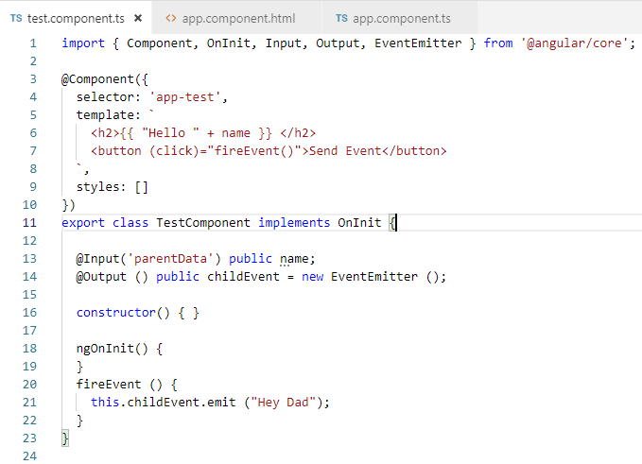
15.3 Summary
https://www.youtube.com/watch?v=N8FBmB2jme8&index=6&list=PLC3y8-rFHvwhBRAgFinJR8KHIrCdTkZcZ
Summary: Send the data from parent to the child,
In the parent component, we have to declare a property
Bind it to the child selector. [parentData] = “str”
Use @input decorator, you can use the same name or alias to render the HTML

Slide 18
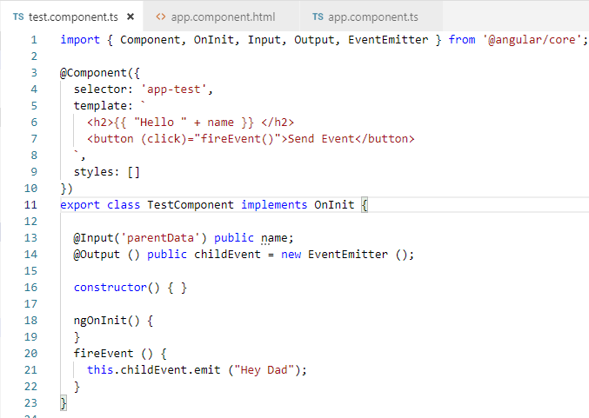
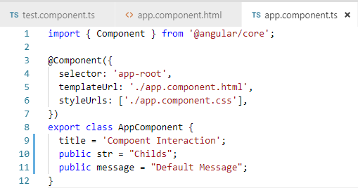
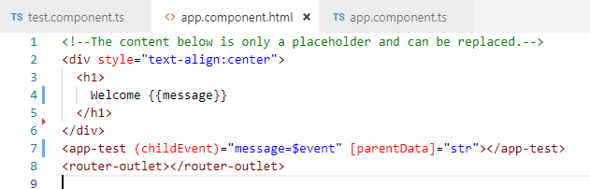
15.3 Summary
https://www.youtube.com/watch?v=N8FBmB2jme8&index=6&list=PLC3y8-rFHvwhBRAgFinJR8KHIrCdTkZcZ
Summary: To send the data from child to parent,,
We create an instance of the event emitter class
Emit it from the child component. We do that by @output decorator.
The parent component get $event variable and assign to property message.

Slide 19
End of Chapter

