Slide 1

16 Pipe
Peter H. Chen

Slide 2
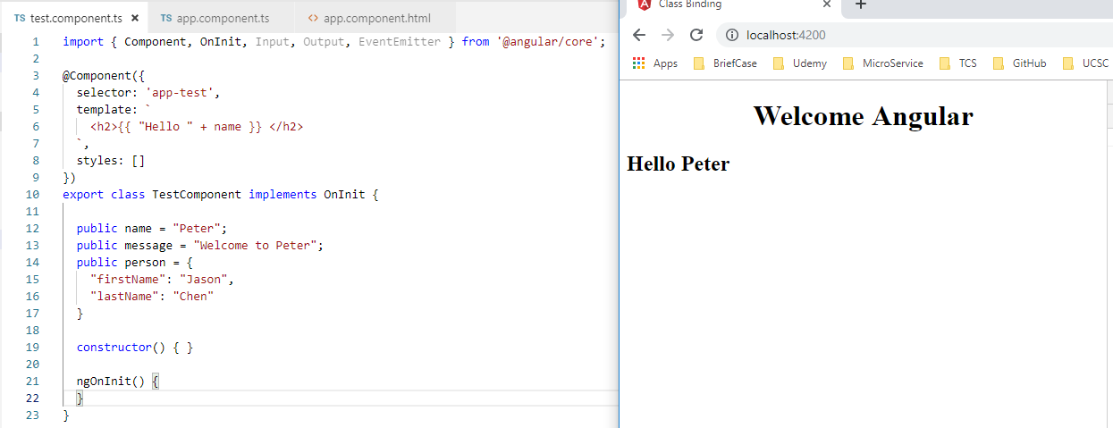
16 Pipe
https://www.youtube.com/watch?v=N8FBmB2jme8&index=6&list=PLC3y8-rFHvwhBRAgFinJR8KHIrCdTkZcZ
We discuss the pipe in this section.
Pipe allow us the transform the data before display in the view.
Right now, we just display simple “name” property.

Slide 3
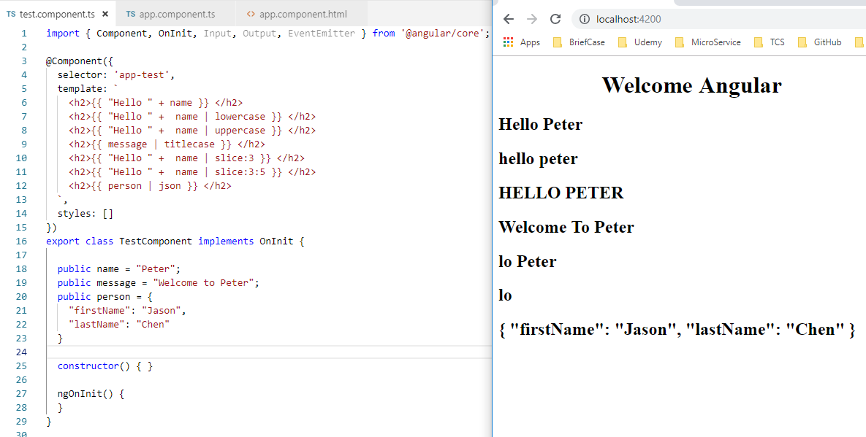
16 Pipe
https://www.youtube.com/watch?v=N8FBmB2jme8&index=6&list=PLC3y8-rFHvwhBRAgFinJR8KHIrCdTkZcZ
The following examples show the string pipe.

Slide 4
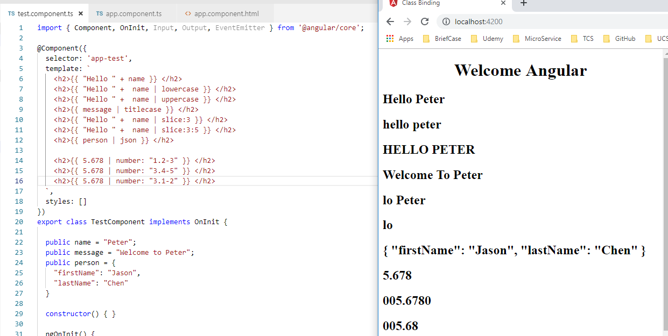
16 Pipe
https://www.youtube.com/watch?v=N8FBmB2jme8&index=6&list=PLC3y8-rFHvwhBRAgFinJR8KHIrCdTkZcZ
The following shows the number pipe.
1.2-3: one digit before decimal point, min digit is 2 and max digit is 3 => 5.678
3.4-5: 3 digits before decimal point, min digit is 4, max digit is 5 => 005.6780
3.1-2: 3 digits before decimal point, min digit is 1, max digit is 2 => 005.68

Slide 5
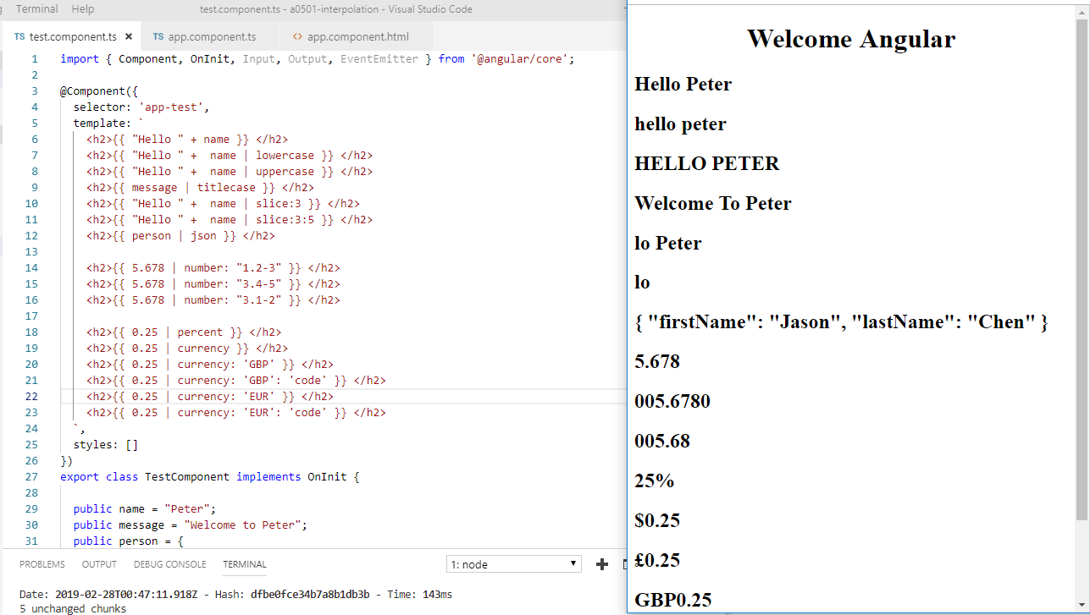
16 Pipe
https://www.youtube.com/watch?v=N8FBmB2jme8&index=6&list=PLC3y8-rFHvwhBRAgFinJR8KHIrCdTkZcZ
The following shows the percent and currency pipe.

Slide 6
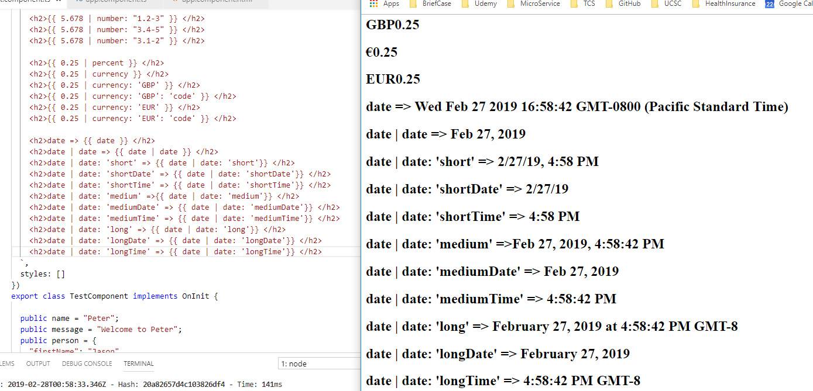
16 Pipe
https://www.youtube.com/watch?v=N8FBmB2jme8&index=6&list=PLC3y8-rFHvwhBRAgFinJR8KHIrCdTkZcZ
The following shows the date and time format.

Slide 7
16 Pipe
https://www.youtube.com/watch?v=N8FBmB2jme8&index=6&list=PLC3y8-rFHvwhBRAgFinJR8KHIrCdTkZcZ
Summary:
The pipe only transform data format in the view. It does not transform data in the property.

Slide 8
End of Chapter

