Slide 1

17 Service
Peter H. Chen

Slide 2
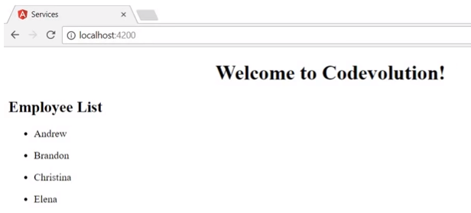
17 Service
https://www.youtube.com/watch?v=N8FBmB2jme8&index=6&list=PLC3y8-rFHvwhBRAgFinJR8KHIrCdTkZcZ
We discuss services in angular in this section.
Why do we need the service?
The following application display a list of employee:

Slide 3
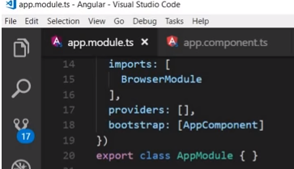
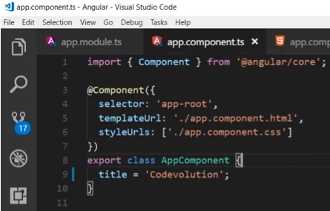
17 Service
https://www.youtube.com/watch?v=N8FBmB2jme8&index=6&list=PLC3y8-rFHvwhBRAgFinJR8KHIrCdTkZcZ
Why service will be required in applicaiotn?
Review code first.
AppModule bootstraps the AppComponent.
In the AppComponent, we have tmnplateUrl which point to app.component.html.

Slide 4
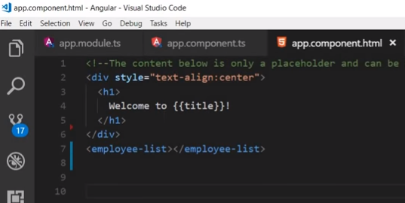
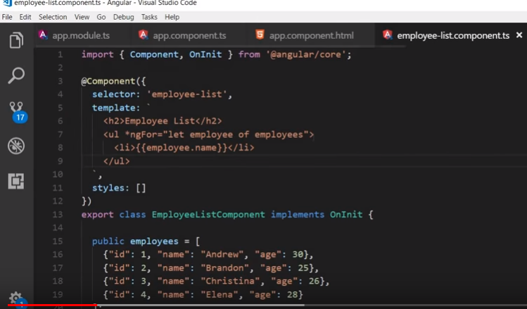
17 Service
https://www.youtube.com/watch?v=N8FBmB2jme8&index=6&list=PLC3y8-rFHvwhBRAgFinJR8KHIrCdTkZcZ
In the app.component.html, we have Welcome to {{title}}.
Under the title, we have <employee-list> component.
In the employ-list component, we have hard-coded employees list.

Slide 5
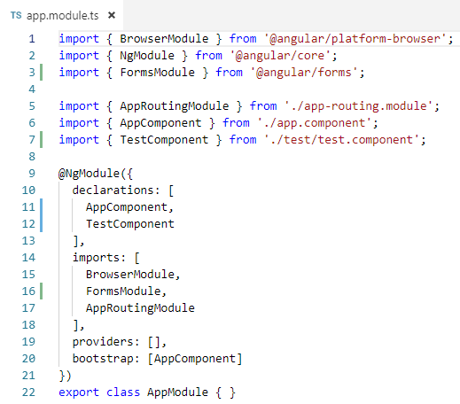
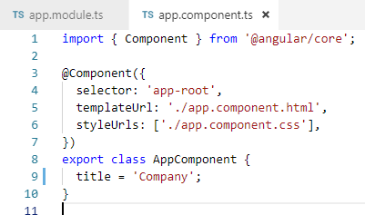
17 Service
https://www.youtube.com/watch?v=N8FBmB2jme8&index=6&list=PLC3y8-rFHvwhBRAgFinJR8KHIrCdTkZcZ
In the App.modules.ts, we bootstrap the AppComponent.

Slide 6
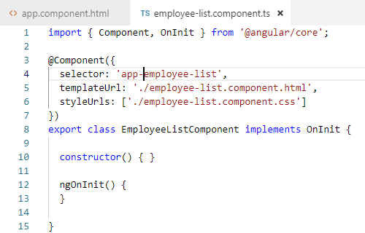
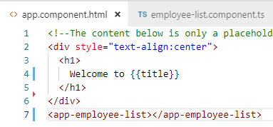
17 Service
https://www.youtube.com/watch?v=N8FBmB2jme8&index=6&list=PLC3y8-rFHvwhBRAgFinJR8KHIrCdTkZcZ
In the App.Component.ts, we have templateUrl point to app.component.html.
In the app.component.html, we have {{ title }} and <cmployee-list> component.

Slide 7
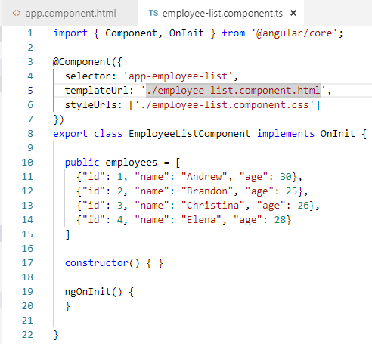
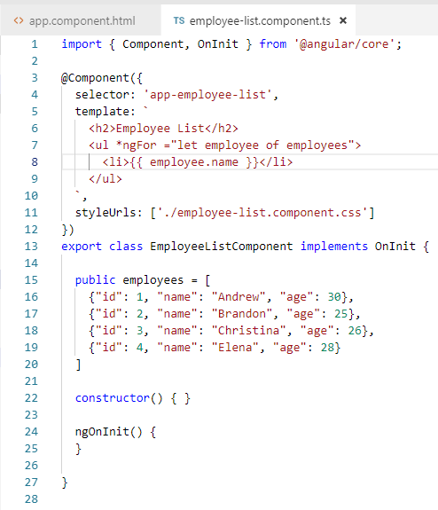
17 Service
https://www.youtube.com/watch?v=N8FBmB2jme8&index=6&list=PLC3y8-rFHvwhBRAgFinJR8KHIrCdTkZcZ
We add the hard code array employees.
Use *ngFor to loop through all the array element.

Slide 8
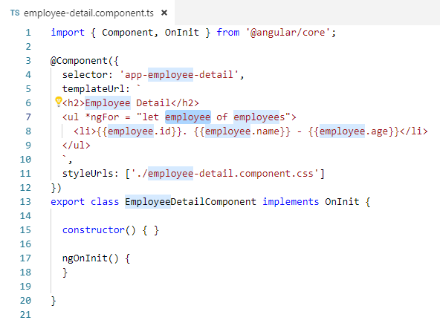
17 Service
https://www.youtube.com/watch?v=N8FBmB2jme8&index=6&list=PLC3y8-rFHvwhBRAgFinJR8KHIrCdTkZcZ
We have new requirement to display the employee-detail.
We have problem to get the employee array because the employees array is localized to employ-list.ts. The employee-detail has no data to bind to the view.
What would be the solution here?

Slide 9
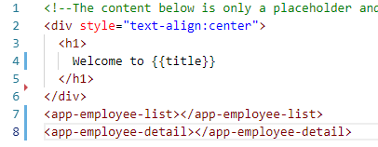
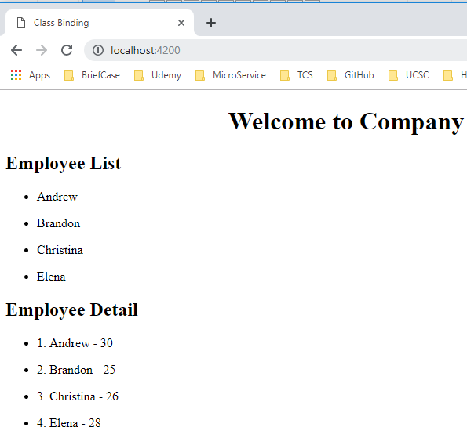
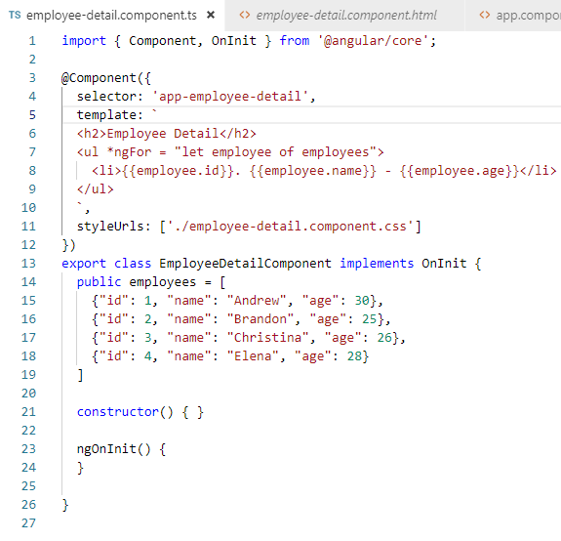
17 Service
https://www.youtube.com/watch?v=N8FBmB2jme8&index=6&list=PLC3y8-rFHvwhBRAgFinJR8KHIrCdTkZcZ
If I paste the employees array and add <app-employee-list>.
We will get the display as below.

Slide 10
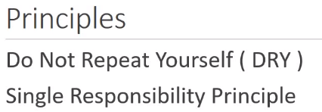
17 Service
https://www.youtube.com/watch?v=N8FBmB2jme8&index=6&list=PLC3y8-rFHvwhBRAgFinJR8KHIrCdTkZcZ
The solution worked but it is not the right solution.
It violates the following:

Slide 11
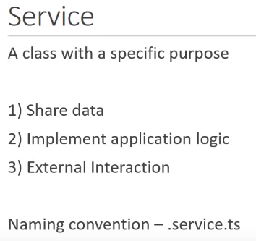
17 Service
https://www.youtube.com/watch?v=N8FBmB2jme8&index=6&list=PLC3y8-rFHvwhBRAgFinJR8KHIrCdTkZcZ
We need the service to solve this.
What is exactly the service? A service is a class with a specific service.
Why we need a service?
The first reason is we need to share data across several components. The service is providing the data for the component asked for it.
The second reason is to implement the application logic. Let say the employee enter their date of birth but we need to calculate their age. We can write the logic to do that. This does not need a view and the logic is reusable code which should be impendent of any individual component. In this scenario, we create a service.
Finally, we can also use services for external interactions, such as, connecting to the database.

Slide 12
17 Service
https://www.youtube.com/watch?v=N8FBmB2jme8&index=6&list=PLC3y8-rFHvwhBRAgFinJR8KHIrCdTkZcZ
In Angular, the convention for file name is .service.ts
For example, the employee service would be employee.service.ts and the class name is EmployeeService.
Now, we know what is service is and why we want to use a service.
Next question is how do we do the service in Angular?
The answer is Dependency Injection.

Slide 13
End of Chapter

