Slide 1

18 Dependency Injection
Peter H. Chen

Slide 2
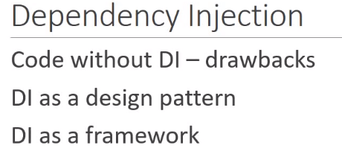
18 Dependency Injection
https://www.youtube.com/watch?v=OFPIGlxunL0&list=PLC3y8-rFHvwhBRAgFinJR8KHIrCdTkZcZ&index=18
We discuss Dependency Injection in this section.
We can write angular services without dive deep into the dependency injection.
But for better understanding the code we write and maintain.
We are going to know DI (Dependency Injection) in three parts:
First, we take a look at the code without using DI and also take a look of the drawback.
Second, we explain the DI as a design pattern and how to overcome the drawback.
Finally, we will discuss about the DI as a framework as Angular provides.

Slide 3
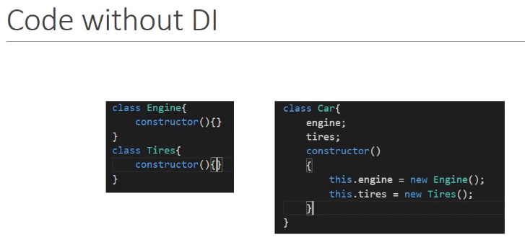
18 Dependency Injection
https://www.youtube.com/watch?v=OFPIGlxunL0&list=PLC3y8-rFHvwhBRAgFinJR8KHIrCdTkZcZ&index=18
Let’s begin with some code does use DI.
Consider three classes, one for the car, one for the engine, and one for the tires.
For simplicity, we only need an engine and few tires to build up a car.
So a car has two dependencies, engine and tires. In the car class, the constructor itself creates copies of engine and tires.
So when we instantiate a new car, the constructor instantiates the new engine and new tires.

Slide 4
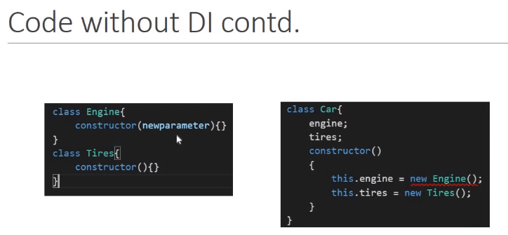
18 Dependency Injection
https://www.youtube.com/watch?v=OFPIGlxunL0&list=PLC3y8-rFHvwhBRAgFinJR8KHIrCdTkZcZ&index=18
There is a problem with this code.
Let’s assume the engine evolves and its constructor can now accept the parameters.
May be the engine type like petrol or diesel. But when we change the engine, our car is broken to repair our car class, we need to pass in the parameter to the engine constructor.
Similarly, if the tires accepts a new parameter, the car class needs to be fixed again.

Slide 5
18 Dependency Injection
https://www.youtube.com/watch?v=OFPIGlxunL0&list=PLC3y8-rFHvwhBRAgFinJR8KHIrCdTkZcZ&index=18
The first drawback is out code is not flexible.
Anytime, the dependencies change, the car class needs to be changed as well.
The second drawback is this code is not suitable for testing.
Anytime, you instantiate the car, you get the same engine and same sets of tires.
What is we want to test our code maybe with a petrol engine, a diesel engine, a new tries, old tires, and so on. It is not possible.
Even we want to change the code, what do we do if the engine and tires in turn have some dependencies. How do we keep track and create those dependencies.

Slide 6
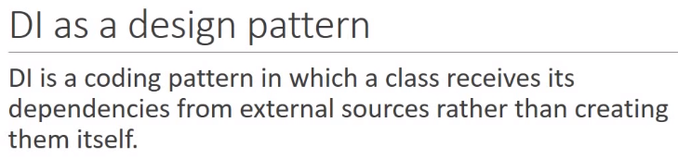
18 Dependency Injection
https://www.youtube.com/watch?v=OFPIGlxunL0&list=PLC3y8-rFHvwhBRAgFinJR8KHIrCdTkZcZ&index=18
Basically, we are not in control of our code.
The second part of this section is dependency injection as a design pattern is going to help us.
Let’s take a look at that.
Basically, the dependency injection is a coding pattern in which a class receives its dependencies from external sources rather than creating them itself.

Slide 7
18.1 W/O DI and With DI
Peter H. Chen

Slide 8
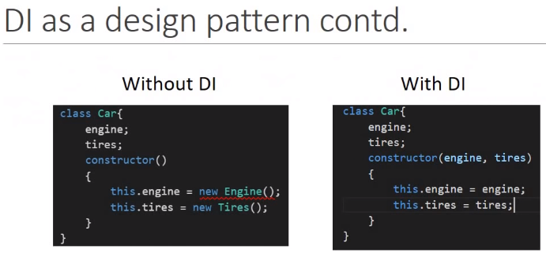
18.1 W/O DI and With DI
https://www.youtube.com/watch?v=OFPIGlxunL0&list=PLC3y8-rFHvwhBRAgFinJR8KHIrCdTkZcZ&index=18
Let’s look at code that make use of DI and understand the definition.
If you see here, we have move the definition of the dependencies inside the constructor to the parameters of the constructor.
The car class does not create the dependencies any more. It just consumes them.
The creation of the dependencies is external to this class. By doing so, both the drawback we have are all solved.

Slide 9
18.2 DI
Peter H. Chen

Slide 10
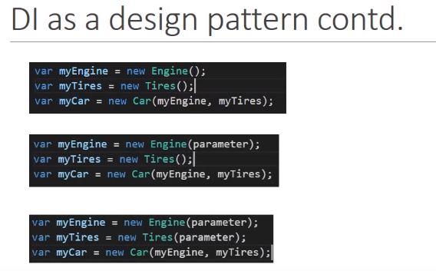
18.2 DI
https://www.youtube.com/watch?v=OFPIGlxunL0&list=PLC3y8-rFHvwhBRAgFinJR8KHIrCdTkZcZ&index=18
To create a car, we have the code something like this.
We first create an engine and a tires, and pass in the parameter when creating a car.
Even the engine evolves to take a parameter, there is no change to how we make a car.
Same as the case with tires, even the tires take the parameter, there is no change how we make the car.

Slide 11
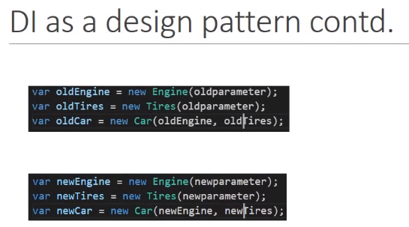
18.2 DI
https://www.youtube.com/watch?v=OFPIGlxunL0&list=PLC3y8-rFHvwhBRAgFinJR8KHIrCdTkZcZ&index=18
Our code is much more flexible now. Even we make change in dependencies, the care class remain intact.
We can mock the data into suit for our testing needs, for example, we can create the old engine and old set of tires and test with the old car.
Or we can create the new engine with new set of tires and test with new car.
So we can test multiple scenarios using this approach.
That is about the DI as the design pattern.

Slide 12
18.2 DI
https://www.youtube.com/watch?v=OFPIGlxunL0&list=PLC3y8-rFHvwhBRAgFinJR8KHIrCdTkZcZ&index=18
Now, we have another problem at hand.
With DI, we create a car by passing the dependencies as parameters but here is the thing.
We as the developer, has to create those parameters first. Right now, we just have two dependencies, so we are fine.
Create a engine and create a tire and pass to the car.
So what about the car have 10 or 20 dependencies? We have to create all the dependencies before pass them into the care as the parameter? What if the dependencies have other dependencies on something else? We would need to create those dependencies.
So as the number of dependencies grow, it becomes really difficult to manage the code.

Slide 13
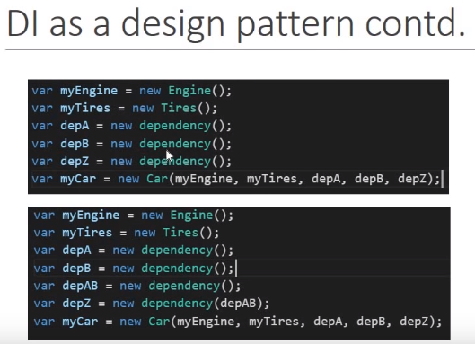
18.2 DI
https://www.youtube.com/watch?v=OFPIGlxunL0&list=PLC3y8-rFHvwhBRAgFinJR8KHIrCdTkZcZ&index=18
Take a look as this example. We have the car again, but this time, the car has multiple dependencies.
It depends on engine tire, dependency A, dependency B, and so on dependency Z.
So we have to create all these dependencies ourselves.

Slide 14
18.2 DI
https://www.youtube.com/watch?v=OFPIGlxunL0&list=PLC3y8-rFHvwhBRAgFinJR8KHIrCdTkZcZ&index=18
So, if we look at second car, it has dependency Z and dependency Z is in turn depends on dependency AB.
We will have to first to create dependency AB before creating dependency Z and eventually the car.
This become extremely difficult to developer and this the dependency injection as a framework of angular come into as the picture.

Slide 15
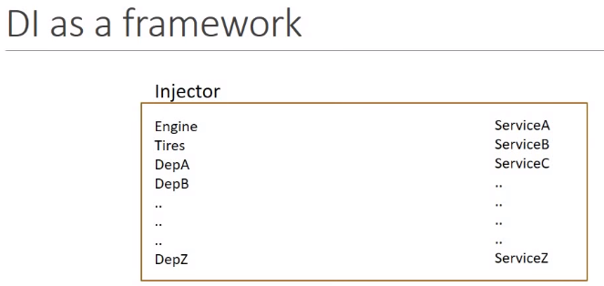
18.2 DI
https://www.youtube.com/watch?v=OFPIGlxunL0&list=PLC3y8-rFHvwhBRAgFinJR8KHIrCdTkZcZ&index=18
The DI framework has something called Injector when you register all your dependencies.
The injector is like a container of all the dependencies like engines, tires dependency A, B , and so on.

Slide 16
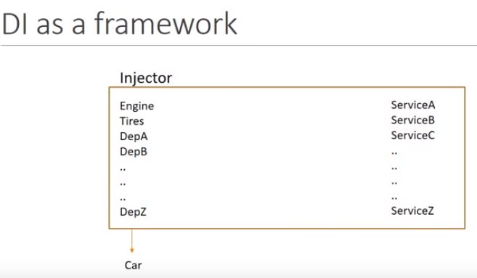
18.2 DI
https://www.youtube.com/watch?v=OFPIGlxunL0&list=PLC3y8-rFHvwhBRAgFinJR8KHIrCdTkZcZ&index=18
So, if you want a car, the framework will manage for you so that you do not have to keep track all the dependencies for you.
The DI framework make the developer jobs that much more easier.

Slide 17
18.2 DI
https://www.youtube.com/watch?v=OFPIGlxunL0&list=PLC3y8-rFHvwhBRAgFinJR8KHIrCdTkZcZ&index=18
If you relate our example, our employee list component may be depends on service A, B, C, and so on.
We register all these dependencies or services with the injector.
Then, when the component is initialized, the injector provides all the necessary dependencies for the proper functioning of the employee list component.

Slide 18
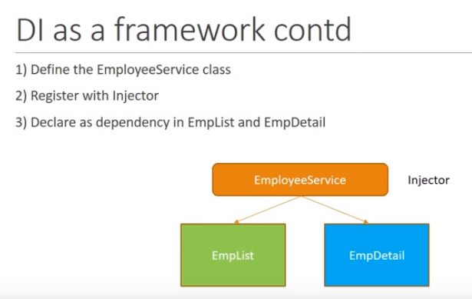
18.2 DI
https://www.youtube.com/watch?v=OFPIGlxunL0&list=PLC3y8-rFHvwhBRAgFinJR8KHIrCdTkZcZ&index=18
Here is how we use the service of Angular.
The first step, we create the service class, in our example, is the Employee Service class.
The second step is the register the service with angular built-in injector.
The last step is to declare the dependency in employee list and employee detail component.
The employee Service will be provided to the employee list and employee detail component.
That is about the DI in Angular.

Slide 19
End of Chapter

