Slide 1

19 Use Service
Peter H. Chen

Slide 2
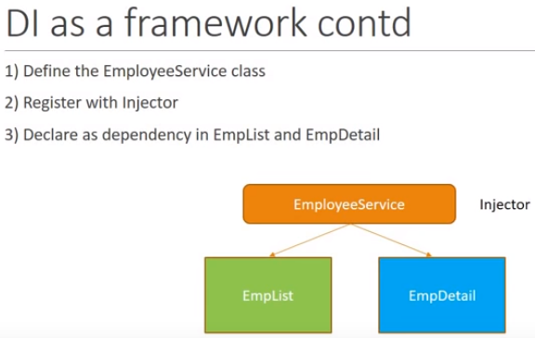
19 Use Service
https://www.youtube.com/watch?v=69VeYoKzL6I&list=PLC3y8-rFHvwhBRAgFinJR8KHIrCdTkZcZ&index=19
In this section, we implement three steps used to use a service in Angular.
Let’s start from step one, creating an EmployeeService class.

Slide 3
19.1 Define Employee Service Class
Peter H. Chen

Slide 4
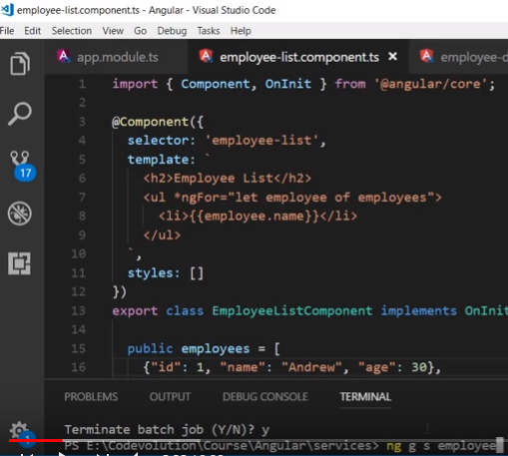
19.1 Define Employee Service Class
https://www.youtube.com/watch?v=69VeYoKzL6I&list=PLC3y8-rFHvwhBRAgFinJR8KHIrCdTkZcZ&index=19
> ng g s employee
Note: ng: angular, g: generate, s: service

Slide 5
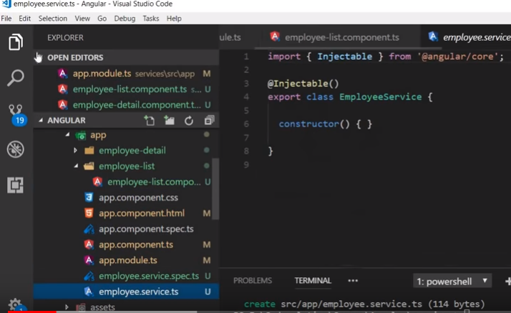
19.1 Define Employee Service Class
https://www.youtube.com/watch?v=69VeYoKzL6I&list=PLC3y8-rFHvwhBRAgFinJR8KHIrCdTkZcZ&index=19
After the command “ng g s employee”, you got the employee.server.ts

Slide 6
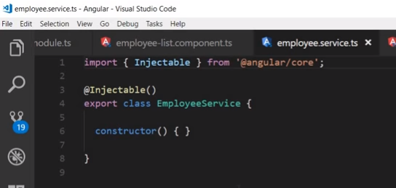
19.1 Define Employee Service Class
https://www.youtube.com/watch?v=69VeYoKzL6I&list=PLC3y8-rFHvwhBRAgFinJR8KHIrCdTkZcZ&index=19
If you take a loot inside the employee.server.ts, you have the template of Angular service.
Now, what is our service responsible for? To provide the employee data.

Slide 7
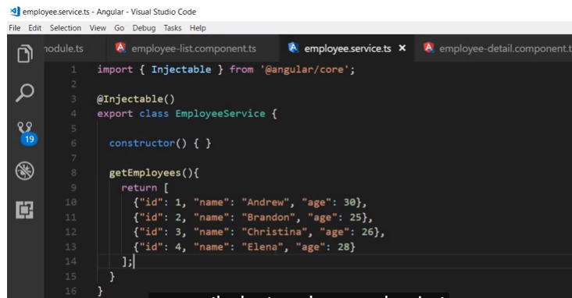
19.1 Define Employee Service Class
https://www.youtube.com/watch?v=69VeYoKzL6I&list=PLC3y8-rFHvwhBRAgFinJR8KHIrCdTkZcZ&index=19
In the employee service class, let’s create a new method getEmplployee().
We just return the array of employees()

Slide 8
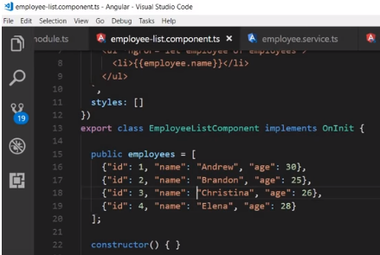
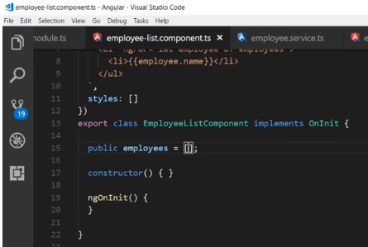
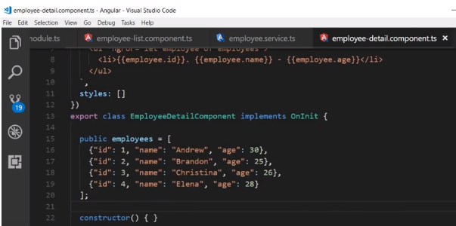
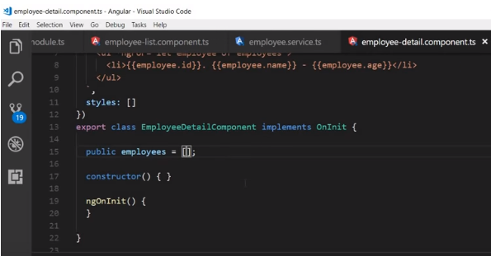
19.1 Define Employee Service Class
https://www.youtube.com/watch?v=69VeYoKzL6I&list=PLC3y8-rFHvwhBRAgFinJR8KHIrCdTkZcZ&index=19
In the employee List and detail Components, initialize the employee array.

Slide 9
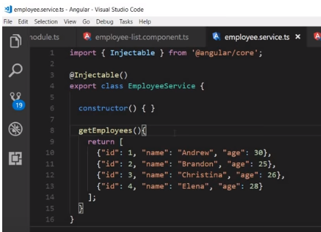
19.1 Define Employee Service Class
https://www.youtube.com/watch?v=69VeYoKzL6I&list=PLC3y8-rFHvwhBRAgFinJR8KHIrCdTkZcZ&index=19
Now, the service component has a method to return the employees.
Our first step is to complete the http service.

Slide 10
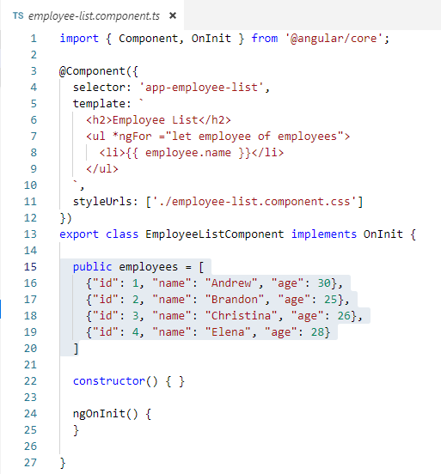
19.1 Define Employee Service Class
https://www.youtube.com/watch?v=69VeYoKzL6I&list=PLC3y8-rFHvwhBRAgFinJR8KHIrCdTkZcZ&index=19
In this section, we implement three steps used to use a service in Angular.
Let’s start from step one, creating an EmployeeService class.

Slide 11
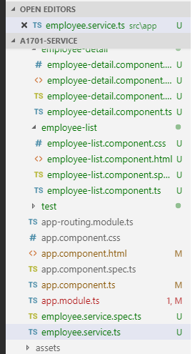
19.1 Define Employee Service Class
https://www.youtube.com/watch?v=69VeYoKzL6I&list=PLC3y8-rFHvwhBRAgFinJR8KHIrCdTkZcZ&index=19
In the service project folder, run the command “ng g s employee”. Here, g for generate, s for service, and service name is employee.
At the end of command, you should have the employee.service.ts.

Slide 12
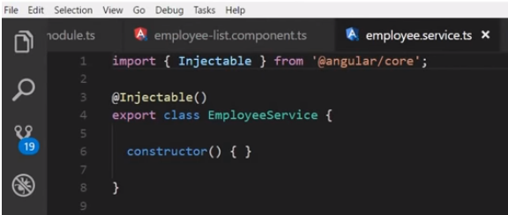
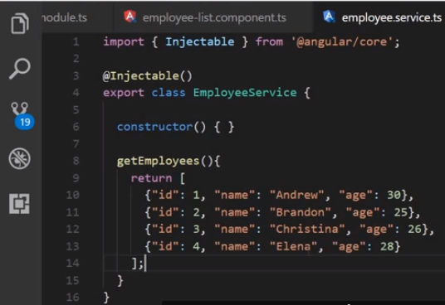
19.1 Define Employee Service Class
https://www.youtube.com/watch?v=69VeYoKzL6I&list=PLC3y8-rFHvwhBRAgFinJR8KHIrCdTkZcZ&index=19
If you look at inside the employee.service.ts, you will find the template for angular service.
Now, what is the responsibility of service for? To provide the employee data.
So, in the EmpolyeeService class, let create a new method, getEmployee () and return the array of employee().

Slide 13
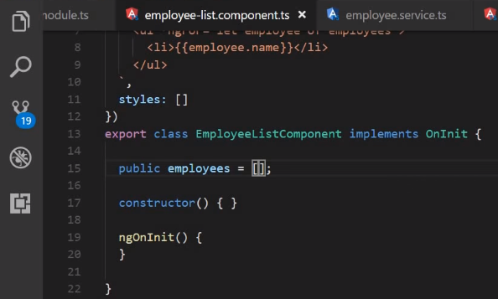
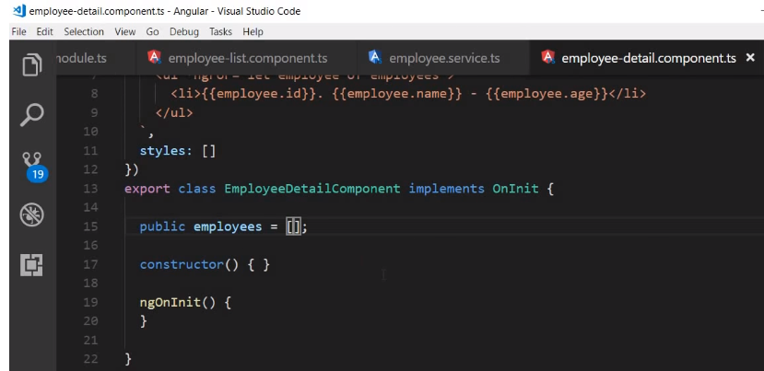
19.1 Define Employee Service Class
https://www.youtube.com/watch?v=69VeYoKzL6I&list=PLC3y8-rFHvwhBRAgFinJR8KHIrCdTkZcZ&index=19
In the employee-list and employee-detail component, initialize the employee to empty array.

Slide 14
19.2 Register Service Class
Peter H. Chen

Slide 15
19.2 Register Service Class
https://www.youtube.com/watch?v=69VeYoKzL6I&list=PLC3y8-rFHvwhBRAgFinJR8KHIrCdTkZcZ&index=19
So, the employeeService component has a method to return the employees.
Our first step is complete. We have created a service.
The second step is to register the service with Angular Injector.

Slide 16
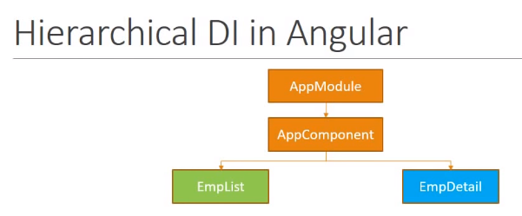
19.2 Register Service Class
https://www.youtube.com/watch?v=69VeYoKzL6I&list=PLC3y8-rFHvwhBRAgFinJR8KHIrCdTkZcZ&index=19
If we do not register, the service will be another regular class according to angular.
There are multiple places you can register the services. But the place is very important because angular is hierarchical dependency injection system.
Consider the example application, it has the app module. The appl module has the app component. The app component has two components nested inside. The employee-list and employee-detail.

Slide 17
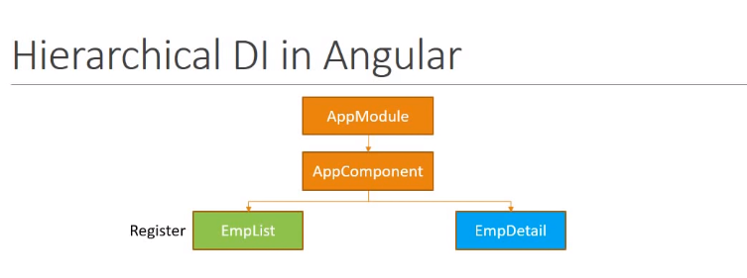
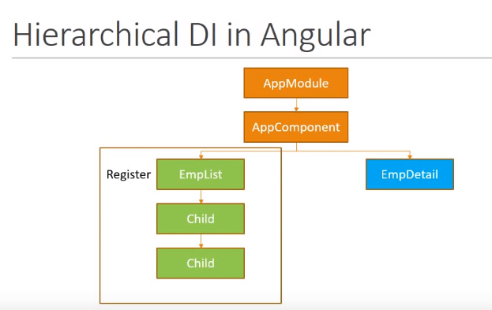
19.2 Register Service Class
https://www.youtube.com/watch?v=69VeYoKzL6I&list=PLC3y8-rFHvwhBRAgFinJR8KHIrCdTkZcZ&index=19
If you register a list-employee component, the service can be used by the employee-list component and its children.
No other components, no even the employ-details component can use it.

Slide 18
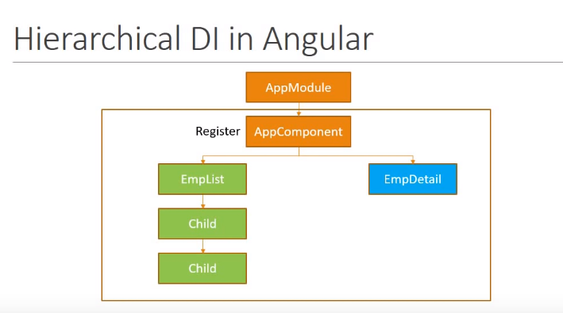
19.2 Register Service Class
https://www.youtube.com/watch?v=69VeYoKzL6I&list=PLC3y8-rFHvwhBRAgFinJR8KHIrCdTkZcZ&index=19
This is not a good choice. If you register with the app component, the app component and all the children can make use of the service.
This work fine but each module usually a feature area in your application and might grow.

Slide 19
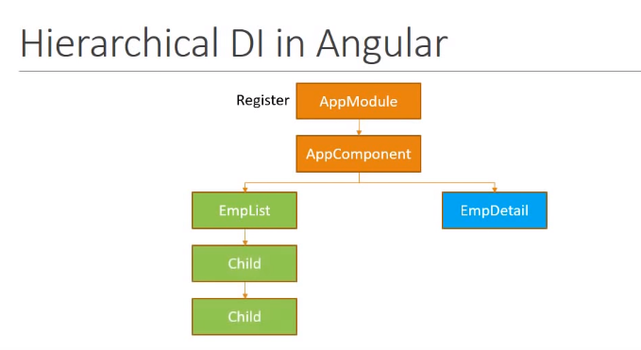
19.2 Register Service Class
https://www.youtube.com/watch?v=69VeYoKzL6I&list=PLC3y8-rFHvwhBRAgFinJR8KHIrCdTkZcZ&index=19
So, it is better to register the service in module level. By doing so, the components under the app module can use it.
To register a service, we use the providers meta data.

Slide 20
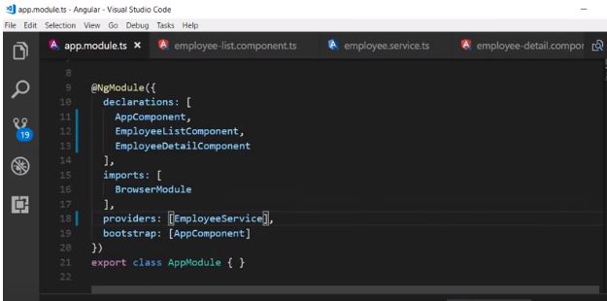
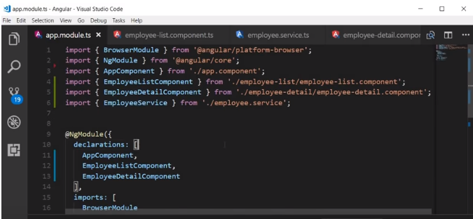
19.2 Register Service Class
https://www.youtube.com/watch?v=69VeYoKzL6I&list=PLC3y8-rFHvwhBRAgFinJR8KHIrCdTkZcZ&index=19
Go back the visual studio code, in the app module, include the employee service in the provider array.
Also, import the EmployeeService.

Slide 21
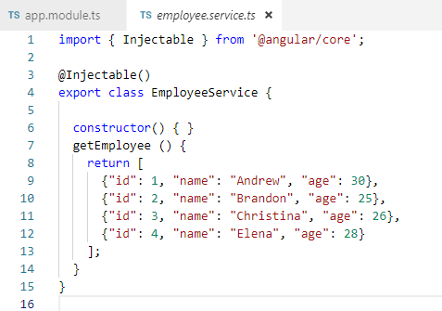
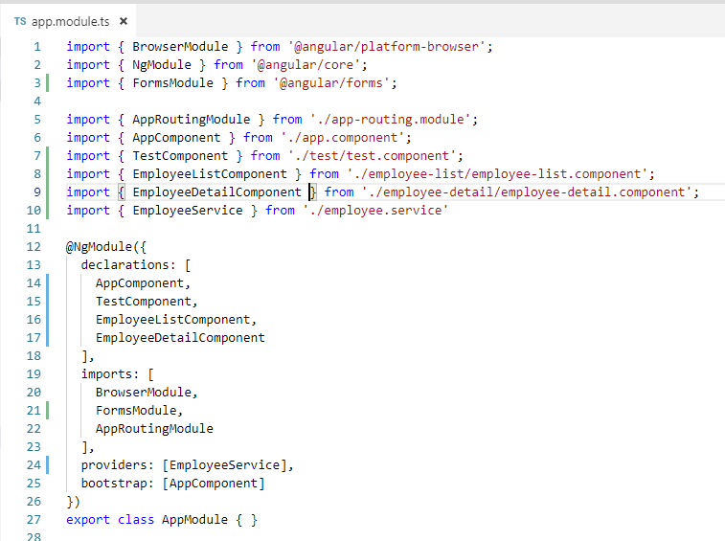
19.2 Register Service Class
https://www.youtube.com/watch?v=69VeYoKzL6I&list=PLC3y8-rFHvwhBRAgFinJR8KHIrCdTkZcZ&index=19
Go back the visual studio code, in the app module, include the employee service in the provider array.
We are done with the second step, register the service.

Slide 22
19.3 Declare DI
Peter H. Chen

Slide 23
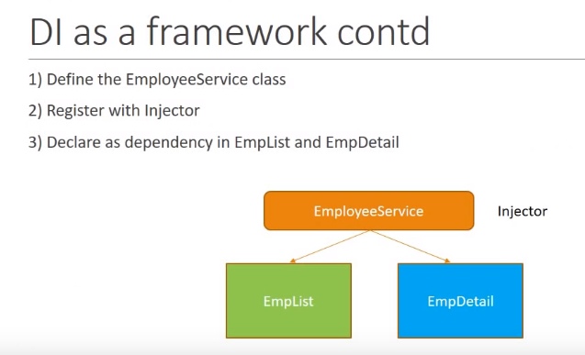
19.3 Declare DI
https://www.youtube.com/watch?v=69VeYoKzL6I&list=PLC3y8-rFHvwhBRAgFinJR8KHIrCdTkZcZ&index=19
We have done the first and second step.
The third step is to declare the dependency that the component that need the service.
The dependency is specified in the constructor.

Slide 24
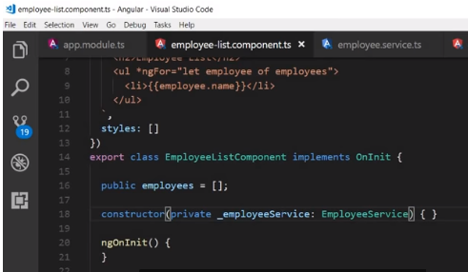
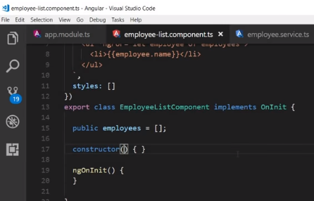
19.3 Declare DI
https://www.youtube.com/watch?v=69VeYoKzL6I&list=PLC3y8-rFHvwhBRAgFinJR8KHIrCdTkZcZ&index=19
Let’s go back to the employee list component.
We are going to use typescript shorthand syntax to make use of the dependency.
In the constructor, we pass in the local variable _employeeService with type EmployeeService.
Now, we have the local variable _employeeService that give us a instance of employee service.

Slide 25
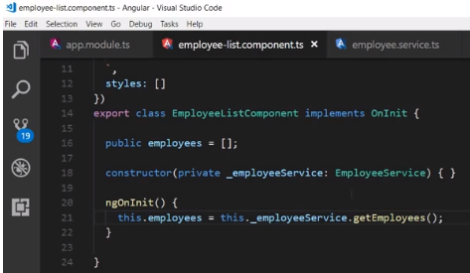
19.3 Declare DI
https://www.youtube.com/watch?v=69VeYoKzL6I&list=PLC3y8-rFHvwhBRAgFinJR8KHIrCdTkZcZ&index=19
Next, we need to make use of the service instance and fetch the employee data and code goes inside the ngOnOnit() life cycle hook. We have not talk about the LifeCycle hook but noOnInit() get calls once the component has been initialized.
So inside the ngOnInit() method, this.employee = this._employeeService.getEmployees();

Slide 26
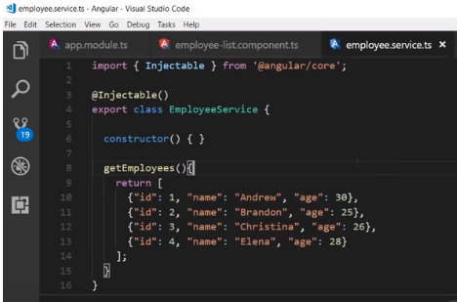

19.3 Declare DI
https://www.youtube.com/watch?v=69VeYoKzL6I&list=PLC3y8-rFHvwhBRAgFinJR8KHIrCdTkZcZ&index=19
Here is how this work.
We have employee.service class, it has getEmployee() method to return the employees data.
The employee-list component holds an instance of employee service which is _employeeService and call getEmployee() method and assign the public employees.

Slide 27
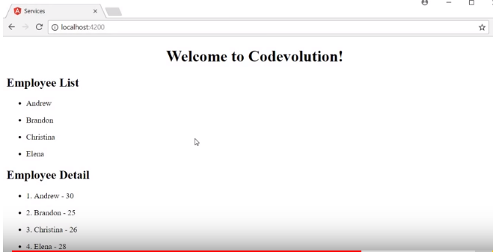
19.3 Declare DI
https://www.youtube.com/watch?v=69VeYoKzL6I&list=PLC3y8-rFHvwhBRAgFinJR8KHIrCdTkZcZ&index=19
We can the same thing for employee detail component.
Restart again. We still have both Employee List and Employee-detail List.
But this time, instead of hard-coded, we use service which is more efficiently.

Slide 28
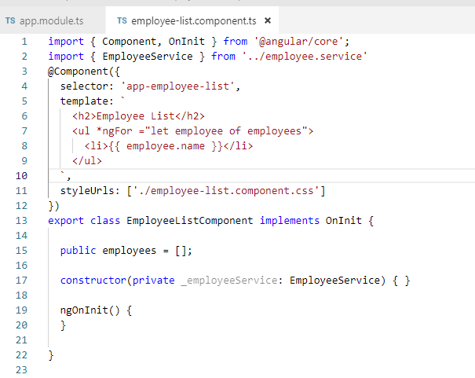
19.3 Declare DI
https://www.youtube.com/watch?v=69VeYoKzL6I&list=PLC3y8-rFHvwhBRAgFinJR8KHIrCdTkZcZ&index=19
Let’s go back to the employee list component.
We are going to use typescript shorthand syntax to make use of the dependency.
In the constructor, we pass in the local variable _employeeService with type EmployeeService.
We import the EmployeeService component.

Slide 29
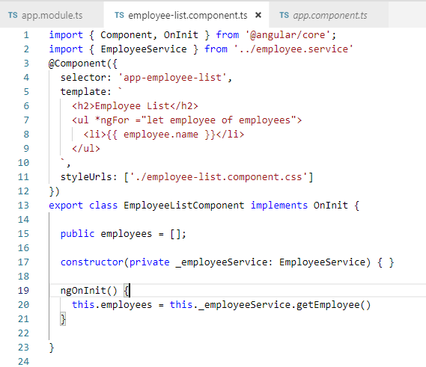
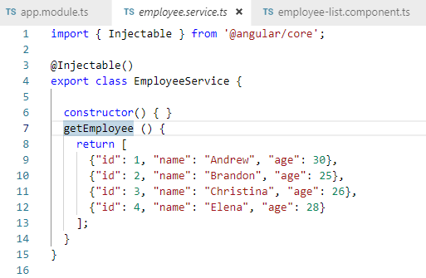
19.3 Declare DI
https://www.youtube.com/watch?v=69VeYoKzL6I&list=PLC3y8-rFHvwhBRAgFinJR8KHIrCdTkZcZ&index=19
Next, we need to make use of service instance in ngOnInit() {} and fetch the employee data.
The code goes inside the ngOnInit() life cycle hook.
We have not talk life cycle hook but ngOnInit() hook get called when once the component has been initialized.
So inside the ngOnInit() method, this.employee = this._employeeService.getEmployee ()

Slide 30
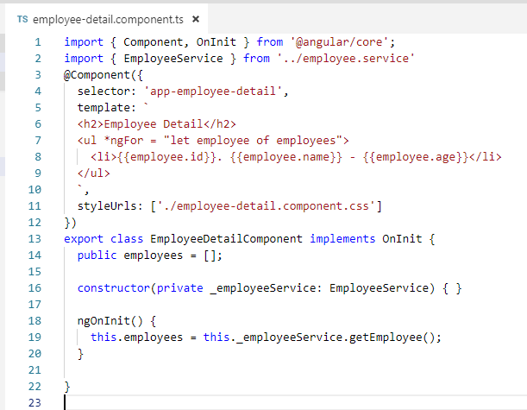
19.3 Declare DI
https://www.youtube.com/watch?v=69VeYoKzL6I&list=PLC3y8-rFHvwhBRAgFinJR8KHIrCdTkZcZ&index=19
Let’s do the same thing for the employee-detail component.

Slide 31
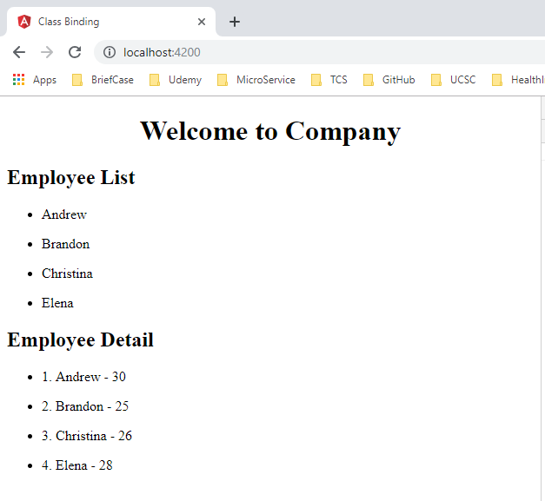
19.3 Declare DI
https://www.youtube.com/watch?v=69VeYoKzL6I&list=PLC3y8-rFHvwhBRAgFinJR8KHIrCdTkZcZ&index=19
Restart the application:
> npm start
We still have component-list and component-detail display, but this time, we get the data from the service instead of hard-code in each component.

Slide 32
19.3 Declare DI
https://www.youtube.com/watch?v=69VeYoKzL6I&list=PLC3y8-rFHvwhBRAgFinJR8KHIrCdTkZcZ&index=19
This is how service work:
Create a Service
Register a Service with injector
Declare the service as an dependency in the constructor of the component that wants to use it.

Slide 33
19.4 Injector Decorator
Peter H. Chen

Slide 34
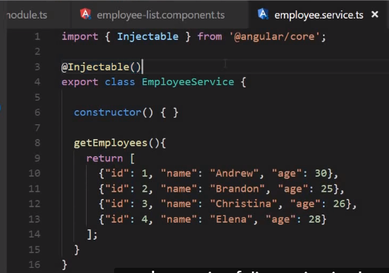
19.4 Injector Decorator
https://www.youtube.com/watch?v=69VeYoKzL6I&list=PLC3y8-rFHvwhBRAgFinJR8KHIrCdTkZcZ&index=19
One last topic is the injector decorator.
Why is it required?
Well, injector decorator tells angular that this service might itself have injected dependencies.
So if you want to inject a service in to another service, Injector decorator is a must.

Slide 35
19.4 Injector Decorator
https://www.youtube.com/watch?v=69VeYoKzL6I&list=PLC3y8-rFHvwhBRAgFinJR8KHIrCdTkZcZ&index=19
Right now, the Employee Service does not have dependencies. So the injectable decorator is not necessary but employee service might have dependencies in the future.
That is why it is recommended to have this injectable decorator as soon as you create a service class.
Since Angular CLI follow the best practices, it adds the injectable decorator when you generate a new service.

Slide 36
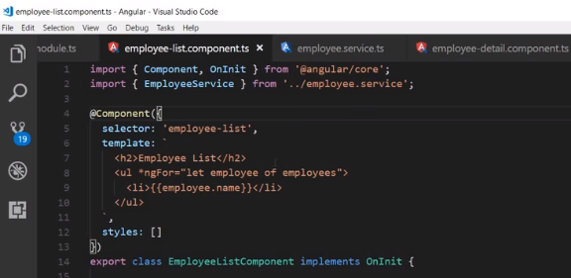
19.4 Decorator
https://www.youtube.com/watch?v=69VeYoKzL6I&list=PLC3y8-rFHvwhBRAgFinJR8KHIrCdTkZcZ&index=19
You might ask, how come we do not use Injector decorator on employee list and employee detail.
We do not see an injector decorator here. Right?
That is because component has its own component decorator that let angular knows, “Hey, I might have dependencies and might make use of the dependency injection system”.
But for a service, we do not have that component decorator. If you remove the injectable decorator as well, it becomes a plain typescript class, nothing to do with angular. That is why injectable is required only for a service and not for component.

Slide 37
19.5 Summary
Peter H. Chen

Slide 38
19.5 Sumamry
https://www.youtube.com/watch?v=69VeYoKzL6I&list=PLC3y8-rFHvwhBRAgFinJR8KHIrCdTkZcZ&index=19
In this section, we define EmployeeService Class
We register the Injector Decorator
We implement the instance in the Constructor () and transfer into the component variables in ngOnInit ()s in the Employee-list and Employee-detail Component.
The ngOnInit() Lifecycle hook is called after the constructor() initialization.

Slide 39
End of Chapter

