Slide 1

20 HTTP Observable
Peter H. Chen

Slide 2
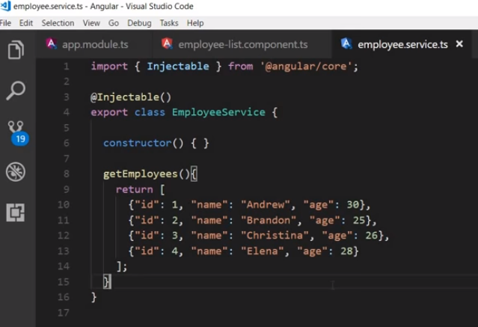
20 HTTP Observable
https://www.youtube.com/watch?v=N8FBmB2jme8&index=6&list=PLC3y8-rFHvwhBRAgFinJR8KHIrCdTkZcZ
In this section, we are going to learn the HTTP and Observable in Angular.
Currently, we hard code data in the employee service. But in real world application, we need to fetch these data from web server.

Slide 3
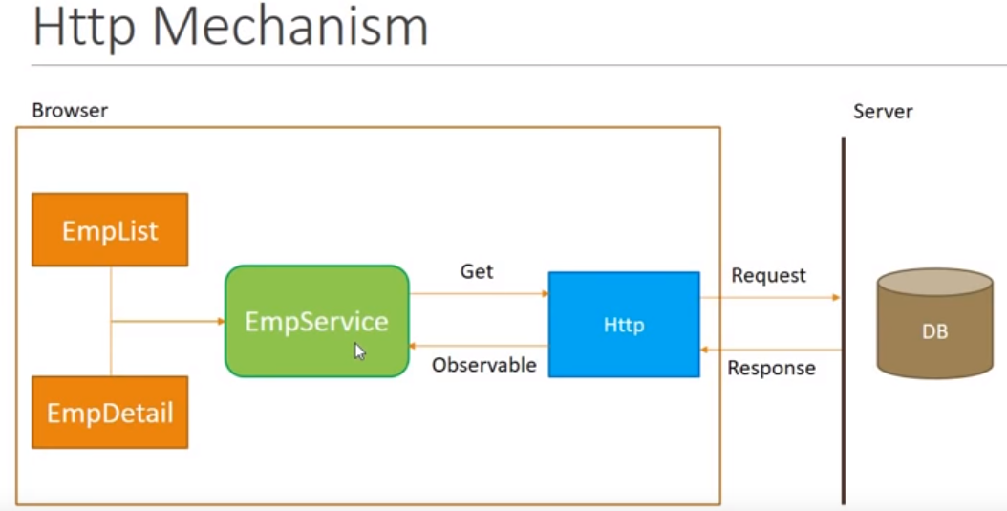
20 HTTP Observable
https://www.youtube.com/watch?v=N8FBmB2jme8&index=6&list=PLC3y8-rFHvwhBRAgFinJR8KHIrCdTkZcZ
So need to replace the hard code data into HTTP call to the server.
Before we proceed with the code, let us first understand the mechanism of an HTTP call and something known as an Observable that is returned by the HTTP call.
We have application that runs on the browser.
In our application, we have two components, employee-list and employee-detail, both components make use of the employee service for their data.
Right now, the employee service provides the hard coded data to the components.
But we want the data to be fetch from the server and for that, we make an HTTP request.

Slide 4
20 HTTP Observable
https://www.youtube.com/watch?v=N8FBmB2jme8&index=6&list=PLC3y8-rFHvwhBRAgFinJR8KHIrCdTkZcZ
The HTTP Get request will hit a web API or a Web Service which will fetch the data from a database and send it back as an HTTP response. The response we get back from the HTTP call is an observable.
Now, the employee service needs to cast this observable into an array of employees and return the same to the employee list and employee detail components.

Slide 5
20 HTTP Observable
https://www.youtube.com/watch?v=N8FBmB2jme8&index=6&list=PLC3y8-rFHvwhBRAgFinJR8KHIrCdTkZcZ
So the HTTP mechanism is just tow steps.
First step, send HTTP request, second step, receive and process the HTTP response.
The second step is a little more complicated.
Let’s understand what the observable is and get a clear picture of HTTP mechanism.
First Step
Second Step

Slide 6
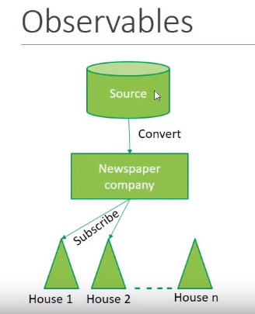
20 HTTP Observable
https://www.youtube.com/watch?v=N8FBmB2jme8&index=6&list=PLC3y8-rFHvwhBRAgFinJR8KHIrCdTkZcZ
To help us understand what an observable is and how to work with them. We are using a very simple example of a newspaper company.
We have a newspaper company and this company has a source of information.
The company make a request to the source to send it the every day news as the response to the company’s request. The source send the sequence of information throughout the day.
Once the information is received, the first thing the newspaper company has to do is convert the information into newspaper format, for example, the source may be a single line of information but the newspaper company have to map the information into a headline, a body for the headline, and so on.
Once is done, the newspaper company has newspaper in the desired format and is ready to be distributed to the houses.
But hang on, does the newspaper company distributes the newspaper to every single house? No, it only distributes the newspaper to those houses that have subscribed to this company.

Slide 7
20 HTTP Observable
https://www.youtube.com/watch?v=N8FBmB2jme8&index=6&list=PLC3y8-rFHvwhBRAgFinJR8KHIrCdTkZcZ
So if the new house subscribes to this company, that house will receive the newspaper as well.
Right now, the first two houses subscribed to this company. Only these two houses will receive the newspaper.
After this point, what people want to do with the newspaper is completely up to them. The newspaper company is not bother about this.
House one may read the newspaper.
House two may make paper planes out of them.
But the company responsibility is done.
How can we relate the this to our observables in the application we are working with?

Slide 8
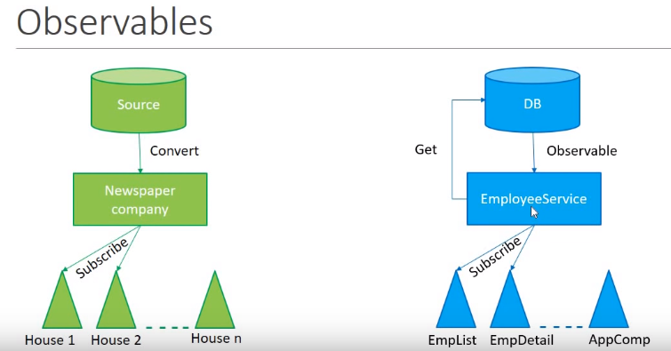
20 HTTP Observable
https://www.youtube.com/watch?v=N8FBmB2jme8&index=6&list=PLC3y8-rFHvwhBRAgFinJR8KHIrCdTkZcZ
The newspaper company is like the employee service in our application.
The source information is like the database, of API of a web service.
The employee service make a request to the database with the HTTP Get call, as a response to the call, we get back and observable.
What exactly the observable? Let’s take a look.

Slide 9
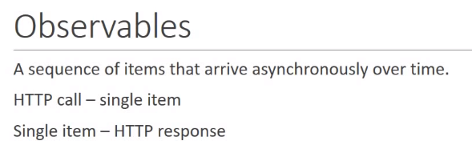
20 HTTP Observable
https://www.youtube.com/watch?v=N8FBmB2jme8&index=6&list=PLC3y8-rFHvwhBRAgFinJR8KHIrCdTkZcZ
An Observable is a sequence of items that arrive asynchronously over time.
But we have to make a note here is what with an HTTP call, it is a single item in stead of a sequence of items and that single item is nothing but HTTP response in the context of HTTP mechanism.
In angular, an Observable is nothing but HTTP response that arrives asynchronously.

Slide 10
20 HTTP Observable
https://www.youtube.com/watch?v=N8FBmB2jme8&index=6&list=PLC3y8-rFHvwhBRAgFinJR8KHIrCdTkZcZ
Back into the application. After we make the Get request, it receives the HTTP response as an observable.
But this is not the format that we can readily use in our application. Once we receive the observable, we have to convert it into the employee array. After conversion, the data is ready to be provided to the components in our application.
Do we provide every component in our application? No, we only provide the data to the component who have subscribed to this employee service.

Slide 11
20 HTTP Observable
https://www.youtube.com/watch?v=N8FBmB2jme8&index=6&list=PLC3y8-rFHvwhBRAgFinJR8KHIrCdTkZcZ
Since we need the data in the employee list and employee detail component, we are going to subscribe this observable only these two components.
After this, it is completely up to the components to decide what to do with the data.
The employee list may be just decide to display the name of employee whereas the employ detail component may decide to display the complete information of the employee.

Slide 12
20 HTTP Observable
https://www.youtube.com/watch?v=N8FBmB2jme8&index=6&list=PLC3y8-rFHvwhBRAgFinJR8KHIrCdTkZcZ
This is the analogue of the observable and newspaper company.
This will make sense to write the code in the next section.

Slide 13
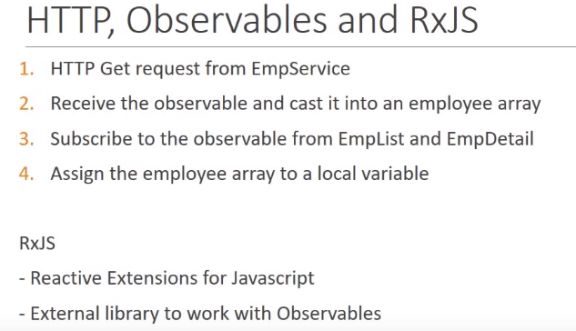
20 HTTP Observable
https://www.youtube.com/watch?v=N8FBmB2jme8&index=6&list=PLC3y8-rFHvwhBRAgFinJR8KHIrCdTkZcZ
Summary (1):
Angular has four steps to make HTTP request:
First step is to make the HTTP request from EmployeeService.
Second step, receive the observable and cast it into an employee array.
The third step, subscribe to observable from employee list and employee details component.
Finally, assign the employee array to a local variable.

Slide 14
20 HTTP Observable
https://www.youtube.com/watch?v=N8FBmB2jme8&index=6&list=PLC3y8-rFHvwhBRAgFinJR8KHIrCdTkZcZ
Summary (2):
The RxJS is a library that enable us to work with observable in Angular application.
It is a reactive extension for JavaScript. It is not related to React Library from Facebook. It just an external library to work with observable.

Slide 15
End of Chapter

