Slide 1

6 Bind Data to Model
Peter H. Chen

Slide 2
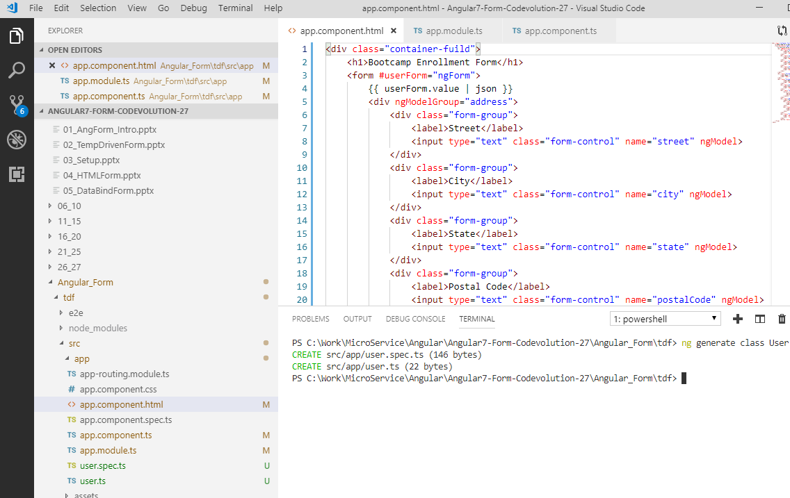
6 Bind Data to Model
https://www.youtube.com/watch?v=2cWPk2X79is&list=PLC3y8-rFHvwhBRAgFinJR8KHIrCdTkZcZ&index=37
In this section, we will see how to bind the Form Data to the Model.
As users enter the Form Data, we have captured the changes and update an instance of the model that can later be sent to the server.
Now, the first step is to generate the model class.
Open the IDE terminal, under tdf folder.
> ng generate class user

Slide 3
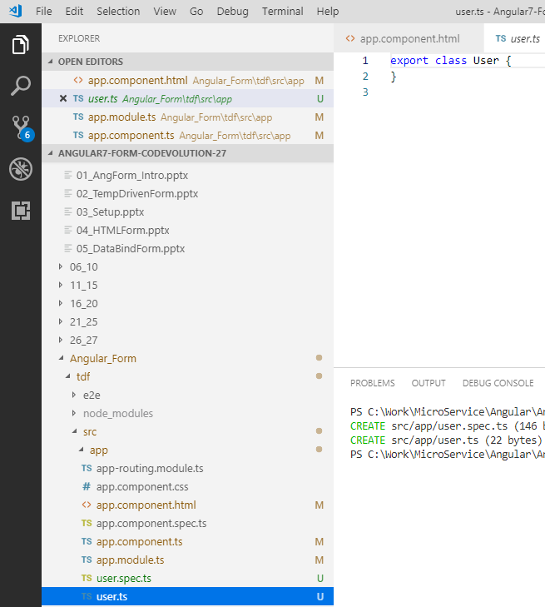
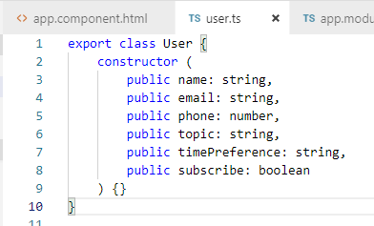
6 Bind Data to Model
https://www.youtube.com/watch?v=2cWPk2X79is&list=PLC3y8-rFHvwhBRAgFinJR8KHIrCdTkZcZ&index=37
Open the file user.ts. Use constructor to for username, email, etc.
These are TypeScript syntax for a constructor.
We have the model.

Slide 4
6 Bind Data to Model
https://www.youtube.com/watch?v=2cWPk2X79is&list=PLC3y8-rFHvwhBRAgFinJR8KHIrCdTkZcZ&index=37
Then, we will use interpolation to bind user Model and display in the view.
This will help us see how the data binding works.
In the HTML, we will add a horizontal line <hr /> for separation and then use a model in the JSON format.
Binding the Data to the form is really simple.
We bind the properties of the model to the ngModel directive.
The properties binding use square bracket [].

Slide 5
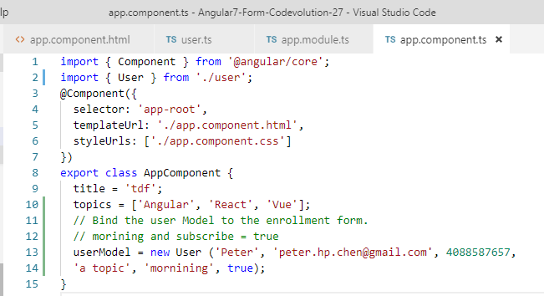
6 Bind Data to Model
https://www.youtube.com/watch?v=2cWPk2X79is&list=PLC3y8-rFHvwhBRAgFinJR8KHIrCdTkZcZ&index=37
Next step is to create an instance of this Model.
In app.component.ts, let’s create a new property.

Slide 6
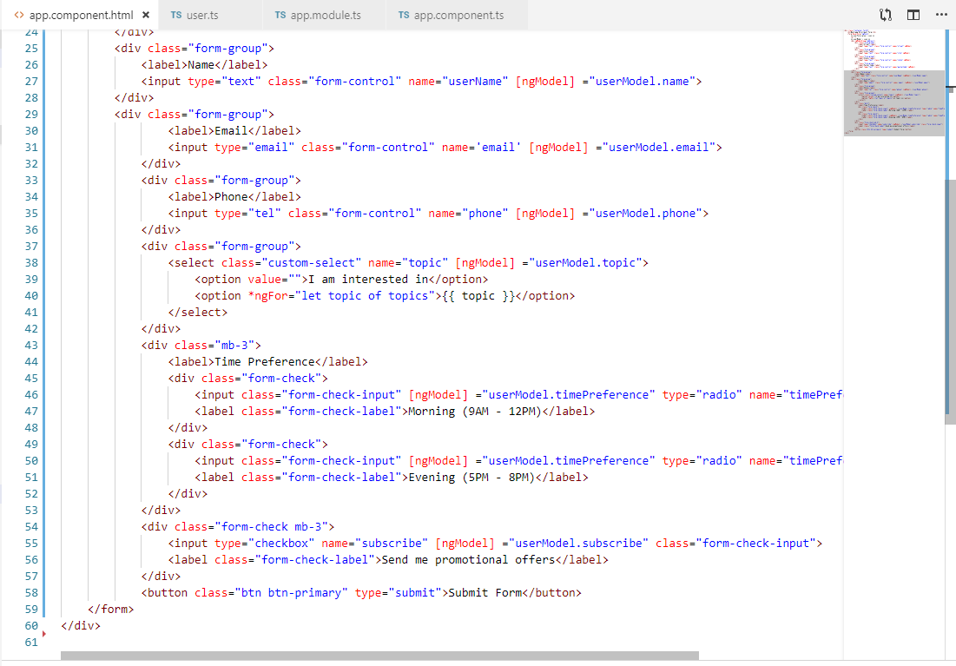
6 Bind Data to Model
https://www.youtube.com/watch?v=2cWPk2X79is&list=PLC3y8-rFHvwhBRAgFinJR8KHIrCdTkZcZ&index=37
Next is to bind the user model to the HTML element.
The square bracket [] is used to bind the user Model to the HTML element.

Slide 7
6 Bind Data to Model
https://www.youtube.com/watch?v=2cWPk2X79is&list=PLC3y8-rFHvwhBRAgFinJR8KHIrCdTkZcZ&index=37
Change the selected into value=“”.

Slide 8
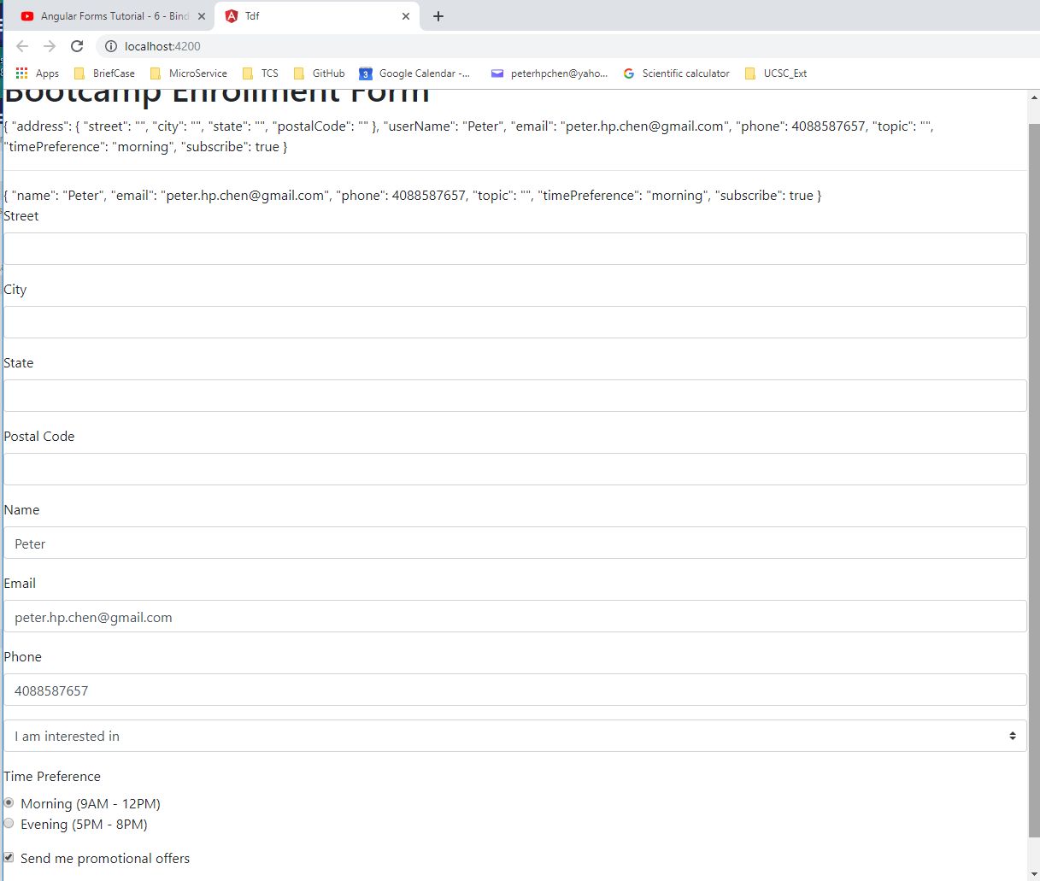
6 Bind Data to Model
https://www.youtube.com/watch?v=2cWPk2X79is&list=PLC3y8-rFHvwhBRAgFinJR8KHIrCdTkZcZ&index=37
Take a look at the browser.

Slide 9
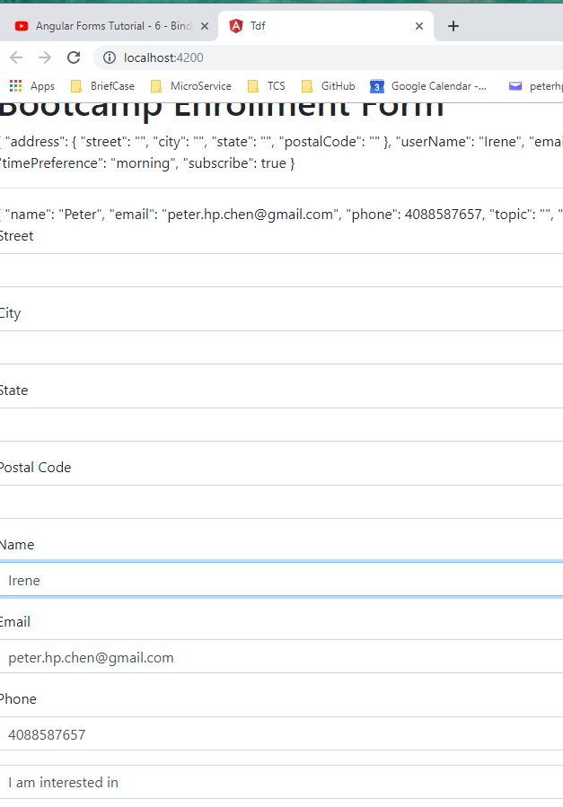
6 Bind Data to Model
https://www.youtube.com/watch?v=2cWPk2X79is&list=PLC3y8-rFHvwhBRAgFinJR8KHIrCdTkZcZ&index=37
When you change name from ‘Peter’ to ‘Irene”, you can see the update value change to ‘Irene” but the user Model still ‘Peter’.
This is because we use the property Binding which is one way binding.
The Data from class (user Model) to view but not the view to the class (suer Model).

Slide 10
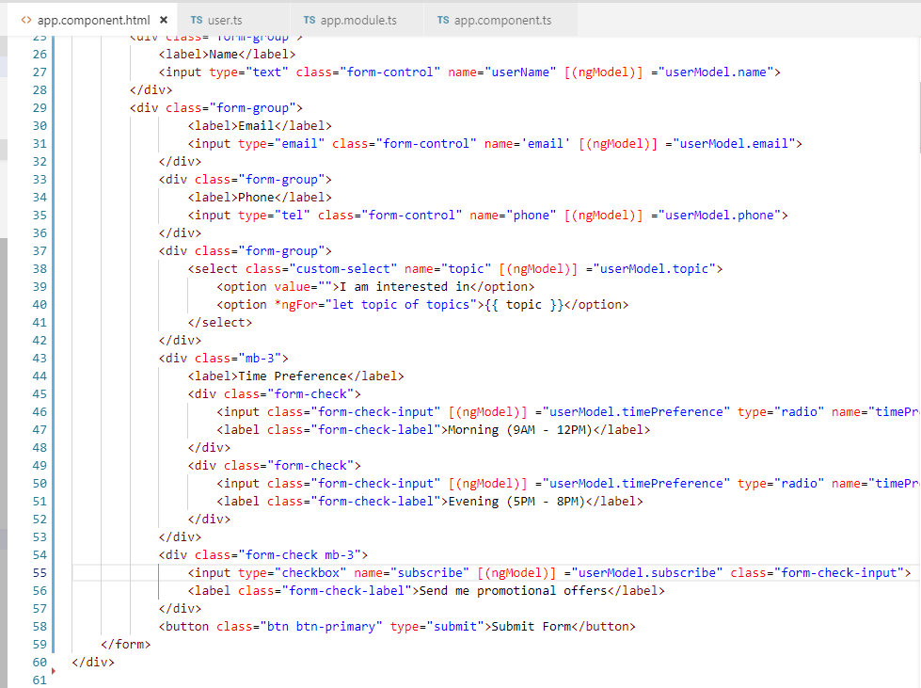
6 Bind Data to Model
https://www.youtube.com/watch?v=2cWPk2X79is&list=PLC3y8-rFHvwhBRAgFinJR8KHIrCdTkZcZ&index=37
What we really want is two way data binding.
Tw way binding can be achieved by Banana in Box syntax of the ngModel directive.
Change each [ngModel] into [(ngModel)].

Slide 11
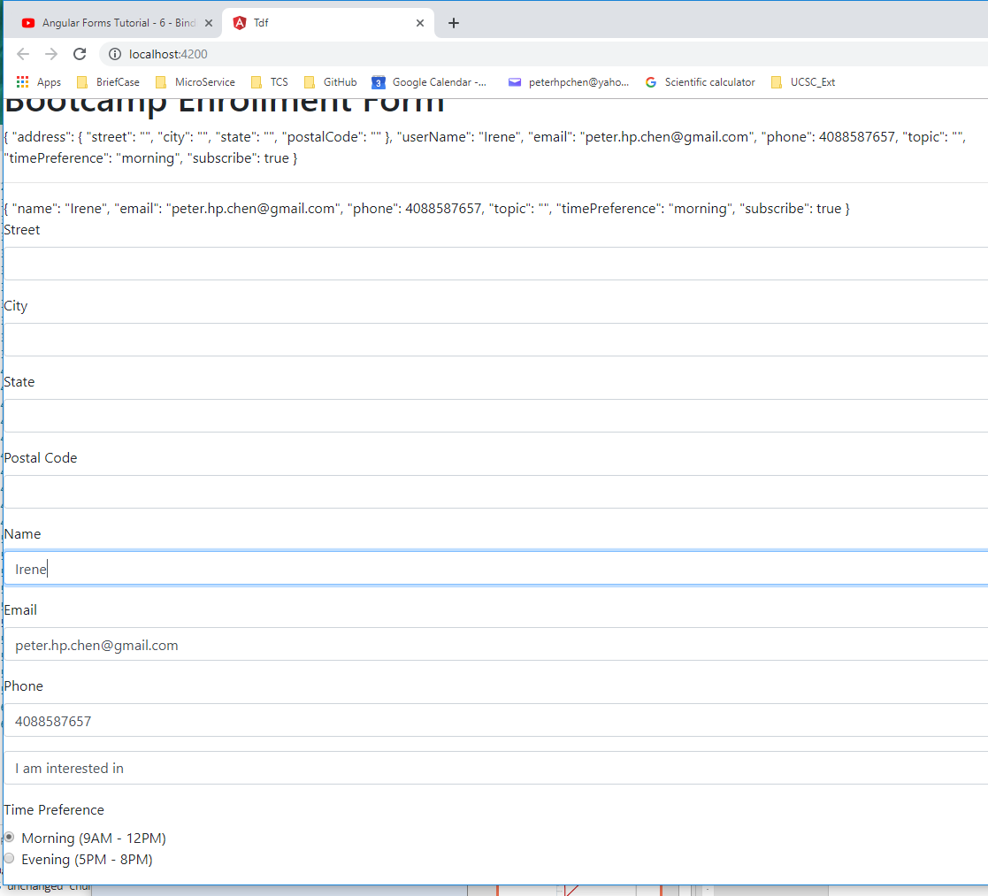
6 Bind Data to Model
https://www.youtube.com/watch?v=2cWPk2X79is&list=PLC3y8-rFHvwhBRAgFinJR8KHIrCdTkZcZ&index=37
Now, change ‘Peter’ into ‘Irene’, we have both View data and user Model data change.

Slide 12
6 Bind Data to Model
https://www.youtube.com/watch?v=2cWPk2X79is&list=PLC3y8-rFHvwhBRAgFinJR8KHIrCdTkZcZ&index=37
We have successfully add the two way data binding from view to user Model and from user Model to View.

Slide 13
End of Chapter

