Slide 1

7 Validate
Peter H. Chen

Slide 2
7 Validate
https://www.youtube.com/watch?v=WyWJwR0FJV0&list=PLC3y8-rFHvwhBRAgFinJR8KHIrCdTkZcZ&index=38
In this section, we will see validation. The validation for providing appropriate visual feedback is very important.
We will see the validation in template driven forms.
Let’s understand how Angular helps us with form validation by tracking the form controls and applying the appropriate classes.

Slide 3
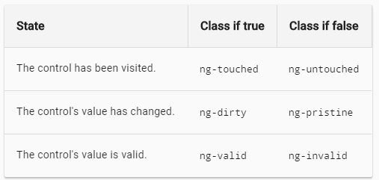
7 Validate
https://www.youtube.com/watch?v=WyWJwR0FJV0&list=PLC3y8-rFHvwhBRAgFinJR8KHIrCdTkZcZ&index=38
I got this snapshot from angular doc (https://angular.io/guide/forms) which points clearly what class is applied to a form control based on its state and validity.
At any point in time, Angular applies three classes to a form control based on its state.

Slide 4
7 Validate
https://www.youtube.com/watch?v=WyWJwR0FJV0&list=PLC3y8-rFHvwhBRAgFinJR8KHIrCdTkZcZ&index=38
The first pair of classes you see here are dependent on whether the user has visited the form control or not.
When you load a form for the very first time, you have not yet visited the form field. So Angular applies a class of ng-untouched.
If you do with it, the form control either by clicking or tapping and then navigating away from the form control. Angular applies a class of ng-touched.
The key point here is that the class will change only on blur. You have to navigate away from the form control.
If the form control has been visited and ng-touched class applied. If not and the un-touched class is going to be applied.

Slide 5
7 Validate
https://www.youtube.com/watch?v=WyWJwR0FJV0&list=PLC3y8-rFHvwhBRAgFinJR8KHIrCdTkZcZ&index=38
Similarly, Angular also tracks if the value of the form control has changed or not.
When you load a form for the first time, the value has not yet changed, Angular applies a class of ng-pristine (new or good condition). If you do change, the value of the form control, Angular applies a class of ng-dirty, for example, when you start typing a value into a input field, the class changes from ng-pristine to ng-dirty.
The final pair of classes is concerned with the validity of the form control. The form control value is valid and ng-valid class is applied. If not, ng-invalid is applied, for example, if an input field contains the required attribute, it implies a value has to be entered. If a value is missing, ng-invalid class is applied. When a value is entered, ng-valid class is going to be applied.
Let’s look at these classes in Angular form.

Slide 6
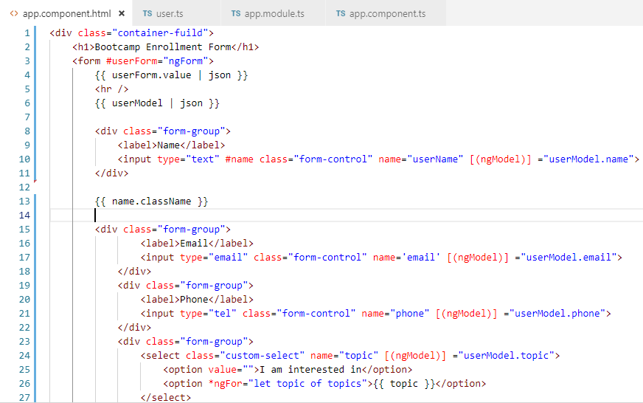
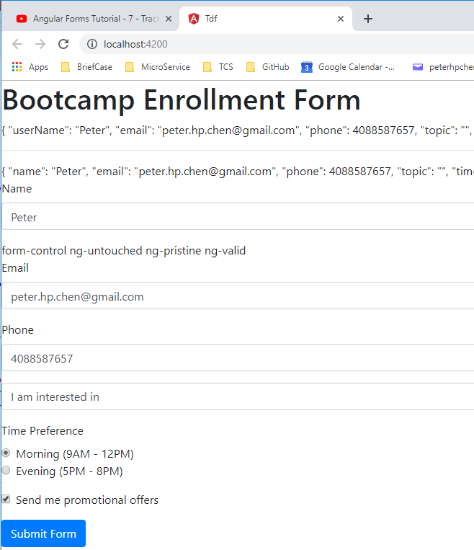
7 Validate
https://www.youtube.com/watch?v=WyWJwR0FJV0&list=PLC3y8-rFHvwhBRAgFinJR8KHIrCdTkZcZ&index=38
Go back to Visual Studio Code.
In the name input element, we are going to add a template reference variable.
The #name (HTML and CSS uses # as the id). Add {{ name.className}}
Refresh browser.

Slide 7
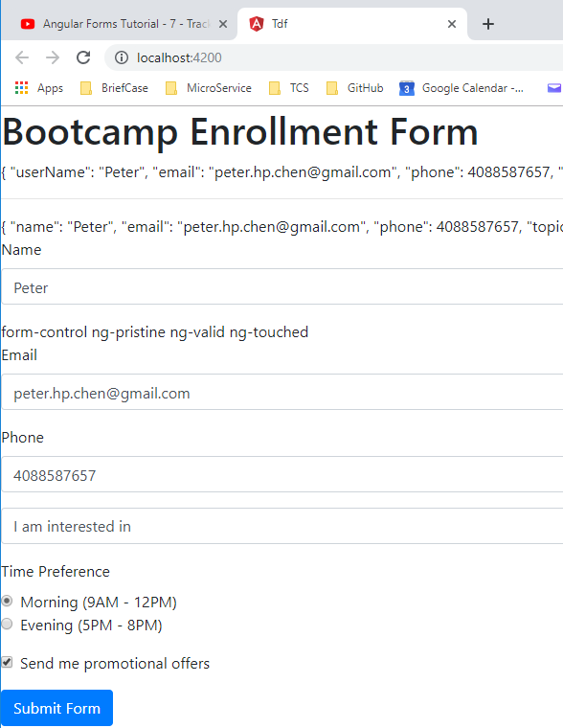
7 Validate
https://www.youtube.com/watch?v=WyWJwR0FJV0&list=PLC3y8-rFHvwhBRAgFinJR8KHIrCdTkZcZ&index=38
We have form-control, ignore this.
We have ng-untouched, ng-pristine, and ng-valid. All these are from Angular.
The ng-untouched is based on whether the form field has been visited or not. On page load, the form field has not been visited. Therefore, Angular applies a class of ng-untouched.
Now, if we click on the input element, we can see the class does not change even though the input element has been visited. However, onblur (Click other element), the class does change into “ng-touched”

Slide 8
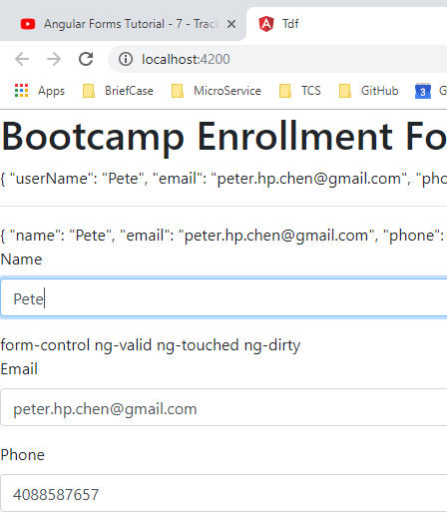
7 Validate
https://www.youtube.com/watch?v=WyWJwR0FJV0&list=PLC3y8-rFHvwhBRAgFinJR8KHIrCdTkZcZ&index=38
Similarly, we have ng-pristine and ng-dirty whether the value of the form has changed or not.
On page load, the value has not changed. So Angular applies ng-pristine. If I changed ‘Peter’ to ‘Pete’, now ng-pristine changed to ng-dirty.

Slide 9
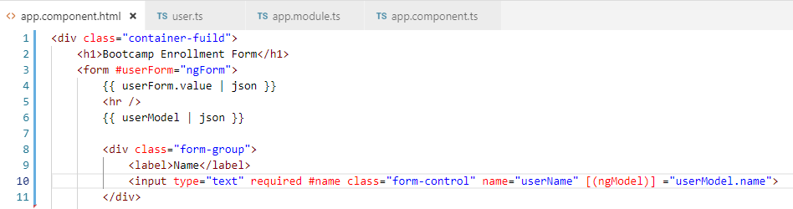
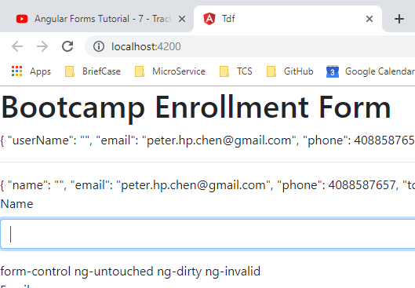
7 Validate
https://www.youtube.com/watch?v=WyWJwR0FJV0&list=PLC3y8-rFHvwhBRAgFinJR8KHIrCdTkZcZ&index=38
Finally, the Angular applies the ng-valid or ng-invalid based on the form fields validity.
Now, to test this, we need some sort of rule on the input element. We need to add the required attribute.
Go back to the browser, we can see “ng-valid”, however, if we remove all the characters, we can see the ng-invalid.

Slide 10
7 Validate
https://www.youtube.com/watch?v=WyWJwR0FJV0&list=PLC3y8-rFHvwhBRAgFinJR8KHIrCdTkZcZ&index=38
As you can see, Angular tries to help us out with form validation by applying the appropriate classes to the form controls.
All those classes can be used to provide visual feedback.
Angular also provides an alternative which is better than each of the classes. Angualr provides an associated property on the ngModel directive.
The property is basically same as the class with the ng- got removed. The ng-untouched is associated with ngModel property untouched, ng-touched is ngModel property touched, ng-pristine is pristine, and similarly, the other classes.
ngModel Properties
class | Property
ng-untouched | untouched
ng-touched | touched
ng-pristine | pristine
ng-dirty | dirty
ng-valid | valid
ng-invalid | invalid

Slide 11
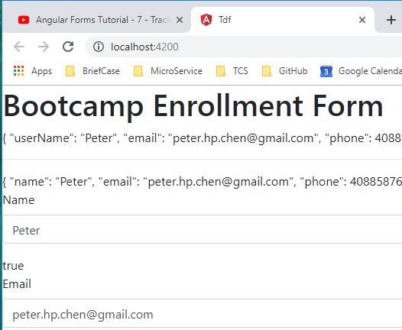
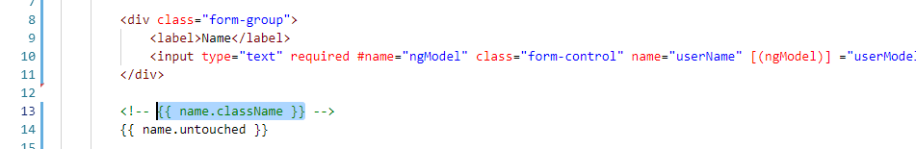
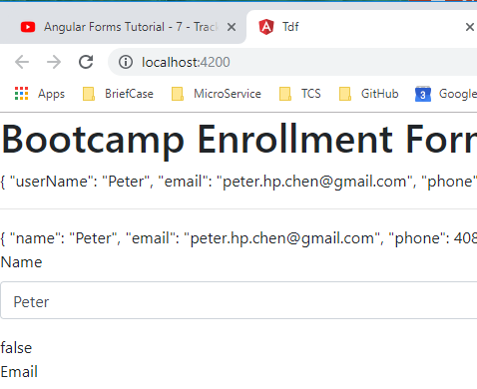
7 Validate
https://www.youtube.com/watch?v=WyWJwR0FJV0&list=PLC3y8-rFHvwhBRAgFinJR8KHIrCdTkZcZ&index=38
Let’s look at these properties in our enrollment form.
The question is how to get access to these ngModel property.
The answer is simply create a reference to this ngModel directive.
Right now, the #name point to the input element of the DOM. By assigning a value of ngModel. The reference variable now points to ngModel of this particular form control.
So, now we have reference to ngModel. We can easily find the different properties.
Let’s look at untouched. The name is {{ name.untouched }}

Slide 12
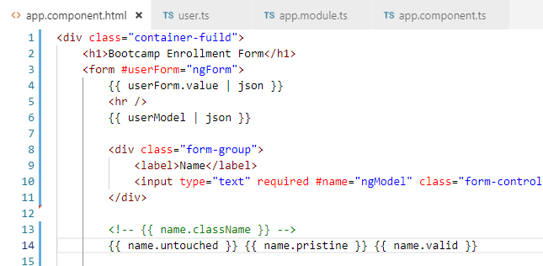
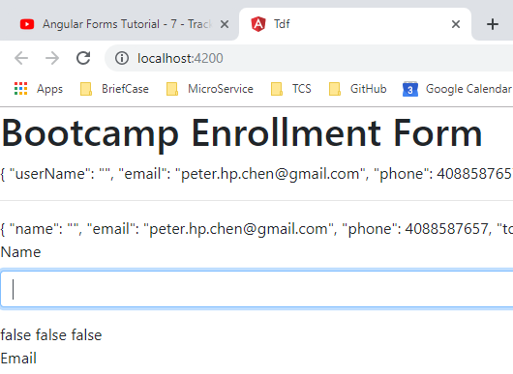
7 Validate
https://www.youtube.com/watch?v=WyWJwR0FJV0&list=PLC3y8-rFHvwhBRAgFinJR8KHIrCdTkZcZ&index=38
Similarly, we can check the {{ name.pristine }} and {{ name.valid}}.

Slide 13
7 Validate
https://www.youtube.com/watch?v=WyWJwR0FJV0&list=PLC3y8-rFHvwhBRAgFinJR8KHIrCdTkZcZ&index=38
We can see the property return the boolean is much easier to work with than class name.
We wan to make sure to understand the difference between the class and property that help us the track the state and validity of form controls.

Slide 14
End of Chapter

