Slide 1

8 Validation with Visual Feedback
Peter H. Chen

Slide 2
8 Validation with Visual Feedback
https://www.youtube.com/watch?v=kFHkztHm8xA&list=PLC3y8-rFHvwhBRAgFinJR8KHIrCdTkZcZ&index=39
A good user experience when fill out the forms is to visually indicate to the user if a form field is invalid as when they enter the details.
In this section, we will see validation with the form fields and visually indicate to the user when the form is invalid.
There are two approaches, you can create your own class with the necessary style that has to be applied to the form control or you can use the validation classes that your CSS framework provided.
We will use a class if invalid which Bootstrap 4 provided but we have to make sure we apply that class conditionally that is only when the form control is invalid.

Slide 3

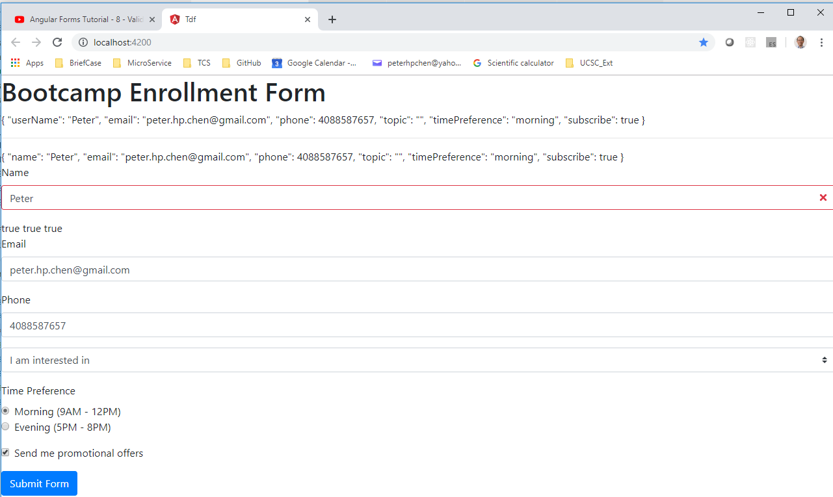
8 Validation with Visual Feedback
https://www.youtube.com/watch?v=kFHkztHm8xA&list=PLC3y8-rFHvwhBRAgFinJR8KHIrCdTkZcZ&index=39
Let’s begin with the name of form control. The class bootstrap 4 provides for invalid state is is-invalid.
When we apply this. We can see the red boarder on the form control.

Slide 4
8 Validation with Visual Feedback
https://www.youtube.com/watch?v=kFHkztHm8xA&list=PLC3y8-rFHvwhBRAgFinJR8KHIrCdTkZcZ&index=39
This is sufficient visual feedback for the demo. We must ensure the when we applied only when the form control is invalid. And for that, we make use of the ngModel properties coupled with class binding.
Class binding begin with square bracket. [class.is-invalid] this is applied only when the form control is invalid.
[class.is-invalid] =“name.invalid”
class=“form-control is-invalid” => class=“form-control”

Slide 5
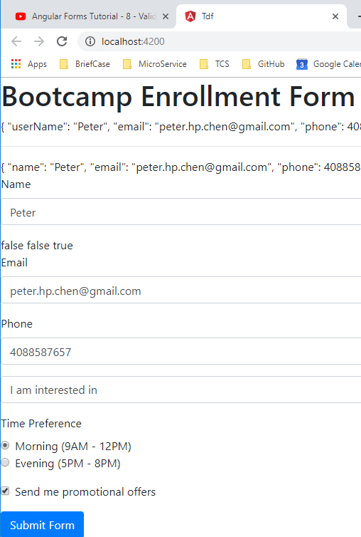
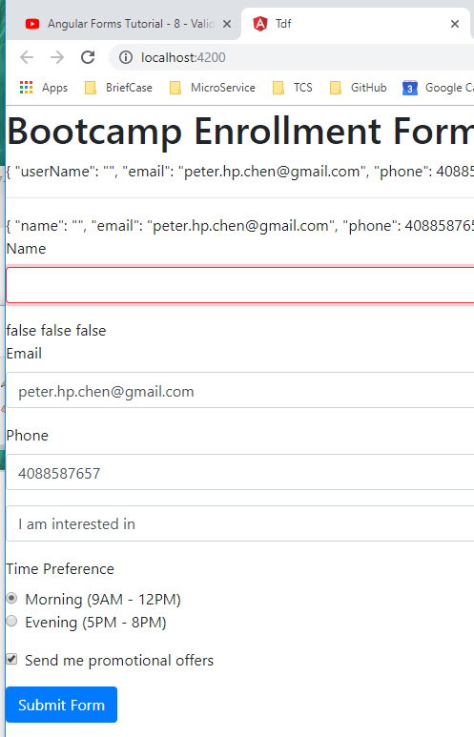
8 Validation with Visual Feedback
https://www.youtube.com/watch?v=kFHkztHm8xA&list=PLC3y8-rFHvwhBRAgFinJR8KHIrCdTkZcZ&index=39
Go back to browser and test for invalid. The visual feedback is working as we expected.
However, there is room for improvement.

Slide 6
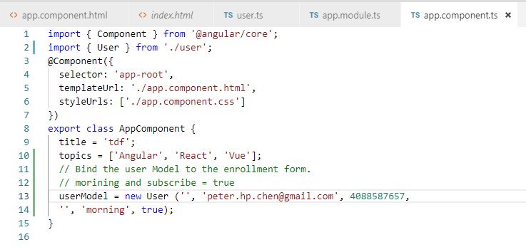
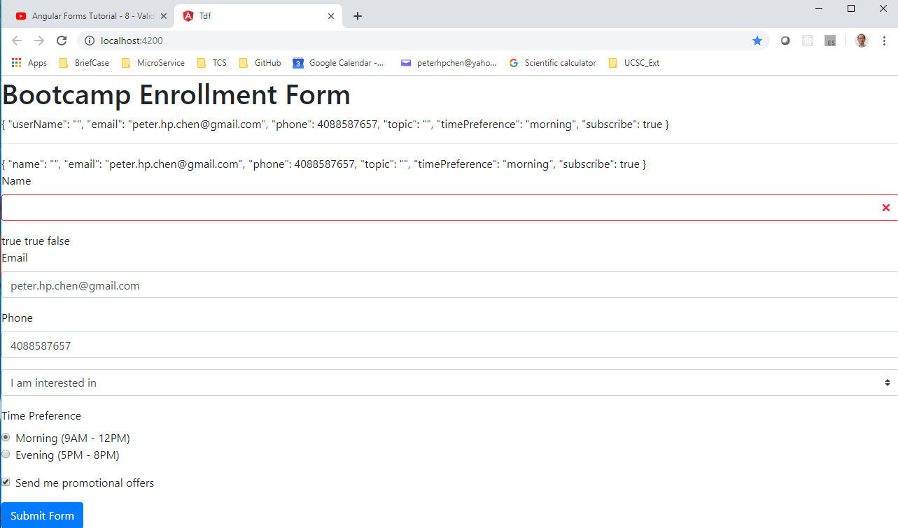
8 Validation with Visual Feedback
https://www.youtube.com/watch?v=kFHkztHm8xA&list=PLC3y8-rFHvwhBRAgFinJR8KHIrCdTkZcZ&index=39
Let’s say we have empty form to begin with. Empty the name field. Then we got red boarder.
If we have 10 fields are in red boarders, that will looks bad.

Slide 7
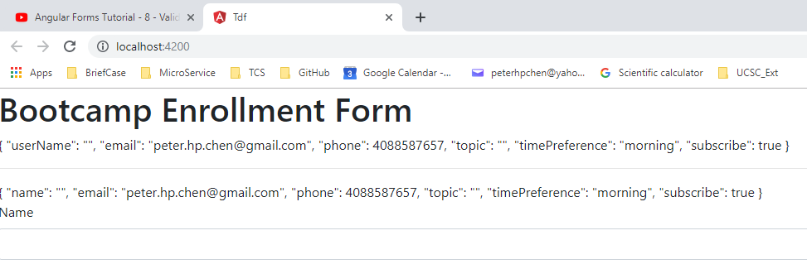
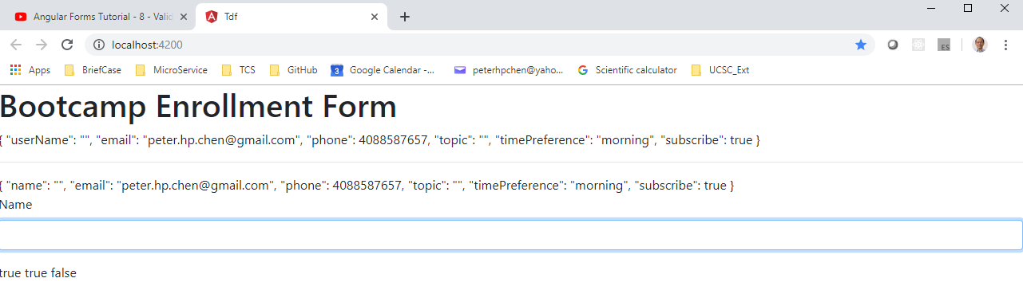
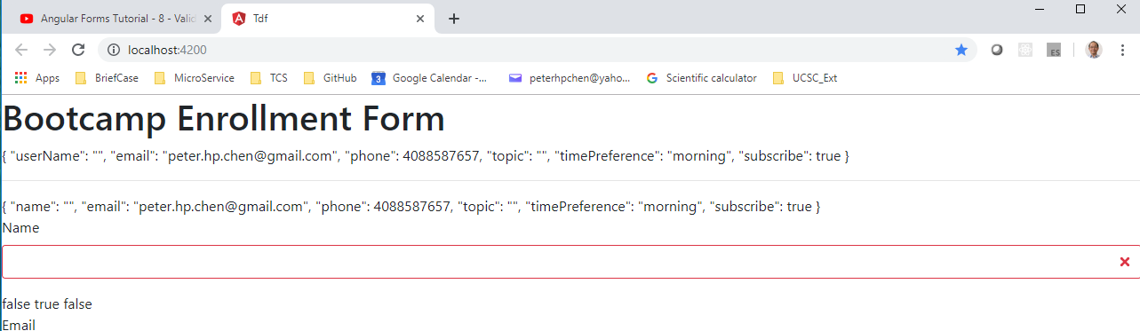
8 Validation with Visual Feedback
https://www.youtube.com/watch?v=kFHkztHm8xA&list=PLC3y8-rFHvwhBRAgFinJR8KHIrCdTkZcZ&index=39
If user touch form field without entering anything, then the field turn red.
Blank at Beginning (normal)
Touched name field (blue)
Touched name field and leave (red)

Slide 8
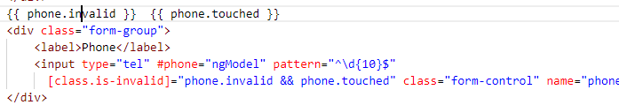
8 Validation with Visual Feedback
https://www.youtube.com/watch?v=kFHkztHm8xA&list=PLC3y8-rFHvwhBRAgFinJR8KHIrCdTkZcZ&index=39
You can add the form field with regular expression checking.
For example, the password have to be 8-15 characters with one special character.
A pin code with a special format.
A phone number in a specific format.
Our example shows the phone number is 10 digit.
First step, get a reference to the ngModel directive.

Slide 9
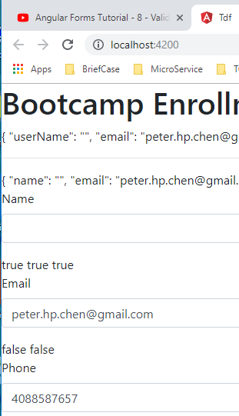
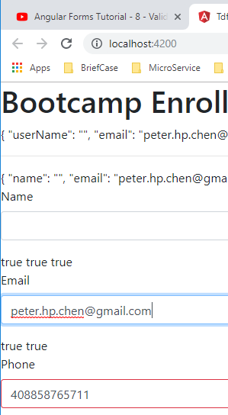
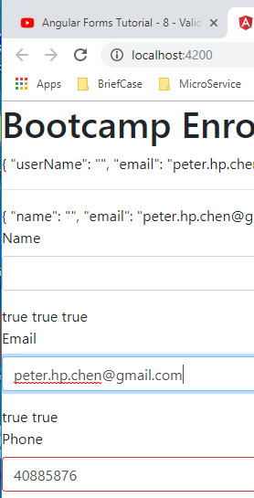
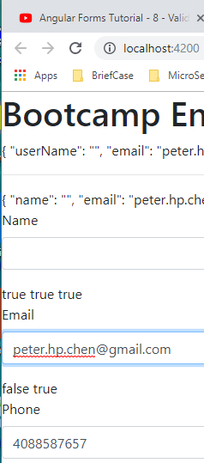
8 Validation with Visual Feedback
https://www.youtube.com/watch?v=kFHkztHm8xA&list=PLC3y8-rFHvwhBRAgFinJR8KHIrCdTkZcZ&index=39
Go back to browser and validate
Initially 10 digits
12 digits and touched outside
12 digits and touched outside
10 digits and touched outside

Slide 10
8 Validation with Visual Feedback
https://www.youtube.com/watch?v=kFHkztHm8xA&list=PLC3y8-rFHvwhBRAgFinJR8KHIrCdTkZcZ&index=39
This is pretty much the idea behind field Validation in template driven form using ngModel properties and class binding conditionally apply a class that visually indicates the invalid state.
Right now, we are providing the visual feedback to the user that something is wrong with the for field, however, that is not enough.
It will be very frustrated if they are not sure what has to be done to correct the error, whenever a form field is invalid, it is essential that we display an appropriate error message.

Slide 11
End of Chapter

