Slide 1

1 Boost Python with C/C++ Lib
Peter H. Chen

Slide 2
1 Boost Python with C/C++ Lib
https://realpython.com/build-python-c-extension-module/
The Python Library is implemented by C/C++
Build Python with C Extension Module:
https://realpython.com/build-python-c-extension-module/
We discuss the following:
Invoke C Function from Python
Pass Arguments from Python to C and Parse the arguments
Raise exception from C code and custom Python exceptions in C
Define global constants in C and make them accessible in Python
Test, package, and distribute the Python C Extension Module
We will focus on 1, 2, and 5, i.e., build package and passing arguments 1, 2, 5.

Slide 3
1 Boost Python with C/C++ Lib
https://realpython.com/build-python-c-extension-module/
The Python Library is implemented by C/C++
Python is written in C/C++.
We can extend the Python functionality with C/C++ Library.
This C/C++ Library can improve the performance and have better access to C-Library function and system calls.
We can be write C/C++ and then use setup.py to add to the site-packages.
After the library is added to site-packages, we can use it.
The example below shows how to add the C function fputs() into the site-packages (library).

Slide 4
1.1 Write method_fputs function

Slide 5
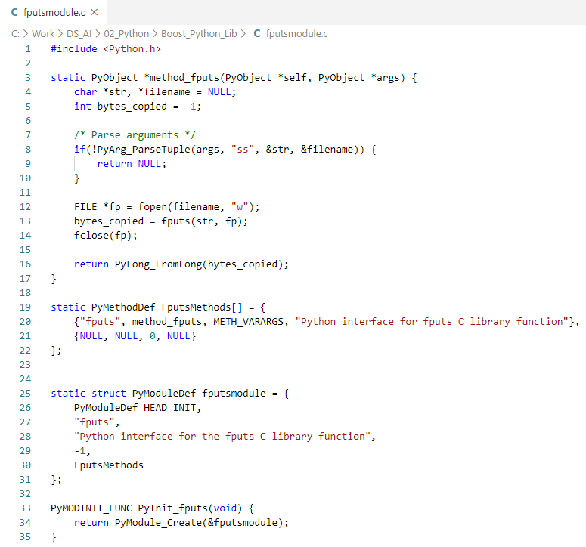
1.1 Write method_fputs function
https://realpython.com/build-python-c-extension-module/
Write fputs () function
C Code: fputmodule.c

Slide 6
1.1 Write method_fputs function
https://realpython.com/build-python-c-extension-module/
Write fputs function
The “int fputs(const char *, FILE *)” is the C Library function we will be wrapping.
The fputs() write the character array to the file * and return a non-negative number.
In the method_fputs() function, we wrap the fputs() function.

Slide 7
1.1 Write method_fputs function
https://realpython.com/build-python-c-extension-module/
Write fputs function
In Python.h, define:
PyObject: define input and output Object types for Python.
PyArg_ParseTuple(): Parse the arguments from Python.
PyLong_FromLong(): Trasnlate C long integer and return a PyLongObject, a Python long integer object.

Slide 8
1.1 Write method_fputs function
https://realpython.com/build-python-c-extension-module/
Write fputs function
PyMethodDef: Tell Python interpreter about the methods. Hold information about the methods. Each Module (Class/Component) can have array of methods.
“fputs”: Method Name.
method_fputs: C function Name.
METHOD_VARARGS: flag
“…”: docstring
{NULL, NULL, 0, NULL}: Sentinel (Guard) elements.

Slide 9
1.1 Write method_fputs function
https://realpython.com/build-python-c-extension-module/
Write fputs function
PyModuleDef: Hold information about Module (Class/Component).
Note: A Module (Class/Component) can contain several method inside.
PyModyleDef_HEAD_INIT: default value.
fputs: Module name of Python/C Extension.
“…”: Module docstring.
-1: flags (no sub-interpreter)
FputsMethods: PyMethodDef array name.

Slide 10
1.1 Write method_fputs function
https://realpython.com/build-python-c-extension-module/
Write fputs function
PyMODINIT_FUNC: Tell the compiler to call to the defined module (and asscoaited methods) at very beginning.
PyModule_Create: call fputModule and return a new module object PyObject.

Slide 11
1.1 Write method_fputs function
https://realpython.com/build-python-c-extension-module/
Write fputs function
Now, put Python/C extension module together.
When you import the Python/C extension module, PyInit_fputs() is first method to be called. Then, PyModule_Create () will be called.
The PyModule_Crreate() will call defined module (and associated methods)
PyInit_fputs
PyModule_Create
Python Interpreter
PyMethodDef
PyModuleDef

Slide 12
1.1 Write method_fputs function
https://realpython.com/build-python-c-extension-module/
Write fputs function
Once the calls are completed, the module (and associated methods inside the module) are all in the Python interpreter.
Python can access module which contains methods (fputs, …)
Module
PyModuleDef
…
PyMethodDef
PyMethodDef
…
Method_fputs
fputs

Slide 13
1.1 Write method_fputs function
https://realpython.com/build-python-c-extension-module/
Write fputs function
Once the method_fputs() is called, the following steps:
PyArg_ParseTuple(): Parse the arguments from Python to C Function.
fputs(): C library function call.
PyLong_FromLong(): return the value from fputs().
method_fputs
PyArg_ParseTuple
fputs()
PyLOng_FromLong()

Slide 14
1.2 Write setup.py

Slide 15
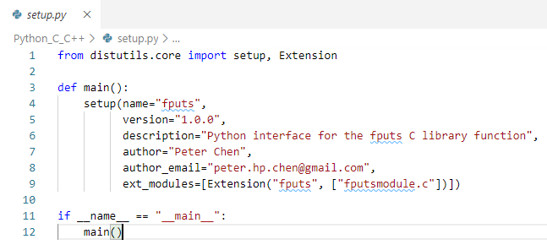
1.2 Write setup.py
https://realpython.com/build-python-c-extension-module/
Write setup.py
Build Python C Extension: setup.py

Slide 16
1.2 Write setup.py
https://realpython.com/build-python-c-extension-module/
Write setup.py
import distutils.core: We use the setup and Extension methods in the python package distutils.core.
You specify the C-library name, version, description, author, email, and etc.
ext_modue: Contains the list of Extension Object with Module name (may includes several methods) and C-file name.

Slide 17
1.3 Build site-packages

Slide 18
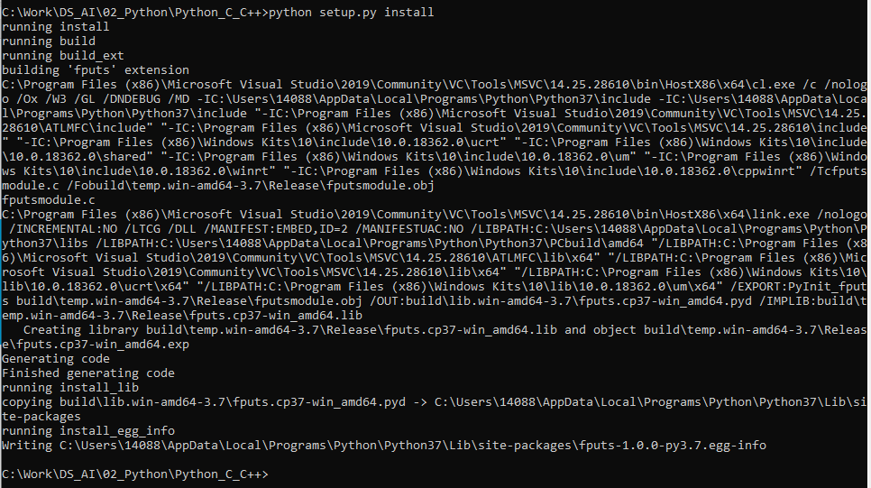
1.3 Build site-packages
https://realpython.com/build-python-c-extension-module/
Build site-packages
> python setup.py install
“C:\Users\14088\AppData\Local\Programs\Python\Python37\Lib\site-packages\fputs-1.0.0-py3.7.egg-info”

Slide 19
1.4 Verify site-packages

Slide 20
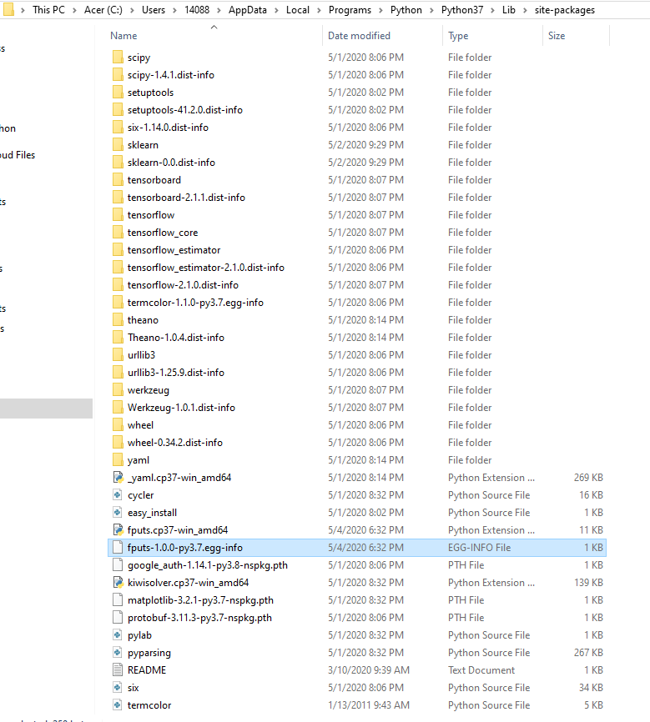
1.4 Verify site-packages
https://realpython.com/build-python-c-extension-module/
Verify site-packages
> python setup.py install
The above command build the Python/C extension module.
You can find the build module information in egg-info file “fputs-1.0.0…” as below:
“C:\Users\14088\AppData\Local\Programs\Python\Python37\Lib\site-packages\fputs-1.0.0-py3.7.egg-info”

Slide 21
1.5 Test fputs

Slide 22
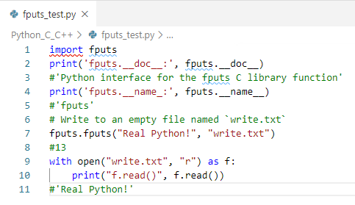
1.5 Test fputs
https://realpython.com/build-python-c-extension-module/
Test fputs
> python fputs_test.py

Slide 23
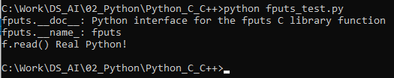
1.5 Test fputs
https://realpython.com/build-python-c-extension-module/
Test fputs
> python fputs_test.py

Slide 24
1.6 Test Passing Arguments

Slide 25
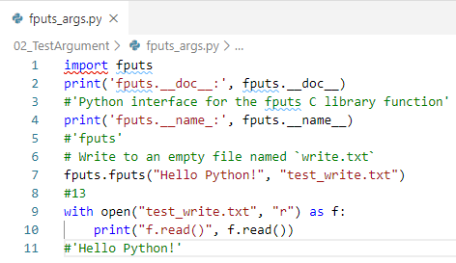
1.6 Test Passing Arguments
https://realpython.com/build-python-c-extension-module/
Test Passing Arguments
> python fputs_args.py

Slide 26
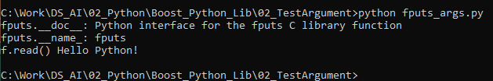
1.6 Test Passing Arguments
https://realpython.com/build-python-c-extension-module/
Test Passing Arguments
> python fputs_test.py

Slide 27
End of Chapter

