Slide 1
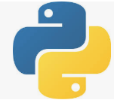
1 Boost Python with C/C++ Lib
Peter H. Chen

Slide 2
1 Boost Python with C/C++ Lib
https://realpython.com/build-python-c-extension-module/
The Python Library is implemented by C/C++.
If we want to add the Python Library, we can be write C/C++ and then use setup.py to add to the site-packages.
After the library is added to site-packages, we can use it.
The example below shows how to add the C function fputs() into the site-packages (library).

Slide 3
1.1 Write fputs function

Slide 4
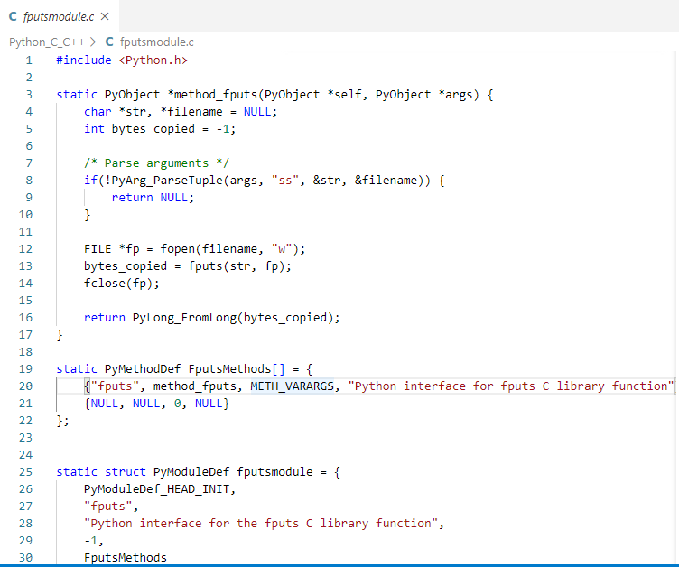
1.1 Write fputs function
https://realpython.com/build-python-c-extension-module/
Write fputs function
Create a file : fputmodule.c

Slide 5
1.2 Write setup.py

Slide 6
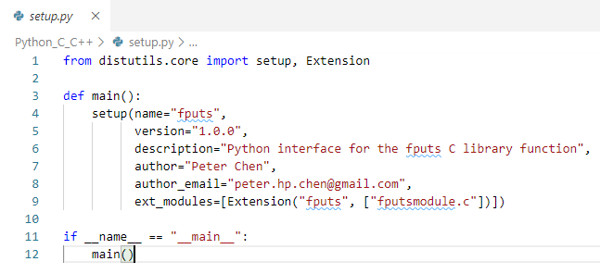
1.2 Write setup.py
https://realpython.com/build-python-c-extension-module/
Write setup.py
Create a file : setup.py

Slide 7
1.3 Build site-packages

Slide 8
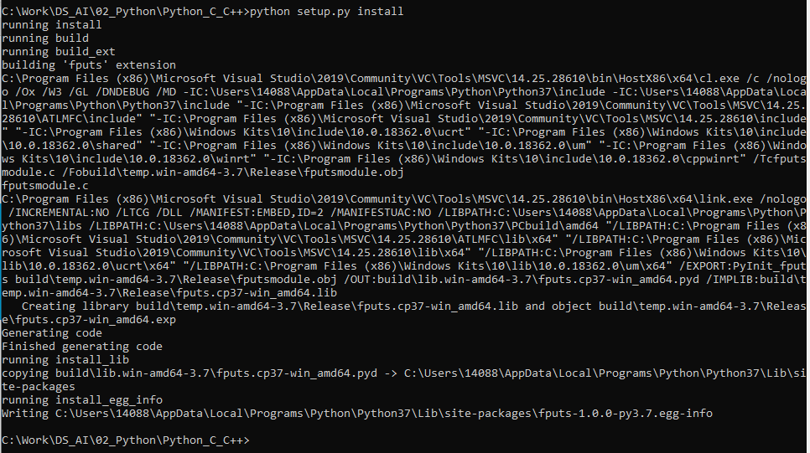
1.3 Build site-packages
https://realpython.com/build-python-c-extension-module/
Build site-packages
> python setup.py install
“C:\Users\14088\AppData\Local\Programs\Python\Python37\Lib\site-packages\fputs-1.0.0-py3.7.egg-info”

Slide 9
1.4 Verify site-packages

Slide 10
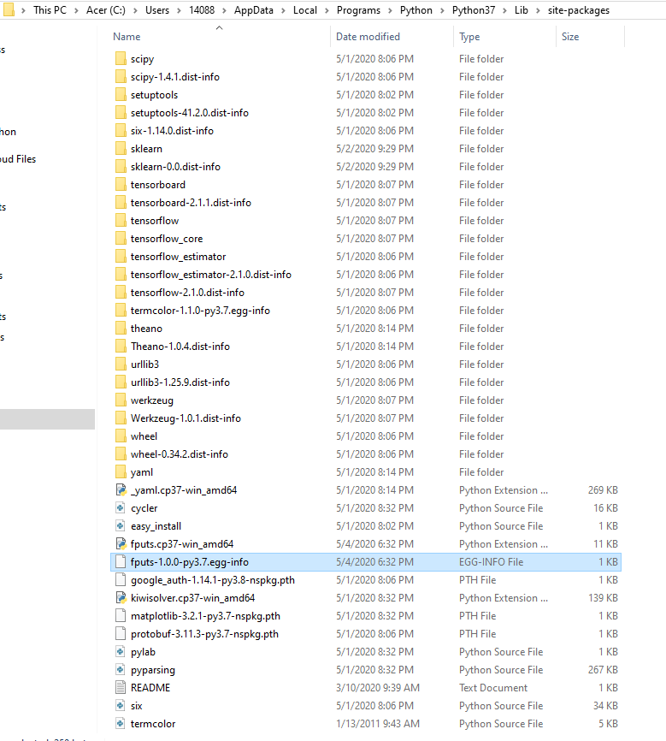
1.4 Verify site-packages
https://realpython.com/build-python-c-extension-module/
Verify site-packages
> python setup.py install
“C:\Users\14088\AppData\Local\Programs\Python\Python37\Lib\site-packages\fputs-1.0.0-py3.7.egg-info”
YOU can find egg-info file “fputs-1.0.0…”

Slide 11
1.5 Test fputs

Slide 12
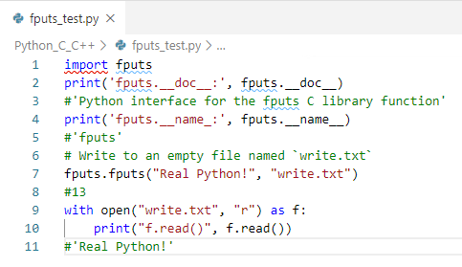
1.5 Test fputs
https://realpython.com/build-python-c-extension-module/
Test fputs
> python fputs_test.py

Slide 13
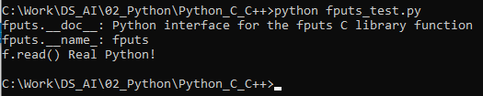
1.5 Test fputs
https://realpython.com/build-python-c-extension-module/
Test fputs
> python fputs_test.py

Slide 14
End of Chapter

