Slide 1

10 Classification
Peter H. Chen

Slide 2
10 Classification
https://www.tutorialspoint.com/machine_learning_with_python/machine_learning_with_python_classification_algorithms_introduction
Classification
Classification is the process of predicting class or category from observed values or given data points.
The categorized output can have the form, such as, “Black”, “White”, “spam”, “no spam”, or etc.
Mathematically, classification is the task of approximating a mapping function (f) from input variables (X) to output variables (Y).
Classification is a kind of Supervised Machine Learning.
In classification, the targets are provided along with the input data set.
For example, the classification problem can be the spam detection in emails.
There can be only two categories of output, “spam” and “no spam”, therefore, this is a binary type classification.
To implement the classification, we first need to train the classifier, for example, “spam” and “no spam” emails would be used as the training data.
After successfully train the classifier, the classifier can be used to detect an unknown email.

Slide 3
10.1 Types of Learner in Classification

Slide 4
10.1 Types of Learner in Classification
https://www.tutorialspoint.com/machine_learning_with_python/machine_learning_with_python_classification_algorithms_introduction
Types of Learner in Classification
We have two types of learning in classification problems:
Lazy Learner
The lazy learner waits for testing data to be appeared after storing the training data. Classification is done after getting the testing data, for example, K-nearest neighbors and case-based reasoning.
Eager Learner
Eager learner construct classification model without waiting for the training data to be appeared after storing the training data. They spend more time on training but less time on predicting, for example, Decision Trees, Naïve Bayes, and ANN (Artificial Neural Network).

Slide 5
10.2 Build Classifier

Slide 6
10.2 Build Classifier
https://www.tutorialspoint.com/machine_learning_with_python/machine_learning_with_python_classification_algorithms_introduction
Build Classifier Problem
Given the Breast Cancer Features/Data and target data /Labels as below.
Features |  |  |  |  |  | Target
mean Radius | Mean texture | mean perimeter | Mean area | Mean smooth | … | Malignant (0) /Benign (1)
17.99 | 10.38 | 122.8 | 10.1 | 0.118 | … | 0
20.5 | 17.7 | 132.9 | 13.2 | 0.08 | … | 1
… | … | … | … | … | … | …
… | … | … | … | … | … | 1
… | … | … | … | … | … | 0

Slide 7
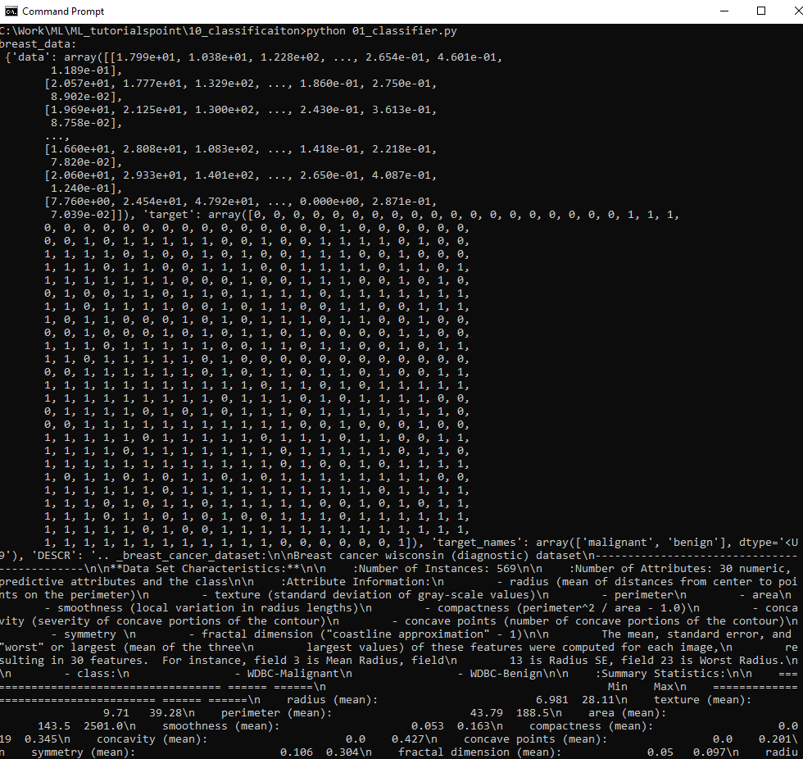
10.2 Build Classifier
https://www.tutorialspoint.com/machine_learning_with_python/machine_learning_with_python_classification_algorithms_introduction
Build Classifier Problem
Given the Breast Cancer Data as below.

Slide 8
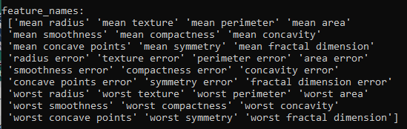
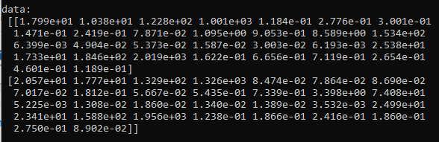
10.2 Build Classifier
https://www.tutorialspoint.com/machine_learning_with_python/machine_learning_with_python_classification_algorithms_introduction
Build Classifier Problem
Feature Names and Feature data:

Slide 9
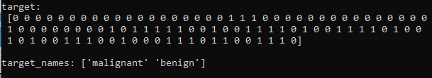
10.2 Build Classifier
https://www.tutorialspoint.com/machine_learning_with_python/machine_learning_with_python_classification_algorithms_introduction
Build Classifier Problem
Target name and target data:

Slide 10
10.2 Build Classifier
https://www.tutorialspoint.com/machine_learning_with_python/machine_learning_with_python_classification_algorithms_introduction
Build Classifier
Scikit-learn is a Python library for machine learning.
Scikit-learn can be used to build a classifier.
Step 1: Import Python Package
> import sklearn
Step 2: import dataset
> from sklearn.datasets import load_breast_cancer
> data = load_breast_cancer()
> label_names = data[‘target_names’]
> labels = data[‘target’]
> feature_names = data[‘feature_names’]
> featuers = data[‘data’]

Slide 11
10.2 Build Classifier
https://www.tutorialspoint.com/machine_learning_with_python/machine_learning_with_python_classification_algorithms_introduction
Build Classifier
Step 3: Organize data into training & testing sets
We need to test our model on unseen data, we will divide our dataset into two parts: a training set and a test set.
We can use traind_test_split() function of sklearn Packageto split the data into two sets.
> from sklearn.model_selection import train_test_split
Target is the labels
Data is features
> train, test, train_labels, test_labels = traint_test_split (data, target, test_size = 0.40, random_state = 42)

Slide 12
10.2 Build Classifier
https://www.tutorialspoint.com/machine_learning_with_python/machine_learning_with_python_classification_algorithms_introduction
Build Classifier
Step 4: Model evaluation
> from sklearn.naive_bayes import GausssianNB
> gnb = GaussianNB()
> model = gnb.fit (train, train_labels)
> preds = gnd.predicts (test)
> print (‘Predictions: ‘, preds)
Step 5: Finding Accuracy
> from sklearn.metrics import accuracy_score
> print (accuracy_acore(test_labels, preds))

Slide 13
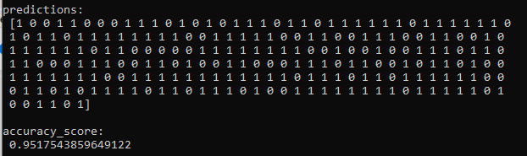
10.2 Build Classifier
https://www.tutorialspoint.com/machine_learning_with_python/machine_learning_with_python_classification_algorithms_introduction
Build Classifier
You can find the read in data locally below.
Note: I copy the data into csv_data folder for reference:
Prediction:
Malignant: 0
Benign: 1
Accuracy = 0.951

Slide 14
10.3 Classification Evaluation Metrics

Slide 15
10.3 Classification Evaluation Metrics
https://www.tutorialspoint.com/machine_learning_with_python/machine_learning_with_python_classification_algorithms_introduction
Classification Evaluation Metrics
The job is not done even if you have finished implementation of your Machine Learning application or model.
We must have to find out how effective our model is?
There can be different evaluation metrics, but we must choose it carefully because the choice of metrics influences how the performance of a machine learning algorithm is measured and compared.
The following are some of the important classification evaluation metrics among which you can choose based upon your dataset and kind of problem

Slide 16
10.3 Classification Evaluation Metrics
https://www.tutorialspoint.com/machine_learning_with_python/machine_learning_with_python_classification_algorithms_introduction
Confusion Matrix (1)
Confusion Matrix is the easiest way to measure the performance of a classification problem where the output can be of two or more type of classes.
https://www.tutorialspoint.com/machine_learning_with_python/machine_learning_with_python_confusion_matrix.htm
It is the easiest wat to measure the performance of a classification problem where the output can be two or more type of classes.
A confusion matrix is nothing but a table with two dimensions, i.e., “Actual” and “Predicted”. Both the dimensions have “True Positives (TP)”, “True Negatives (TN)”, “False Positives (FP)”, “False Negatives (FN)” as shown below
 |  | Actual
 |  | 1 | 0
Predicted | 1 | True Positive (TP) | False Positive (FP)
 | 0 | False Negative (FN) | True Negative (TN)

Slide 17
10.3 Classification Evaluation Metrics
https://www.tutorialspoint.com/machine_learning_with_python/machine_learning_with_python_classification_algorithms_introduction
Confusion Matrix (2)
https://www.tutorialspoint.com/machine_learning_with_python/machine_learning_with_python_confusion_matrix.htm
> from sklearn.metrics import confsion_matrix
For the output
> [[ 73 7]
> [4 144]]

Slide 18
10.3 Classification Evaluation Metrics
https://www.tutorialspoint.com/machine_learning_with_python/machine_learning_with_python_classification_algorithms_introduction
Confusion Matrix (3)
https://www.tutorialspoint.com/machine_learning_with_python/machine_learning_with_python_confusion_matrix.htm
Accuracy
It may be defined as the number of correct predictions made by our ML model. We can easily calculate it by confusion matrix with the help of following formula −
Accuracy=(TP+TN)/(TP+FP+FN+TN)
For above built binary classifier, TP + TN = 73+144 = 217 and TP+FP+FN+TN = 73+7+4+144=228.
Hence, Accuracy = 217/228 = 0.951754385965 which is same as we have calculated after creating our binary classifier.

Slide 19
10.3 Classification Evaluation Metrics
https://www.tutorialspoint.com/machine_learning_with_python/machine_learning_with_python_classification_algorithms_introduction
Confusion Matrix (3)
https://www.tutorialspoint.com/machine_learning_with_python/machine_learning_with_python_confusion_matrix.htm
Precision
Precision, used in document retrievals, may be defined as the number of correct documents returned by our ML model. We can easily calculate it by confusion matrix with the help of following formula −
Precision=TP/(TP+FP)
For the above built binary classifier, TP = 73 and TP+FP = 73+7 = 80.
Hence, Precision = 73/80 = 0.915

Slide 20
10.3 Classification Evaluation Metrics
https://www.tutorialspoint.com/machine_learning_with_python/machine_learning_with_python_classification_algorithms_introduction
Confusion Matrix (3)
https://www.tutorialspoint.com/machine_learning_with_python/machine_learning_with_python_confusion_matrix.htm
Recall or Sensitivity
Recall may be defined as the number of positives returned by our ML model. We can easily calculate it by confusion matrix with the help of following formula −
Recall=TP/(TP+FN)
For above built binary classifier, TP = 73 and TP+FN = 73+4 = 77.
Hence, Recall = 73/77 = 0.94805

Slide 21
10.3 Classification Evaluation Metrics
https://www.tutorialspoint.com/machine_learning_with_python/machine_learning_with_python_classification_algorithms_introduction
Confusion Matrix (3)
https://www.tutorialspoint.com/machine_learning_with_python/machine_learning_with_python_confusion_matrix.htm
Specificity
Specificity, in contrast to recall, may be defined as the number of negatives returned by our ML model.
We can easily calculate it by confusion matrix with the help of following formula −
Specificity=TN/(TN+FP)
For the above built binary classifier, TN = 144 and TN+FP = 144+7 = 151.
Hence, Specificity = 144/151 = 0.95364

Slide 22
10.4 ML Classification Algorithms

Slide 23
10.4 ML Classification Algorithms
https://www.tutorialspoint.com/machine_learning_with_python/machine_learning_with_python_classification_algorithms_introduction
ML Classification Algorithms
The followings are some important ML classification algorithms −
Logistic Regression
Support Vector Machine (SVM)
Decision Tree
Naïve Bayes
Random Forest

Slide 24
10.5 Applications

Slide 25
10.5 Applications
https://www.tutorialspoint.com/machine_learning_with_python/machine_learning_with_python_classification_algorithms_introduction
Applications
Some of the most important applications of classification algorithms are as follows −
Speech Recognition
Handwriting Recognition
Biometric Identification
Document Classification

Slide 26
End of Chapter

