Slide 1

21 Hierarchical Clustering
Peter H. Chen

Slide 2
21 Hierarchical Clustering
https://www.tutorialspoint.com/machine_learning_with_python/machine_learning_with_python_clustering_algorithms_hierarchical.htm
Introduction to Hierarchical Clustering
Hierarchical clustering is another unsupervised learning algorithm that is used to group together the unlabeled data points having similar characteristics.
Hierarchical clustering algorithms include two categories.
Agglomerative hierarchical algorithms − In agglomerative hierarchical algorithms, each data point is treated as a single cluster and then successively merge or agglomerate (bottom-up approach) the pairs of clusters. The hierarchy of the clusters is represented as a dendrogram or tree structure.
Divisive hierarchical algorithms − On the other hand, in divisive hierarchical algorithms, all the data points are treated as one big cluster and the process of clustering involves dividing (Top-down approach) the one big cluster into various small clusters.

Slide 3
21 Steps of Hierarchical Clustering
https://www.tutorialspoint.com/machine_learning_with_python/machine_learning_with_python_clustering_algorithms_hierarchical.htm
Steps to Perform Agglomerative Hierarchical Clustering
The steps to perform the most used and important Hierarchical clustering, i.e., agglomerative.
Step 1 − Treat each data point as single cluster. Hence, we will be having, say K clusters at start. The number of data points will also be K at start.
Step 2 − Now, in this step we need to form a big cluster by joining two closet datapoints. This will result in total of K-1 clusters.
Step 3 − Now, to form more clusters we need to join two closet clusters. This will result in total of K-2 clusters.
Step 4 − Now, to form one big cluster repeat the above three steps until K would become 0 i.e. no more data points left to join.
Step 5 − At last, after making one single big cluster, dendrograms (Tree-like diagram) will be used to divide into multiple clusters depending upon the problem.

Slide 4
21 Steps of Hierarchical Clustering
https://www.tutorialspoint.com/machine_learning_with_python/machine_learning_with_python_clustering_algorithms_hierarchical.htm
Role of Dendrograms in Agglomerative Hierarchical Clustering
The role of dendrogram starts once the big cluster is formed.
Dendrogram (Tree-like diagram) will be used to split the clusters into multiple cluster of related data points depending upon our problem.

Slide 5
21.1 Hierarchical Clustering Example 1

Slide 6
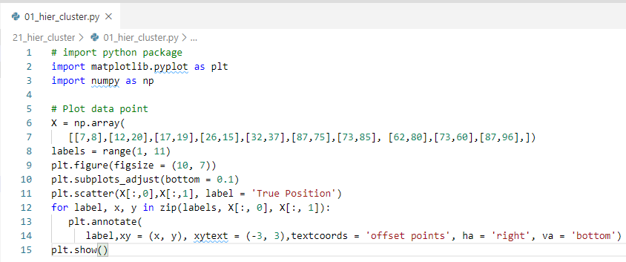
21.1 Hierarchical Clustering Example 1
https://www.tutorialspoint.com/machine_learning_with_python/machine_learning_with_python_clustering_algorithms_hierarchical.htm
Hierarchical Clustering Example 1
Two clusters

Slide 7
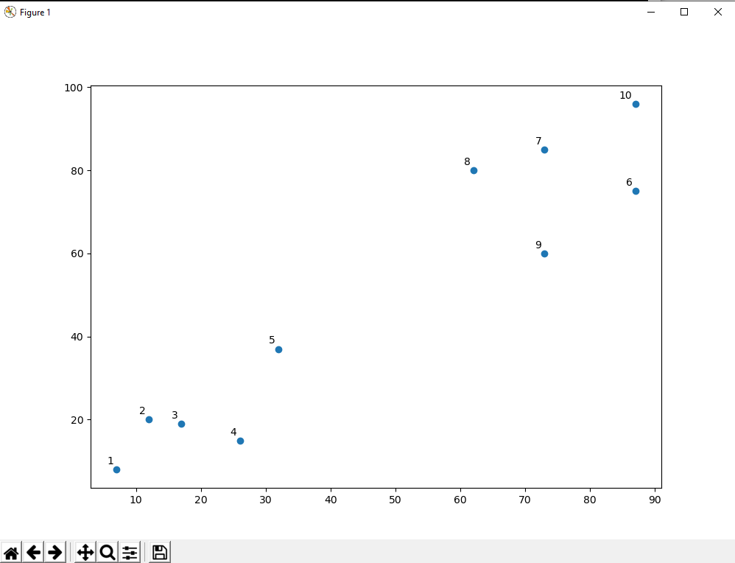
21.1 Hierarchical Clustering Example 1
https://www.tutorialspoint.com/machine_learning_with_python/machine_learning_with_python_clustering_algorithms_hierarchical.htm
Hierarchical Clustering Example 1
Display Result

Slide 8
21.2 Hierarchical Clustering Example 2

Slide 9
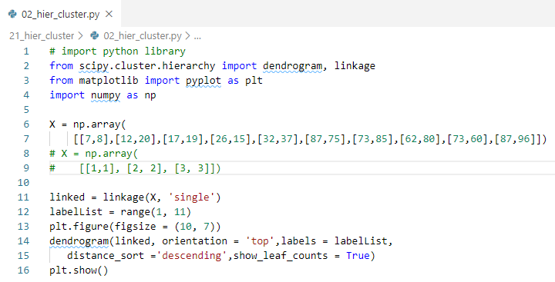
21.2 Hierarchical Clustering Example 2
https://www.tutorialspoint.com/machine_learning_with_python/machine_learning_with_python_clustering_algorithms_hierarchical.htm
Hierarchical Clustering Example 2
From the above diagram, it is very easy to see that we have two clusters in out datapoints but in the real world data, there can be thousands of clusters.
Next, we will be plotting the dendrograms of our datapoints by using Scipy library.

Slide 10
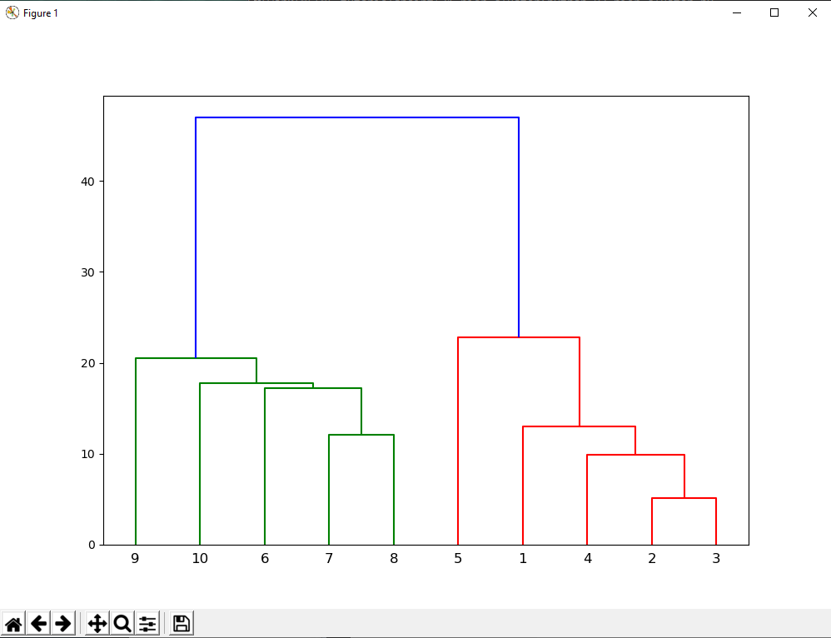
21.2 Hierarchical Clustering Example 2
https://www.tutorialspoint.com/machine_learning_with_python/machine_learning_with_python_clustering_algorithms_hierarchical.htm
Hierarchical Clustering Example 2
Display Result

Slide 11
21.3 Hierarchical Clustering Example 3

Slide 12
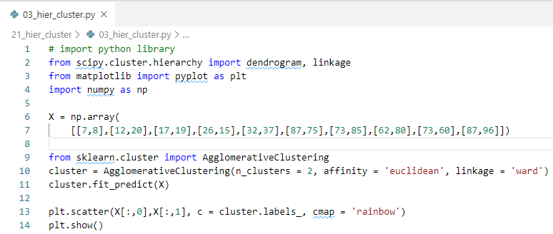
21.3 Hierarchical Clustering Example 3
https://www.tutorialspoint.com/machine_learning_with_python/machine_learning_with_python_clustering_algorithms_hierarchical.htm
Hierarchical Clustering Example 3
Next, we need to import the class for clustering and call its fit_predict method to predict the cluster.
We are importing AgglomerativeClustering class of sklearn.cluster library

Slide 13
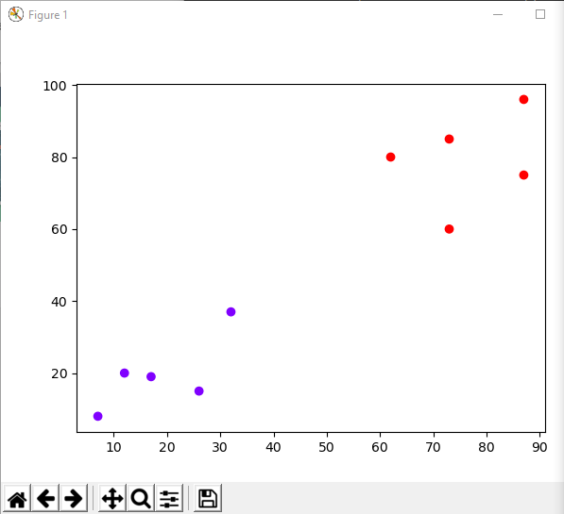
21.3 Hierarchical Clustering Example 3
https://www.tutorialspoint.com/machine_learning_with_python/machine_learning_with_python_clustering_algorithms_hierarchical.htm
Hierarchical Clustering Example 2
Display Result

Slide 14
21.4 Hierarchical Clustering Example 4

Slide 15
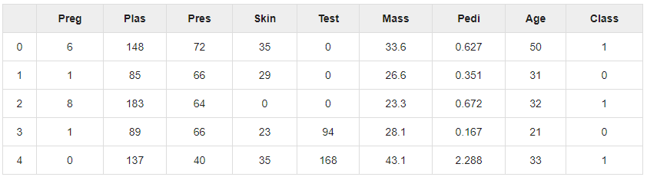
21.4 Hierarchical Clustering Example 4
https://www.tutorialspoint.com/machine_learning_with_python/machine_learning_with_python_clustering_algorithms_hierarchical.htm
Hierarchical Clustering Example 4
Pima Indian Diabetes Dataset by Hierarchical Clustering.

Slide 16
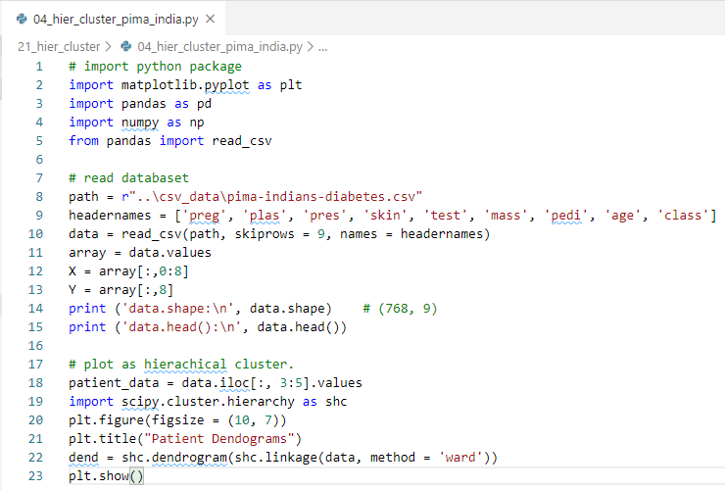
21.4 Hierarchical Clustering Example 4
https://www.tutorialspoint.com/machine_learning_with_python/machine_learning_with_python_clustering_algorithms_hierarchical.htm
Hierarchical Clustering Example 4
Pima Indian Diabetes Dataset by Hierarchical Clustering.

Slide 17
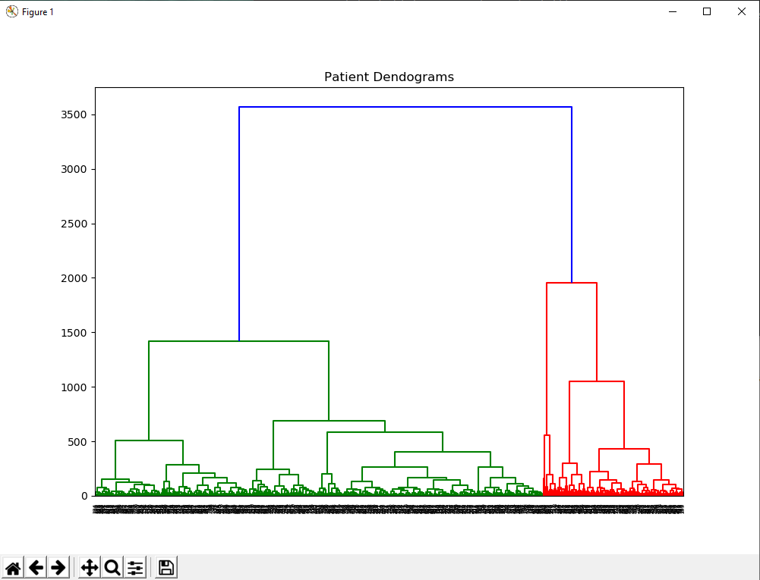
21.4 Hierarchical Clustering Example 4
https://www.tutorialspoint.com/machine_learning_with_python/machine_learning_with_python_clustering_algorithms_hierarchical.htm
Hierarchical Clustering Example 5
Display Result

Slide 18
21.4 Hierarchical Clustering Example 5

Slide 19
21.5 Hierarchical Clustering Example 5
https://www.tutorialspoint.com/machine_learning_with_python/machine_learning_with_python_clustering_algorithms_hierarchical.htm
Hierarchical Clustering Example 4
Pima Indian Diabetes Dataset by Hierarchical Clustering.

Slide 20
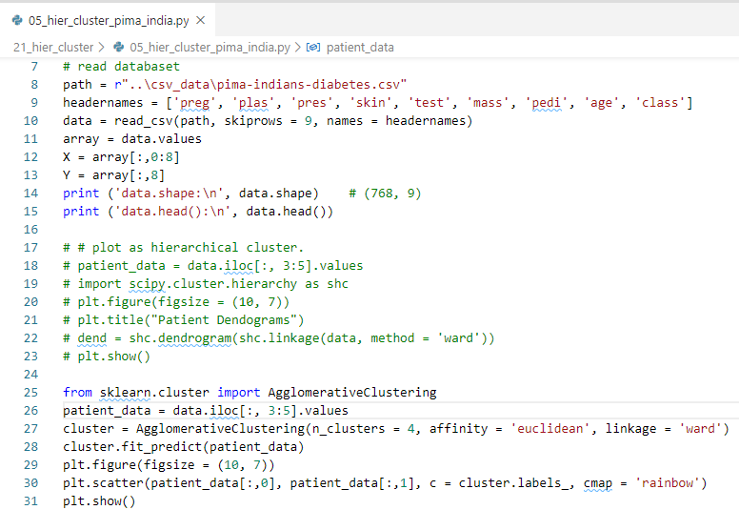
21.5 Hierarchical Clustering Example 5
https://www.tutorialspoint.com/machine_learning_with_python/machine_learning_with_python_clustering_algorithms_hierarchical.htm
Hierarchical Clustering Example 4
Pima Indian Diabetes Dataset by Hierarchical Clustering.

Slide 21
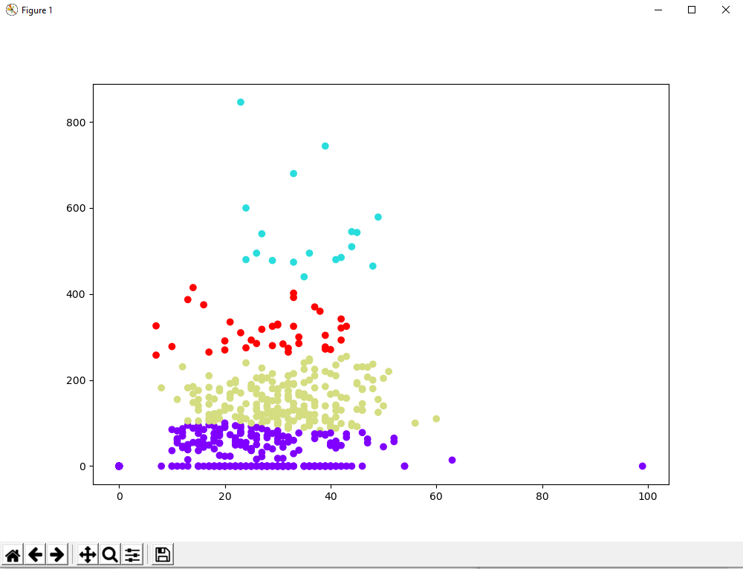
21.5 Hierarchical Clustering Example 5
https://www.tutorialspoint.com/machine_learning_with_python/machine_learning_with_python_clustering_algorithms_hierarchical.htm
Hierarchical Clustering Example 5
Display Result

Slide 22
End of Chapter

