Slide 1

26 Improve Model with Algorithm
Peter H. Chen

Slide 2
26 Improve Model with Algorithm
https://www.tutorialspoint.com/machine_learning_with_python/machine_learning_with_python_improving_performance_of_ml_model.htm
Improve Model Performance with Algorithm Tuning
ML models are parameterized in such a way that their behavior can be adjusted for a specific problem.
Algorithm tuning means finding the best combination of these parameters so that the performance of ML model can be improved.
This process sometimes called hyperparameter optimization and the parameters of algorithm itself are called hyperparameters and coefficients found by ML algorithm are called parameters.
we discuss about some methods for algorithm parameter tuning provided by Python Scikit-learn.
Grid Search Parameter Tuning
Grid Search tuning is a parameter tuning approach.
The key point of working of this method is that it builds and evaluate the model methodically for every possible combination of algorithm parameter specified in a grid.

Slide 3
25.1 Improve with Algorithm Example 1

Slide 4
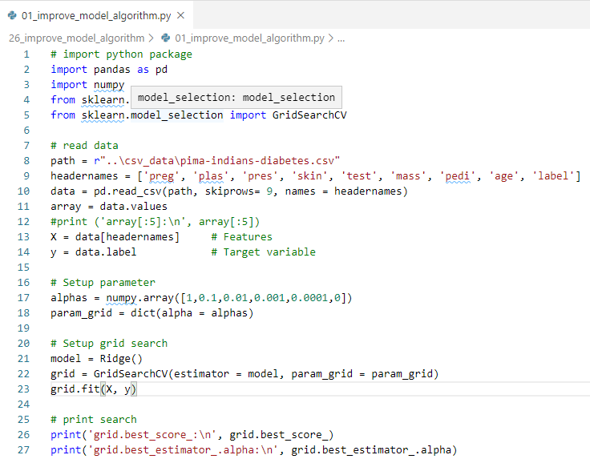
25.1 Improve with Algorithm Example 1
https://www.tutorialspoint.com/machine_learning_with_python/machine_learning_with_python_improving_performance_of_ml_model.htm
Improve Model Performance with Ensemble Example 1

Slide 5
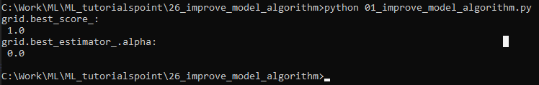
25.1 Improve with Algorithm Example 1
https://www.tutorialspoint.com/machine_learning_with_python/machine_learning_with_python_improving_performance_of_ml_model.htm
Improve Model Performance with Ensemble Example 1
Display Result

Slide 6
25.2 Improve with Algorithm Example 2

Slide 7
25.1 Improve with Algorithm Example 2
https://www.tutorialspoint.com/machine_learning_with_python/machine_learning_with_python_improving_performance_of_ml_model.htm
Improve Model Performance with Algorithm Example 2
Random Search Parameter Tuning
It is a parameter tuning approach.
The key point of working of this method is that it samples the algorithm parameters from a random distribution for a fixed number of iterations.

Slide 8
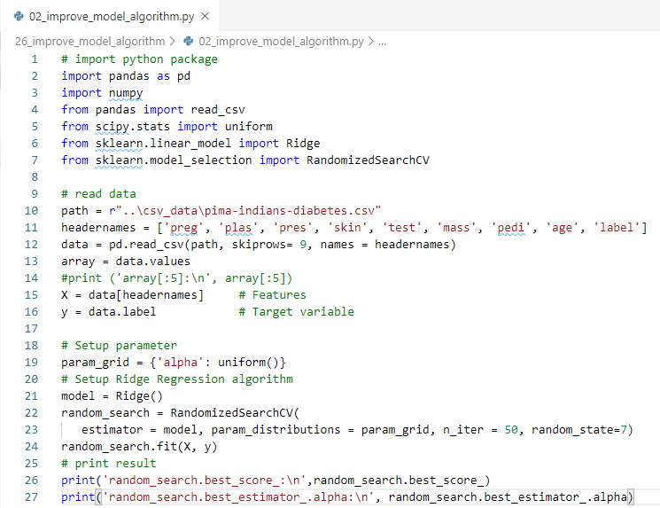
25.1 Improve with Algorithm Example 2
https://www.tutorialspoint.com/machine_learning_with_python/machine_learning_with_python_improving_performance_of_ml_model.htm
Improve Model Performance with Algorithm Example 2

Slide 9
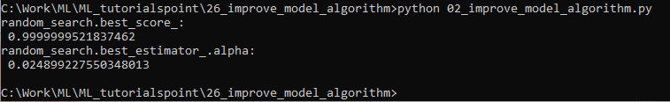
25.1 Improve with Algorithm Example 2
https://www.tutorialspoint.com/machine_learning_with_python/machine_learning_with_python_improving_performance_of_ml_model.htm
Improve Model Performance with Ensemble Example 2
Display Result

Slide 10
End of Chapter

