Slide 1

20 Means-Shift
Peter H. Chen

Slide 2
20 Means-Shift
https://www.tutorialspoint.com/machine_learning_with_python/machine_learning_with_python_clustering_algorithms_mean_shift.htm
Introduction to Mean-Shift Algorithm
K-Mean is another powerful clustering algorithm used in unsupervised learning.
Unlike K-means clustering, Mean-Shift algorithm does not make any assumptions, therefore, Mean-Shift is a non-parametric algorithm.
Mean-Shift algorithm assigns the datapoints to the clusters iteratively by shifting points towards the highest density of datapoints, i.e., cluster centroid.
The difference between K-Means algorithm and Mean-Shift is that later one does not need to specify the number of clusters in advance because the number of clusters will be determined by the algorithm with respect to data.

Slide 3
19.1 Mean-Shift Algorithm

Slide 4
20.1 Mean-Shift Algorithm
https://www.tutorialspoint.com/machine_learning_with_python/machine_learning_with_python_clustering_algorithms_mean_shift.htm
K-Means Algorithm
Mean-Shift clustering algorithm steps:
Step 1 − Data points assigned to a cluster of their own.
Step 2 − Compute the centroids.
Step 3 − Location of new centroids will be updated.
Step 4 − Iterated and moved to the higher density region.

Slide 5
19.2 Mean-Shift Example 1

Slide 6
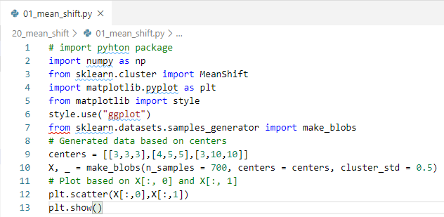
19.2 Mean-Shift Example 1
https://www.tutorialspoint.com/machine_learning_with_python/machine_learning_with_python_clustering_algorithms_mean_shift.htm
Mean-Shift Example 1

Slide 7
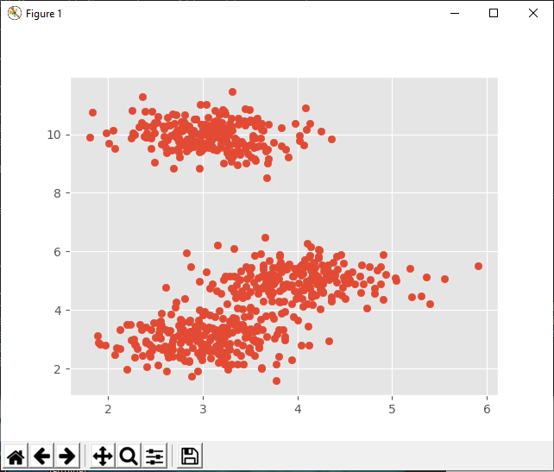
19.2 Mean-Shift Example 1
https://www.tutorialspoint.com/machine_learning_with_python/machine_learning_with_python_clustering_algorithms_mean_shift.htm
Mean-Shift Example 1
Display Result

Slide 8
19.2 Mean-Shift Example 2

Slide 9
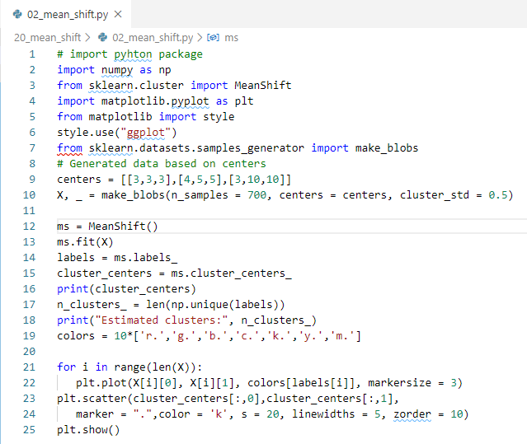
19.2 Mean-Shift Example 2
https://www.tutorialspoint.com/machine_learning_with_python/machine_learning_with_python_clustering_algorithms_mean_shift.htm
Mean-Shift Example 2

Slide 10
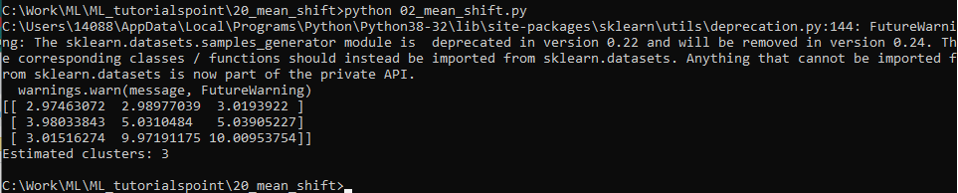
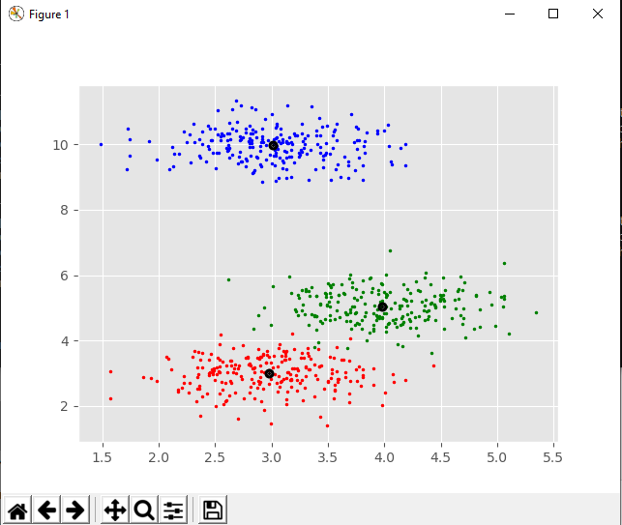
19.2 Mean-Shift Example 2
https://www.tutorialspoint.com/machine_learning_with_python/machine_learning_with_python_clustering_algorithms_mean_shift.htm
Mean-Shift Example 2
Display Result

Slide 11
19.3 Pros and Cons

Slide 12
19.3 Pros and Cons
https://www.tutorialspoint.com/machine_learning_with_python/machine_learning_with_python_clustering_algorithms_mean_shift.htm
Pros
Advantages of Mean-Shift clustering algorithm:
It does not need to make any model assumption as like in K-means or Gaussian mixture.
It can also model the complex clusters which have nonconvex shape.
It only needs one parameter named bandwidth which automatically determines the number of clusters.
There is no issue of local minima as like in K-means.
No problem generated from outliers.

Slide 13
19.3 Pros and Cons
https://www.tutorialspoint.com/machine_learning_with_python/machine_learning_with_python_clustering_algorithms_mean_shift.htm
Cons
Disadvantages of Mean-Shift clustering algorithm:
Mean-shift algorithm does not work well in case of high dimension, where number of clusters changes abruptly.
We do not have any direct control on the number of clusters but in some applications, we need a specific number of clusters.
It cannot differentiate between meaningful and meaningless modes.

Slide 14
End of Chapter

