Slide 1

12 Introduction to Decision Tree
Peter H. Chen

Slide 2
12 Introduction to Decision Tree
https://www.tutorialspoint.com/machine_learning_with_python/machine_learning_with_python_classification_algorithms_decision_tree.htm
Introduction to Decision Tree
In general, Decision tree analysis is a predictive modelling tool that can be applied across many areas.
Decision trees can be constructed by an algorithmic approach that can split the dataset in different ways based on different conditions. Decisions trees are the most powerful algorithms that falls under the category of supervised algorithms.
They can be used for both classification and regression tasks. The two main entities of a tree are decision nodes, where the data is split and leaves, where we got outcome.

Slide 3
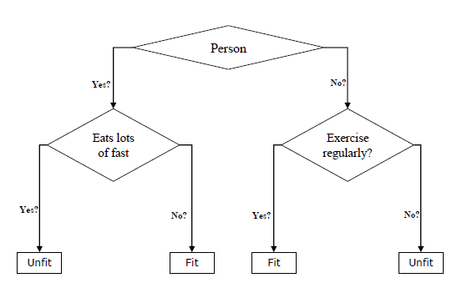
12 Introduction to Decision Tree
https://www.tutorialspoint.com/machine_learning_with_python/machine_learning_with_python_classification_algorithms_decision_tree.htm
Introduction to Decision Tree
The example of a binary tree for predicting whether a person is fit or unfit providing various information like age, eating habits and exercise habits, is given below.

Slide 4
12 Introduction to Decision Tree
https://www.tutorialspoint.com/machine_learning_with_python/machine_learning_with_python_classification_algorithms_decision_tree.htm
Introduction to Decision Tree
In the above decision tree, the question are decision nodes and final outcomes are leaves. We have the following two types of decision trees.
Classification decision trees − In this kind of decision trees, the decision variable is categorical. The above decision tree is an example of classification decision tree.
Regression decision trees − In this kind of decision trees, the decision variable is continuous.

Slide 5
12.1 Decision Tree Algorithm

Slide 6
12.1 Decision Tree Algorithm
https://www.tutorialspoint.com/machine_learning_with_python/machine_learning_with_python_classification_algorithms_decision_tree.htm
Decision Tree Algorithm
Gini Index (Gini Coefficient or Gini Ratio)
https://en.wikipedia.org/wiki/Gini_coefficient
It is the name of the cost function that is used to evaluate the binary splits in the dataset and works with the categorial target variable “Success” or “Failure”.
Higher the value of Gini index, higher the homogeneity.
A perfect Gini index value is 0 and worst is 0.5 (for 2 class problem).
Gini index for a split can be calculated with the help of following steps:
First, calculate Gini index for sub-nodes by using the formula p^2+q^2, which is the sum of the square of probability for success and failure.
Next, calculate Gini index for split using weighted Gini score of each node of that split.
Classification and Regression Tree (CART) algorithm uses Gini method to generate binary splits.

Slide 7
12.1 Decision Tree Algorithm
https://www.tutorialspoint.com/machine_learning_with_python/machine_learning_with_python_classification_algorithms_decision_tree.htm
Decision Tree Algorithm
Split Creation
A split is basically including an attribute in the dataset and a value.
We can create a split in dataset with the help of following three parts −
Part 1: Calculating Gini Score − Refer to previous section.
Part 2: Splitting a dataset - It may be defined as separating a dataset into two lists of rows having index of an attribute and a split value of that attribute. After getting the two groups - right and left, from the dataset, we can calculate the value of split by using Gini score calculated in first part. Split value will decide in which group the attribute will reside.
Part 3: Evaluating all splits - Next part after finding Gini score and splitting dataset is the evaluation of all splits. For this purpose, first, we must check every value associated with each attribute as a candidate split. Then we need to find the best possible split by evaluating the cost of the split. The best split will be used as a node in the decision tree.

Slide 8
12.2 Build Tree

Slide 9
12.2 Build Tree
https://www.tutorialspoint.com/machine_learning_with_python/machine_learning_with_python_classification_algorithms_decision_tree.htm
Build Tree
As we know that a tree has root node and terminal nodes. After creating the root node, we can build the tree by following two parts −
Part 1: Terminal node creation
While creating terminal nodes of decision tree, one important point is to decide when to stop growing tree or creating further terminal nodes. It can be done by using two criteria namely maximum tree depth and minimum node records as follows −
Maximum Tree Depth − As name suggests, this is the maximum number of the nodes in a tree after root node. We must stop adding terminal nodes once a tree reached at maximum depth, i.e., once a tree got maximum number of terminal nodes.
Minimum Node Records − It may be defined as the minimum number of training patterns that a given node is responsible for. We must stop adding terminal nodes once tree reached at these minimum node records or below this minimum.

Slide 10
12.2 Build Tree
https://www.tutorialspoint.com/machine_learning_with_python/machine_learning_with_python_classification_algorithms_decision_tree.htm
Build Tree
Assumptions
The following are some of the assumptions we make while creating decision tree −
While preparing decision trees, the training set is as root node.
Decision tree classifier prefers the features values to be categorical. In case if you want to use continuous values then they must be done discretized prior to model building.
Based on the attribute’s values, the records are recursively distributed.
Statistical approach will be used to place attributes at any node position i.e.as root node or internal node.

Slide 11
12.2 Build Tree
https://www.tutorialspoint.com/machine_learning_with_python/machine_learning_with_python_classification_algorithms_decision_tree.htm
Build Tree
Part 2: Recursive Splitting
As we understood about when to create terminal nodes, now we can start building our tree. Recursive splitting is a method to build the tree. In this method, once a node is created, we can create the child nodes (nodes added to an existing node) recursively on each group of data, generated by splitting the dataset, by calling the same function again and again.
Prediction
After building a decision tree, we need to make a prediction about it. Basically, prediction involves navigating the decision tree with the specifically provided row of data.
We can make a prediction with the help of recursive function, as did above. The same prediction routine is called again with the left or the child right nodes.

Slide 12
12.3 Decision Tree Example

Slide 13
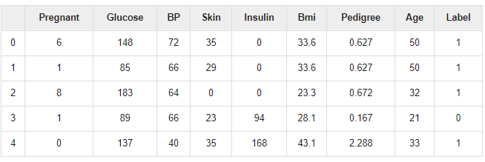
12.3 Decision Tree Example
https://www.tutorialspoint.com/machine_learning_with_python/machine_learning_with_python_classification_algorithms_decision_tree.htm
Decision Tree Example
Read the Pima Indian Diabetes Dataset
Use the Decision Tree Algorithm
Use 70% data for training and 30% data for testing.

Slide 14
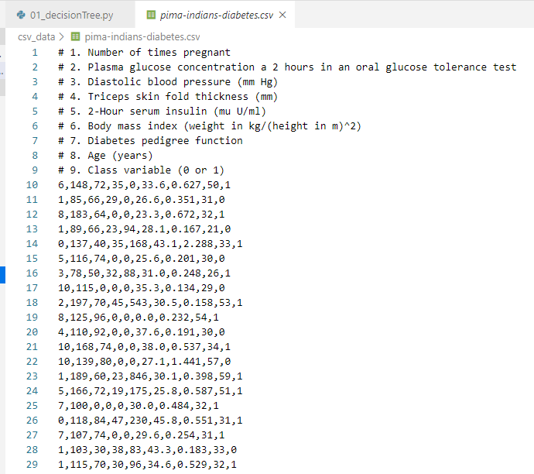
12.3 Decision Tree Example
https://www.tutorialspoint.com/machine_learning_with_python/machine_learning_with_python_classification_algorithms_decision_tree.htm
Decision Tree Example
Read the Pima Indian Diabetes Dataset:

Slide 15
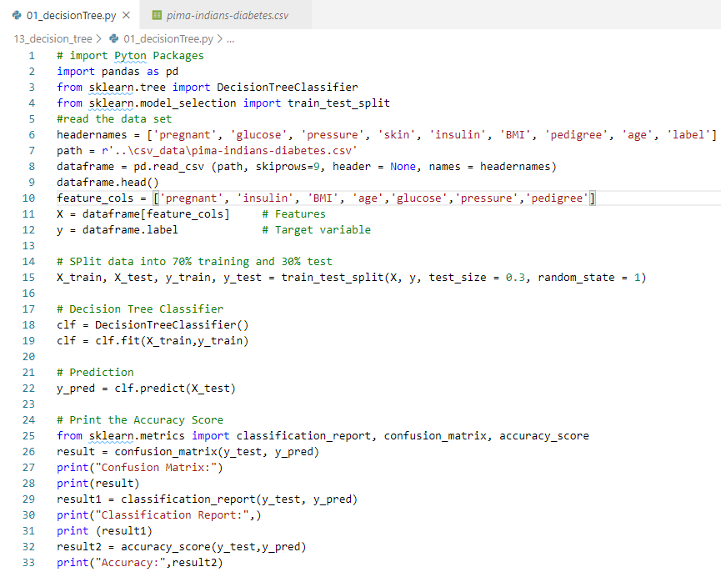
12.3 Decision Tree Example
https://www.tutorialspoint.com/machine_learning_with_python/machine_learning_with_python_classification_algorithms_decision_tree.htm
Decision Tree Example
Code:

Slide 16
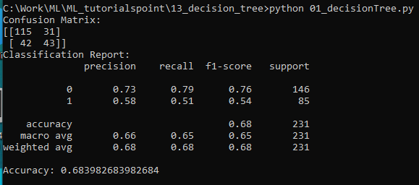
12.3 Decision Tree Example
https://www.tutorialspoint.com/machine_learning_with_python/machine_learning_with_python_classification_algorithms_decision_tree.htm
Decision Tree Example
Result:

Slide 17
12.4 Display Decision Tree

Slide 18
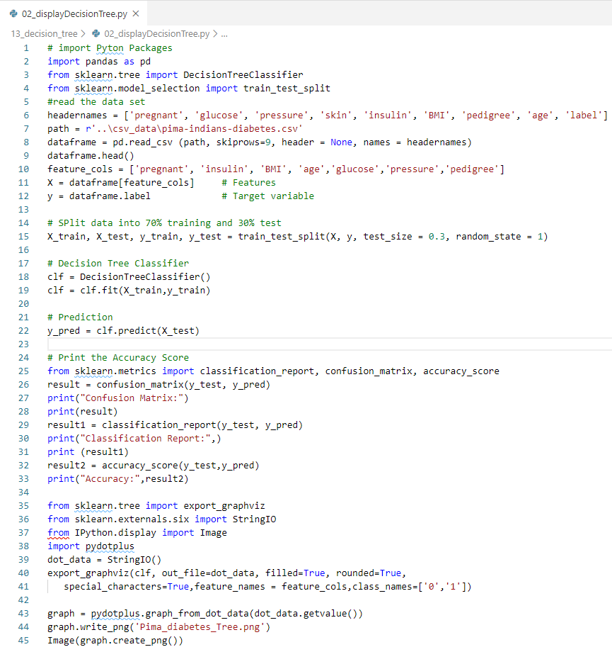
12.4 Display Decision Tree
https://www.tutorialspoint.com/machine_learning_with_python/machine_learning_with_python_classification_algorithms_decision_tree.htm
Display Decision Tree
Generate the Image in the folder.

Slide 19
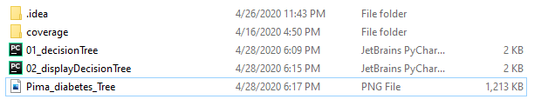
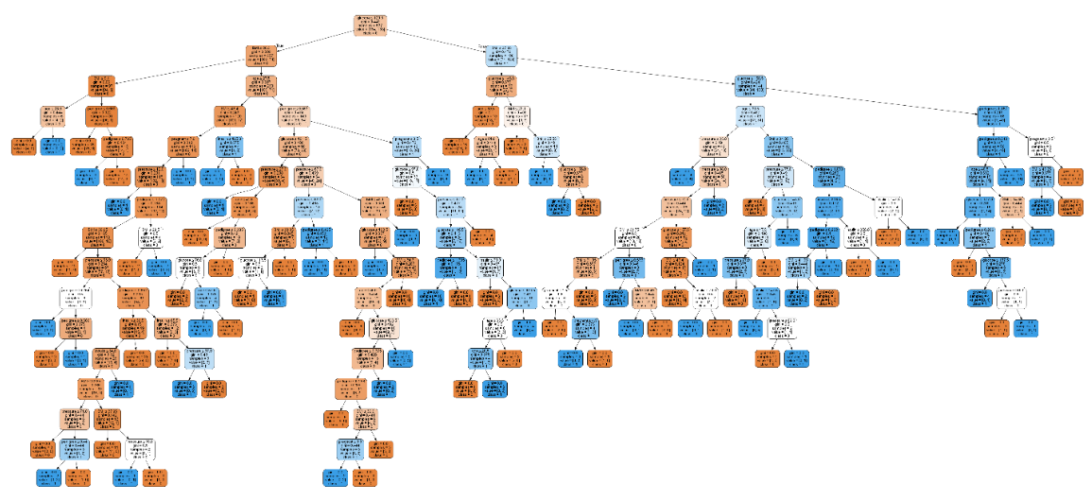
12.4 Display Decision Tree
https://www.tutorialspoint.com/machine_learning_with_python/machine_learning_with_python_classification_algorithms_decision_tree.htm
Display Decision Tree
Double click image file to display

Slide 20
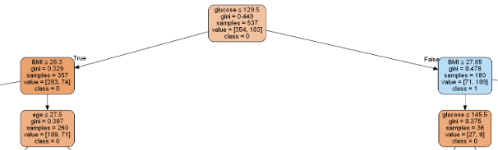
12.4 Display Decision Tree
https://www.tutorialspoint.com/machine_learning_with_python/machine_learning_with_python_classification_algorithms_decision_tree.htm
Display Decision Tree
Zoom in to check the data features inside each node.

Slide 21
12.5 Summary of Decision Tree

Slide 22
12.5 Summary of Decision Tree
https://www.tutorialspoint.com/machine_learning_with_python/machine_learning_with_python_classification_algorithms_decision_tree.htm
Summary of Decision Tree
Decision tree analysis is a predictive modelling tool.
Decisions trees are the most powerful algorithms that falls under the category of supervised algorithms.
Decision Trees can be used for both classification and regression tasks.
The two main entities of a tree are decision nodes and leaves.
The decision nodes are the data is split.
The leaves are the outcome.

Slide 23
End of Chapter

