Slide 1

25 Improve Model with Ensemble
Peter H. Chen

Slide 2
25 Improve Model with Ensemble
https://www.tutorialspoint.com/machine_learning_with_python/machine_learning_with_python_improving_performance_of_ml_models.htm
Improve Model Performance with Ensemble
Ensembles can give to boost the machine learning result by combining several models.
Ensemble models consist of several individually trained supervised learning models and their results are merged in various ways to achieve better predictive performance compared to a single model.

Slide 3
25 Improve Model with Ensemble
https://www.tutorialspoint.com/machine_learning_with_python/machine_learning_with_python_improving_performance_of_ml_models.htm
Improve Model Performance with Ensemble
Ensemble methods can be divided into following two groups:
Sequential ensemble methods
The base learners are generated sequentially. The motivation of such methods is to exploit the dependency among base learners.
Parallel ensemble methods
The base learners are generated in parallel. The motivation of such methods is to exploit the independence among base learners.

Slide 4
25 Improve Model with Ensemble
https://www.tutorialspoint.com/machine_learning_with_python/machine_learning_with_python_improving_performance_of_ml_models.htm
Ensemble Learning Methods
The following are the most popular ensemble learning methods, i.e., the methods for combining the predictions from different models:
Bagging
The bagging is also known as bootstrap aggregation. In bagging methods, ensemble model tries to improve prediction accuracy and decrease model variance by combining predictions of individual models trained over randomly generated training samples. The final prediction of ensemble model will be given by calculating the average of all predictions from the individual estimators. One of the best examples of bagging methods are random forests.
Boosting
In boosting method, the main principle of building ensemble model is to build it incrementally by training each base model estimator sequentially. As the name suggests, it basically combine several week base learners, trained sequentially over multiple iterations of training data, to build powerful ensemble. During the training of week base learners, higher weights are assigned to those learners which were misclassified earlier. The example of boosting method is AdaBoost.

Slide 5
25 Improve Model with Ensemble
https://www.tutorialspoint.com/machine_learning_with_python/machine_learning_with_python_improving_performance_of_ml_models.htm
Ensemble Learning Methods
Voting
In this ensemble learning model, multiple models of different types are built and some simple statistics, like calculating mean or median etc., are used to combine the predictions. This prediction will serve as the additional input for training to make the final prediction.

Slide 6
25 Improve Model with Ensemble
https://www.tutorialspoint.com/machine_learning_with_python/machine_learning_with_python_improving_performance_of_ml_models.htm
Ensemble Learning Methods
Bagging Ensemble Algorithms
The following are three bagging ensemble algorithms −
Bagged Decision Tree
Random Forest
Extra Trees
Boosting Ensemble Algorithms
The followings are the two most common boosting ensemble algorithms −
AdaBoost
Stochastic Gradient Boosting
Voting Ensemble Algorithms
As discussed, voting first creates two or more standalone models from training dataset and then a voting classifier will wrap the model along with taking the average of the predictions of sub-model whenever needed new data.

Slide 7
25.1 Improve with Ensemble Example

Slide 8
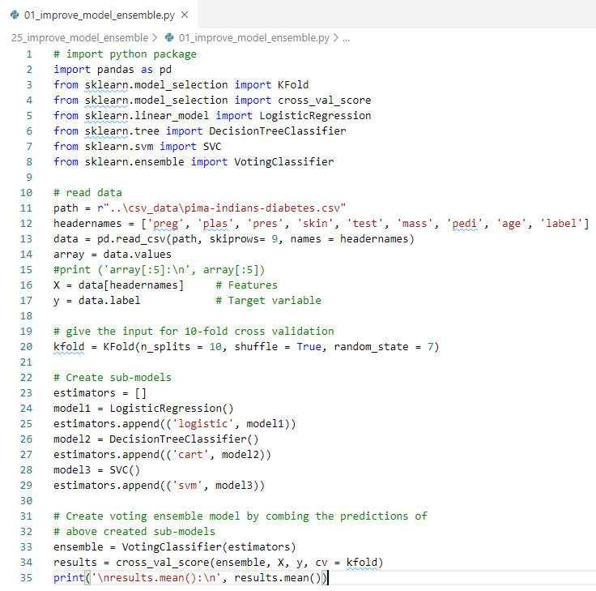
25.1 Improve with Ensemble Example
https://www.tutorialspoint.com/machine_learning_with_python/machine_learning_with_python_improving_performance_of_ml_models.htm
Improve Model Performance with Ensemble Example

Slide 9
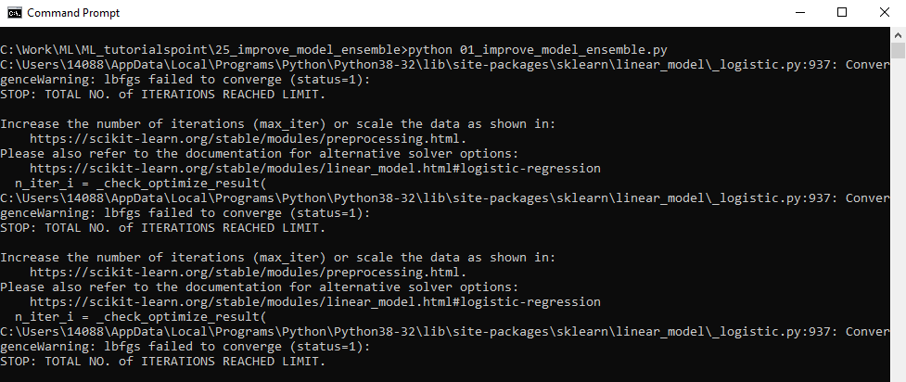
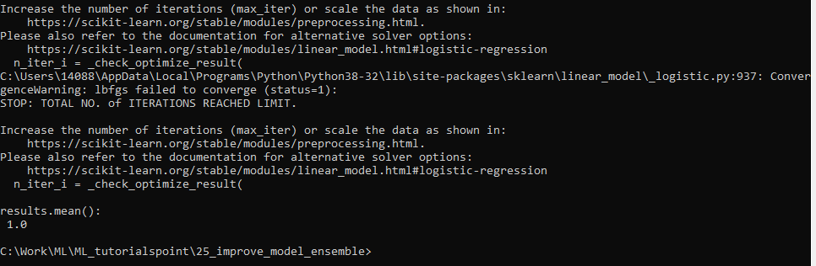
25.1 Improve with Ensemble Example
https://www.tutorialspoint.com/machine_learning_with_python/machine_learning_with_python_improving_performance_of_ml_models.htm
Improve Model Performance with Ensemble Example
Display Result
…

Slide 10
End of Chapter

