Slide 1

19 K-Means Clustering
Peter H. Chen

Slide 2
19 K-Means Clustering
https://www.tutorialspoint.com/machine_learning_with_python/machine_learning_with_python_clustering_algorithms_k_means.htm
Introduction to K-Means Algorithm
K-means clustering algorithm computes the centroids and iterates until we it finds optimal centroid.
It assumes that the number of clusters are already known.
It is also called flat clustering algorithm.
The number of clusters identified from data by algorithm is represented by ‘K’ in K-means.
In this algorithm, the data points are assigned to a cluster in such a manner that the sum of the squared distance between the data points and centroid would be minimum.
It is to be understood that less variation within the clusters will lead to more similar data points within same cluster.

Slide 3
19.1 K-Means Algorithm

Slide 4
19.1 K-Means Algorithm
https://www.tutorialspoint.com/machine_learning_with_python/machine_learning_with_python_clustering_algorithms_k_means.htm
K-Means Algorithm
K-Means clustering algorithm steps:
Step 1 − First, we need to specify the number of clusters, K, need to be generated by this algorithm.
Step 2 − Next, randomly select K data points and assign each data point to a cluster. In simple words, classify the data based on the number of data points.
Step 3 − Now it will compute the cluster centroids.
Step 4 − Next, keep iterating the following until we find optimal centroid which is the assignment of data points to the clusters that are not changing any more
4.1 − First, the sum of squared distance between data points and centroids would be computed.
4.2 − Now, we have to assign each data point to the cluster that is closer than other cluster (centroid).
4.3 − At last compute the centroids for the clusters by taking the average of all data points of that cluster.

Slide 5
19.1 K-Means Algorithm
https://www.tutorialspoint.com/machine_learning_with_python/machine_learning_with_python_clustering_algorithms_k_means.htm
K-Means Algorithm
K-means follows Expectation-Maximization approach to solve the problem.
The Expectation-step is used for assigning the data points to the closest cluster and the Maximization-step is used for computing the centroid of each cluster.
While working with K-means algorithm we need to take care of the following things:
While working with clustering algorithms including K-Means, it is recommended to standardize the data because such algorithms use distance-based measurement to determine the similarity between data points.
Due to the iterative nature of K-Means and random initialization of centroids, K-Means may stick in a local optimum and may not converge to global optimum. That is why it is recommended to use different initializations of centroids.

Slide 6
19.2 K-Means Example 1

Slide 7
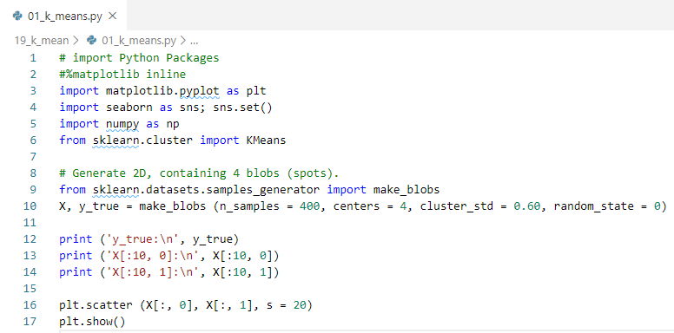
19.2 K-Means Example 1
https://www.tutorialspoint.com/machine_learning_with_python/machine_learning_with_python_clustering_algorithms_k_means.htm
K-Means Example 1

Slide 8
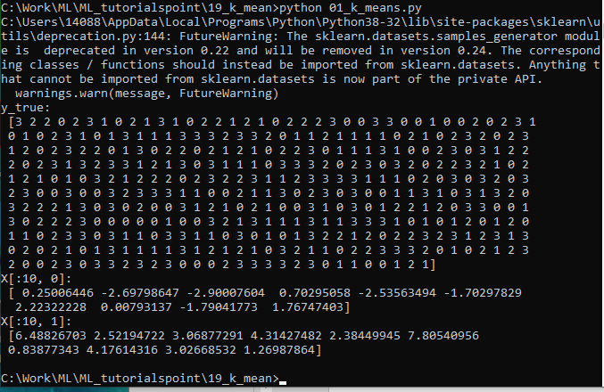
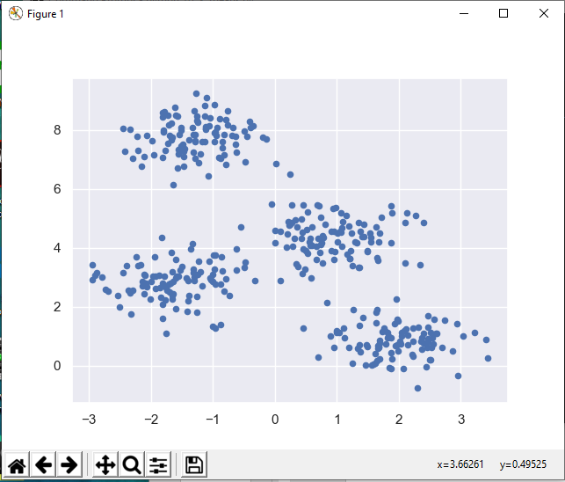
19.2 K-Means Example 1
https://www.tutorialspoint.com/machine_learning_with_python/machine_learning_with_python_clustering_algorithms_k_means.htm
K-Means Example 1
Display Result

Slide 9
19.3 K-Means Example 2

Slide 10
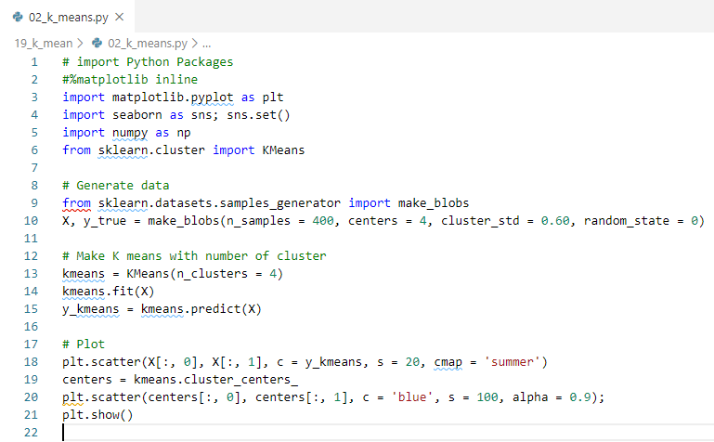
19.3 K-Means Example 2
https://www.tutorialspoint.com/machine_learning_with_python/machine_learning_with_python_clustering_algorithms_k_means.htm
K-Means Example 2

Slide 11
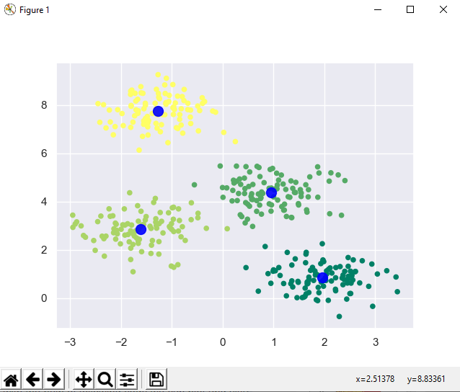
19.2 K-Means Example 2
https://www.tutorialspoint.com/machine_learning_with_python/machine_learning_with_python_clustering_algorithms_k_means.htm
K-Means Example 2
Display Result

Slide 12
19.3 K-Means Example 3

Slide 13
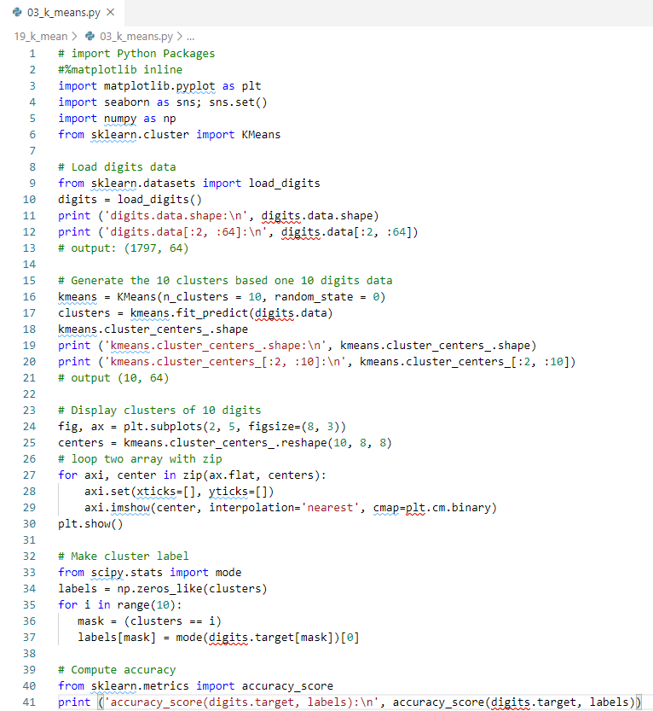
19.3 K-Means Example 3
https://www.tutorialspoint.com/machine_learning_with_python/machine_learning_with_python_clustering_algorithms_k_means.htm
K-Means Example 3

Slide 14
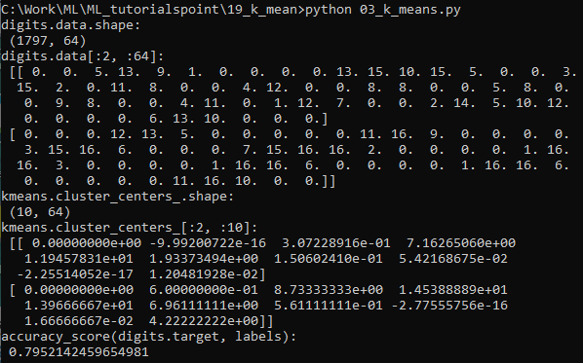
19.3 K-Means Example 3
https://www.tutorialspoint.com/machine_learning_with_python/machine_learning_with_python_clustering_algorithms_k_means.htm
K-Means Example 3
Display Result

Slide 15
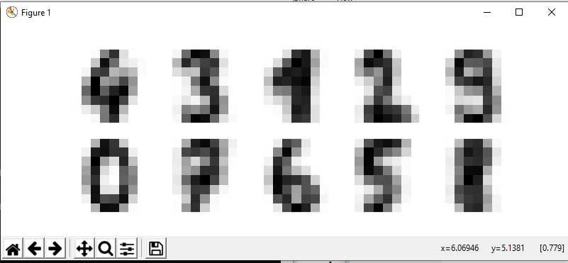
19.3 K-Means Example 3
https://www.tutorialspoint.com/machine_learning_with_python/machine_learning_with_python_clustering_algorithms_k_means.htm
K-Means Example 3
Display Result

Slide 16
19.4 K-Means Pros and Cons

Slide 17
19.4 K-Means Pros and Cons
https://www.tutorialspoint.com/machine_learning_with_python/machine_learning_with_python_clustering_algorithms_k_means.htm
K-Means Pros and Cons
Pros
The following are some advantages of K-Means clustering algorithms −
It is very easy to understand and implement.
If we have large number of variables then, K-means would be faster than Hierarchical clustering.
On re-computation of centroids, an instance can change the cluster.
Tighter clusters are formed with K-means as compared to Hierarchical clustering.

Slide 18
19.4 K-Means Pros and Cons
https://www.tutorialspoint.com/machine_learning_with_python/machine_learning_with_python_clustering_algorithms_k_means.htm
K-Means Pros and Cons
Cons
The following are some disadvantages of K-Means clustering algorithms −
It is difficult to predict the number of clusters, i.e., the value of k.
Output is strongly impacted by initial inputs like number of clusters (value of k)
Order of data will have strong impact on the final output.
It is very sensitive to rescaling. If we will rescale our data by means of normalization or standardization, then the output will completely change.
It is not good in doing clustering job if the clusters have a complicated geometric shape.

Slide 19
19.5 K-Means Applications

Slide 20
19.5 K-Means Applications
https://www.tutorialspoint.com/machine_learning_with_python/machine_learning_with_python_clustering_algorithms_k_means.htm
K-Means Applications
The main goals of cluster analysis are −
To get a meaningful intuition from the data we are working with.
Cluster-then-predict where different models will be built for different subgroups.
To fulfill the above-mentioned goals, K-means clustering is performing well enough for the following applications −
Market segmentation
Document Clustering
Image segmentation
Image compression
Customer segmentation
Analyzing the trend on dynamic data

Slide 21
End of Chapter

