Slide 1

9 Feature Selection
Peter H. Chen

Slide 2
9 Feature Selection
https://www.tutorialspoint.com/machine_learning_with_python/machine_learning_with_python_data_feature_selection.htm
Importance of Data Feature Selection
The Machine Learning model is directly proportional to the data features used to train it.
The Machine Learning model will be affected negatively if the data features provided to it are irrelevant.
Use of relevant data features can increase the accuracy of your Machine Learning model especially linear and logistic regression.
Question:
What is Automatic Feature Selection?
When we select features that are most relevant to the output or prediction variable. It is also called attribute selection.
The benefits of Feature Selection before modeling the data:
Performing Feature Selection before data modeling will reduce the overfitting.
Performing Feature Selection before data modeling will increases the accuracy of Machine Learning model.
Performing Feature Selection before data modeling will reduce the training time

Slide 3
9 Feature Selection
https://www.tutorialspoint.com/machine_learning_with_python/machine_learning_with_python_data_feature_selection.htm
Feature Selection Techniques
The following are automatic feature selection techniques:

Slide 4
9.1 Univariate Feature Selection

Slide 5
9.1 Univariate Feature Selection
https://www.tutorialspoint.com/machine_learning_with_python/machine_learning_with_python_data_feature_selection.htm
Univariate Feature Selection
The Univariate Selection is used in selecting the features, with the statistical testing, we have the strongest relationship with the prediction variables.
We use Univariate Feature Selection technique with the SelectKBest class of scikit-learn of Python library.

Slide 6
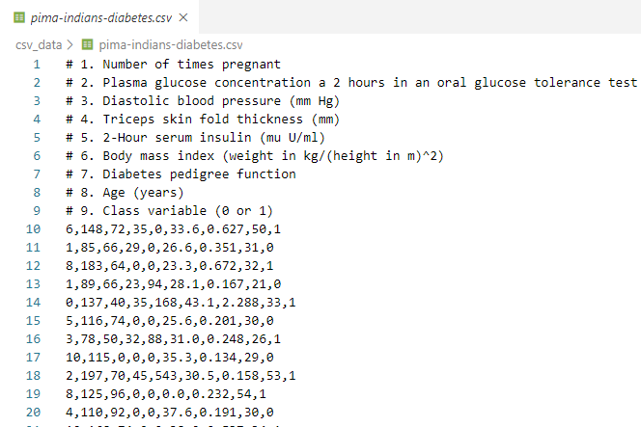
9.1 Univariate Feature Selection
https://www.tutorialspoint.com/machine_learning_with_python/machine_learning_with_python_data_feature_selection.htm
Univariate Feature Example
Given Pima (North America) Indians Diabetes dataset.

Slide 7
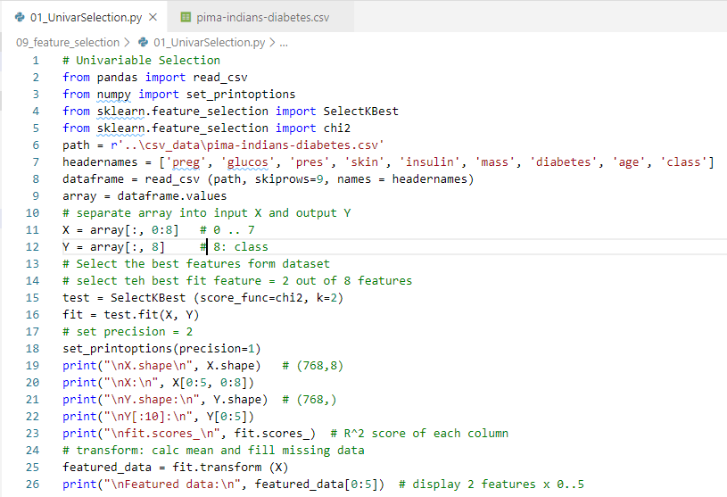
9.1 Univariate Feature Selection
https://www.tutorialspoint.com/machine_learning_with_python/machine_learning_with_python_data_feature_selection.htm
Univariate Feature Example
Original 8 features: 0..7, output is class: 0 or 1
Select 2 best fit features (K = 2) out of 8 features

Slide 8
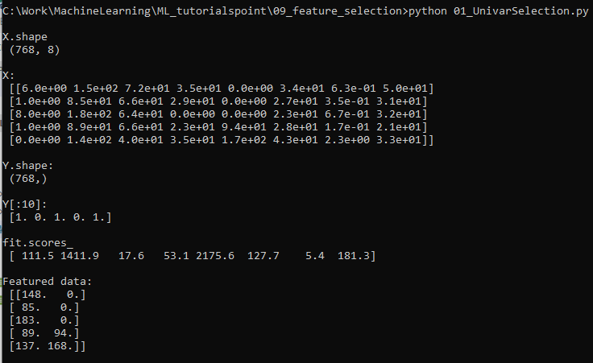
9.1 Univariate Feature Selection
https://www.tutorialspoint.com/machine_learning_with_python/machine_learning_with_python_data_feature_selection.htm
Univariate Feature Example
Select 2 best fit features (K = 2) out of 8 features.
Data has transform into R-square

Slide 9
9.2 Recursive Feature Elimination

Slide 10
9.2 Recursive Feature Elimination
https://www.tutorialspoint.com/machine_learning_with_python/machine_learning_with_python_data_feature_selection.htm
Recursive Feature Elimination
REF (Recursive Feature Elimination) Feature Selection Technique remove the attributes recursively and builds the model with remaining attributes.
We implement RFE feature selection with RFE class of scikit-learn Python Library.

Slide 11
9.2 Recursive Feature Elimination
https://www.tutorialspoint.com/machine_learning_with_python/machine_learning_with_python_data_feature_selection.htm
Recursive Feature Elimination Example
Given Pima (North America) Indians Diabetes dataset.

Slide 12
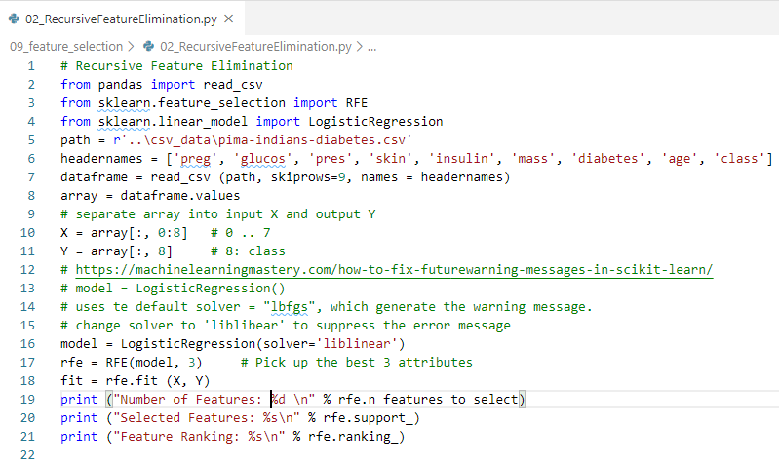
9.2 Recursive Feature Elimination
https://www.tutorialspoint.com/machine_learning_with_python/machine_learning_with_python_data_feature_selection.htm
Recursive Feature Elimination Example
Select 3 out of 8 features by LogisticRegression

Slide 13
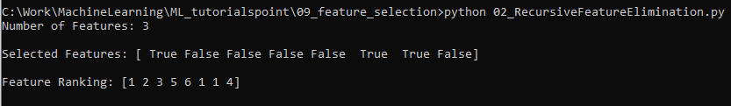
9.2 Recursive Feature Elimination
https://www.tutorialspoint.com/machine_learning_with_python/machine_learning_with_python_data_feature_selection.htm
Recursive Feature Elimination Example

Slide 14
9.3 Principal Component Analysis

Slide 15
9.3 Principal Component Analysis
https://www.tutorialspoint.com/machine_learning_with_python/machine_learning_with_python_data_feature_selection.htm
Principal Component Analysis (PCA)
Principal Component Analysis (PCA), generally called data reduction technique, is very useful feature selection technique as it uses linear algebra to transform the dataset into a compressed form.
We can implement PCA feature selection technique with the help of PCA class of scikit-learn Python library.
We can select number of principal components in the output.

Slide 16
9.3 Principal Component Analysis
https://www.tutorialspoint.com/machine_learning_with_python/machine_learning_with_python_data_feature_selection.htm
Principal Component Analysis (PCA) Example
Given Pima (North America) Indians Diabetes dataset.

Slide 17
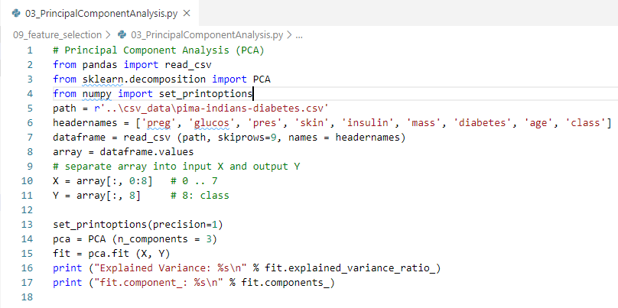
9.3 Principal Component Analysis
https://www.tutorialspoint.com/machine_learning_with_python/machine_learning_with_python_data_feature_selection.htm
Principal Component Analysis (PCA) Example
Select 3 out of 8 features by PCA (Principal Component Analysis)

Slide 18
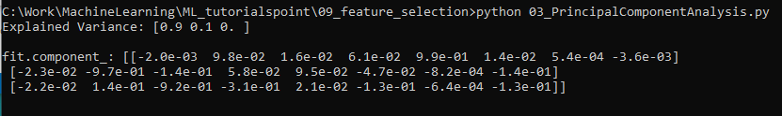
9.3 Principal Component Analysis
https://www.tutorialspoint.com/machine_learning_with_python/machine_learning_with_python_data_feature_selection.htm
Principal Component Analysis (PCA) Example

Slide 19
9.4 Feature Importance

Slide 20
9.4 Feature Importance
https://www.tutorialspoint.com/machine_learning_with_python/machine_learning_with_python_data_feature_selection.htm
Feature Importance
As the name suggests, Feature Importance technique is used to choose the importance features.
It basically uses a trained supervised classifier to select features.
We can implement this feature selection technique with ExtraTreeClassifier class of scikit-learn Python library

Slide 21
9.4 Feature Importance
https://www.tutorialspoint.com/machine_learning_with_python/machine_learning_with_python_data_feature_selection.htm
Feature Importance Example
Given Pima (North America) Indians Diabetes dataset.

Slide 22
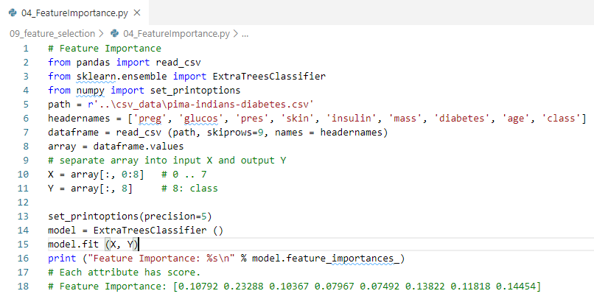
9.4 Feature Importance
https://www.tutorialspoint.com/machine_learning_with_python/machine_learning_with_python_data_feature_selection.htm
Feature Importance Example
Each attribute has a score. Higher numbers are more important.

Slide 23
9.4 Feature Importance
https://www.tutorialspoint.com/machine_learning_with_python/machine_learning_with_python_data_feature_selection.htm
Feature Importance Example
Each attribute has the score. The high score is more important.

Slide 24
9.5 Summary

Slide 25
9.5 Summary
https://www.tutorialspoint.com/machine_learning_with_python/machine_learning_with_python_data_feature_selection.htm
summary
In the discussion, we discussed preprocess of data (Scale and normalized data).
In this discussion, we discussed data feature selection (data reduction) for the classification.

Slide 26
End of Chapter

