Slide 1

1 Python Machine Learning
Peter H. Chen

Slide 2
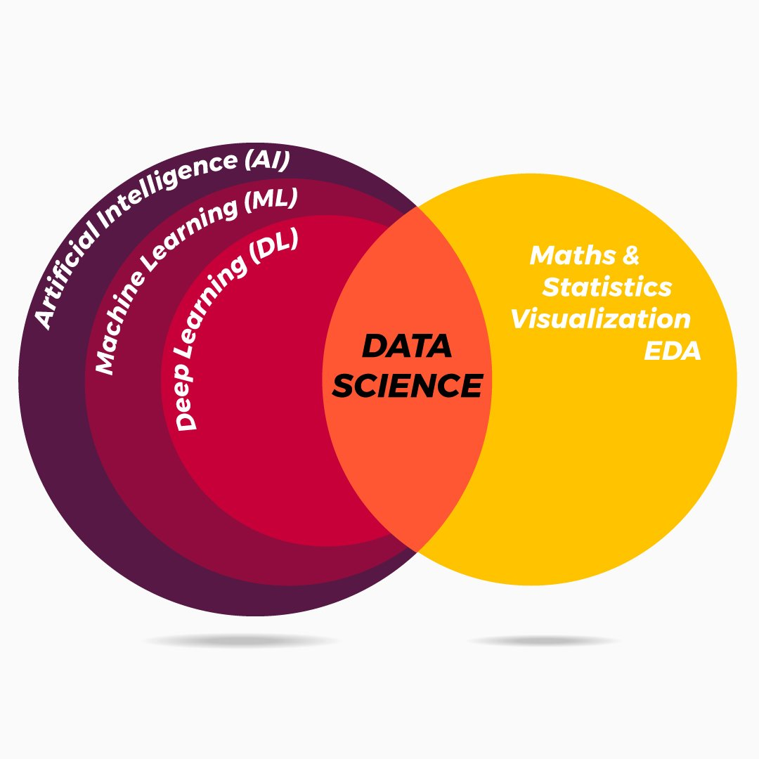
1 Python Machine Learning
https://www.tutorialspoint.com/machine_learning_with_python/index.htm
Python Machine Learning
Machine Learning (ML) provides sense to data. The sense is in much the same way as human beings do.
ML is a type of artificial intelligence that extract patterns out of raw data by using an algorithm or method.
The key focus of ML is to allow computer systems to learn from experience without being explicitly programmed or human intervention.

Slide 3
End of Chapter

