Slide 1

2 Basic
Peter H. Chen

Slide 2
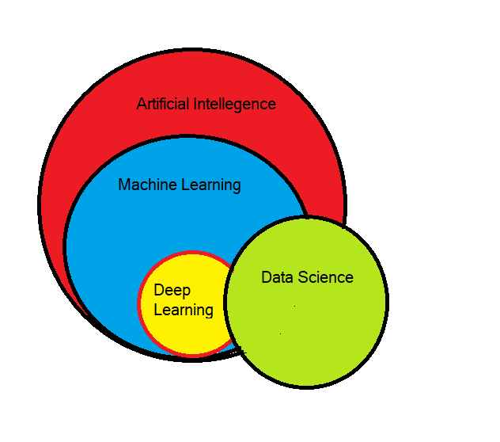
2 Basic
https://www.tutorialspoint.com/machine_learning_with_python/machine_learning_with_python_basics.htm
What is Machine Learning?
Machine Learning (ML) is computer systems can provide sense to data in much the same way as human beings do.
The relation of Data Science, AI (Artificial Intelligence), ML (Machine Learning), and DL (Deep Learning) are shown as follow.

Slide 3
2 Basic
https://www.tutorialspoint.com/machine_learning_with_python/machine_learning_with_python_basics.htm
Application Examples of Machines Learning
Following are some real-world applications of ML −
Emotion (complex psychological state) analysis
Sentiment (mental attitude based on existence of emotion) analysis
Error detection and prevention
Weather forecasting and prediction
Stock market analysis and forecasting
Speech synthesis
Speech recognition
Customer segmentation
Object recognition
Fraud detection
Fraud prevention
Recommendation of products to customer in online shopping

Slide 4
End of Chapter

